Slide 1

Apprenticeships: a Talent Development Strategy
Presentation for Businesses

Slide 2

New established State Office– July 2019
ApprenticeshipTN is a statewide office, under the direction set by Governor Bill Lee, and powered by the Tennessee Workforce Development System (TNWDS).
TNWDS is a consortium of seven state agencies working together to bolster the number of apprenticeships in Tennessee.
  The Department of Labor and Workforce Development,
  Tennessee College System,
  Tennessee Higher Education Commission,
  Department of Education,
  Department of Economic and Community Development,
  Department of Human Services, and
  Department of Correction

Slide 3
What Do We Do?
  Outreach – Outreach – Outreach
  Consultation with employers on program design
  Development of documentation / registration paperwork to hand off to US DOL
  Work with US DOL on employer's behalf
  Provide technical assistance to program sponsors/employers

Slide 4

What Is A Registered Apprenticeship?
Apprenticeship is a flexible and proven talent development strategy that can help grow talent at your company.

Slide 5





What is An Apprenticeship?
National Structured Training and Employment Program Registered with the U.S. Department of Labor
Related Technical Instruction – (RTI)
Employer Involvement
Structured
On-the-Job Learning – (OJL)
Rewards for Skill Gains
National Occupational Credential
Five Core Components of
Apprenticeship
Registered with the U.S. Department of Labor, Office of Apprenticeship and/or Federally Recognized State Apprenticeship Agencies

Slide 6

Journeyworker Credential

Slide 7
On-the-Job Learning &
Related Technical Instruction
On-The-Job Learning (OJL) | Related Technical Instruction (RTI) (minimum) | Approximate Time in Years
2000 hours | 144 hours or more | ≈1 year
4000 hours | 288 hours or more | ≈ 2 years
6000 hours | 432 hours or more | ≈ 3 years
8000 hours | 576 hours or more | ≈ 4years

Slide 8
Three Responsibilities of RAPs
Sponsor
Registers apprentices in RAPIDS 2.0
Documents OJL & RTI hours
Employer
Hires apprentices
Assumes cost of training
Training Provider
Provides required RTI
Pays apprentices according to a structured wage progressions scale
Provides required OJL
An employer may assume all three responsibilities or partner with other organizations who may serve as the sponsor and/or training provider.

Slide 9




Definitions and Understanding
Form Talent Pipeline Partnerships
Registered Apprenticeship
Full-time /long–term employment
Training hours defined by occupation
Pre-Apprenticeship
Education with or without a job requirement
Interview
Colleges
High Schools
Adult Education
Corrections
Employer
Disabilities Offices
Non-Profits
3rd Parties
Other
Youth Registered Apprenticeship
Age 16 - 24
Part-time
employment
Credit Awarded

Slide 10
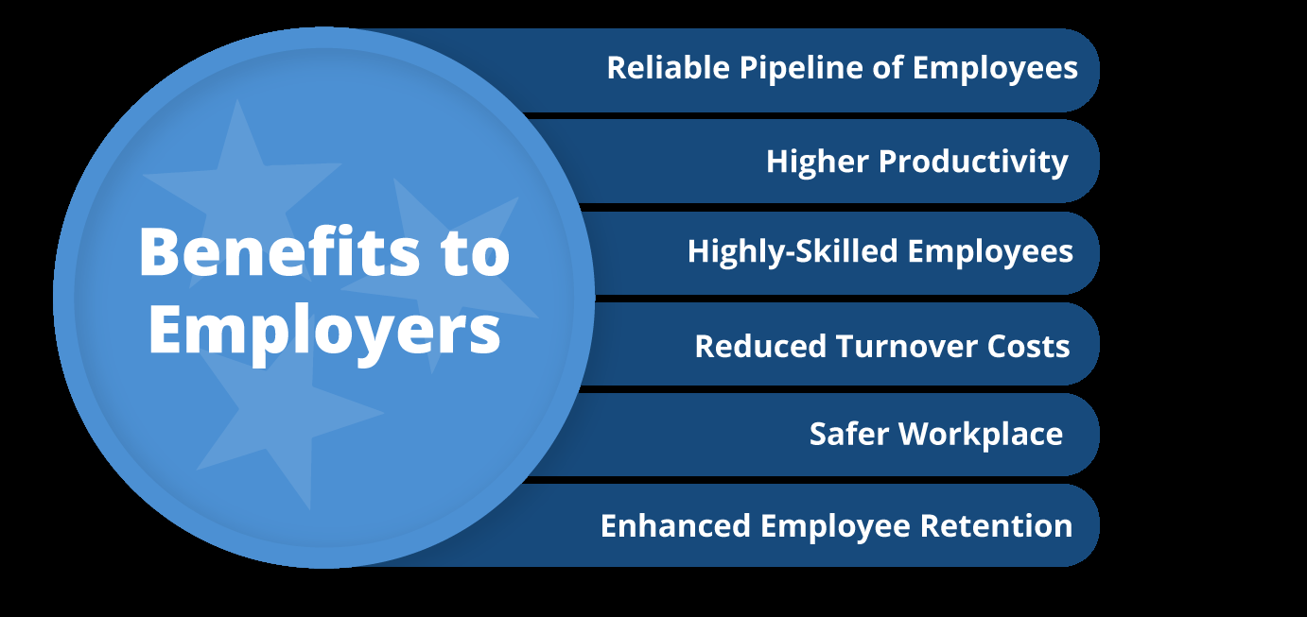

ROI: $1.47 / $1.00

Slide 11

Most Common Apprenticeship Myths

Slide 12
Myth
Fact
For small and large businesses, non-union and union shops, organizations and colleges are all RA sponsors
Only for Unions or large employers
More than 1,000 approved apprentice occupations INCLUDING “professional” occupations. There are apprenticeship programs in all industries!
Only for construction trades and manufacturing
Apprenticeships blend work and education. Many programs include college-level education.
Only for non-college bound individuals
The Office of Apprenticeship set the framework. The program is designed and managed by the sponsor. As the employer, decide WHO to hire/fire, HOW MUCH to pay, and How to manage.
The Federal Government will micromanage my workforce and tell me who to hire

Slide 13
Visit our website and follow us on Facebook and LinkedIn
www.ApprenticeshipTN.com

Slide 14
Your Local Business Service Team
West TN
Greater Memphis
Roderick Woody Tracy Lovelace
901-573-1455 / Email
Northwest
Ginger Powell
731-286-3585 ext. 409 / Email
Southwest
Judy Moorman
731-660-6601 / Email
West TN Executive Directors
Kyla Guyette, GM
kguyette@workforcemidsouth.com
901-512-7455
Jennifer Bane, NW
jbane@nwtnworks.org
731-286-3585 ext. 406
Kena Hamm, SW
kena.hamm@swhra.org
731-983-3687 (O); 731-435-0109 (C)
Regional Director Grand West TN
Kristie Bennett
Kristie.Bennett@tn.gov
Middle TN
Northern Middle
Freda Herndon
615-533-0635 / Email
Southern Middle
Travis Wilson
931-309-0962 / Email
Upper Cumberland
Jeremiah Miller
931-520-9590 / Email
Middle TN Executive Directors
Marla Rye, NM
mrye@workforceessentials.com
931-206-3783 (C)
Barbara Kizer, SM
bkizer@sctdd.org
Becky Hull, UC
BHull@ucworkforce.org
931-520-9511 (O); 931-229-0435 (C)
Regional Director Grand Middle TN
Selina Moore
Selina.Moore@tn.gov
East TN
Southeast
Beth Keylon
423-643-2328 / Email
East
Ginger Armstrong
865-594-5500 / Email
Northeast
Brian Vaughn
423-610-0222 ext. 208 / Email
East TN Executive Directors
Michelle Holt, SE
Michele@sedev.org
423-424-4210 (O); 423-240-2180 (C)
Bill Walker, E
Bwalker@ethra.org
865-705-9765 (C)
Kathy Pierce, NE
kpierce@ab-t.org
423-547-7515 ext. 126 (O);
423-895-1105 (C)
Regional Director Grand East TN
TBD
Business Services Contacts
Local Workforce Board
Contacts

Slide 15
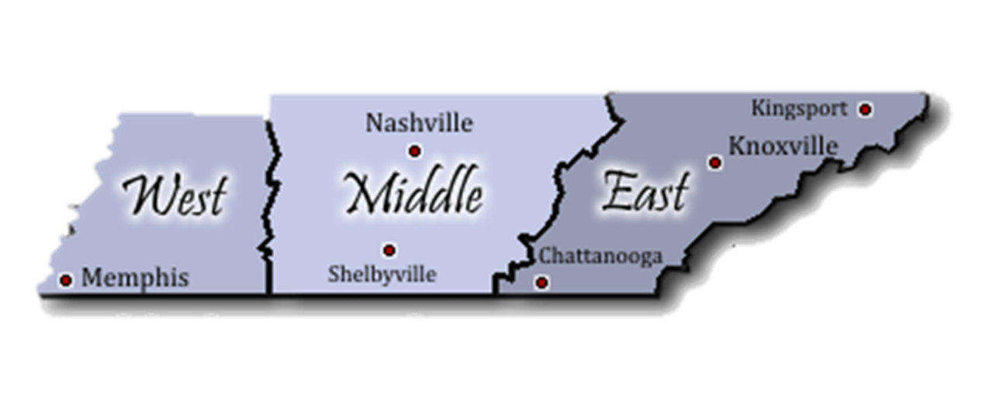
Apprenticeship TN Contacts
West TN Regional Apprenticeship Director
Shalondria Shaw
Shalondria.Shaw@tn.gov
731-202-6027
Middle TN Regional Apprenticeship Director
Charlene Sands Russell
Charlene.Russell@tn.gov
931-303-7638
State Apprenticeship Director/East TN Apprenticeship Director
Holly Free-Ollard
Holly.Free-Ollard@tn.gov
865-973-8157
State Apprenticeship Assistant Director
Jessica Barnett
Jessica.L.Barnett@tn.gov
423-440-0128
Grants Program Manager
Lynn Kirby
Lynn.Kirby@tn.gov
615-330-1631
Administrative Services Assistant
Erika Haire
Erika.R.Haire@tn.gov
615-532-0148

