Slide 1
Grier Appeals
February 2017

Slide 2
Learner Objectives
Grier Revised Consent Decree
Review and Denial Process
  Submission of service request
  Plans Review procedures
  Appeals Unit procedures
  Hearing procedures
  How to file an appeal
  How to withdraw an appeal
DIDD Protocols

Slide 3
Origins of Grier
1979 - Daniels vs. White
1994 – TennCare
August 1, 2000 - Grier Revised Consent Decree
Due process additions- 2003
Agreed Order- vacated – June 17, 2015
Notes:
1979 - Daniels v. White -Grier began as a Federal class action law suit which was filed in U.S. District Court on behalf of present and future Medicaid recipients under the name Daniels v. White. It claimed that Tennessee’s Medicaid Program violated the requirements of the Medicaid Act & the Due Process clause of the 14th Amendment. The original Plaintiffs asserted that Tennessee’s Medicaid Program failed to provide them with adequate notice and procedural protection upon denial of their claims.
Over the course of the next several decades, the parties attempted to resolve their disputes through various consent decrees and revisions to those decrees. The first decree was entered into in 1986, then another in 1992.
1994 – TennCare – in January 1994,Tennessee converted its traditional Medicaid fee-for-service program to a managed care model known as TennCare. Instead of directly purchasing medical services for eligible individuals, TennCare contracts with MCCs to provide healthcare to TennCare enrollees.
August 1, 2000 -On October 26, 1999, the Grier Revised Consent Decree was entered as the result of a settlement conference. It became effective on August 1, 2000 after there was some clarification of some terms and technical errors. Revisions were made to the decree since then which modified and clarified the appeal process.
In March 2003, negotiations were entered to revise the 2000 consent decree. In October, 2003 the district court finally approved and entered the Revised Consent Decree. According to the court, the 2003 Consent Decree contained the strongest due process protections. This decree also stated that the State would continue to have primary responsibility for monitoring and compliance of the decree.

Slide 4
Grier applies when:
An Enrollee experiences an adverse action regarding TennCare benefits or services (medical assistance funded wholly or in part with federal funds under the Medicaid Act) administered by TennCare through their managed care contractors (MCC).

Slide 5
Key Provisions of Grier
Outlines Due Process requirements
Compliance requirements
Appeal rights
Appeal must be filed within 30 days
Timing/types of appeals
Notes:
Standard – 90 days- heard by an ALJ with the Administrative Procedures Division
Expedited – appeal will be decided within 3 business days. Heard at TennCare by a TennCare hearing officer.
The region determines whether or not an appeal is expedited. If determined not to be expedited, the Standard Appeal timeframe applies.

Slide 6
Expedited Appeal
constitutes an “emergency”
  Person’s life
  Person’s physical/mental health
  Person’s ability to attain, regain, or maintain full function
Notes:
An emergency means that if you don’t get a decision on your appeal in 3 business days, it could seriously jeopardize:

Slide 7
Expedited Appeal
  Each MCO must establish and maintain an expedited review process for appeals, when the MCO determines (for a request from the enrollee) or the provider indicates (in making the request on the enrollee's behalf or supporting the enrollee's request) that taking the time for a standard resolution could seriously jeopardize the enrollee's life or health or ability to attain, maintain, or regain maximum function.
  42 CFR Sec. 438.410(a).
Notes:
An emergency means that if you don’t get a decision on your appeal in 3 business days, it could seriously jeopardize:

Slide 8
Expedited Appeal
The agency must take final administrative action as follows:
As expedited as the enrollee's health condition requires, but no later than 3 working days after the agency receives, from the MCO, the case file and information for any appeal of a denial of a service that:
(i) Meets the criteria for expedited resolution, but was not resolved within the timeframe for expedited resolution; or
(ii) Was resolved within the timeframe for expedited resolution, but reached a decision wholly or partially adverse to the enrollee.
42 CFR Sec. 431.244(f)(2).

Slide 9
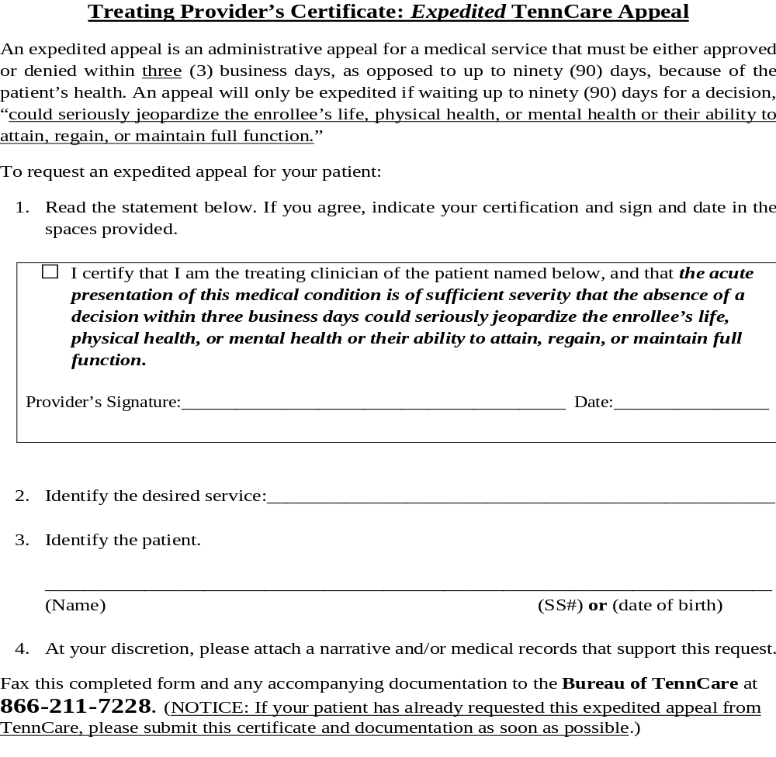
http://tn.gov/tenncare/topic/miscellaneous-provider-forms
Notes:
An expedited appeal may be filed by the person, ISC, etc.. or may be filed by the person’s physician. This form is the Treating Provider’s Certificate. The term “treating provider” means the person’s treating physician, not the person’s provider.
The person’s physician would fill out this form and either include it with the initial appeal, or it could be sent after the expedited appeal is filed. In either scenario, the region would use this information to weigh in on whether or not the appeal is expedited.

Slide 10
Key Provisions of Grier
If a covered service is denied:
  Medical necessity denial
  Individualized determination
  Based on person’s clinical documentation
If a non-covered service is denied:
  Denial is based on a rule
  Not individualized
  Clinical documentation is not a factor in decision
In either case, denial notice must include a valid legal basis

Slide 11
Key Provisions of Grier
Compliance Requirements:
  Continuity of care
  Services provided as authorized in ISP
  Plans Review and Appeals Unit timeframes
  Notice content
  Timely response to TennCare ORRs
  Timely/full compliance with directives/orders
Procedural Protection:
  Plans Review process – DIDD protocols
  Appeals Unit process- notices, timeframes
  Hearing process - includes specific hearing rights

Slide 12
Appeal Rights
Persons under the waiver have the following appeal rights:
To appeal adverse actions affecting TennCare services.
TennCare Rule 1200-13-13-.11(2)(a)
http://share.tn.gov/sos/rules/1200/1200-13/1200-13-13.20150323.pdf

Slide 13
An adverse action is…
Denial
Delay
Termination
Suspension
Reduction
Any act, or failure to act that impacts the quality, availability, or timeliness of a Medicaid waiver service to an eligible person.

Slide 14
Grier does not apply when:
State-funded services are denied
Person is on the waiting list -not enrolled to receive Medicaid services
Services provided without prior authorization- no FFP
Dispute over rate for service
Non-valid Factual Dispute
  Failing to support factual error that TennCare/MCC made

Slide 15
Review and Denial Process

Slide 16
Initial Request for Service
Standard PA Request
  Decision must be made within 14 calendar days
  A 14 day extension may be approved
Expedited PA Request
  Decision must be made within 3 business days
  A 14 day extension may be approved
Notes:
An extension request form is on the next slide which is used for either request

Slide 17
Standard PA Request
Timing of Written Notice. An MCC must notify an enrollee of its decision in response to a request by or on behalf of an enrollee for medical or related services within fourteen (14) days of the request for prior authorization, or as expedited as the enrollee’s health condition requires. If the request for prior authorization is denied, the MCC shall provide a written notice to the enrollee.
TennCare Rules 1200-13-14-.11(1)(b)(2) and 1200-13-13-.11(1)(b)(2).
Notes:
TennCare did not adopt an emergency rule regarding Grier language which was previously codified into their rules, so TennCare Rules 1200-13-13 & 1200-13-14 are still valid.

Slide 18
Standard PA Request Extension
For standard authorization decisions, provide notice as expedited as the enrollee’s health condition requires and within State-established timeframes that may not exceed 14 calendar days following receipt of the request for service, with a possible extension of up to 14 additional calendar days, if—
(i) The enrollee, or the provider, requests extension; or
(ii) The MCO justifies (to the State agency upon request) a need for additional information and how the extension is in the enrollee’s interest.
CFR 42 § 438.210 (d)
Notes:
A 14 calendar day extension is available for standard PA requests if adequate justification is given to support the request; adequate justification requires an explanation regarding how an extension of time will benefit the enrollee.

Slide 19
Expedited PA Request
For cases in which a provider indicates, or the MCO determines, that following the standard timeframe could seriously jeopardize the enrollee’s life or health or ability to attain, maintain, or regain maximum function, the MCO must make an expedited authorization decision and provide notice as expedited as the enrollee’s health condition requires and no later than 3 working days after receipt of the request for service.
CFR §438.210 (d)(2).
Notes:
TennCare did not adopt an emergency rule regarding Grier language which was previously codified into their rules, so TennCare Rules 1200-13-13 & 1200-13-14 are still valid.

Slide 20
Expedited PA Request Extension
The MCO may extend the 3 working days time period by up to 14 calendar days if the enrollee requests an extension, or if the MCO justifies (to the State agency upon request) a need for additional information and how the extension is in the enrollee’s interest.
CFR 42 § 438.210 (d)
Notes:
A 14 calendar day extension is available for standard PA requests if adequate justification is given to support the request; adequate justification requires an explanation regarding how an extension of time will benefit the enrollee.

Slide 21
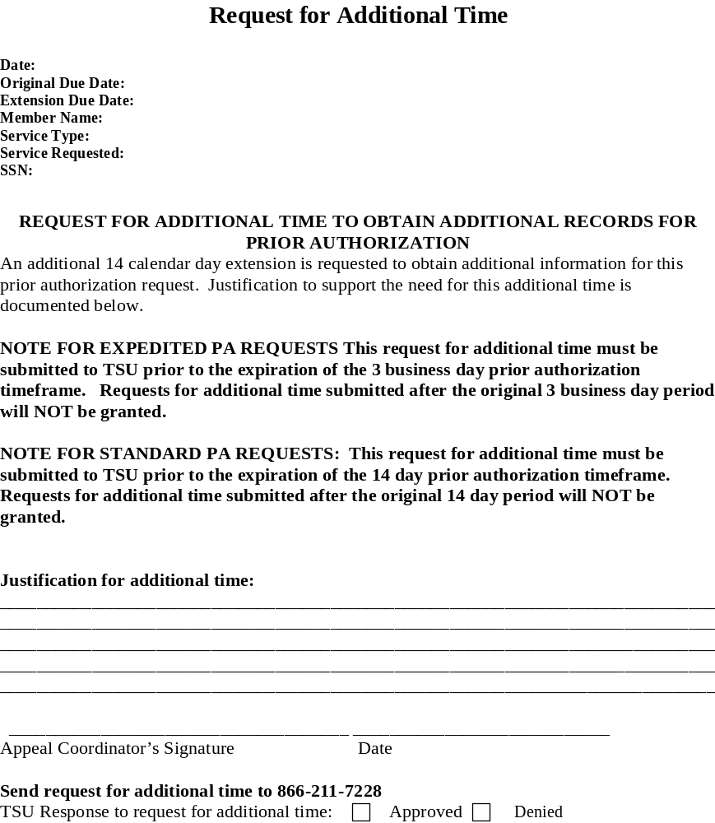
Notes:
Note- appeal coordinator's signature is the plans reviewer’s signature

Slide 22
Grier Notice Content
Service Requested
  Includes Type, Frequency, Intensity, Duration
Offer alternative service if applicable
Appeal rights
6th Grade Fogg Index
Covered Service:
  Individualized
  DIDD Protocol
  Valid Legal Basis
  List of specific clinical records reviewed
Non-covered service- rule

Slide 23
The Department of Intellectual and Developmental Disabilities (DIDD) won’t pay for this care for you:
< Amount and type of service requested>.
The person who asked for this care is <ISC name>.
Why we won’t pay: [Complete appropriate option; delete unused option]
[Option 1:]
This kind of care is not covered for anyone under the <waiver type> Waiver [Home and Community Based Services Waiver for the Mentally Retarded and Developmentally Disabled (applicable Control #) under Section 1915 of the Social Security Act, effective March 27, 2015, cite].

Slide 24
[Option 2:]
Our Rules say this kind of care is not covered for <category that applies, i.e., anyone under 21> under the <waiver type> Waiver.
Our records show that you are < under 21>. So, we can’t pay for this care. <Official legal citation>.

Slide 25
[If this is a service—NOT R&B—appeal AND there is a covered, medically necessary alternative to the denied service, complete as follows. If N/A, delete text to marker below.]
But, the DIDD will pay for this care for you:
<amount and type of service approved>.
This care is covered under the <waiver type> Waiver and we think it is medically necessary. And, we think it will work for your health problem.
Do you have questions? You, your ISC, or another person that helps you with your medical decisions can call <appeal director> at < DIDD regional phone number >. You may also want to talk to your doctor.
If you think we made a mistake, you can appeal. You have 30 days after you get this letter to appeal. After 30 days, it’s too late to appeal this decision.

Slide 26
You are not getting this kind or amount of care from TennCare now. It’s care that you want to start getting. So, even if you ask, we can’t pay for it during your appeal. But, if you win your appeal, you can ask us to pay you back.
When you appeal, you’re asking to tell a judge the mistake you think TennCare made. It’s called a fair hearing. To get a fair hearing, both of these things must be true:
  You must give TennCare the facts they need to work your appeal.
  And, you must tell TennCare the mistake you think we made. That mistake must be something that, if you’re right, means that TennCare will pay for this care.

Slide 27
Do you think you have an emergency?
Usually, your appeal is decided within 90 days after you file it. But, if you have an emergency and your health plan agrees that you do, you will get an expedited appeal. An expedited appeal will be decided in 3 business days. An emergency means that if you don’t get a decision on your appeal in 3 business days, it could seriously jeopardize (put in danger):
your life;
your physical health;
your mental health; or
your ability to reach, get back, or keep your mind and body as healthy as possible.

Slide 28
Do you still think you have an emergency? If so, you can ask TennCare for an expedited appeal. You can call us at 1-800-878-3192 to ask for this kind of appeal. Your doctor can also ask TennCare for an expedited appeal for you. If your doctor wants to ask for this kind of appeal, your doctor can complete a “Provider’s Expedited Appeal Certificate” and fax it to TennCare. Your doctor should fax your medical records to us also. Your doctor can get the page from our website. Go to tn.gov/tenncare. Click “Providers,” and then click “Miscellaneous Provider Forms.” TennCare and your health plan will look at your request and then decide if your appeal should be expedited. If it should be, you will get a decision on your appeal in 3 business days.
Notes:
The next slide regards a covered service

Slide 29
The Department of Intellectual and Developmental Disabilities (DIDD) won’t pay for this care for you:
<amount and type of service denied>.
The person who asked for this care is <ISC name>.
To find out why we won’t pay, keep reading. Then, if you think we made a mistake, you can appeal. This letter tells you how to appeal. Do you think you have an emergency? Then, you can ask TennCare for an emergency appeal.

Slide 30
[If this is a service—NOT R&B—appeal AND there is a covered, medically necessary alternative to the denied service, complete as follows. If N/A, delete text to marker below.]
But, the DIDD will pay for this care for you:
<amount and type of service approved>.
We think this care is medically necessary. And, we think it will work for your health problem.

Slide 31
Why we won’t pay for <type of service denied>:
TennCare only pays for care that is medically necessary.
The DIDD has guidelines that say when <service> is
medically necessary. To get <service> paid for by the DIDD, you must meet those guidelines. To get a copy of the guidelines, call us at <DIDD regional phone # >.
<Nurse name>, <nurse credentials, e.g., Registered Nurse), looked at these medical records to decide if this care is medically necessary for you: <medical record source citation>.

Slide 32
You don’t meet all of the guidelines for <type of service>.
Here are the guidelines that you don’t meet:
[Specify in easy-to-understand language each guideline that
is not met and explain why each applicable guideline is not
met by this member].
Because you don’t meet these guidelines, we don’t
think this care is medically necessary for you.
Why the care is not medically necessary:
[Specify what prong(s) of medical necessity definition
are not met (select from below) AND explain why each
applicable prong is not met by this member. Delete prongs
(including legal citations) that are not applicable].

Slide 33
Your doctor did not say you need this care [TennCare
Rule 1200-13-16-.05(1)(a)].
The reason you want this care is not to diagnose or
treat a medical problem [TennCare Rules 1200-13-16
.05(1)(b) and 1200-13-16-.05(2)-(4)].
The care is not safe and effective [TennCare Rules
1200-13-16-.05(1)(c) and 1200-13-16-.05(5)].
The care is not the least costly way to diagnose or
treat your problem that will work [TennCare Rules
1200-13-16-.05(1)(e) and 1200-13-16-.05(7)].

Slide 34
How to file an appeal

Slide 35
You can file an appeal by …
Mailing:
TennCare Solutions Unit
P. O. Box 000593
Nashville, TN 37202-0593
Calling/Faxing
The phone number is 1-800-878-3192 and the FAX number is 1-888-345-5575
Appeal Page:
Go to tn.gov/tenncare. Click “For
Members/Applicants” then click on “How to file a ….medical appeal”. Or, to have TennCare mail you an ….appeal page, call them for free at 1- 800-878-3192.
Notes:
Have everyone pull out appeal form and go over it

Slide 36
Withdrawing appeal:
Person, ISC or Legal Representative
If no hearing scheduled, must be in writing
If hearing is scheduled, should be withdrawn through LSU

Slide 37
Appeal Procedures

Slide 38
Procedures
Continuation of Benefits (COB)
Reconsideration Process
  Expedited Appeal
    Determines to be expedited and COB not approved or not requested, responds in 1 business day
    Determines to be expedited and COB approved, responds in 2 business days
    Determines appeal is NOT expedited, responds in 2 business days
    Provider certification of expedited appeal, responds in 1 business day
    No additional records requested from provider
    No extensions granted to obtain additional records
    No reconsideration notice issued
    KEPRO Medical Review
      Uphold, set for hearing on next business day
      Overturn, direct region to provide service
Notes:
COB would be approved if:
the service is a covered benefit under the waiver for the eligibility category in which the person is enrolled
2) the person has not exceeded the benefit limits of the service - in cases of approaching limits, COB would be approved up to that point.
3) the appeal is a service and not reimbursement or billing appeal
4) the appeal is for a type and amount of care that the recipient was receiving, or recently reinstated at the time of notice of adverse action by the Regional Office
5) If service requires PO, PO is current

Slide 39
Procedures
Standard Appeal -14 days
  Response timeframe is the same, regardless of COB status
  Additional records may be requested
  No extensions granted to obtain additional records
  Reconsideration notice issued
  KEPRO Medical Review
    Uphold, schedule for hearing within Grier timeframes
    Overturn, direct region to provide service

Slide 40
Procedures
Legal Solutions Unit
Assignment of TennCare attorney and hearing date
Notice of Hearing

Slide 41
Hearing rights
In-person/telephone or other hearing accommodation as required for person’s disability
Legal Representation
Review facts relied on by TennCare and DIDD before hearing
Cross-examine witnesses
Review/present info from medical records

Slide 42
Hearing rights
Present evidence challenging adverse action
Ask for an independent medical opinion
Standard appeal- COB pending hearing decision
Written ALJ or hearing officer decision
Resolution, including a hearing with an ALJ or hearing officer if the case has not been previously resolved in the person’s favor within the 90 or 3 day timeframe

Slide 43
After hearing:
ALJ or hearing officer provides decision in writing (Initial Order- IO)
IO is based on facts and conclusions of law
Request for reconsideration within 15 days
Final Order is then entered
SSAU

Slide 44
DIDD Protocols

Slide 45
What are DIDD Protocols?
MEDICAL NECESSITY GUIDELINES shall mean evidence-based guidelines approved by the Chief Medical Officer of the Bureau of TennCare for the purpose of guiding medical necessity determinations for particular courses of diagnosis or treatment.
TennCare Rule 1200-13-16-.01(33)
Notes:
Medical necessity determinations are explained on the next slide

Slide 46
Medical Necessity Determination
A decision made by the Chief Medical Officer of the Bureau of TennCare or his or her clinical designee or by the Medical Director of one of its Managed Care Contractors or his or her clinical designee regarding whether a requested medical item or service satisfies the definition of medical necessity contained in Tennessee Code Annotated, Section 71-5-144 and these rules as defined herein. Items or services that are not determined medically necessary shall not be paid for by TennCare.
TennCare Rule 1200-13-16-.01(32)

Slide 47
What are DIDD Protocols?
Medical protocols developed using evidence-based medicine that are authorized by the bureau of TennCare pursuant to § 71-5-107 shall satisfy the standard of medical necessity. Such protocols shall be appropriately published to all TennCare providers and managed care organizations.
T.C.A. 71-5-144 (e)
Notes:
Published to providers and MCOs- protocols are not promulgated, however there is a statutory requirement for the protocols to be published to providers and MCOs as stated here at T.C.A. 71-5-144(e)
Protocol example- next slide- EAM

Slide 48
What are DIDD Protocols?
Not rules or regulations
Used by Plans Reviewers for service requests
Provide layout for consistent, systemic review
Cited in a denial letter when a covered service is not medically necessary.
Notes:
Not rules or regulations- There is no legal requirement for DIDD Protocols to be regulations. One of the reasons that the protocols are not adapted as rules or regulations is to allow flexibility to make changes to the protocols based on the current medical evidence.

Slide 49
Is the requested modification one of the following specific exclusions in the waiver service definition?
a. Any adaptation or modification of the home which is of general utility and is not of direct medical or remedial benefit to the enrollee; OR
b. Any adaptation or modification which is considered to be general maintenance of the residence; OR
c. Any physical modification to the exterior of the enrollee’s place of residence or lot (e.g., driveways, sidewalks, fences, decks, patios, porches) that is not explicitly listed in the waiver service definition as being covered; OR

Slide 50
Medical necessity review questions:
Is there sufficient information in the Individual Support Plan
(ISP) and/or supporting documentation to show that the
person has functional limitations involving ambulation,
mobility, or other activities of daily living or safety needs and
that such limitations or safety needs would be mitigated by one
or more of the following:
(1) Physical modifications to the interior of an enrollee’s
place of residence to increase the person’s mobility
and accessibility within the residence; OR
(2) Physical modifications to an existing exterior doorway of
the person’s place of residence to increase the person’s
Mobility and accessibility for entrance into and exit from
the residence; OR
(3) A wheelchair ramp and modifications directly related
to, and specifically required for, the construction or
installation of the ramp; OR

Slide 51
DIDD Protocols :
http://tn.gov/didd/article/protocols

Slide 52
Appeals Directors
Central Jon Hamrick (615) 253-8734
East Lori Shelton (865) 594-9299
Middle Deborah Ball (615) 884-6090
West Libby Taylor (901) 745-7327

Slide 53
THE END
Notes:
The End!

