Slide 1
Respite ministries grant

Slide 2
Overview of Grant
Providing opportunities for rest for individuals and caretakers of people with intellectual and developmental disabilities
  Respite Events
  Day Programs
  Sunday School
Applications open from April 22 – June 14
  Grant execution period: October 1, 2024 – June 30, 2025

Slide 3
Grant Timeline
1. Release of Request for Applications | April 22, 2024
2. Final Date for written questions from applicants | May 31, 2024
3. Applications due to the State | June 14, 2024
4. Evaluation Team completes the evaluations and submits recommendations | July 26, 2024
5. Notification and clarifications between the Department and prospective grantees completed | July 29, 2024
6. Projected grant start date | October 1, 2024
7. Projected grant end date | June 30, 2025

Slide 4
Grant Funding
Up to $25,000 seed funding to kickstart programs
  Reimbursement grant
You tell us your budget in your application
  Staff
  Building modifications
  Equipment
  Materials

Slide 5
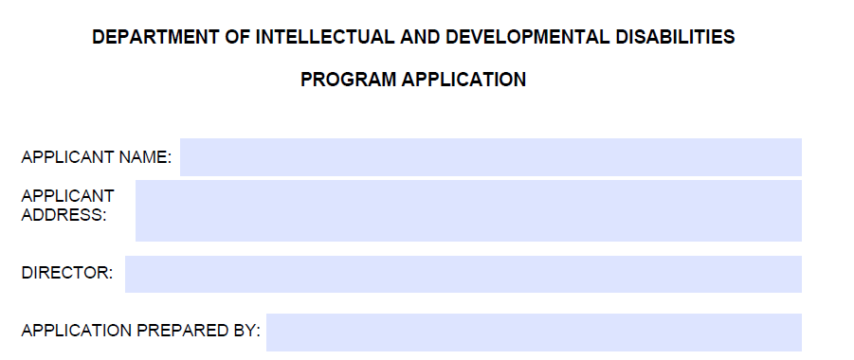
Where to Apply
Grant Application Website
Fillable PDF form
  Required fields on pages 4 & 5

Slide 6
Application Components
Church/Non-profit (Y/N)
  Statement of 501(c)(3) status, copy of IRS tax-exempt certificate, etc.
Identification of Need
  Why are you starting this ministry? What led you to come here today?
  No right/wrong answers
Program Description
  Services/education/offerings you will provide
    Benefits of these services
  Times & availability
  Staff/volunteers

Slide 7
Application Components
Health & Safety Protocols
  Facilities & ADA Compliance
  Training
Budget & Financial Resources
  Plans for funding
  Plans for self-sustainability
Submit applications to braden.odom@tn.gov

Slide 8
Takeaways
10-month grant to develop ministry
  October 1, 2024 – June 30, 2025
Freedom for grantees
No minimum amount
  $25,000 maximum amount
Applications due June 14

Slide 9
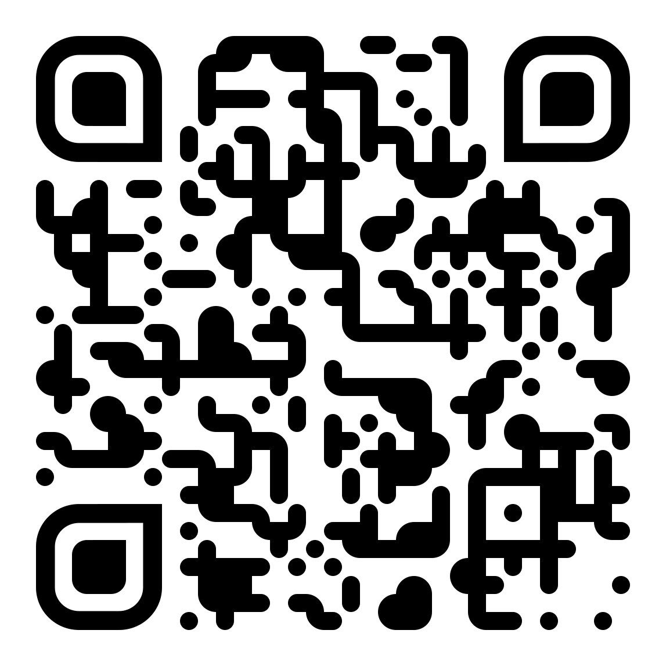
Questions?
Email: braden.odom@tn.gov
Phone: (615) 295-6825

