Slide 1
Rural Schools
Integrated Leadership Course: Session 1
Notes:
Welcome to Session 1 of the Rural Schools’ Integrated Leadership Course

Slide 2
Agenda
Overview
The Story of Rural Districts in Tennessee
Vision for Success
Academic Strategy: Identifying Complex Texts
Introduction to Core Action 4
Next Steps
Academic Strategy: Identifying High-Quality Questions and Tasks
Introduction to Core Action 5
  Evidence of Core Action 5
  Core Action 5 in Action
Planning for Change
Notes:
Review Agenda—packed day so brisk pacing!

Slide 3
Welcome
Name
Title/School and District
Email
Name
Title/School and District
Email
*All materials can be accessed at the Integrated Leadership Course series webpage.
Notes:
Customize, please.
Facilitator introductions and participant introductions. This group will be a cohort of sorts so allowing time for quick introductions will help build a stronger learning environment.
*determine introduction strategy…based on size of room.

Slide 4
Outcomes
Leaders will be oriented to the content, context, and use of the Literacy Learning Walkthrough Tool (LLW).
Leaders will develop a deeper understanding of three key literacy practices for pre-K–12 classrooms.
  Selection of complex texts
  Creation of aligned and strategically sequenced tasks and questions
  Development of student ownership of learning
Leaders will integrate new learning about text complexity, questions, and tasks into daily observation practices.
Notes:
RSN ILC two-day outcomes
Bold = session 1
Other = session 2
Facilitator should share that we are not training on the LLW, but on key literacy practices measured by the LLW. The goal is to improve the leaders’ understandings about literacy – regardless of grade – and to learn to analyze the depth of teacher understanding and quality of teacher practice in three key areas: complex texts, questions and tasks, student ownership.
FOR THE FACILITATOR:
Remember, we must model good practices in this training, so we must push the leaders to own the learning and be strategic in what we do, ask, and how we respond. Keep wait time, probing questions, and participant discussion in mind throughout these sessions.

Slide 5
Overview
Notes:
To start us off, let’s collectively ground ourselves in the vision, strategies and goals that have been articulated in the Tennessee Succeeds Plan.

Slide 6

Tennessee Succeeds: Our Vision
Districts and schools in Tennessee will exemplify excellence and equity such that all students are equipped with the knowledge and skills to successfully embark upon their chosen path in life.
Notes:
The strategic plan is guided by a shared vision – That Districts and schools in Tennessee will exemplify excellence and equity such that all students are equipped with the knowledge and skills to successfully embark upon their chosen path in life.
This vision unifies us as we all are working to see success for our students upon graduation from high school.

Slide 7




Our Goals
Notes:
And to monitor our progress and work towards a high bar for excellence, Tennessee has set four goals for us to drive towards.
Question—what is the underlying connector here? (Literacy)

Slide 8
The Story of Rural Districts in Tennessee

Slide 9
Fewer than half of Tennessee’s rural students are meeting grade-level benchmarks in math and reading.
Notes:
2018 data for rural schools only
Rural = all districts minus Shelby, Davidson, Knox, Hamilton, & Montgomery

Slide 10
Fewer than half of Tennessee’s rural students are meeting grade-level benchmarks in math and reading.
Notes:
2018 data for rural schools only
Rural = all districts minus Shelby, Davidson, Knox, Hamilton, & Montgomery
Notice…the highest % on the graph is 40.0%, not 100%....the visuals might be a bit deceiving if one is not aware of the scale.

Slide 11
Students rarely engage in tasks that reflect the demands of the standards.
N = 162 assignments
N = 161 assignments
TNTP Opportunity Myth: https://tntp.org/assets/documents/TNTP_The-Opportunity-Myth_Web.pdf
Notes:
In fact, our data suggests that last year only 20% of literacy assignments students were given were aligned with the expectations of the standards for their grade level.
Students are rarely asked to convince others, inform or explain concepts to others, or tell stories:
Only 6% of assignments asked students to write an informational piece.
Only 6% of assignments asked students to write and opinion piece.
Only 2% of assignments asked students to write a narrative.
In the newest TNTP report (Opportunity Myth), we see 71% students succeed on their assignments but only meet the grade-level standards 17% of the time on the same assignments.
To access the report: https://tntp.org/assets/documents/TNTP_The-Opportunity-Myth_Web.pdf

Slide 12
Less than 10 percent of observed lessons reflected the vision for Teaching Literacy in Tennessee.
Notes:
And when we were assigning all components of the lesson, only 8% were considered to be aligned to the shifts expected by TN’s standards. In addition to this, we have data to suggest that teachers are pulling texts on their own and using them and aren’t always pulling texts that are rigorous enough for the grade levels.
Question for the group -- why aren’t teachers pulling rigorous texts? Where are they getting ideas for texts? What is your role in this? (setting expectations through eval and coaching conversations…setting high expectations for lesson design through planning)
All of this data informs our problem of practice – increasing the rigor and alignment of all classes, regardless of grade band or content.
From Opportunity Myth—Students spend:
180 hours in each core subject/year
151 of those hours are on lessons with weak alignment and instruction
29 of those hours are on lessons with strong alignment and instruction

Slide 13
The Vision for Success

Slide 14
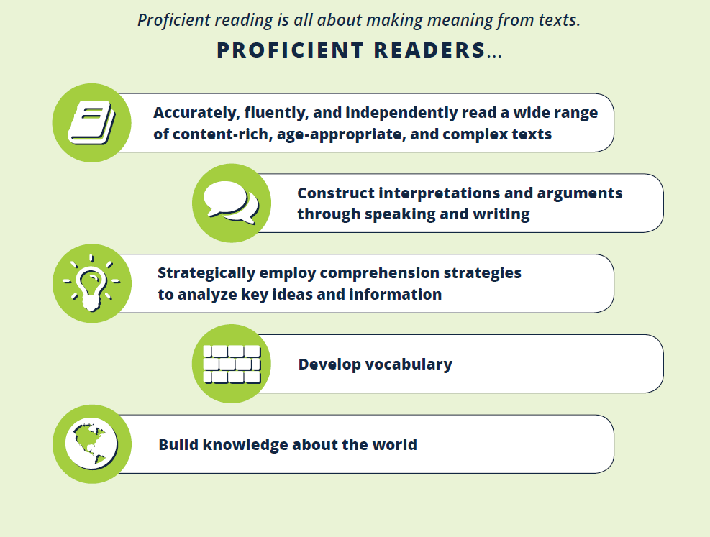
Vision for Proficient Readers
Notes:
From TLit—vision for success—all third grade readers should be proficient readers. This is the vision for reading proficiency—making meaning from texts.

Slide 15
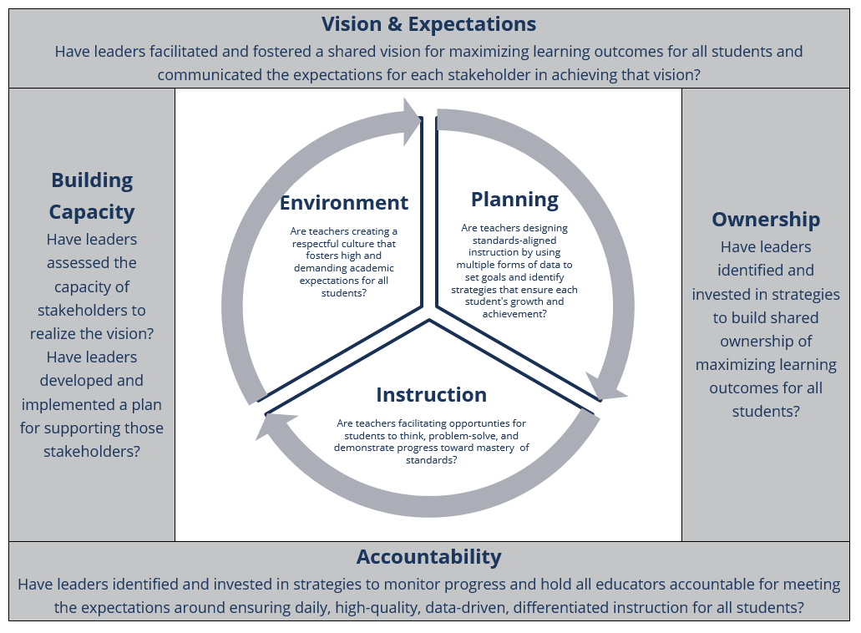
Structures for Support
HANDOUT 1_TEAM Admin Rubric
Notes:
This is our framework of support. From where do these phrases come? How do you use this to guide your actions and plans for support? (TEAM admin rubric, TEAM teacher rubric—list of best practices)
Use swimming pool analogy (credit = Sharon); If we imagine this framework for support based on the TEAM rubrics is a swimming pool, administrators live on the deck and teachers swim in the pool—today we are going to take a dip into the pool to better understand classroom practices. This will help you, as school leaders, be better prepared to support instructional practices.
So, what is influencing the current quality of questions and tasks in your building? If not you, who is the primary driver of the quality of instruction in your building?
Briefly review expectations for high-quality leadership (academic levers framework).
Note—vision and expectations is at the top, because expectations set the stage for student achievement.
From Opportunity Myth: While 82% of teachers support their state’s standards in theory, only 44% of those same teachers expected their students could meet the demands of those standards.
Basic to meeting the expectation of the standards is exposure to on grade-level work. Questions and tasks must be aligned to high-quality texts to make this happen.
How do we, as leaders, know if this is happening? The LLW is a tool to provide some of that data.
Remind participants that our job as leaders is to analyze data and make leadership level decisions based on that. The Literacy Learning Walk Tool is one source of data on instructional quality.

Slide 16
Think-Pair-Share
What connections do you see between the TEAM rubrics and the strategies being used in your school for reaching your school-wide literacy goal?
Vision & Expectations:
  How are you building a shared vision of excellent literacy instruction and student success?
  What challenges might you face as a rural school leader while building this shared vision with all stakeholders?
Self-Reflection:
  In what areas might you need to consider strategic changes to address your challenges?
  What resources might you access to support these changes?
HANDOUT 1_TEAM Admin Rubric
Notes:
HANDOUT 1_TEAM Administrator Evaluation Rubric
As a part of your strategy work, there were sections within each lever to consider the alignment to TEAM – why did we include this? What connections did you make?
Vision & Expectations: Connections between TEAM and your strategy for building a shared vision of excellent literacy instruction?
In Tennessee, it is expected that the vision of the school, developed in collaboration with multiple partners and aligned with the district’s vision, will drive the actions demonstrated in the indicators and descriptors in this rubric over time to increase student achievement. The vision provides a powerful communication and coalescing tool for all stakeholders in the school, creating a “word picture” of what is to be created and maintained.
Curriculum & Assessment: Connections between TEAM and your strategy for ensuring all teachers have access to and are using standards-aligned instructional materials?
A1. Capacity Building Builds capacity of educators to provide all students a rigorous curriculum, aligned with Tennessee state standards
Utilizes shared leadership practices to build capacity of nearly all educators for: Studying, analyzing, and evaluating approved curriculum resources, including texts.
Capacity Building: Connections between TEAM and your strategy for building the knowledge and skills of educators in your building?
A1. Capacity Building Builds capacity of educators to provide all students a rigorous curriculum, aligned with Tennessee state standards
Utilizes shared leadership practices to build capacity of nearly all educators for: Developing an accurate understanding of Tennessee adopted standards and instructional practices.
Where else on the rubric do you see places where you might build capacity?
Where might you need to consider strategic changes?
Turn and talk

Slide 17
The Solution: Key Instructional Shifts in Literacy
KNOWLEDGE | Building knowledge through content-rich non-fiction.
COMPLEXITY | Regular practice with complex text and its academic language.
TEXT-FOCUSED | Reading, writing, and speaking grounded in evidence from text, both literary and informational.
Notes:
THE SOLUTION
This literacy walk-through tool is a critical step forward, as we know that to teach to more rigorous standards, teachers are having to make shifts in their instruction. The shifts that teachers must make to their instruction in English language arts, which I’m sure you can all recite at this point are knowledge, complexity, and text focused instruction. Key—in all classes not just ELA!
STRATEGY: Assign one area to each table group. Have table groups discuss and chart responses. Group share out with no repeats.
Instructional Shift #1: Building knowledge through content-rich non-fiction.
Traditional approach to literacy instruction: The majority of reading instruction involved literary texts. Curriculum organized around “themes” or “skills” rather than topics or concepts. Texts were read in isolation and not paired or organized into sets.
What it should look like now: Curriculum organized around concepts. Students study the same concept over many weeks in many ways (e.g. multiple instructional strategies and texts for different purposes in the Literacy Block). Students have many opportunities to talk about the concept. Structures are built for independent reading on the same concept. As students move through the grades, they should read a greater proportion of informational texts so that they are well-prepared for the kinds of reading that will be required of them in college, career, and life (see balance of Literature and Informational Text by grade band on page 25 of the ELA standards).
Instructional Shift #2: Regular practice with complex text and its academic language.
Traditional approach to literacy instruction: In all subjects and grades, too many students are not challenged to read complex text (or hear it read aloud in grades K-2).
What it should look like now: Students read texts of increasing complexity as they move through K-12 so that they are ready for college and career ready reading by the time they graduate. Curriculum prioritizes high-quality, complex texts. Instruction prioritizes how to unlock the meaning of complex texts and a greater focus on academic vocabulary. In grades K-2, students’ work with complex texts through read-aloud and shared reading as they simultaneously work to master foundational reading skills.
Academic Vocabulary is defined as words that are traditionally used in academic dialogue and text. Specifically, it refers to words that are not necessarily common or frequently encountered in informal conversation. More about CCSS Academic Vocabulary.
Instructional Shift # 3: Reading, writing and speaking grounded in evidence from text, both literary and informational.
Traditional approach to literacy instruction: The majority of writing in school centers on personal narratives and personal opinions.
What it should look like now: Students read for, talk and write with evidence. Students read with care so that they can understand a concept deeply and then present clear analyses, well-defended claims, and clear information based on evidence in the text in speaking or writing. Rather than asking questions that students can answer from experience, teachers ask text-dependent questions that point students back to the text to support their ideas.
FOR FACILITATOR: some leaders in the room may not know about this so this activity will generate conversation and get the language of the shifts into the room for everyone.

Slide 18

Our shared problem of practice:
Students across Tennessee are not yet engaging in literacy instruction that reflects the demands of Tennessee’s rigorous ELA standards.
Notes:
(THE PROBLEM)
Reminder: Our shared problem of practice - Students across Tennessee are not yet engaging in literacy instruction that reflects the demands of Tennessee’s rigorous ELA standards.
As we dig into the research behind Core Actions 4 and 5, remember our purpose here - the Literacy Learning Walk Tool can be used to inform your strategy and measure progress towards your vision for change in literacy.

Slide 19
The Commitment: High Expectations for Student Engagement
Listening to/ reading text
Thinking about text
Talking about text
Writing about text
Our goal for students is that they can clearly and coherently express their understanding of complex texts.
Notes:
THE COMMITMENT
We can no longer teach reading, writing, and speaking & listening in isolation; the standards call for deep integration of the strands, all centered around a set of worthy texts.
Read About It: In this new paradigm, teachers let the texts do the teaching. They position the texts as the “expert” in the room. Lessons are structured so that students are active readers, annotating as they go, organizing information and ideas, engaging in discussion protocols, and completing writing tasks that bring them back to the text over and over.
Think About It: In this new paradigm, teachers set a purpose for reading and provide time for students to think about the text. Often what focuses students is a question, which is followed by a structure that gives them time to think about their response and ultimately to talk and write about it.
Talk About It: In this new paradigm, teachers help students deepen their understanding of text through discourse. In every lesson there are structures that promote productive and equitable conversation among students. Talking to each other about what they are reading gives students a chance to hear the ideas of their peers, build off of them, and clarify their own misconceptions.
Write About It: Writing is an integral part of the learning process: writing is a way for students to crystalize their thinking (i.e. “writing to learn”). Writing is also a way for students to communicate their learning (i.e. “writing to demonstrate learning”).
Questions:
Why is the “talk about it” paradigm key? (Kids that can’t speak their thoughts also can’t write their thoughts.)
How does “read and think/about it” play into “talk about it?” (reading gives language, thinking allows coherency)
What evidence might you see in a classroom that would indicate this is happening?

Slide 20
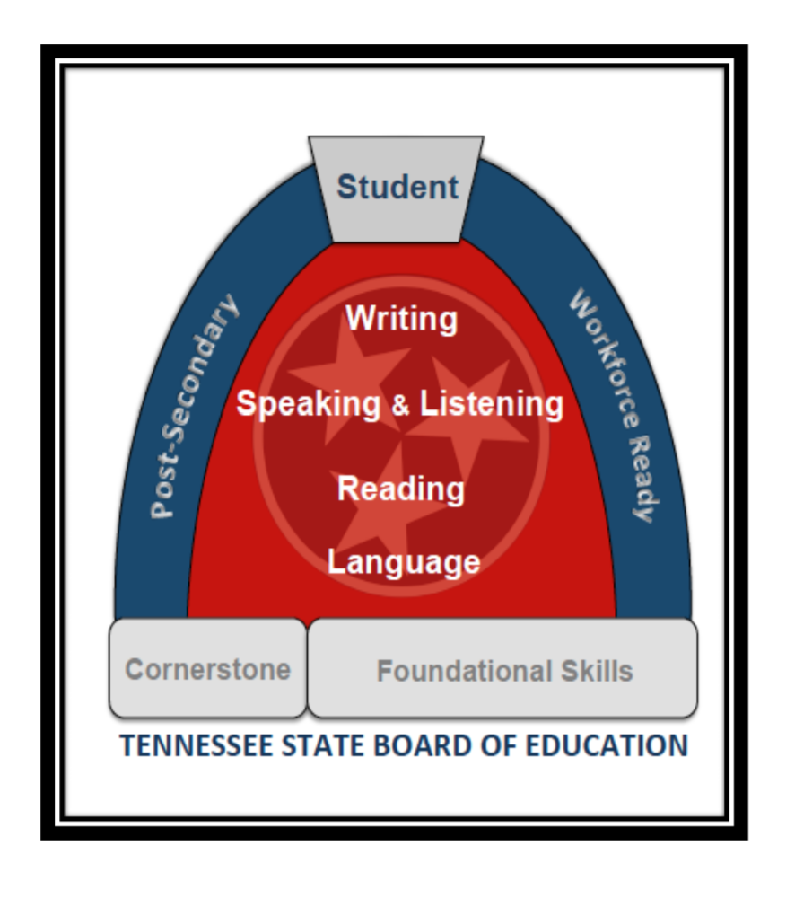
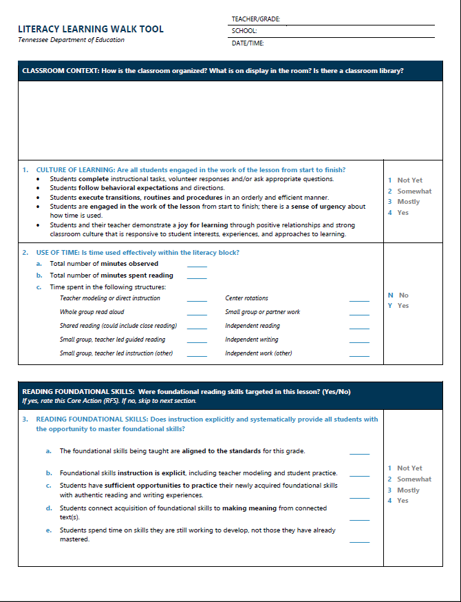
The Commitment: Achieving Dramatically Different Results
Establish Highly Rigorous Standards
Establish and Support the Expectation for High-Quality Instruction
Notes:
THE COMMITMENT
So, given the strategic plan and the outcomes that we are working to improve – what exactly are we going to do to move forward? What’s the strategy? The good news is that this is what we are talking about today – the path forward.
To that end, we have done a variety of things, including:
Adopted rigorous academic standards for ELA and math that are grounded in the most current research about what works to produce dramatically different results for students.
Adapted a Literacy Walk Tool for us to use in classrooms that is grounded in the same research base and describes excellent instruction aligned to the standards. This tool is a modified version of the IPG from Student Achievement Partners and you may have seen it/used it before with: LIFT, D2D, TNTP, or their CORE office (if they're a TELN district or engaging in Literacy Learning Walks).
Who here is familiar with the Literacy Walkthrough Tool or the IPG? Fist to five on familiarity.
This tool is a living document and the TDOE is currently exploring some modifications. Will be updated to reflect our evolving vision and understanding of excellent instruction.
We are also working on adapting a similar tool for math that will be available next year.

Slide 21
The Action: Lead the Change
Clear vision and high expectations for educators
  It is critical that everyone understands and invests in the plan to accelerate literacy learning.
Focused, shared leadership will be key to the success of this work.
What might your teachers answer if asked to communicate your vision for literacy and high expectations?
How might teachers in your building respond if asked to describe the leadership style in the building?
Notes:
THE ACTION
**Questions on right hand side of slide are animated
What will it take to lead change? Here’s what we know: (read points)
This change will take a real commitment from you to prioritize the effort and investment from others in your school buildings. How are you going to translate your belief in the importance of this work down to each of your students – it has to be through your teachers and families and you need to PLAN for the change.

Slide 22
Academic Strategy: Identifying Complex Texts
Notes:
Now that we have grounded ourselves in the vision, strategies and goals and have a student in mind that we know can do better, let’s begin to plan for the level of change that we know will be required of us to be successful in this era of higher standards for students.

Slide 23
The Commitment: Producing Dramatically Different Results for Students
Our Theory of Action:
If our students are…
  Engaging in a high volume of reading
  Reading and listening to complex texts on or beyond grade level
  Thinking deeply about and responding to text through speaking and writing
  Developing the skill and craft of a writer
  Practicing foundational skills that have been taught explicitly and systematically and applied through reading and writing
…we will produce dramatically different results for our students.
Notes:
THE COMMITTMENT
To support your efforts to provide students with these daily opportunities, the TDOE released a resource “Teaching Literacy in Tennessee” designed to provide practical guidance for developing proficient readers, writers, and thinkers. The intended audience of this resource is K-3 teachers and leaders. However, it is grounded in a theory of action that extends to teaching literacy at all grade levels.
If students are:
Engaging in a high volume of reading;
Reading and listening to complex texts that are on or beyond grade level – We explored this significant change during the first session.
Thinking deeply about and responding to text through speaking and writing;
Developing the skill and craft of a writer; and
Practicing foundational skills that have been taught explicitly and systematically and applied through reading and writing.
We will produce dramatically different results for our students.
ANIMATION: Today, we will be focusing on this component – how do we get students to think deeply about and respond to text through speaking and writing?
Optional Question for Slide: Which of these fall under skills-based instruction and which under knowledge-based?

Slide 24
Literacy Learning Walk (LLW) Tool
Deepen your understanding of standards-aligned instruction to inform your vision.
Diagnose the current trend teaching and learning in your school to inform your academic strategy.
Monitor progress towards your vision for change.
HANDOUT 2_LITERACY LEARNING WALK TOOL
Notes:
Have participants access LLW tool. HANDOUT 2_LITERACY LEARNING WALK TOOL
Survey the room for familiarity.
Why use this tool? To identify trends.
Changing trends changes buildings—because if the trend is to teach to the rigor of the standard, we are in a different place than if the trend is below grade level instruction.
We will do this by training you to leverage high impact portions of TDOE’s Literacy Learning Walk Tool which describes excellent instruction aligned to the standards.
Again, this tool is a modified version of the IPG from Student Achievement Partners and you may have seen it/used it before with: LIFT, D2D, TNTP, or their CORE office (if they're a TELN district or engaging in Literacy Learning Walks).
This tool can be a useful tool to:
Deepen your understanding of standards-aligned instruction to inform your vision.
Diagnose the current state of teaching and learning in your school to inform your academic strategy.
Monitor progress towards your vision for change.
Critical to remember that this is NOT a tool for evaluation of practice. Also important to note that this is a broad picture of literacy instruction and doesn’t encompass all of the critical attributes found within each of the literacy strategies being supported through the R2BR work.
In this course we are going to dive deeply into one area of the tool to build our own understanding, diagnose our current state, and inform our academic strategy.
However, we do not have enough time to do the extensive learning and norming that is required to use this tool to monitor progress. If you are interested in this kind of work, reach out to your district supervisors to explore options for support from your CORE Office.

Slide 25
The LLW Tool Has 6 Core Actions
Our Focus: Core Actions 4, 5, 6
CORE ACTION 1: Are all students engaged in the work of the lesson from start to finish?
CORE ACTION 2: Is time used effectively within the literacy block?
CORE ACTION 3: (K-5 only) Does instruction explicitly and systematically provide all students with the opportunity to master foundational skills?
CORE ACTION 4: Is the lesson centered on a high-quality text or texts?
CORE ACTION 5: Do questions and tasks integrate the standards and build comprehension of the text(s) and its meaning?
CORE ACTION 6: Are students responsible for doing the thinking in this classroom?
HANDOUT 2_LITERACY LEARNING WALK TOOL
Notes:
NOT training on this tool—focusing on the key actions for literacy.
HANDOUT C_Literacy Learning Walk Tool
Core Action 1 is focused on the culture of learning in the classroom.
Core Action 2 is focused on the use of time in the classroom.
Core Action 3 is focused on the quality of the reading foundational skills instruction that is happening in the classroom.
Core Action 4 is focused on the quality of the texts used in the classroom.
Core Action 5 is focused on the quality of the questions and tasks used in the classroom.
Core Action 6 is focused on ownership of the learning in the classroom.
Today, we will look at CA 4 and 5.
Next session, CA 6
Why might we have chosen CA 4, 5, 6 as our focus? (grade band/content agnostic, focused on concrete teacher practices, lead to student growth/achievement)

Slide 26
Introducing Core Action 4

Slide 27
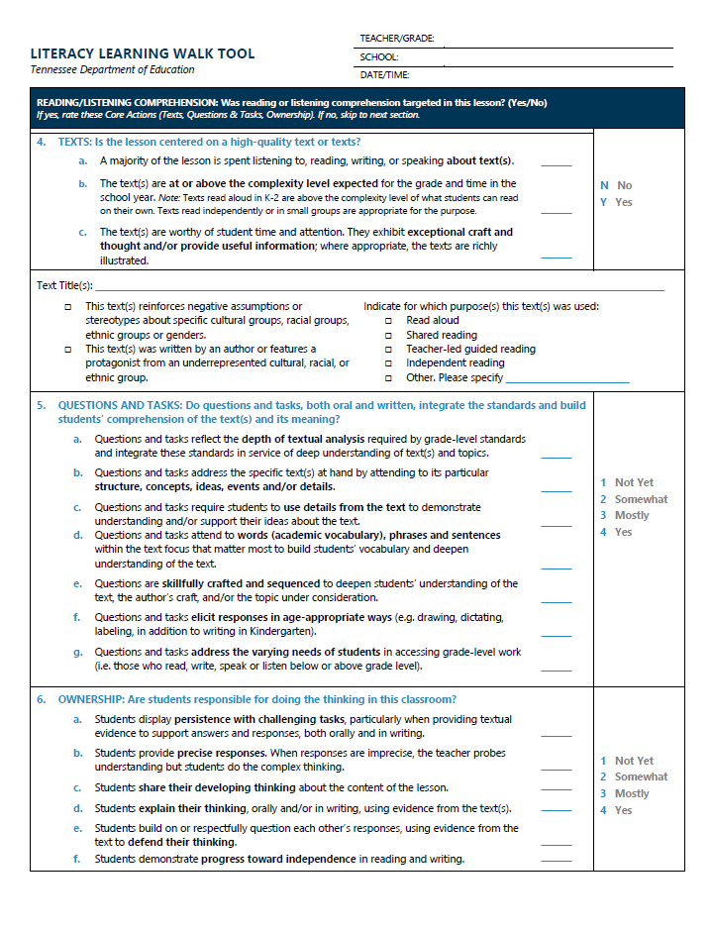
Core Action 4: High Quality Texts
Is the lesson centered on a high-quality text or texts?
HANDOUT 2_LITERACY LEARNING WALK TOOL
Notes:
HANDOUT 2: LITERACY LEARNING WALK TOOL
Now we have refined our academic strategy to help ensure that all students in our building have the opportunity to read or listen to adequately complex texts that are worthy of time and attention (Core Action 4), we need to consider how students in our buildings are provided with the support – through carefully planned questions and tasks – to actually understand complex text and demonstrate their understanding. We cannot just put more complex text in front of students. They need carefully planned instruction that “unlocks” the text and supports deep understanding.
Take 3 minutes to open Handout C, the Literacy Learning Walk Tool and read the indicators in Core Action 5 to familiarize yourself with the vision for this type of questioning.

Slide 28
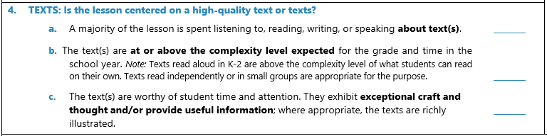
Core Action 4: High-Quality Text(s)
HANDOUT 2_LITERACY LEARNING WALK TOOL
Notes:
Why start here? Complex text is the foundation of all learning. Neither teaching nor learning can exceed the complexity of the text.

Slide 29
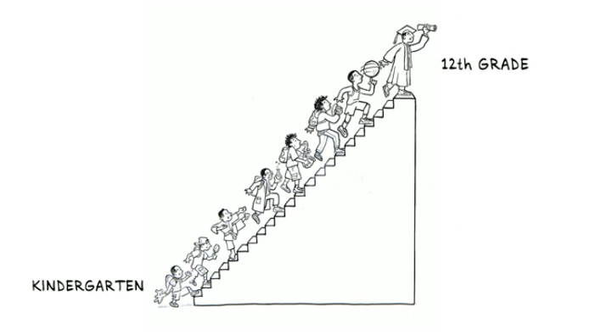
The standards are based on steadily increasing complexity.
Notes:
The standards call for students to comprehend texts of steadily increasing complexity as they progress through school.
So that by graduation, they can read and comprehend independently and proficiently the kinds of complex texts commonly found in college and careers.
This staircase is noted in the standards themselves, in the grade band recommendations.

Slide 30
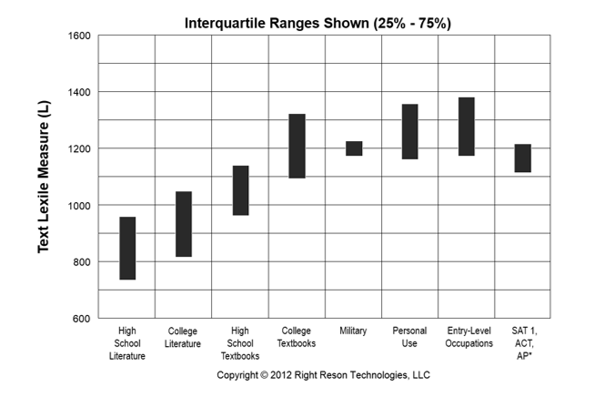
Our literacy standards combat the significant gap between school and college/workplace expectations.
Notes:
This was intended to combat the significant gap between school and college/workplace expectations.
Metametrics, the organization that developed the “Lexile” as one indicator for measuring complexity did an interesting analysis where they looked at the complexity of what students read in high school, college and career. They found significant gaps in the difficultly level between what students are reading in high school literature and college literature and then again between high school text books and college text book difficulty ranges. When you compare these even to the levels of military level reading, personal use, entry level occupations and ACT levels, which is one of our state goals, we see that even the average level of text books difficulty may not be preparing students for the kinds of complex texts they’ll encounter in this college entrance exam.
[Animate Slide]
The standards define a grade-by-grade “staircase” of increasing text complexity that rises from beginning reading to the college and career readiness level, to ensure our 12th graders are comprehending independently and proficiently the kinds of texts found in college and career. 11th and 12th grade lexile bands should rise to 1355, topping out college level text complexity as well as that of the ACT.

Slide 31
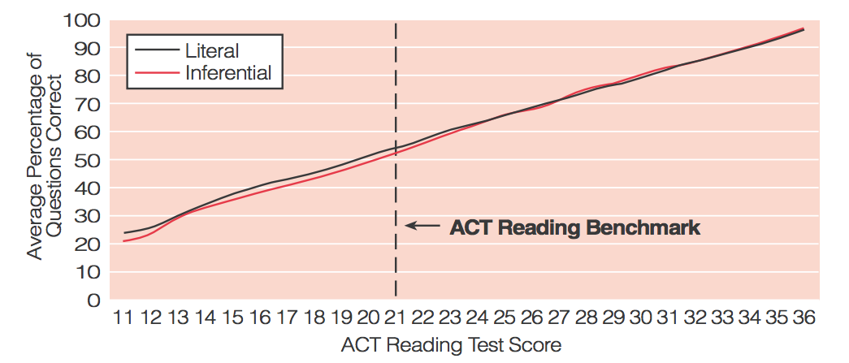
Identifying College Ready Readers
Performance on the ACT Reading Test by Comprehension Level
Source: Reading Between the Lines: What the ACT Reveals About College Readiness in Reading
Notes:
Here we will ask a strategically placed question and model how to push to an “all the way right answer.” Call on NON-volunteers for answers. (this lets you model)
QUESTION: WHY 21? WHY IS AN ACT SCORE OF 21 THE MARK OF ACT SUCCESS?
LIKEY ANSWERS: kids get scholarship (true statement, but not the answer); college entry (true, not answer); kids read well (true, not answer)
The 2006 ACT study, Reading Between the Lines, was instrumental in the shift to focusing on complex text. ACT sought to understand what separated college-ready readers from their peers. We know many of our students in TN take the ACT and the ACT has a lot of data about students who have taken the exam.
Here you can see some of this data:
Along the X axis you can see student’s ACE reading scores.
Along the Y axis on the left you can see the % of questions students are getting correct.
ACE has a reading benchmark at the score of 21. Students who score a 21 or higher struggle less in college and need less remediation.
Their first hypothesis was that students who struggled weren’t able to make inferences about the text they were reading. They thought that perhaps students who struggled could answer the “right there” literal questions, but not the inferential questions. As you can see here, students at all score levels do almost exactly the same on both types of questions. There is no statistical difference in student’s ability to answer the different types of questions at each level.
So, a kid who is scoring a 16 is getting about 40% of literal questions right, and 40% of inferential questions right. If we were to follow conventional wisdom from the field, we would expect that literal, 'right there' questions would be easier for students, especially more struggling readers. We might expect this student to get 50% of literal questions right and 30% of inferential questions right. But that's not what's happen - kids at all score levels answer literal and inferential questions correctly at just about the exact same rate!

Slide 32
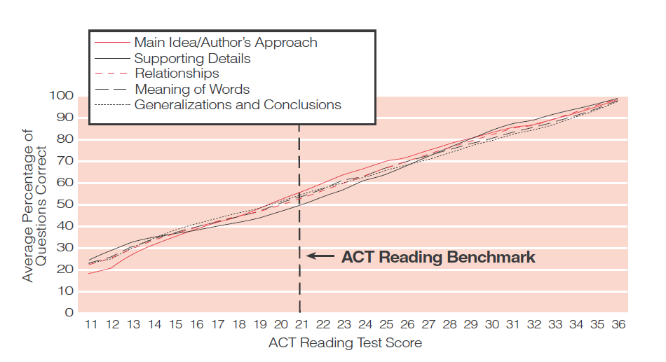
Identifying College Ready Readers
Performance on the ACT Reading Test by Textual Element
Source: Reading Between the Lines: What the ACT Reveals About College Readiness in Reading
Notes:
ASK WHY 21?
The same research question was applied to differences in correct responses on questions designed to assess understanding of various textual elements. Similarly, question types by textual element—such as main idea or author’s purpose-- did not differentiate students’ performance. Similarly, a student who is scoring a 16 is getting about 40% of the questions on main idea, supporting details, word meanings, generalizations and conclusions.
Which begs the question– why are these individual standards or skills the driver for literacy instruction. If the student performs poorly on the main idea question, he/she is very likely to perform poorly on the details and conclusion questions.
So what is tripping the students up? The complexity of the text! Until the college and career ready benchmark (the score of 21) kids are basically guessing– they are flat-lining on complex text. But as students’ ability to comprehend the complex text improves, they are getting more answers correct.

Slide 33
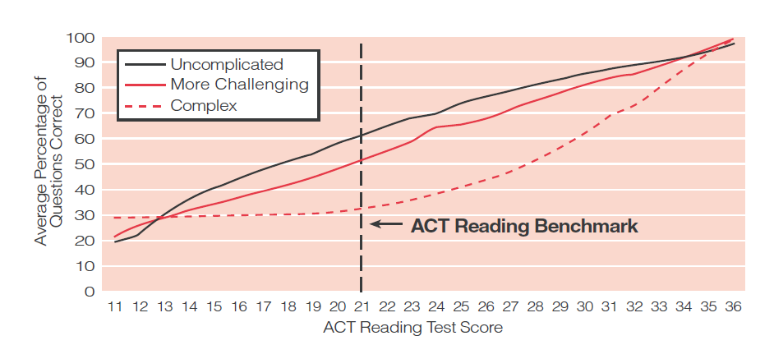
Identifying College Ready Readers
Performance on the ACT Reading Test by Degree of Text Complexity
Source: Reading Between the Lines: What the ACT Reveals About College Readiness in Reading
Notes:
ASK WHY 21?
Finally, they looked at the text itself instead of the what students were trying to do with the texts. And here you can see a separation. Text complexity is what makes a different. Students who struggled had a hard time answering questions of any type on complex texts. Until the college and career ready benchmark (the score of 21) kids are basically guessing– they are flat-lining on complex text. But as students’ ability to comprehend the complex text improves, they are getting more answers correct.
Pause– What take-aways do you have about this study? What does this mean for the instruction in our schools?
We need students to have practice with complex texts and exposure to and ability to understand them.
What is separating kids is their ability to understand the text- not the strategies and skills.
That we can’t just put increasingly complex texts in front of our students, but rather, we also need to move from instruction that focuses on question types or individual standards (revisit the 2 preceding slides), to alternate means for getting kids into complex texts.
FOR THE FACILITATOR’S UNDERSTANDING: (This is why.)
At an ACT of 21, students can make meaning out of text that are complex. An ACT of 21 means the student has the BASIC skills required to take on complex texts. This is why ACT projects post-secondary success. If a kid can’t make meaning from written language, he/she will struggle to master the skills required of post-secondary work.
Consider the reading requirements of nursing students, the complexity of technical manuals, the rigor of the design questions asked of engineering students, the nuance of military strategy and number of factors to consider in a given environment.
Note…the movement between scores on the ACT is logarithmic, meaning the jump between 12-13 is smaller that the jump from 21-21 which is smaller than the jump from 35-36. This is why it is so hard to move an average ACT score—and nearly impossible until the student can manage complex text.

Slide 34
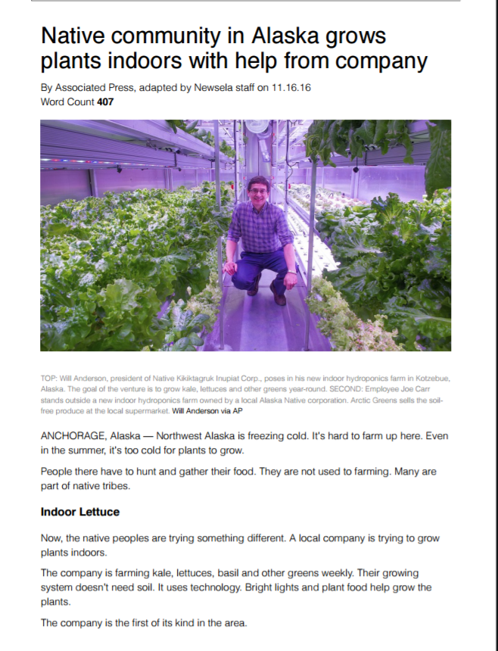
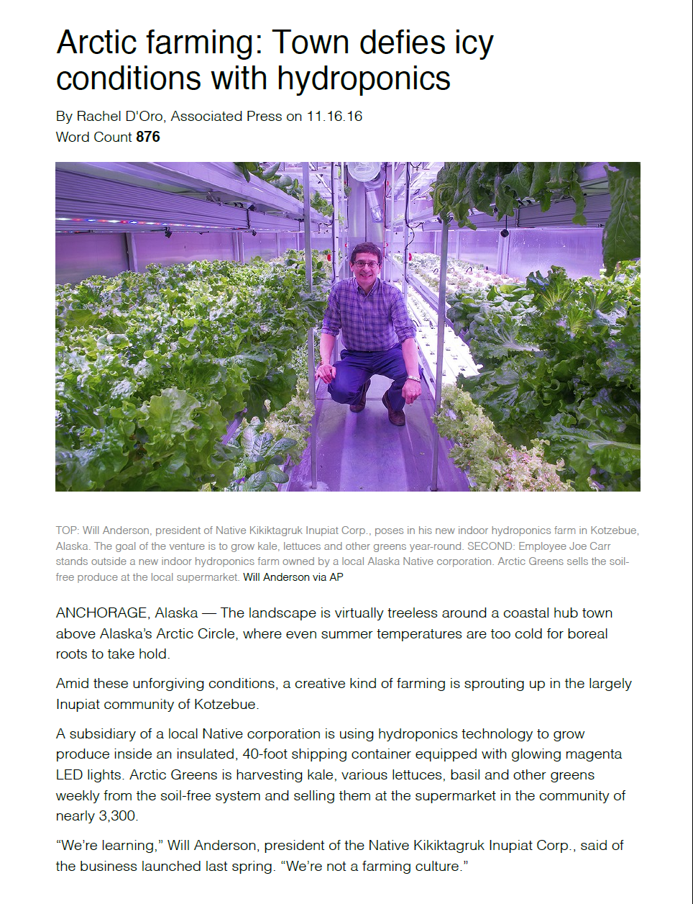
What is complex text?
Collaboratively explore the difference between the two articles.
HANDOUTS 3 and 4 NEWSELA articles
Notes:
HANDOUTS 3 and 4 NEWS ELA articles--Complex Text; Not Complex Text
In your table teams, collaboratively explore the difference between the two articles and be prepared to share out your thoughts.
FACILITATOR: Lead popcorn response and use paraphrasing to capture big ideas and consolidate them for the room. After a quick pop-corn response, move to the next slide and review the char of complex texts.
DEBRIEF:
The article that is not as complex has headers, shorter sentences and paragraphs, simplified vocabulary, clear transitions and linking words, explicit purpose.
Note: If administrator’s ask about the value of differentiating texts for students, consider sharing some of the challenges with a leveled-only approach to literacy instruction:
The instructional approach of matching text difficulty levels to student ability levels is not directly addressed by the Standards, but is a widely practiced approach.
High-volume independent reading must necessarily be at levels that students can read independently, and hence difficulty levels will vary by student.
The standards suggest a balance of high-volume independent reading with heavily-scaffolded instructional reading of more complex text.
Research suggests that with such scaffolds even struggling readers can access significantly more complex text then that to which they have been traditionally given access.

Slide 35
Characteristics of Complex Texts
Dense information
Lack of words, sentences or paragraphs that review or pull things together for the student.
Lengthy paragraphs
Complex sentences
Text structure that is less narrative and mixes structures
Subtle and/or frequent transitions
Multiple and/or subtle themes and purposes
Uncommon vocabulary
Unfamiliar settings, topics or events
Lack of repetition, overlap, or similarity in words and sentences
Notes:
The standards call for lots of opportunities for students to practice making sense of the concepts, vocabulary, and sentence structures in sophisticated text – the key to proficient reading.
More recent research confirms that vocabulary and syntax are the features of complex text that likely cause the greatest difficulty. “Students with a sufficient lexicon and ability to comprehend syntax may have the capacity to make the connections needed to comprehend the text without explicit text connectors. If this analysis is correct, it may suggest the value of more practice with texts containing more complex syntax, and it reinforces the call for more and better vocabulary instruction, which apparently has continued, long after observations on this problem by Durkin (1979), to be a small and unsystematic part of literacy instruction.” - Nelson, Perfetti, Liben, and Liben

Slide 36
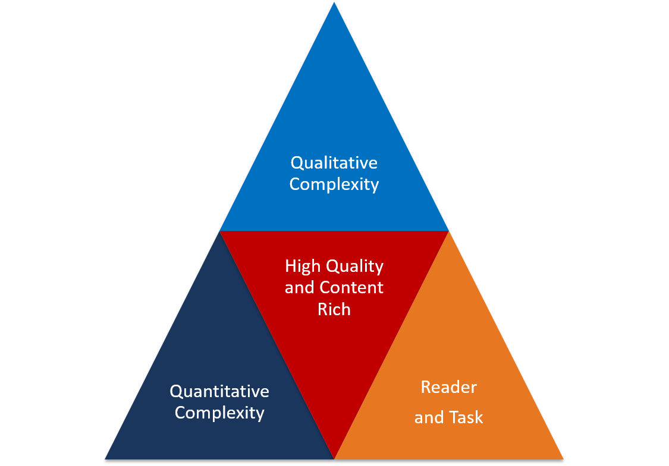
Identifying Worthy Texts
Quantitative measures of complexity —like Lexile—are a pretty rough but generally accurate assessment of complexity. They allow us to place the text in the appropriate grade band.
Much more important are the qualitative complexity measures that help us situate the text within the grade band and plan for instruction.
Additional information about the readers in the room and the associated tasks also help contextualize the appropriateness of a text.
HANDOUT 5_QUALITATIVE RUBRIC
Notes:
Animated slide
Note—point three “grayed out” because be are not addressing this characteristic in this session.
HANDOUT 6_QUALITATIVE RUBRIC
During Session 1 we explored how the standards call for high-quality texts worthy of time and attention selected to build knowledge.
We spent a lot of time talking about how to ensure texts were adequately complex quantitatively, qualitatively and when considering specific information about readers in the room. (refer to bullets on slide)
But remember, It is also critically important that texts are content rich – that they are selected and organized around concepts that systematically develop the knowledge base of students.
Questions:
Why is text complexity so critical? This is the foundation of the lesson. If students are engaged with the right content, questions and tasks will not be driving at grade level learning.
What are we talking about when we think about qualitative complexity? Take out HANDOUT B to refamiliarize yourself with these features.
Why do we need to understand the aspects of a text that make it qualitatively complex? We need to support teachers to conduct the qualitative analysis to understand the text considerations for both the readers' learning needs and the potential of the text to provide knowledge building opportunities based on the instructional purpose. We also use this information to drive questions and tasks as these are the features students will likely need support with to make meaning of the text.

Slide 37
First, we analyze quantitative measures of complexity to place the text in the appropriate grade band.
Quantitative Measures of Text Complexity
Lexile Measures by Grade Band
Grade Band | The Lexile Framework
K-1 | Up to 530L
2-3 | 420L to 820L
4-5 | 740 to 1010L
6-8 | 925L to 1185L
9-10 | 1050L to 1335L
11-12 | 1185L to 1385L
Sources: Tennessee English Language Arts Standards and https://lexile.com/about-lexile/grade-equivalent/grade-equivalent-chart/
Notes:
Both quantitative and qualitative analyses are important for text selection. They inform educators about different elements of the text.
The quantitative analysis is the scientific analysis—it can (with relative accuracy) place text in the appropriate grade band. It includes metrics that a computer can count about a text such as…
Word length
Word frequency
Word difficulty
Sentence length
Text length
Text cohesion
The quantitative happens first—It is the driver of the text band placement.
Appropriately places text in the correct grade band (usually), but not the correct grade level.
This helps to ensure the complexity of the text continues to rise throughout the grades.

Slide 38
Qualitative Measures of Evaluation
Levels of Meaning and Purpose
Density and Complexity
Figurative Language
Purpose
Structure
Genre
Organization
Narration
Text Features
Graphics
Language Convention and Clarity
Register
Knowledge Demands
Prior Knowledge
Cultural Knowledge
Background Knowledge
Vocabulary
Standard English and Variations
Fisher and Frey, 2013
Notes:
Talking Points: Now let’s take a look some qualitative dimensions of text complexity, yet also talk a bit more about the reader. Qualitative measures examine text attributes that can only be evaluated by the person who is reading or selecting the book or passage. Qualitative features are a critical component in determining text complexity related to the text being used, including Levels of Meaning and Purpose, Structure, and Language Convention and Clarity. The area of Knowledge Demands also involves aspects that a reader brings to the text. As detailed on the slide:
Levels of Meaning & Purpose reflects the complexity of the ideas. The characteristics to consider are multiple and/or subtle themes and purposes, and language.
Structure is the design and organization of the text. Characteristics to consider related to structure include…
Subtle and/or frequent transitions
Longer paragraphs
Any text structure which is less narrative and/or mixes structures
Density of information
Lack of repetition, overlap/similarity in words/sentences
Language Convention and Clarity represents the vocabulary, patterns, and style of the text. Characteristics to consider are
Uncommon vocabulary
Complex sentences and syntax
Lack of words, sentences, or paragraphs that review or pull things together
Knowledge demands relate to a student’s background knowledge and prior experiences necessary for comprehension. Characteristics to consider are the student’s level of familiarity with aspects, such as a text’s setting, concepts, vocabulary, or events.
Nancy Frey, Doug Fisher. Rigorous Reading, 2013
Teachers can use qualitative analysis text complexity rubrics found in the shared reading manual at tn.gov/readtobeready. Text analysis examples can also be found here.

Slide 39
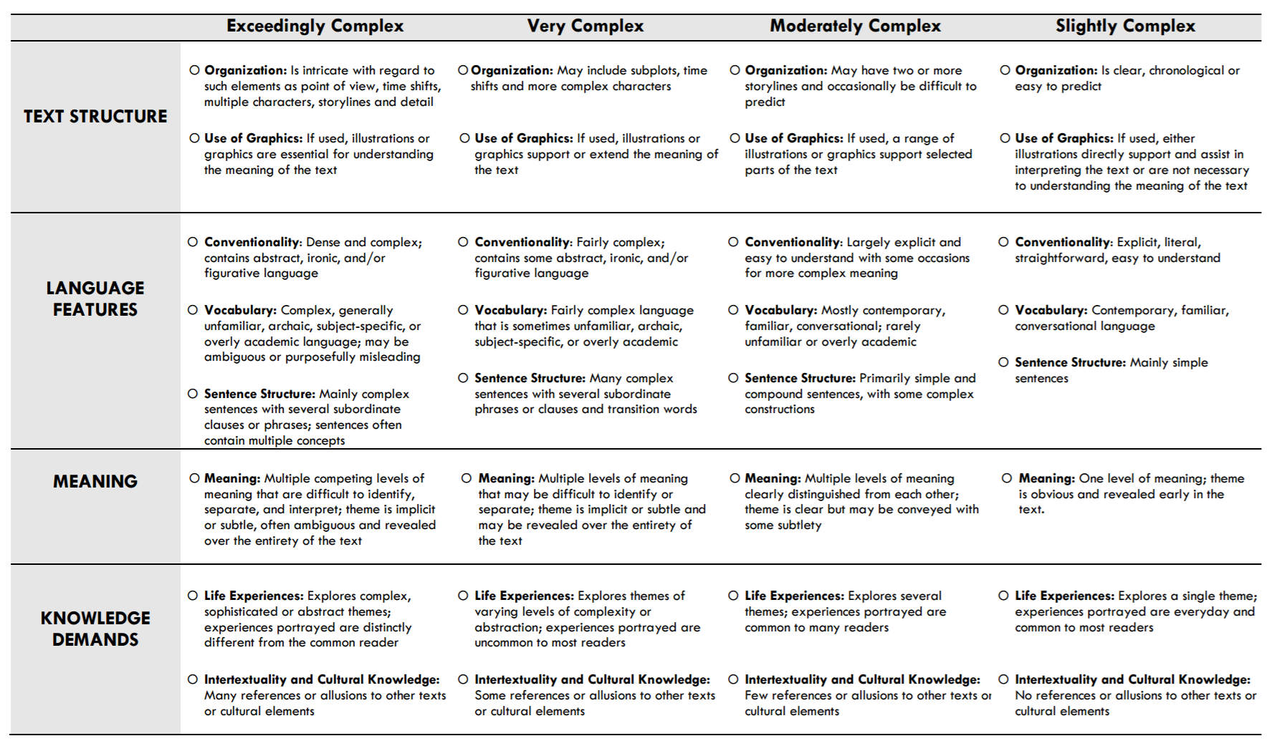
Qualitative Measures: Literature
Council of Chief State School Officers (2013). Navigating Text Complexity.
ccso.org/Navigating_Text_Complexity.html
HANDOUT 5_QUALITATIVE RUBRIC
Notes:
Hand-out in Participant Pack (12 min)
Talking Points: Let’s take a moment to review the information in the Text Complexity Qualitative Measures Rubrics for both Literature and Informational Text. These features can help guide teachers to begin thinking deeply about whether or not these measures are met with any text they are thinking about using. These measures help guide us to select texts that will give us rich vocabulary, a variety of sentence structures, complex ideas and multiple themes with rich characters and content. Analyzing qualitative text measure will help strengthen the purpose for using texts and the placement of texts into a larger conceptual arch of learning. We are no longer doing a unit on pumpkins because it’s fall – we have to help our teachers think broader about where pumpkins would fit in a larger concept whether it’s on farming or seasons or something else.

Slide 40
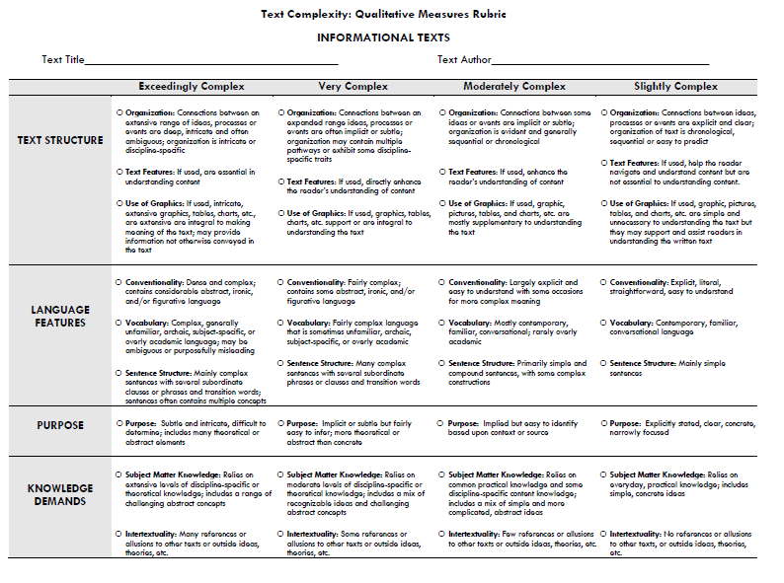
Qualitative Measures: Informational Text
Council of Chief State School Officers (2013). Navigating Text Complexity.
ccso.org/Navigating_Text_Complexity.html
HANDOUT 5_QUALITATIVE RUBRIC
Notes:
Talking Points: review the measures for informational text. What are some of the differences between slightly/moderately/very/exceedingly complex? Ask participants to share out a few notices from each of the 4 areas.

Slide 41
Influence of Delivery Mechanism on Text Complexity
Delivery Mechanism | Text Complexity | Who Does the Work | Load of Work
Read Aloud (teacher reading aloud full text to students) | 1-3 grade levels above current grade level | The teacher does all of the print work; the teacher and students work together to make meaning. | Teacher 90% Students 10%
Shared Reading (teacher and students reading a text together) | On or slightly above grade level | The teacher and the students do the print and meaning work together. | Teacher 50% Students 50%
Small Group (students reading from a common text with support from the teacher) | On readers’ instructional level or appropriate level of complexity | The student does most of the print and meaning work. | Teacher 30% Students 70% (will vary by support needed)
Independent Reading (students reading independently from different texts) | Based on students’ independent reading levels, interests, unit concepts | The student does all of the print and meaning work. | Students 100%

Slide 42

How do I know if the texts my teachers are using are worthy, compelling, and complex?
Access your pre-work reading and notes.
  HANDOUT A_pre-read article 1
  HANDOUT B_pre-read article 2
  HANDOUT C_pre-read article 3
Use the knowledge gained from your pre-reading to debrief the Core Action 4 indicators.
Table groups will chart and display responses.
Notes:
****Pre-work to read the articles
(20 minutes to read the article, 10 minutes to chart, 10 minutes to share out)
When we left we were discussing the research behind Core Action Four, the importance of complex text and how building background knowledge is critical for students to develop schema and access information as we present them with increasingly complex texts to read and comprehend. So, let’s work to build our own background knowledge a little bit and engage with some articles that further speak to the importance of shifting our instruction to align to approach.
HANDOUT A – aligns to Indicator 4a
HANDOUT B – aligns to Indicator 4b
Group 3: HANDOUT C – aligns to Indicator 4c

Slide 43
Pre-Reading Alignment
Is the lesson centered on a high-quality text(s)?
A majority of the lesson is spent listening to, reading, writing, or speaking about text(s).
The text(s) are at or above the complexity level expected for the grade and time in the school year.
The text(s) are worthy of student time and attention. They exhibit exceptional craft and thought and/or provide useful information; where appropriate, the texts are richly illustrated.
Alignment to
Core Action 4 indicators
Reading Comprehension Instruction: Focus on Content or Strategies?
Education Leadership: How Knowledge Powers Reading
Knowledge Matters: Restoring Wonder and Excitement to the Classroom
Notes:
20 minutes – (10 minutes to chart and 10 minutes to share out)
Given the research you just engaged in, let’s consider what we might see and hear in a classroom where this kind of instruction is in place.
HANDOUT A – aligns to Indicator 4a
Evidence:
Is there a text, either present in the lesson or referred to through writing, speaking, or listening?
What are students spending the majority of time doing?
Are students actually engaging with the text themselves by listening to, reading, writing, or speaking about it?
Indicator 4b
HANDOUT B
Evidence:
What is the quantitative complexity of the text(s)?
What is the qualitative complexity of the text(s)?
Does the text(s) reflect the complexity of the exemplar texts for this grade band?
Indicator 4c
HANDOUT C
Evidence:
Is the text authentic? For example, are students reading primary sources, novels, scientific journals, etc.?
How does the text build students’ knowledge of the world around them? Could it be part of a sequence that is building knowledge and context? Or could it only stand-alone?
Is the text worth reading and re-reading? Are there layers of meaning, complex syntax, figurative language, etc. that are worth students digging into and exploring?

Slide 44
Model
Read the poem “New Colossus.” Listen and annotate the text and qualitative rubric as I analyze this text.
  Quantitative Analysis: Navigate to www.lexile.com and search for the title of the text to get a quantitative measure. Determine the quantitative complexity of the text and place it in the appropriate grade band using the Tennessee Text Complexity Framework.
  Qualitative Analysis: Using the rubric, evaluate the qualitative features of the text. Provide evidence for each feature. Place the passage in the appropriate grade.
HANDOUT 5_QUALITATIVE RUBRIC
Notes:
5 minutes – guided think-aloud
HANDOUT 6_New Colossus Poem
Since this is a poem, a quantitative analysis through Lexile.com will not provide us the information we need. <Facilitators could ask participants to articulate why to reinforce prior learning.>
Given that, we move to the qualitative analysis which asks us to analyze the elements of this poem that make it complex.
What first jumps out at me is the poem’s structure which is necessary to analyze and understand in order to grasp the meaning and intent of this poem. The structure is very complex. This text is an Italian sonnet made up of 14 lines with a rhyme scheme of abba, abba for the first stanza and cdcdcd rhyme scheme for the final stanza. The first 8 lines of the poem are an octave. The octave is where an idea is introduced in a sonnet. In this poem, the octave introduces and describes the subject. Readers must infer that the “Mother of Exiles” the author describes is The Statue of Liberty. The volta is line 9 which is where the sonnet changes and begins a new perspective and begins the final stanza. The 2nd stanza is composed of the last 6 lines (line 9-line 14). This stanza is a sestet. In this poem, the sestet is where the writer shifts perspective and writes from The Statue of Liberty’s point of view and puts the entire stanza in The Statue of Liberty’s dialogue. The reader must infer that the second stanza is written from The Statue of Liberty’s point of view by analyzing dialogue such as: “ ‘I lift my lamp beside the golden door!’”
The language features of this text also jump out at me. Upon analysis and looking at the qualitative rubric, they are very complex. There are many archaic vocabulary words the author uses such as: “colossus” and “brazen” to describe The Colossus of Rhodes. She also uses some words that students may be unfamiliar with such as: exile, tempest-tost, and the noun form of refuse. There are many different examples of figurative language used throughout the poem. She makes an allusion to The Colossus of Rhodes to contrast this statue with The Statue of Liberty in the first line. She uses metaphor by comparing The Statue of Liberty’s light to “imprisoned lightning.” In this metaphor, “imprisoned lightning” is also an example of an oxymoron. She uses the techniques of oxymorons throughout the poem to develop ideas. The Statue of Liberty speaks “with silent lips”, “mild eyes command.”
The meaning is also very complex: This text contains multiple levels of meaning that may be difficult to identify. The major theme of the poem is implicit and is revealed throughout the entirety of the poem. The major theme that is revealed throughout the text is that everyone deserves freedom. This is never explicitly stated and must be inferred from the text and connected to background knowledge readers have about The Statue of Liberty. Evidence for the major theme of the text can be found throughout the poem. This evidence includes: “Mother of Exiles”, “...her beacon-hand Glows world-wide welcome.” The Statue of Liberty speaks in the second stanza directly to the old world countries and states, “Give me your tired, your poor, Your huddled masses yearning to breathe free.”
<<Facilitators can highlight one or two of the levels of meaning in this poem which are below>>
The Statue of Liberty: The author does not directly state that this poem is about The Statue of Liberty. The reader must infer this information from the textual evidence including: “...woman with a torch…”and “Mother of Exiles.” Readers must connect inferences to their background knowledge in order to understand the idea that this poem is about The Statue of Liberty.
The Colossus of Rhodes: The author compares The Statue of Liberty to The Colossus of Rhodes. This is another level of meaning that students must infer from textual evidence and from background knowledge. The author never directly states that she is alluding to The Colossus of Rhodes. Students must infer this information from evidence such as: “Not like the brazen giant of Greek fame” and the title, “The New Colossus.”
New York Harbor: The idea that The Statue of Liberty is located in New York Harbor in New York City is not directly stated. Readers must infer this information from lines in the text, “ The air bridged harbor that twin cities frame.” They must also use their background knowledge about New York City during the time period that this poem was written to understand this reference.
Old World/New World: Another idea that is developed in the poem is that America is the new world where freedom is available for everyone. The old world is made up of countries that people are fleeing because they do not have freedom there. This idea of old world/new world is never referred to explicitly. Students must make inferences about the old world versus the new world and connect these inferences to their background knowledge about this time period. Clues in the text which refer to the old world/new world idea include: “The New Colossus” compared to “giant of Greek fame” and “Keep, ancient lands your storied pomp!”
Immigrants in America: The idea about immigration in America is never directly stated in the poem. Readers must refer to textual evidence and make inferences based on this and their background knowledge to understand this idea. Clues that this poem is about immigration in America include: “Mother of Exiles”, “Give me your tired, your poor,” “Send these, the homeless, tempest-tost to me.”
The Statue of Liberty’s light is a symbol for freedom: The idea that The Statue of Liberty is a light literally and figuratively for those seeking freedom is not directly stated. Readers must infer this from evidence such as: “ I lift my lamp beside the golden door!” and “From her beacon-hand Glows world-wide welcome.”
Finally, as I consider these layers of meaning, I’m noting that this requires background knowledge. The knowledge demands are very complex. In order to understand the subject of the poem and in order to understand the deeper levels of meaning in this poem, that The Statue of Liberty symbolizes freedom for immigrants, students will have to have some background knowledge about The Statue of Liberty. Students will need to connect their background knowledge to the textual evidence to make inferences that this poem is about The Statue of Liberty. Students will also need to have background knowledge about The Colossus of Rhodes in order to understand the allusion that the author is making when she is contrasting The Colossus of Rhodes with The Statue of Liberty. Having prior knowledge about sonnets will also help the reader understand how Lazarus changes perspective in the second stanza. Additionally, prior knowledge about historical events in New York City regarding immigration in the port of New York will help students develop a deeper understanding of the poem.
Now you will practice on a text from your grade band.

Slide 45
Practice: Elementary Leaders
Read the text “The Story of Ruby Bridges.” With a partner analyze the complexity of the text:
  Quantitative Analysis: Navigate to www.lexile.com and search for the title of the text to get a quantitative measure. Determine the quantitative complexity of the text and place it in the appropriate grade band using the Tennessee Text Complexity Framework.
  Qualitative Analysis: Using the rubric, evaluate the qualitative features of the text. Provide evidence for each feature. Place the passage in the appropriate grade.
1
2
Notes:
20 minutes – to read the text, provide the quantitative and qualitative analysis and discuss with your table facilitator
IMPORTANT NOTE FOR ELEMENTARY LEADERS: The texts that we read aloud in K-2 should be in the 2-3 or 4-5 band, more complex than the students can read themselves.

Slide 46
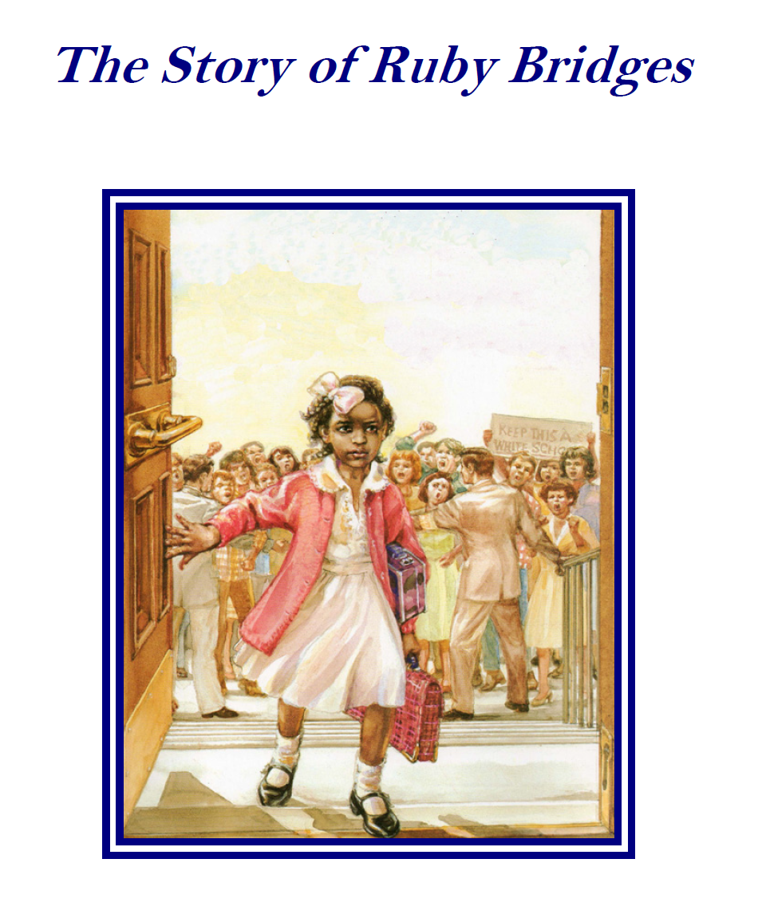
Practice: Elementary Leaders
Is this text at or above the complexity level expected for grade 3? Why or why not?
Is this text worthy of student time and attention? Why or why not?
HANDOUT 5_QUALITATIVE RUBRIC, HANDOUT 7_Ruby Bridges
Notes:
HANDOUT_7_Ruby Bridges
HANDOUT N_Qualitative Complexity Rubric
20 minutes (10 minutes to read the text, quantitative analysis, qualitative analysis, 5 minutes to plan your share out – what will you highlight for our group here as you explain your analysis, share)
Group Elementary Leaders into teams of 3-5 for this activity. Provide them with chart paper to chart their responses to the questions on the slide.
ANSWER:
Yes
Lexile: 800
Appendix B exemplar text
Qualitative Features:
Purpose: moderately – some of the purpose/meaning is explicit, but the significance of the event and the characterization of Ruby that contributes to the meaning
Structure: slightly complex – the structure is straightforward and a chronology/timeline (through explicit dates and transition words) is explicit throughout the text. It is not difficult to map the events.
Language: moderately – some tier two and three vocabulary, but not much. Most words and their meaning in context are accessible
Knowledge Demands: very complex – this is the most challenging complexity of this text – the understanding of the time period and reference to laws and historical significance which relates back to grasping the purpose/meaning.

Slide 47
Practice: Middle School Leaders
Read the text “The Great Fire.” With a partner analyze the complexity of the text:
  Quantitative Analysis: Navigate to www.lexile.com and search for the title of the text to get a quantitative measure. Determine the quantitative complexity of the text and place it in the appropriate grade band using the Tennessee Text Complexity Framework.
  Qualitative Analysis: Using the rubric, evaluate the qualitative features of the text. Provide evidence for each feature. Place the passage in the appropriate grade.
1
2
HANDOUT 5_QUALITATIVE RUBRIC, HANDOUT 8_The Great Fire
Notes:
HANDOUT 8_The Great Fire
HANDOUT N_Qualitative Complexity Rubric

Slide 48
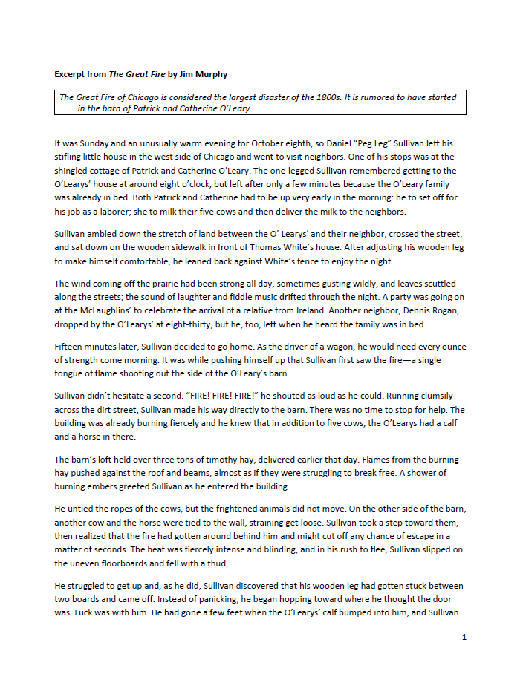
Practice: Middle School Leaders
Is this text at or above the complexity level expected for grade 6? Why or why not?
Is this text worthy of student time and attention? Why or why not?
Notes:
Group Middle School Leaders into teams of 3-5 for this activity. Provide them with chart paper to chart their responses.
ANSWER:
Yes
Lexile: 1130L
Qualitative Features:
Structure –The structure of the text is mostly cause and effect, showing the main reasons the Great Fire started in Chicago when it did. The relationship between the main idea and supporting details is clear.
Language features –The vocabulary used in the test is accessible to the average sixth grader and appropriate for grade level. The few words that may be challenging for this audience are surrounded by strong context clues that will enable students to understand the unfamiliar terms. The sentence structure varies from simple to complex but are of average length and can be dissected easily if needed.
Purpose – The purpose is singular – to explain the reasons the Great Fire started.
Knowledge demands – The passage is self-contained, meaning that no outside knowledge is required. Students may or may not know the location of Chicago, but a lack of knowledge of that fact will not impact understanding. Also, no prior knowledge of the Great Fire is needed, as the text describes it fully. Students will need to infer that wood burns easily, but there is context in the text to support that inference.
The text, as indicated by both quantitative and qualitative data, should be assigned to Grade 6. While sufficiently complex and of high quality, ,the text does not place unreasonable demands on the student, as the vocabulary level, syntax, and knowledge demands help with accessibility.

Slide 49
Practice: High School Leaders
Read the text “Because I Could Not Stop for Death.” With a partner analyze the complexity of the text:
  Quantitative Analysis: Navigate to www.lexile.com and search for the title of the text to get a quantitative measure. Determine the quantitative complexity of the text and place it in the appropriate grade band using the Tennessee Text Complexity Framework.
  Qualitative Analysis: Using the rubric, evaluate the qualitative features of the text. Provide evidence for each feature. Place the passage in the appropriate grade.
1
2
HANDOUT 5_QUALITATIVE RUBRIC, 9_Because I Could Not Stop For Death
Notes:
HANDOUT 9_Because I Could Not Stop for Death
HANDOUT 5_Qualitative Complexity Rubric

Slide 50
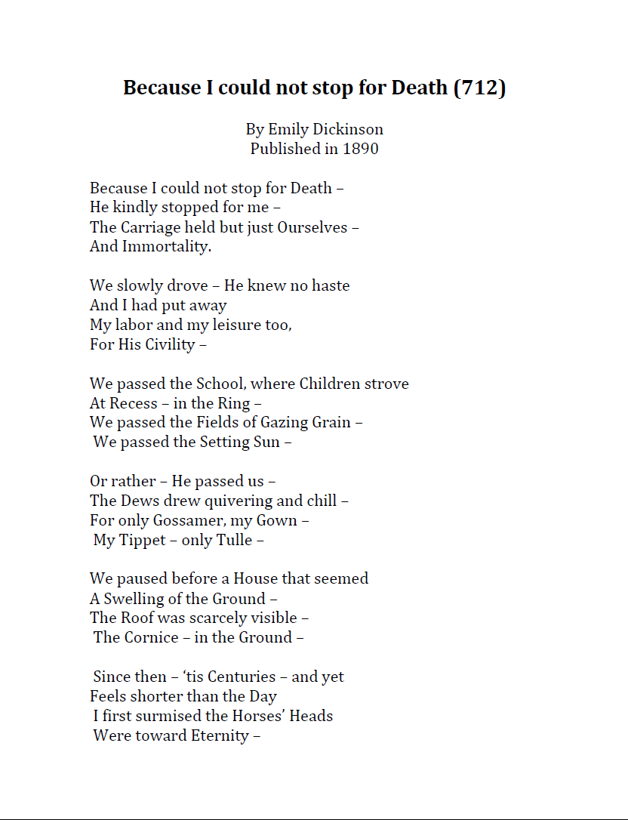
Practice: High School Leaders
Is this text at or above the complexity level expected for grade 11? Why or why not?
Is this text worthy of student time and attention? Why or why not?
Notes:
Group High School Leaders into teams of 3-5 for this activity. Provide them with chart paper to chart their responses.
ANSWER:
Yes
Lexile: NP
Qualitative Features:
Text Structure: Moderately complex: The text is organized fairly chronologically on the literal level, however the connection between the literal and the figurative is more subtle and implied. The text relays its meaning through the use of metaphor, symbolism, and sound devices (she plays with meter, alliteration, assonance, etc.). The intentional use of dashes and punctuation (this characterizes her particular style) is critical to understanding the meaning.
Language Features: Very complex: Language appears to be simplistic and straightforward, however there are sophisticated levels of figurative and connotative meaning; words like “kindly, knew no haste, labor and leisure, civility, quivering, chill” carry connotative meaning; the 3rd and 5th stanzas, in particular, have heavy figurative meaning (symbolism/metaphor with life cycle in 3rd stanza and grave references in the 5th)
Meaning/Purpose: Exceedingly complex: Dickinson personifies death in such a way as to make it seem as though it is a simple shift and not a major shake up. She paints it as a continual journey and not a final destination. This makes us question what we think about life and death. Are they completely dichotomous? She challenges the traditional concept of death as a negative and life as a positive state of being.
Knowledge Demands: Moderately complex: Poem does not require extensive prior knowledge, students may stumble over a few words and descriptions like the references to her gossamer gown and her tulle tippet. Students may need support in understanding the grave reference in stanza 5 (architectural term: cornice).
This text isn’t going to challenge them much at the literal level. The challenge will come in understanding the figurative level. Students may be deceived by its apparent simplicity and overlook how Dickinson is using symbolism, sound devices, imagery, and metaphor to communicate larger ideas. Students should have an understanding of each of these concepts in order to work with this text with some success.
Students will probably understand almost immediately that this is about death (duh….the title gives that away), but the challenge comes in asking yourself what Dickinson is saying about death. What is her perspective on death? How does she communicate that to us? How do we pick apart the poem to get at her meaning? Where do we begin to decipher it all? How do we know what to pay attention to, what to tackle, what is important?

Slide 51
Next Steps

Slide 52
Reflect on and Consider Improvements to Your Literacy Strategy
Have you prioritized time and support for teachers to read, discuss, and analyze the texts they use with students? What evidence would support your answer?
What support can you provide them to help with this important work?
What challenges might you face as a rural school leader in planning prioritized time and support for teachers do this critical work?
Notes:
Reflect on these questions and be prepared to share your responses after lunch. Ideas to consider:
How has your vision and expectations changed after your learning today?
What is something concrete for you that you know you want to take as a next step coming out of this morning’s session?
What evidence do you have to support your feelings about literacy instruction in your building?

Slide 53
Academic Strategy: Identifying High-Quality Questions and Tasks
Notes:
Return from Lunch: Now that we have grounded ourselves in the vision, strategies and goals and have a student in mind that we know can do better, let’s begin to plan for the level of change that we know will be required of us to be successful in this era of higher standards for students.

Slide 54
Our shared problem of practice:
Students across Tennessee are not yet engaging in literacy instruction that reflects the demands of Tennessee’s rigorous ELA standards.
Notes:
THE PROBLEM
Reminder: Our shared problem of practice - Students across Tennessee are not yet engaging in literacy instruction that reflects the demands of Tennessee’s rigorous ELA standards.
As we dig into the research behind Core Action 5, remember our purpose here - the Literacy Learning Walk Tool can be used to inform your strategy and measure progress towards your vision for change in literacy.

Slide 55
The Action: Lead the Change
Clear vision and high expectations for educators
  It is critical that everyone understands and invests in the plan to accelerate literacy learning.
Focused, shared leadership will be key to the success of this work.
Notes:
THE ACTION
What will it take to lead change? Here’s what we know: (read points)
This change will take a real commitment from you to prioritize the effort and investment from others in your school buildings. How are you going to translate your belief in the importance of this work down to each of your students – it has to be through your teachers and families and you need to PLAN for the change.

Slide 56
This Morning: Text Complexity and Identifying Worthy Texts
Quantitative measures of complexity (Lexile) allow us to place the text in the appropriate grade band.
Qualitative measures that help us situate the text within the grade band.
Additional information about the readers in the room contextualize the appropriateness of a text.
HANDOUT 5_QUALITATIVE RUBRIC
Notes:
HANDOUT 5_QUALITATIVE RUBRIC
This morning, we explored how the standards call for high-quality texts worthy of time and attention selected to build knowledge.
We spent a lot of time talking about how to ensure texts were adequately complex quantitatively, qualitatively and when considering specific information about readers in the room. (refer to bullets on slide)
But remember, It is also critically important that texts are content rich – that they are selected and organized around concepts that systematically develop the knowledge base of students.
Questions:
Why is text complexity so critical? This is the foundation of the lesson. If students are engaged with the right content, questions and tasks will not be driving at grade level learning.
What are we talking about when we think about qualitative complexity? Take out HANDOUT B to refamiliarize yourself with these features.
Why do we need to understand the aspects of a text that make it qualitatively complex? We need to support teachers to conduct the qualitative analysis to understand the text considerations for both the readers' learning needs and the potential of the text to provide knowledge building opportunities based on the instructional purpose. We also use this information to drive questions and tasks as these are the features students will likely need support with to make meaning of the text.

Slide 57
Stand and Talk
What leader inputs (systems, resources, support, time) are you considering to influence the quality and complexity of texts in your building?
What challenges do you face in this endeavor as a rural leader?
Notes:
Have participants number off. Even numbers are the outside circle, odd numbers the inside. Make groups of four, two even, two odd. After 3 minutes, odd pair moves clockwise and a new conversation starts.
FACILITATOR: Have group divide into halves, form inner and outer circle, and stand facing a partner. Time the conversation and have the inner circle shift while the outer stays stationary. This give multiple talking partners. You will need space to make large circles. If space is an issue, you may wish to use a shoulder partner conversation instead, but this limits the movement needed after lunch.
This is the bridge from morning.
Encourage leaders to explore how they know their inputs are having the desired impact.

Slide 58
Introducing Core Action 5

Slide 59
Core Action 5: Questions & Tasks
Do questions and tasks, both oral and written, integrate the standards and build students’ comprehension of the text(s) and its meaning?
HANDOUT 2_LITERACY LEARNING WALK TOOL
Notes:
HANDOUT 2: LITERACY LEARNING WALK TOOL
Now we have refined our academic strategy to help ensure that all students in our building have the opportunity to read or listen to adequately complex texts that are worthy of time and attention (Core Action 4), we need to consider how students in our buildings are provided with the support – through carefully planned questions and tasks – to actually understand complex text and demonstrate their understanding. We cannot just put more complex text in front of students. They need carefully planned instruction that “unlocks” the text and supports deep understanding.
Take 3 minutes to open Handout C, the Literacy Learning Walk Tool and read the indicators in Core Action 5 to familiarize yourself with the vision for this type of questioning.

Slide 60
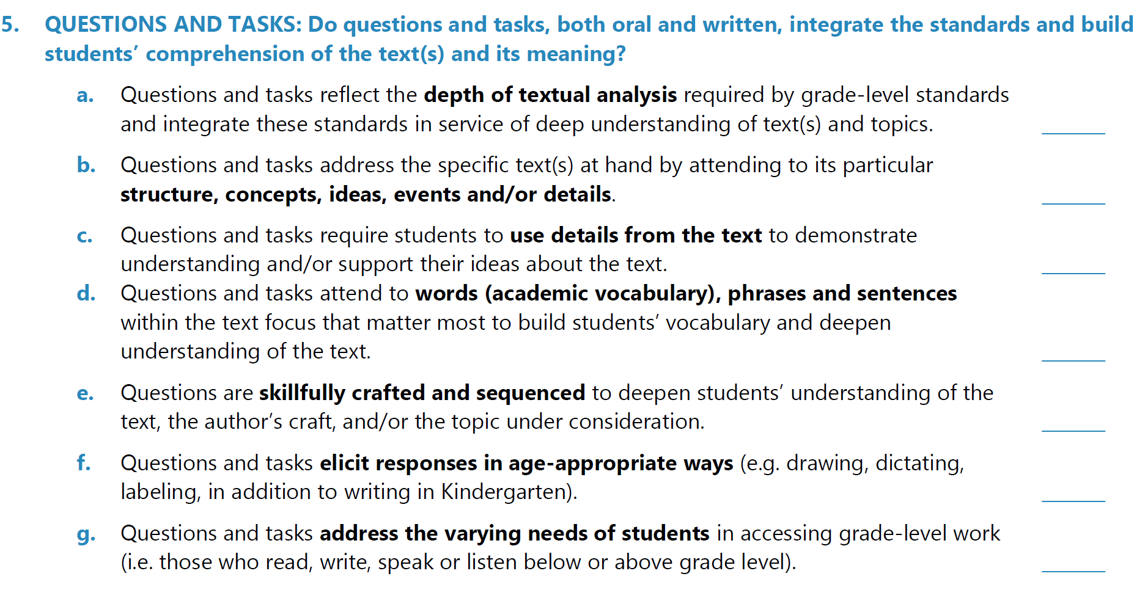
Students need opportunities to think deeply about and respond to text.
Core Action 5 – Questions & Tasks
HANDOUT 2_LITERACY LEARNING WALK TOOL
Notes:
Students need opportunities to think deeply about and respond to text. How can we get them to do this?
First, they must have access to high quality, complex texts, which was the focus of session 1 in Core Action 4.
Then, they must have access to strong questions and tasks to help them make meaning of those texts, this is what we are taking about today in Core Action 5.

Slide 61
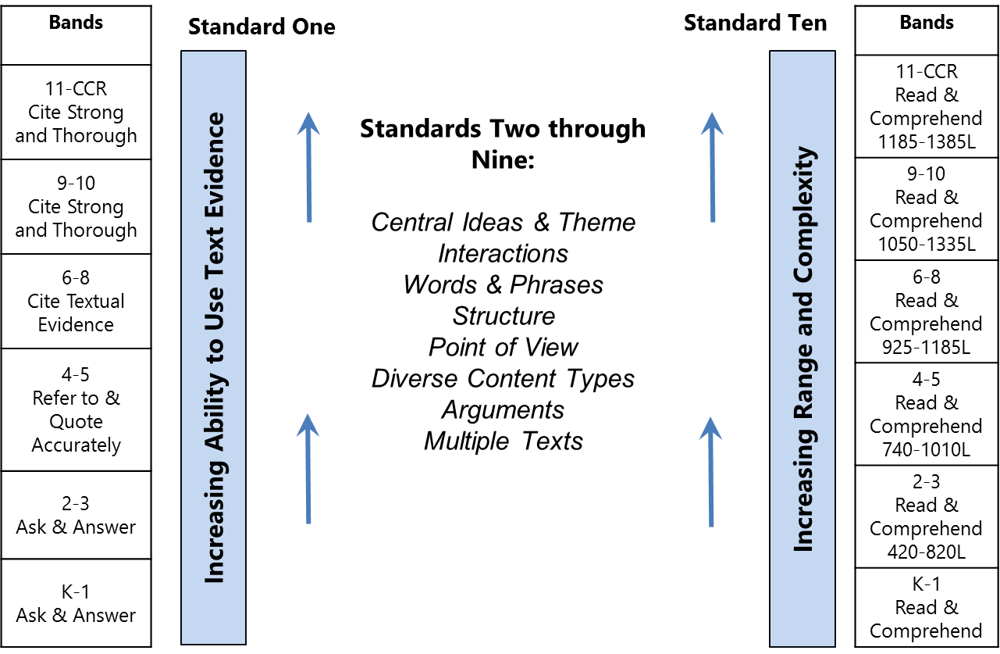
So, what does this mean in terms of changes to instruction?
Notes:
Just as the standards call for deep integration of the strands in the ELA standards, they also call for deep integration of standards within strands. This challenges us to reorient from the reading standards as “the end” to reading standards as “the means.” Standards 2-9 are not a list of skills to be mastered. Instead, they are a description of the kinds of thinking proficient readers engage in to make sense of grade-level text. Proficient readers never “use” or “do” one standard. Instead, they integrate and coordinate multiple actions simultaneously.
However, standards 1 and 10 are always at play– students should be engaged in grade level text and use details/evidence from the text to make meaning.
Standards 2-9 come into play based on the specific complexities of the text at hand, rather than the specific standards to “cover”. A qualitative analysis of the text should drive the sequence of questions to help students unlock meaning of texts that may be complex for different reasons. But a strong sequence of text-specific questions will inherently hit grade-level reading standard because they prompt the kind of thinking proficient readers engage in to make sense of a complex text.
This is a pretty significant shift from literacy instruction of the past decade (and all current basals) – where we chose a standard and selected a text to teach that standard. We have to flip our orientation on it’s head and choose a compelling set of texts and then craft questions that prompt the thinking described in the standards. Which standards are at play will always depend on the features of the text at hand.
However, what is even more important here, and perhaps the greatest shift, is that we are focusing on knowledge first. When we talk about the importance of texts, and texts being at the center of instruction, what we are saying is – what’s most important is the content students are learning – not a set of isolated skills that teachers may be used to focusing on in their literacy instruction. What topics or issues do we want students to master or more deeply understand? From there, we should decide what they should read – that reading should be appropriately complex for their grade level, and we should make sure we understand how the texts they are reading are qualitatively complex, so that we can help them unlock the meaning of the text. But again, the purpose is the learning of the content, not the mastery of the standards.
We should also take note of the verbs used in standards 2-9. We are not just asking students about details all the way through 12th grade. They need to do complex work with the text at hand to meet the demands of the standards. Consider some of these examples:
Key Ideas and Details:
CCSS.ELA-LITERACY.CCRA.R.1: Make logical inferences from it; cite specific textual evidence when writing or speaking to support conclusions drawn from the text.
CCSS.ELA-LITERACY.CCRA.R.2: Determine central ideas or themes of a text and analyze their development; summarize the key supporting details and ideas.
CCSS.ELA-LITERACY.CCRA.R.3: Analyze how and why individuals, events, or ideas develop and interact over the course of a text.
Craft and Structure:
CCSS.ELA-LITERACY.CCRA.R.4: Interpret words and phrases as they are used in a text, including determining technical, connotative, and figurative meanings, and analyze how specific word choices shape meaning or tone.
CCSS.ELA-LITERACY.CCRA.R.5: Analyze the structure of texts, including how specific sentences, paragraphs, and larger portions of the text (e.g., a section, chapter, scene, or stanza) relate to each other and the whole.
CCSS.ELA-LITERACY.CCRA.R.6: Assess how point of view or purpose shapes the content and style of a text.
Integration of Knowledge and Ideas:
CCSS.ELA-LITERACY.CCRA.R.7: Integrate and evaluate content presented in diverse media and formats, including visually and quantitatively, as well as in words.¹
CCSS.ELA-LITERACY.CCRA.R.8: Delineate and evaluate the argument and specific claims in a text, including the validity of the reasoning as well as the relevance and sufficiency of the evidence.
CCSS.ELA-LITERACY.CCRA.R.9: Analyze how two or more texts address similar themes or topics in order to build knowledge or to compare the approaches the authors take.
Range of Reading and Level of Text Complexity:
CCSS.ELA-LITERACY.CCRA.R.10: Read and comprehend complex literary and informational texts independently and proficiently.

Slide 62
Looking for Evidence of Core Action 5
Notes:
So now that we have reviewed how the standards are intended to be integrated and serve deep understanding of text, let’s talk about what we should look for in classrooms. How will we know this is happening through the texts, questions and tasks that we see? Let’s spend a few minutes with three tools to support our thinking:
The Framework for Teaching Literacy in Tennessee
The TEAM Rubric
The Literacy Learning Walk Tool

Slide 63

Core Action 5: Indicator A
Questions and tasks reflect the depth of textual analysis required by grade-level standards and integrate these standards in service of deep understanding of text(s) and topics.
Evidence:
Questions and tasks reflect deep integration of the strands; reading, writing, and speaking and listening are not taught in isolation.
Questions and tasks focus on making meaning of the texts and concepts at hand instead of “teaching” the standards in isolation.
How does the language and evidence for this indicator deepen your interpretation of the TEAM rubric?
HANDOUT 10_NON-EXAMPLE VS EXAMPLE
Notes:
HANDOUT 10: Non-Example vs. Example
Now let’s dig into the specific evidence we would look for during a classroom observation using the Literacy Learning Walk Tool.
Lesson Level Look-Fors: Core Action 5). Also, as you’re reviewing the examples, think about how the language and evidence for this indictor deepens your interpretation of the TEAM rubric.
However, as we go through, I want you to notice the words we highlighted in each indicator – to deepen student understanding. We don’t want teachers asking questions for the sake of asking questions – they must be driving students towards a deeper understanding of the text or concept at hand. In fact, sometimes we see teachers stop to ask so many questions that it distracts from the learning. This is also not what Core Action 5 is getting at. Questions should be strategic and purposeful to drive towards meaning-making.
Have participants reflect on and discuss the differences between the two examples.
Key Takeaways:
The non-example is isolated instruction targeting Reading Standard 2: Determine the central message, lesson, or moral and explain how it is conveyed through key details in the text (i.e. the main idea standard).
The teacher is attending to the language of the standards, but not yet integrating the standards in service of deep comprehension; instead she is planning questions and tasks to target isolated skills.
Focusing on one or two standards or strategies could not possibly unlock The New Colossus’ meaning for Grade 5 students. Instead, they need to recognize the structure/ syntax is crucial to unpacking its meaning; see that the author is contrasting 2 statutes and includes additional information of the 2nd statute to reveal its character; and that the poem offers both a critique of antiquity and a plea for immigrants to come to America.
The bottom line is we want students to demonstrate a deep understanding– to be able to comprehend– the poem so questions integrate standards 1, 3 and 5 in service of understanding.

Slide 64
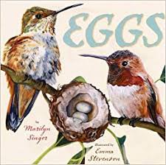
Non-Example (Grade 3)
QUESTION SEQUENCE
What is our book about?
What else did it say it [an egg] could be used as?
Can you find the main idea?
Where do we look for the main idea?
Which one is the main idea in this paragraph?
HANDOUT 10_NON-EXAMPLE VS EXAMPLE
Notes:
Have group read and analyze these questions.
QUESTIONS
What did you find? (Have one group share out)
FACILITATORS: The non-example is isolated instruction targeting Reading Standard 2: Determine the central message, lesson, or moral and explain how it is conveyed through key details in the text (i.e. the main idea standard).
The teacher is attending to the language of the standards, but not yet integrating the standards in service of deep comprehension; instead she is planning questions and tasks to target isolated skills.

Slide 65
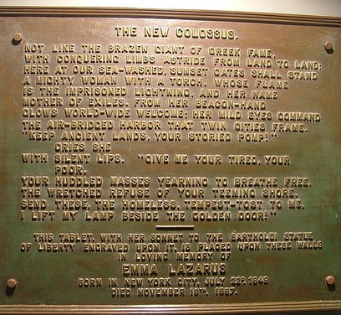
Example (Grade 5)
QUESTION SEQUENCE
What is the rhyme scheme of the poem? What does that reveal about the structure of the poem?
Which lines are about the first statue and which the second? What comparisons are made?
What can we infer about the location of the second statue?
Who does the second statue welcome to the shores of America? How is the land of the second statue characterized?
HANDOUT 10_NON-EXAMPLE VS EXAMPLE
Notes:
What did you find? (have one group share out)
Focusing on one or two standards or strategies could not possibly unlock The New Colossus’ meaning for Grade 5 students. Instead, they need to recognize the structure/ syntax is crucial to unpacking its meaning; see that the author is contrasting 2 statutes and includes additional information of the 2nd statute to reveal its character; and that the poem offers both a critique of antiquity and a plea for immigrants to come to America.
The bottom line is we want students to demonstrate a deep understanding– to be able to comprehend– the poem so questions integrate standards 1, 3 and 5 in service of understanding.
As you know, part of our vision for excellence is that teachers create units around enduring understandings - the ideas we want students to understand, not just recall, from deep exploration of our unit concept. We want students to understand "why the United States was and is called the land of opportunity” and "what it means to be a citizen of a country." The focus of this particular lesson would be "the significance of Ellis Island and the Statue of Liberty.“
How does this deepen your interpretation of the TEAM rubric? What should you see in a classroom to know that this indicator is at play?

Slide 66
Core Action 5: Indicator C
Questions and tasks require students to use details from the text to demonstrate understanding and/or support their ideas about the text.
Evidence:
The questions can only be answered after reading the texts (TDQs & TSQs).
Questions require students to use knowledge they gained from the texts to determine the correct answer.
Where applicable, students support their ideas with evidence and/or knowledge gained from the texts.
How does the language and evidence for this indicator deepen your interpretation of the TEAM rubric?
HANDOUT 11_NON-EXAMPLE VS EXAMPLE
Notes:
HANDOUT 11: Non-Example vs. Example
TDQs: Text Dependent Questions
TSQs: Text Specific Questions
Have participants reflect on and discuss the differences between the two examples.
Key Takeaways:
The non-example does not allow students to demonstrate critical thinking and textual analysis skills and convey conceptual knowledge around enduring understandings. It could be answered without reading the text and does not require students to use knowledge they gained from the texts to determine the correct answer.
The example task gives students the opportunity to demonstrate their understanding, synthesizing their learning from multiple unit texts and asks students to demonstrate understanding in an authentic and meaningful context.

Slide 67

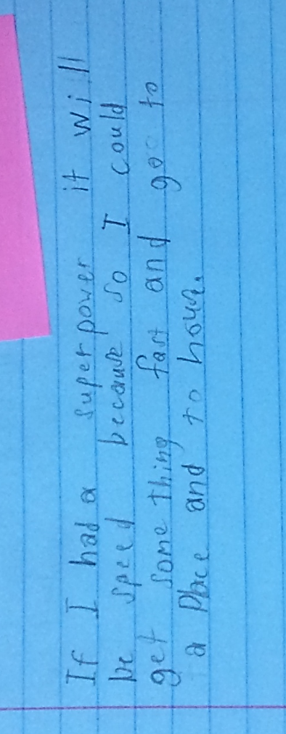
Non-Example (Grade 3)
TASK
Writing Prompt: If you had a superpower, what would it be? Why?
HANDOUT 11_NON-EXAMPLE VS EXAMPLE
Notes:
The non-example does not allow students to demonstrate critical thinking and textual analysis skills and convey conceptual knowledge around enduring understandings. It could be answered without reading the text and does not require students to use knowledge they gained from the texts to determine the correct answer.

Slide 68
Example (Grade 3)
TASK
Writing Prompt: Imagine you are a NASA scientist and the president has asked you if we can relocate people to other planets. You have to prepare a brief for the president on why Earth is ideally suited for life but the other planets are not.
Be sure to do the following when you write your brief:
Write an introduction.
Use information from unit texts to explain why earth is ideally suited for life.
Use information from unit texts to explain why each of the other planets in our solar system is not suitable for life. In your explanations, be sure to talk about the specific characteristics of each planet.
Use linking words and phrases to connect your ideas.
Use vocabulary words from our words of study: climate, patterns, distance, atmosphere, surface.
Write a concluding statement.
HANDOUT 11_NON-EXAMPLE VS EXAMPLE
Notes:
Grade 3 (TDOE Unit Starter). In this unit, Grade 3 students deeply explored a collection of 10 complex texts about our solar system and the distinguishing characteristics of each planet.
Note: This is an end-of-unit task which asks students to pull together thinking from multiple text experiences.
The example task gives students the opportunity to demonstrate their understanding, synthesizing their learning from multiple unit texts and asks students to demonstrate understanding in an authentic and meaningful context.
How does this deepen your interpretation of the TEAM rubric? What should you see in a classroom to know that this indicator is at play?

Slide 69
Core Action 5: Indicator D
Questions and tasks that attend to words (academic vocabulary), phrases and sentences within the text focus that matter most to build students’ vocabulary and deepen understanding of the text.
Evidence:
Questions and tasks address the specific language features that make this text challenging for students (e.g., complex vocabulary, unconventional language or sentence structure) to help them make sense of the text.
Questions and tasks employ appropriate vocabulary instructional strategies.
How does the language and evidence for this indicator deepen your interpretation of the TEAM rubric?
HANDOUT 12_NON-EXAMPLE VS EXAMPLE
Notes:
HANDOUT 12: Non-Example vs. Example
Have participants reflect on and discuss the differences between the two examples.
Key Takeaways:
The non-example focuses on figurative language but asks students to complete a sort of figurative, connotative and technical words. While this might appear to address the standard because of its focus on figurative, connotative and technical language, it does not actually require students to analyze the impact of word choices on meaning and tone of the text. While students have to refer to the text to pull out quotes, they do not have to do so in service of developing an understanding of the text itself, or the overarching themes of the text.
The examples is focused on making sense of figurative or connotative language to help unlock the meaning of a text.

Slide 70
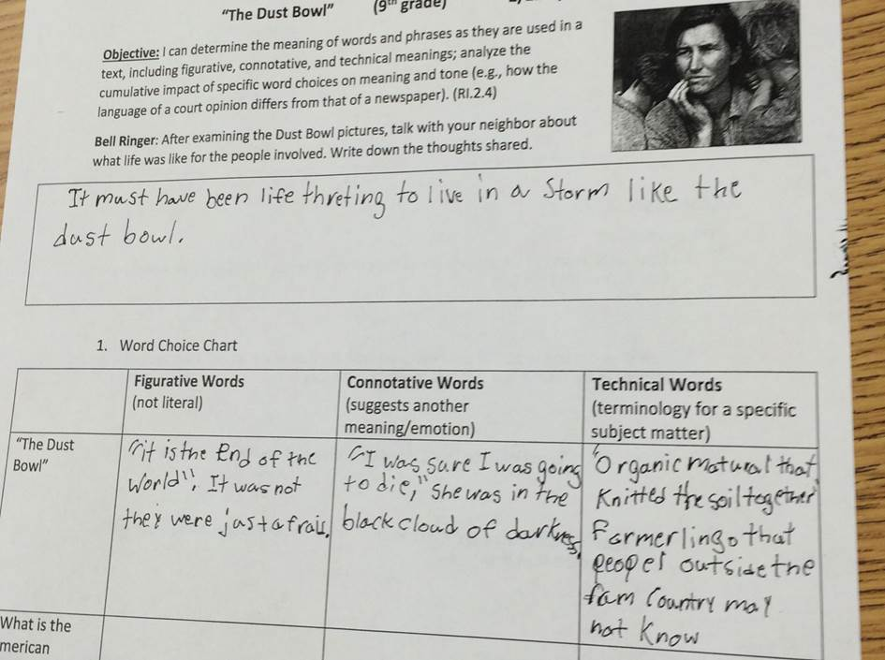
Non-Example (Grade 9)
TASK
HANDOUT 12_NON-EXAMPLE VS EXAMPLE
Notes:
The non-example focuses on figurative language but asks students to complete a sort of figurative, connotative and technical words. While this might appear to address the standard because of its focus on figurative, connotative and technical language, it does not actually require students to analyze the impact of word choices on meaning and tone of the text. While students have to refer to the text to pull out quotes, they do not have to do so in service of developing an understanding of the text itself, or the overarching themes of the text.
Side note – Identifying figurative and connotative language is found in standards in grades 6-8. So, aside from this not being a strong task, it is also concretely below grade level for 9th graders.

Slide 71
Example (Grade 6)
QUESTION SEQUENCE
The author used the word crept in paragraph 8 instead of a word like “walked” or “marched.” As used in the story, what does the use of the word crept suggest about Skidmore?
Which detail from the story best supports the same conclusion about Skidmore?
HANDOUT 12_NON-EXAMPLE VS EXAMPLE
Notes:
The examples is focused on making sense of figurative or connotative language to help unlock the meaning of a text.
How does this deepen your interpretation of the TEAM rubric? What should you see in a classroom to know that this indicator is at play?

Slide 72
Core Action 5: Indicator E
Questions and tasks are skillfully crafted and sequenced to deepen students’ understanding of the text, the author’s craft, and/or the topic under consideration.
Evidence:
Questions and tasks lead students to the enduring understandings for the unit.
Questions and tasks are intentionally sequenced to lead students toward success on the end-of-unit task.
How does the language and evidence for this indicator deepen your interpretation of the TEAM rubric?
HANDOUT 13_NON-EXAMPLE VS EXAMPLE
Notes:
HANDOUT 13: Non-Example vs. Example
Facilitator Notes: It’s critical here to think about how multiple texts and the daily task experiences build toward a larger, integrated end-of-unit task. How are teachers leveraging questions and tasks within a lesson and across a series of lessons to build deeper understanding of the text and students ability to produce high-quality, standards level work around the text at hand? How are teachers sequencing questions across texts? This is critical as we think about standards that call for students to compare multiple texts –teachers need to be ready to help students make those connections.
Have participants reflect on and discuss the differences between the two examples.
Key Takeaways:
For the non-example, if the ultimate goal of reading instruction is deep comprehension of the text at hand, randomly sequenced questions will not get students there.
In the example, the text is complex (knowledge demands, language features, etc.), and questions are sequenced to build toward the desired conceptual understandings about how our thinking about our world and universe has changed over time.

Slide 73

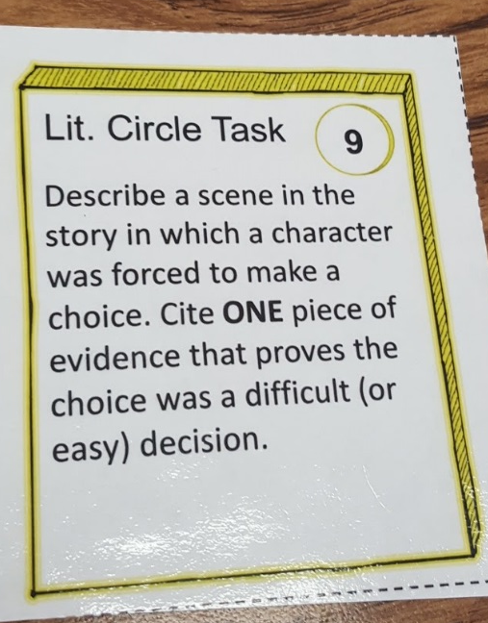
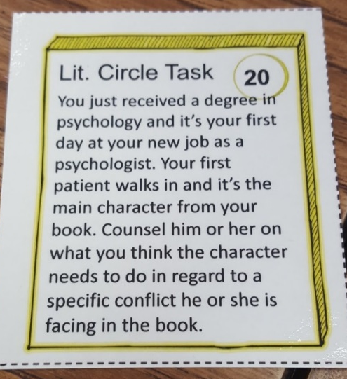
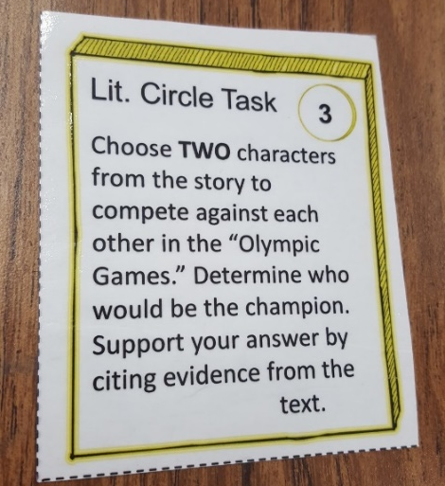
Non-Example (Grade 9)
TASK
HANDOUT 13_NON-EXAMPLE VS EXAMPLE
Notes:
2 minutes
For the non-example, if the ultimate goal of reading instruction is deep comprehension of the text at hand, randomly sequenced questions will not get students there.

Slide 74

Non-Example (Grade 3)
QUESTION SEQUENCE
What does the word “heavens” mean in this context?
What else can “heavens” mean?
Who helped people realize they were wrong about the Earth being flat?
What is something you’ve been wrong about before?
HANDOUT 13_NON-EXAMPLE VS EXAMPLE
Notes:
Grade 3 – This sequence of questions is not driving students towards a deeper understanding of the topic at hand.

Slide 75

Example (Grade 3)
QUESTION SEQUENCE
What does the word “heavens” mean in this context?
What did people think was true about the Earth long ago?
What did people realize about the Earth? What evidence did they have that this was true?
Do you think we will keep changing our minds about the solar system? Why do you think this?
TASK: Write an opinion piece on why you believe we will keep changing our minds about the solar system based on the history we learned about in our text. Provide examples of the kinds of discoveries that were given in the text to the sorts of scientific work going on in our text from yesterday.
HANDOUT 13_NON-EXAMPLE VS EXAMPLE
Notes:
Grade 3 (from TDOE Unit Starter)
Notice: the first questions is the same in both question sequences
In the example, the text is complex (knowledge demands, language features, etc.), and questions are sequenced to build toward the desired conceptual understandings about how our thinking about our world and universe has changed over time.
How does this deepen your interpretation of the TEAM rubric? What should you see in a classroom to know that this indicator is at play?

Slide 76
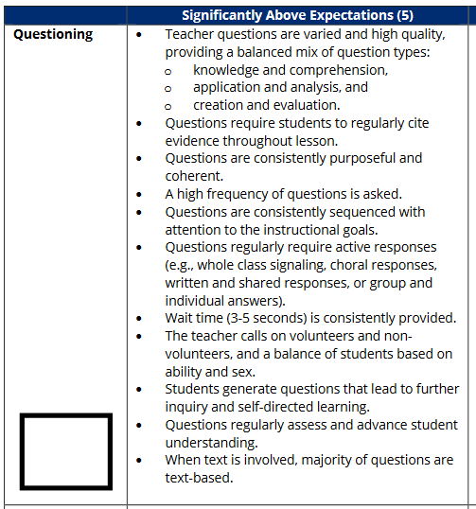
Connecting to Best Instructional Practices
HANDOUT 14_TEAM RUBRIC QUESTIONING
Notes:
Question: So now that we have walked through the indicators, how does this deepen your interpretation of the TEAM rubric? Share your thoughts.
How might your evaluation practice change tomorrow as a result of your new learning—with a focus on questioning?
Possible Responses – more than text evidence, questions are purposeful, etc.
Ultimately, these indicators help us consider:
Are students reading, thinking, speaking and/or writing about the specific texts at hand?
Are questions and tasks leading to deep understanding of the concepts at hand?
Remember: If you have a high quality and compelling text in place, and questions and tasks are truly leading to deeper comprehension of that text then students are likely meeting the expectations of the grade-level reading standards because these standards are a description of the things proficient readers do to make meaning from grade-level text.

Slide 77
Core Action 5
In Action
Notes:
Core Action 5 In Action Section:
Core Action 5 Literacy Learning Walk Tool can help us surface how students in our buildings are provided with the support – through carefully planned questions and tasks – to actually comprehend and demonstrate comprehension of complex texts.
But why is this important to me as a leader? Remember that the Literacy Learning Walk Tool can be used to inform your strategy and measure progress towards your vision.
To understand the quality of questions and tasks in your building you can observe instruction using the Literacy Learning Walk Tool and surface trends to inform your academic strategy.
We are going to practice observing a lesson using Core Action 5 to gather evidence of the quality of tasks. Remember, in your own buildings you would observe lessons across the building to surface trends.

Slide 78
Our shared problem of practice:
Students across Tennessee are not yet engaging in literacy instruction that reflects the demands of Tennessee’s rigorous ELA standards.
Notes:
Reminder: Our shared problem of practice - Students across Tennessee are not yet engaging in literacy instruction that reflects the demands of Tennessee’s rigorous ELA standards.
As we explore how to look for Core Action 5 in action, remember our purpose here - the Literacy Learning Walk Tool can be used to inform your strategy and measure progress towards your vision for change in literacy.

Slide 79
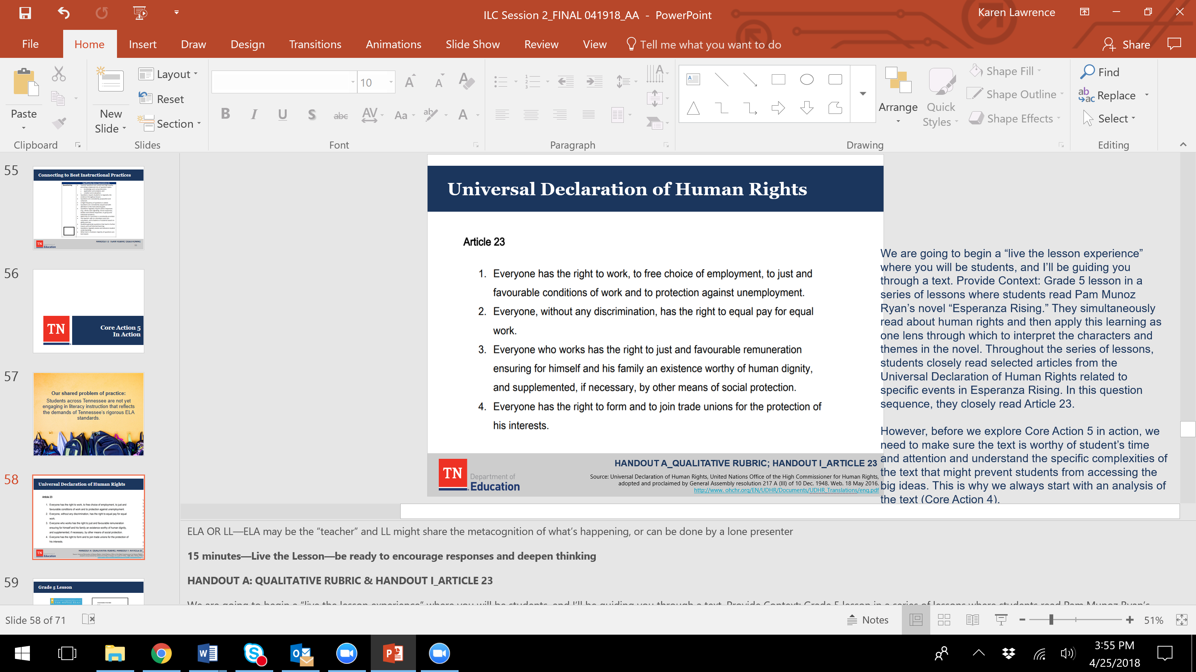
Live the Lesson: Universal Declaration of Human Rights
Article 23
Living the Lesson Context
Grade 5 lesson series
Texts
  “Esperanza Rising”
  UDHR
Students closely read selected articles from the UDHR as one lens through which to interpret the characters and themes in the novel
Living the Lesson Experience
Analyze the qualitative complexity of Article 23
Engage as students and leaders in the lesson experience
Reflect on the lesson’s alignment to Core Action 5 and the extent to which it integrates the standards for literacy
Source: Universal Declaration of Human Rights, United Nations Office of the High Commissioner for Human Rights,
adopted and proclaimed by General Assembly resolution 217 A (III) of 10 Dec. 1948. Web. 18 May 2016.
http://www. ohchr.org/EN/UDHR/Documents/UDHR_Translations/eng.pdf
HANDOUT 5_QUALITATIVE RUBRIC; HANDOUT 15_Article 23
Notes:
share the metacognition
Live the Lesson—be ready to encourage responses and deepen thinking
HANDOUT 5: QUALITATIVE RUBRIC & HANDOUT 15_ARTICLE 23
We are going to begin a “live the lesson experience” where you will be students, and I’ll be guiding you through a text. Provide Context: Grade 5 lesson in a series of lessons where students read Pam Munoz Ryan’s novel “Esperanza Rising.” They simultaneously read about human rights and then apply this learning as one lens through which to interpret the characters and themes in the novel. Throughout the series of lessons, students closely read selected articles from the Universal Declaration of Human Rights related to specific events in Esperanza Rising. In this question sequence, they closely read Article 23.
However, before we explore Core Action 5 in action, we need to make sure the text is worthy of students’ time and attention and understand the specific complexities of the text that might prevent students from accessing the big ideas. This is why we always start with an analysis of the text (Core Action 4).
Have participants read Article 23 and complete a qualitative analysis using the Qualitative Rubric.
Questions:
What do we want students to learn here?
1) Human rights belong to everyone, but they can look different to different people in different places. Everyone deserves to be treated fairly.
2) We can better understand how human rights can be threatened by reading about the experiences of fictional characters in stories.
3) We can raise awareness of human rights issues by writing about the issues fictional characters face.
Is this text appropriately complex for 5th grade? Yes
What is complex about it? Complexities: Purpose/meaning, language (remuneration, dignity), knowledge demands (unions).
Why did we just do a qualitative analysis of this text? To make sure teachers are help students unlock the meaning of this text through aligned questions and tasks.
You should be thinking about this as you observe the question sequence in this lesson.

Slide 80


Model: Grade 5 Lesson
Source: Lesson adapted from EL Curriculum, Grade , Module 1, Lesson 5
Notes:
Live the lesson, cont.
Model the lesson.
Point out the use of the word he rather than she and explain that on official documents like this, he is often used to mean “a person.” So, although it says he, it is referring to all people.
QUESTION 1: What is the gist of this article? What is it mostly about?
Focus students on Part 1 of the article. Invite students to circle unfamiliar vocabulary.
Focus students on the word unemployment at the end of this part of the article.
QUESTION 2: Break up the word unemployment into affixes and root. Use your affix list to determine the meaning of the prefix and suffix and a dictionary to determine the meaning of the root, if you need to. So, what does unemployment mean?
Focus students on the phrase “protection against unemployment.”
ment: a suffix of nouns that denote an action or resulting state
Un: not
QUESTION 3: You know what unemployment is, so what is protection against unemployment?
Focus students on the words “to just and favorable conditions of work” and read this phrase aloud.
Tell students that conditions are the things that affect the way we do something. For example, the conditions at school are the things that affect the school environment and the way things are at school. How clean the classroom is might affect how we work.
QUESTION 4: So what are just and favorable conditions of work? What examples might you give of work being fair and suitable?
QUESTION 5: How would you say Part 1 of the article in your own words? Turn and talk to your partner. Question for Leaders: What would be hard about this for students thus far?
Focus students on Part 2 of the article and read it aloud for the group.
QUESTION 6: What does equal mean? So, what is equal pay? What is equal work? Who has the right to equal pay for equal work?
QUESTION 7: How would you say Part 2 of the article in your own words? Turn and talk to your partner. Question for Leaders: What do you notice about these questions so far?
Focus students on Part 3 of the article and read it aloud for the group.
Remind them of what just and favorable mean and define the word remuneration.
Focus students on the phrase “an existence worthy of human dignity.”
QUESTION 8: Invite students to work in pairs to determine the meaning of the words existence and dignity.
QUESTION 9: How would you say Part 3 of the article in your own words? Turn and talk to your partner. Question for Leaders: What would be hard about this for students thus far?
Focus students on Part 4 of the article and read it aloud for the group.
Tell students that trade unions are groups that protect workers, so this article is saying that people should be free to form and join groups like this to protect them in their work.
Re-read page 36 of “Esperanza Rising” beginning with “My father and I have lost faith in our country” to “… we have a chance to be more than servants.” LINK: https://books.google.com/books?id=Ly6KPrawvqIC&pg=PA36&lpg=PA36&dq=My+father+and+I+have+lost+faith+in+our+country%E2%80%9D+to+%E2%80%9C%E2%80%A6+we+have+a+chance+to+be+more+than+servants&source=bl&ots=-1A4zeWe-z&sig=OQ7xKsPHTVzwdcLxTYJtmJ9EUfI&hl=en&sa=X&ved=0ahUKEwid86aVmsLaAhXJtlMKHQFLBrIQ6AEISTAD#v=onepage&q=My%20father%20and%20I%20have%20lost%20faith%20in%20our%20country%E2%80%9D%20to%20%E2%80%9C%E2%80%A6%20we%20have%20a%20chance%20to%20be%20more%20than%20servants&f=false
QUESTION 10: How would Esperanza’s uncles treat her family if they stayed?
QUESTION 11: How would this threaten their human rights and go against the articles in the Universal Declaration of Human Rights? Turn and talk to your partner. Question for Leaders: What would be hard about this for students thus far? Do you think students will understand what we want them to as a result of this sequence of questions?

Slide 81
Table Discussion
What role do the texts play in this lesson?
How did the question sequence help build meaning?
How does this connect to our qualitative text analysis?
Can you find evidence of Core Action 5 indicators?
Can you find evidence there is integration of the standards in this question sequence?
HANDOUT 16_Question Sequence
HANDOUT 2_LITERACY LEARNING WALK
Notes:
HANDOUT 16_QUESTION SEQUENCE AND HANDOUT 2_LITERACY LEARNING WALK TOOL
We know want to give you all some time to debrief this experience and consider how this lesson shows evidence of a shift in instruction aligned to the indicators in Core Action 5. Open up Handout J_Question Sequence as well as Handout C_Literacy Learning Walk and begin to discuss the questions on this slide with your table.
Give tables 10 minutes to debrief and then share out thinking in the whole group for five minutes. Share out should focus on evidence of standards.
As you are debriefing with the whole group – use chart paper to capture thinking and to create a culminating chart to clarify understanding that shows the sequence of planning – from
Enduring Understanding -> Text Selection -> Qualitative Analysis -> Creation of Question Sequence -> Creation of Daily Task and Ultimately Unit Task

Slide 82
Planning for
Change

Slide 83
Putting it Together: Your Vision for Excellent Literacy Instruction
Discuss and Reflect with Your Table:
What should you see on a daily basis when you observe literacy?
Where are your teachers in this process? Do they share your vision for literacy – complex texts and intentionally sequenced questions and tasks?
What can you do to align expectations in your building?
What resources do you have to address the challenges unique to your school setting?
Notes:
We want to give you some space to put the pieces together when it comes to Core Action 4 and 5. Again, as you think about all the levers you can pull, we want you deeply focused at this point on grounding your Vision and Expectations in the learnings from these ILC Sessions – complex text should be at the center of literacy instruction and questions and tasks should integrate the standards and guide students towards making meaning from complex texts.
Take approximately 15 minutes to discuss these guiding questions with your table and then we will pull it back together to share our thinking for the benefit of the group.
Whole Group Discussion: (15 minutes)
How has your vision for literacy instruction changed? What do you want to see? What do you currently see?
What sorts of action steps did your tables consider to support your teachers with moving towards implementation of your vision for excellent literacy instruction?
What barriers do you think you will face?
Can you move forward without ensuring you have high quality curriculum in your building?
How will you leverage TEAM to hold teachers accountable?

Slide 84
Next Steps: Your Vision for Excellent Literacy Instruction
Reflect and Write:
How might you gather evidence on how your vision for high quality literacy instruction is being incorporated into classrooms at your school?
What might you do to align expectations in your building?
Who might you leverage to assist in supporting strong literacy instruction for your students?
Notes:
We want to give you some space to put the pieces together when it comes to Core Action 4 and 5. Again, as you think about all the levers you can pull, we want you deeply focused at this point on grounding your Vision and Expectations in the learnings from these ILC Sessions – complex text should be at the center of literacy instruction and questions and tasks should integrate the standards and guide students towards making meaning from complex texts.
Take approximately 15 minutes to discuss these guiding questions with your table and then we will pull it back together to share our thinking for the benefit of the group.
Whole Group Discussion: (15 minutes)
How has your vision for literacy instruction changed? What do you want to see? What do you currently see?
What sorts of action steps did your tables consider to support your teachers with moving towards implementation of your vision for excellent literacy instruction?
What barriers do you think you will face?
Can you move forward without ensuring you have high quality curriculum in your building?
How will you leverage TEAM to hold teachers accountable?

Slide 85
To Do Before Session 2:
Observe instruction in a minimum of five classrooms using Core Action 4 and 5 of the Literacy Learning Walk Tool.
Script the sequence of questions and record associated tasks.
Complete a text complexity analysis (quantitative and qualitative complexity) of at least two of the texts.
Bring the question and task sequences, your notes and ratings on Core Actions 4 and 5, and your assessment of the texts’ complexities to session 2.
Come prepared to discuss.
Notes:
Asking you to mark assessments on CA 4-5
Evidence = question scripts, the analysis you have done
Facilitator = warn that they are likely to struggle with accuracy of scoring, we want you to try and learn
*you may want to involve your teacher in your analysis of text

Slide 86
Our shared problem of practice:
Students across Tennessee are not yet engaging in literacy instruction that reflects the demands of Tennessee’s rigorous ELA standards.
Notes:
Reminder: Our shared problem of practice - Students across Tennessee are not yet engaging in literacy instruction that reflects the demands of Tennessee’s rigorous ELA standards.
As we explore how to look for Core Action 5 in action, remember our purpose here - the Literacy Learning Walk Tool can be used to inform your strategy and measure progress towards your vision for change in literacy.

Slide 87
Shoulder Partners: Closing Reflection
How has your learning about texts and text-based questions been enhanced from today’s session?
What approaches might you be considering to support your teachers in your setting?
Summarize your partner’s “ah-has” on a sticky note and leave [insert location] on your way out.
Notes:
Capture pics of sticky notes and send to Martha/Hank.

Slide 88
Thank you for your participation!
Name
Title/School and District
Email
Name
Title/School and District
Email
*All materials can be accessed at the Integrated Leadership Course series webpage.
Notes:
Customize, please.

