Slide 1
Using the TN Educational Broadband Consortium Contract(s) and Conducting a Mini-Bid
Funding Year 2021 and Beyond
Kim Friends, TN State E-rate Coordinator

Slide 2
Category 1 (C1) TEBC Mini-Bid Process

Slide 3
Category 1 Consortium Mini-Bid Process
Conduct Mini-Bid
  No Form 470 required (TEBC filed Form 470 when contracts were being competitively bid)
  New: Sign SMC Order Form with the vendor and use those Be sure to include these items:
      SMC Order Form signing date (must be before 471 filing date)
      Agreement term: 7/1/2021 through 6/30/2026
      Purchase is contingent upon E-rate funding and local funding approval
  School board may need to approve contract prior to signing
    Vendor SMC Order Form/agreement must be signed before submitting Form 471

Slide 4

Step 1: Create Needs List
Use the template to create list locations and services needed
Include installation (NRC), if needed
Use C1 Mini-Bid template
Attach this list to cover e-mail

Slide 5
Step 2: Compose E-mail to Potential/Possible Vendors
Use template and personalize to your needs:
  Include additional disqualification factors
  Include pre-bid meeting info, if applicable
  Give due date for responses

Slide 6
Step 3: Determine All Vendors in “Category”
Must conduct mini-bid among all potential vendors in that Category
  Category One (C1)
    Data Transmission Services
    Internet Access

Slide 7
Step 4: Conduct Bid Evaluation
Using prices from mini-bid quotes, conduct bid evaluation
  Use template – available at https://www.tn.gov/education/district-technology/erate.html
May consider other factors besides price
Price of eligible products and services MUST be the most heavily weighted factor

Slide 8

Mini-Bid Evaluation Example (best practice)
Evaluation Criteria | Maximum # Points | Vendor 1 | Vendor 2 | Vendor 3
Price of E-Rate Eligible Goods/Services | 50 | 50 | 42 | 35
Able to deliver service on July 1 (or whatever date you choose) | 25 | 25 | 25 | 20
Previous Experience— District with SP | 25 | 25 | 15 | 10
 |  | 100 | 82 | 65

Slide 9
Step 5: Notify Winning Bidder/Sign Contracts
Notify apparent winning bidder via e-mail, contingent on board approval
Use template
Finalize exact quantities and capacities
Ask for final quote on vendor letterhead
  Must include service term ie: 7/1/2021 – 6/30/2022
  Purchase is contingent on E-rate funding (if applicable)
SMC Order Form must be signed by the District before submitting the 471

Slide 10
Step 6: Update Contract Record in EPC
Refer to “TEBC Form 471 Contract-FRN Filing Guide” for more information
This step must be completed BEFORE you can file your Form 471 application

Slide 11
Category 2 TEBC Mini-Bid Process

Slide 12
Category 2 Consortium Mini-Bid Process
Conduct Mini-Bid
  No Form 470 required (TEBC filed Form 470 when contracts were being competitively bid)
  More appropriate for equipment purchase/installation, rather than cabling project
  New: Sign SMC Order Form with the vendor
  School board will likely need to approve SMC Order Form prior to signing
    SMC Order Form must be signed before submitting Form 471

Slide 13
Category 2 Consortium Mini-Bid Process
More on TEBC Contracts:
  Cannot just go to TEBC contract list and select vendor and equipment you want/need
  Must request ‘mini-bids’ from all vendors in a particular category
  A “category list” is available
    INSERT NAME OF DOCUMENT TO REFERENCE
  Can list preferred manufacturer, but must seek bids for “equivalent” products
  Minimum 7–14 day bidding period suggested
  Then conduct bid evaluation among all product lines that offer the ‘category’ of service, including equivalents
  Can consider other factors besides price
    Price of eligible equipment must be the most heavily weighted factor
  New EPC Contract wizard requires you to list # of bids received
    Keep those “losing” bids /quotes because you may be asked to submit them

Slide 14
Step 1: Create Equipment/Services List
Use the template to create list of equipment and services you are seeking in your bid
Include installation, if needed
May list preferred manufacturer, but cover e-mail must allow for equivalent product lines to be submitted
Include any “compatibility” or “interoperability” requirements
Attach equipment list to cover e-mail

Slide 15
Step 2: Compose E-mail to Potential/Possible Vendors
Use template and personalize to your needs:
  Include additional disqualification factors
  Include pre-bid meeting info, if applicable
  Give due date for responses
  Explain that equivalent bids may be submitted
Template available at https://www.tn.gov/education/district-technology/erate.html

Slide 16
Step 3: Determine All Vendors in “Category”
Must conduct mini-bid among all product lines in that “category”
  So, if bidding switches, you must send the mini-bid request to all awarded switching vendors on the list
  Categories mirror E-rate Eligible Services List
      Internal connections
      Basic Maintenance of Internal Connection
      Managed Internal Broadband Services

Slide 17
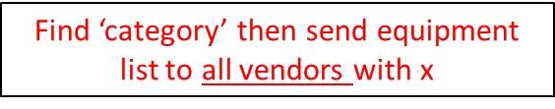

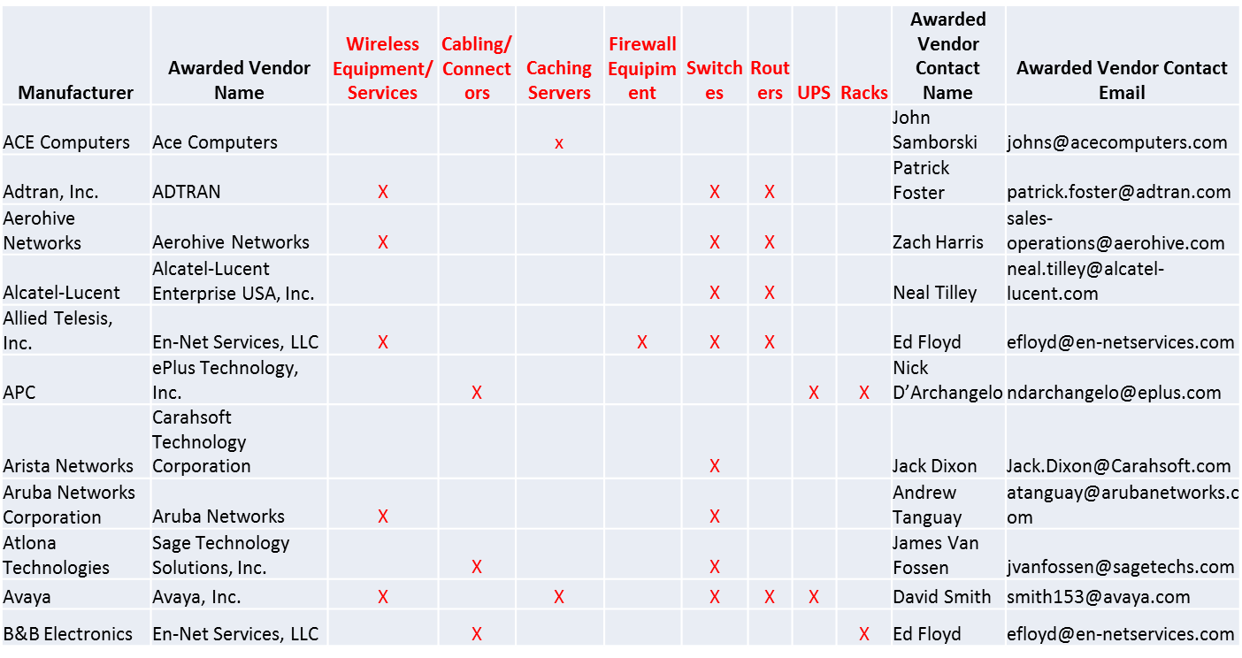
Mini-Bid Category List (SAMPLE)

Slide 18
Step 4: Conduct Bid Evaluation
Using prices from mini-bid quotes, conduct bid evaluation
  Use template – available at
    https://www.tn.gov/education/district-technology/erate.html
  May consider other factors besides price
Price of eligible equipment/services MUST be the most heavily weighted factor

Slide 19
Mini-Bid Evaluation Example (best practice)
Evaluation Criteria | Maximum # Points | Vendor 1 | Vendor 2 | Vendor 3
Price of E-Rate Eligible Goods/Services | 50 | 50 | 42 | 35
Ability to Integrate Equipment into Existing Network | 30 | 30 | 25 | 10
Previous Experience— District with SP | 15 | 15 | 10 | 10
Completeness of Response | 5 | 5 | 5 | 5
 |  | 100 | 82 | 60

Slide 20
Step 5: Notify Winning Bidder/Sign Contracts
Notify winning bidder via e-mail, contingent on board approval
Use template
Finalize exact quantities of equipment prior to contract signing
Ask for final quote on vendor letterhead
  Must include contract term: 4/1/2021 – 6/30/2026
  Purchase is contingent on E-rate funding (if applicable)
SMC Order Form must be signed by the district before submitting the 471

Slide 21
Step 6: Update Contract Record in EPC
Refer to “TEBC Form 471 Contract-FRN Filing Guide” for more information
This step must be completed BEFORE you can file your Form 471 application

Slide 22
TEBC Bidding Guide
TEBC bidding guide and all associated documents available at:
  https://www.tn.gov/education/district-technology/erate.html
STAY TUNED for more developments!

Slide 23
Mini-Bid vs RFP
Mini-Bid
Don’t have to post Form 470/Issue RFP
Don’t have to advertise in newspaper
DO have to conduct mini-bid of every vendor that sells equipment in that category
Don’t have to wait full 28 days during mini-bid process
Can consider non-cost factors as long as costs of E-rate eligible equipment/services are most heavily weighted factor
Can require compatibility and interoperability with existing equipment
RFP/470
Must post 470, upload RFP and follow all local guidelines
Must wait at least 28 days before selecting a provider
Can provide greater specificity about requirements
Can require compatibility and interoperability with existing equipment
Can list binary disqualification factors
Don’t have to solicit bids from all vendors

Slide 24
Questions?

