Slide 1

Supplier Maintenance Agency Training Workshop #4
Topic:
Statewide Accounting Supplier Maintenance & Accounts Payable common inquiries, useful queries, and other tidbits
June 28, 2022

Slide 2

Keep in mind when entering vouchers:
  Supplier Maintenance no longer adds a Location for every Address
  Choose the appropriate Location (1099 reportability and bank account)
    Query: TN_AP33C_VENDOR_SEARCH
  Choose the appropriate Address (Should match remittance address on invoice)
  Do not assume the Default Location or Address is correct

Slide 3
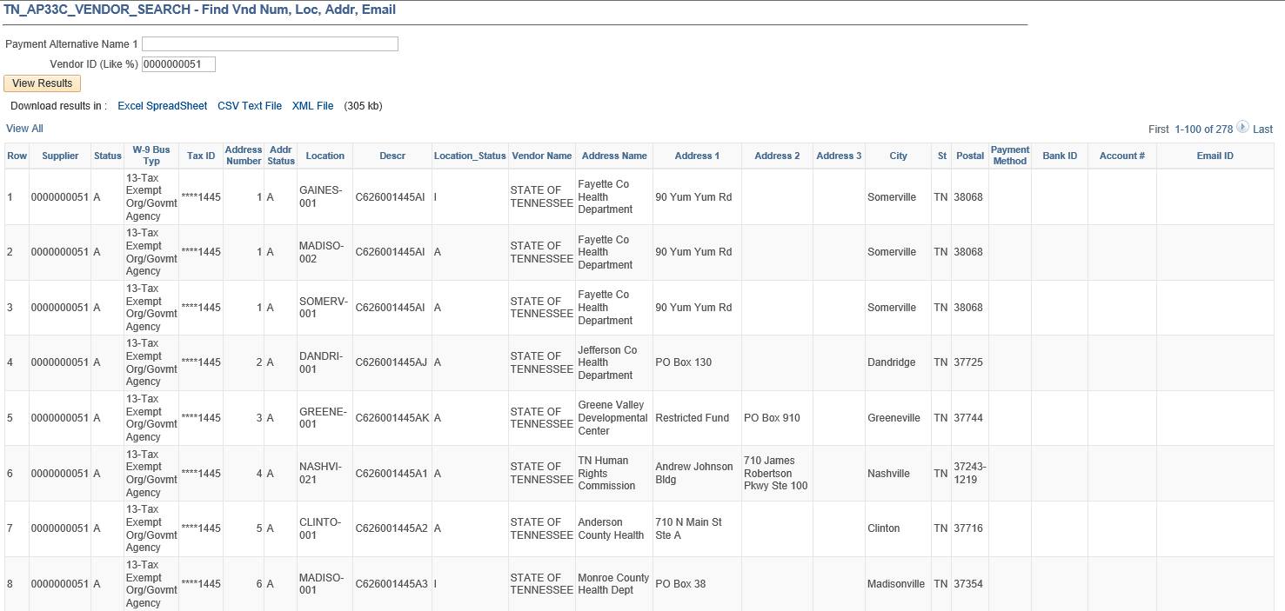
Query: TN_AP33C_VENDOR_SEARCH
Location Name, Description of Location, and Location Status (A = Active,
I = Inactive)
If bank information is on file, Payment Method = EFT
Bank ID = Routing #
Account # = Last four digits of bank account
Email ID = for electronic remittance advices
Supplier Name (Line 1 of IRS W-9)
Address information: Payment Alternate name (DBA name) and address
Supplier ID
Supplier Business Type
Supplier ID status
A = Approved
I = Inactive
R = Ready for Review
Address ID # and Address Status
(A = Active;
I = Inactive)
Last four digits of tax ID

Slide 4

If you find any data entry errors or potential fraud, email Katelyn.Huckaby@tn.gov and Angelo.Bruno@tn.gov immediately!

Slide 5

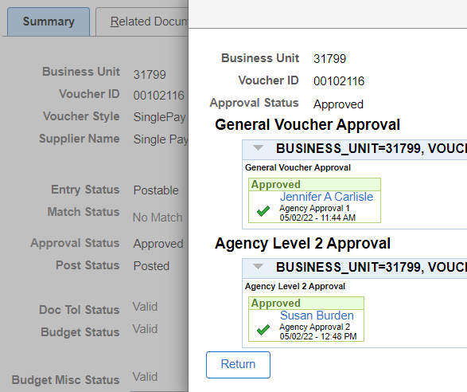
Show Me the Money!
1. Verify that the voucher has had final approval. (Can be viewed on summary tab of voucher)

Slide 6
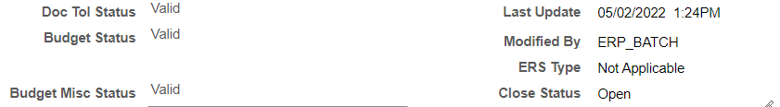
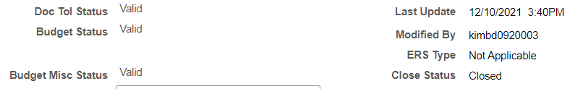
Show Me the Money!
2. Verify that the voucher is still in ‘OPEN’ status. (Can be viewed on summary tab of voucher)

Slide 7
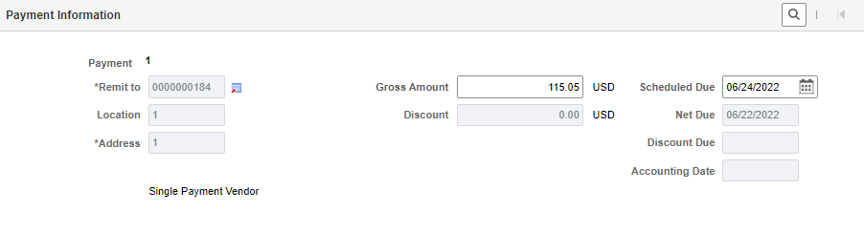
Show Me the Money!
3. Review the Scheduled Due date to confirm that it is scheduled to be paid on the correct date. Note: Verify the year is correct.

Slide 8
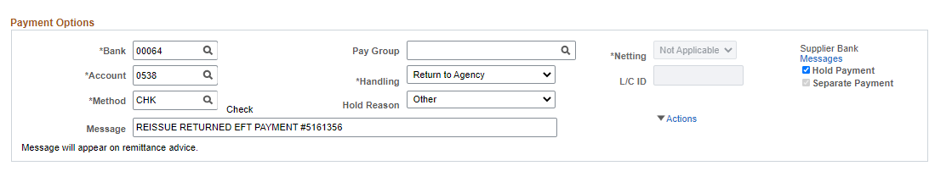
Show Me the Money!
4. Is the Payment Hold checkbox checked? Determine why the payment was placed on hold. If appropriate, unselect the checkbox and save voucher. Voucher should be picked up in next pay cycle (if payment currently or past due).

Slide 9
Show Me the Money!
5. There may be outstanding Credit Vouchers that exceed the amount of unpaid invoice vouchers. Run the TN_AP55D_VCHRS_PDG_PDG_BYVDR query to determine if this is the case.

Slide 10
Show Me the Money!
5. Verify that the Supplier is approved, and the Address and Locations selected are active.
TN_AP112_VNDR_UNAPPRVD
TN_AP111_REMITVNDR_ONHOLD
TN_AP110_VNDR_INACTIVE
TN_AP111_REMITVNDR_INACTIVE

Slide 11
Supplier request reprint of remittance advice
We cannot reprint the remittance advice, but you can obtain the payment detail.
TN_AP04_VNDR_CHK_REMIT_NVID – supplier # not required
TN_AP04_VNDR_REMIT_ADVICE_INFP – can use % for supplier number. Make sure you verify supplier name.
TN_AP04_VNDR_REMIT_ADVICE_NVID -

Slide 12
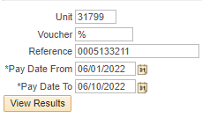
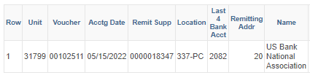
What bank account was deposit made into?
TN_AP149_VENDOR_BANK_ACCT_VIEW

Slide 13
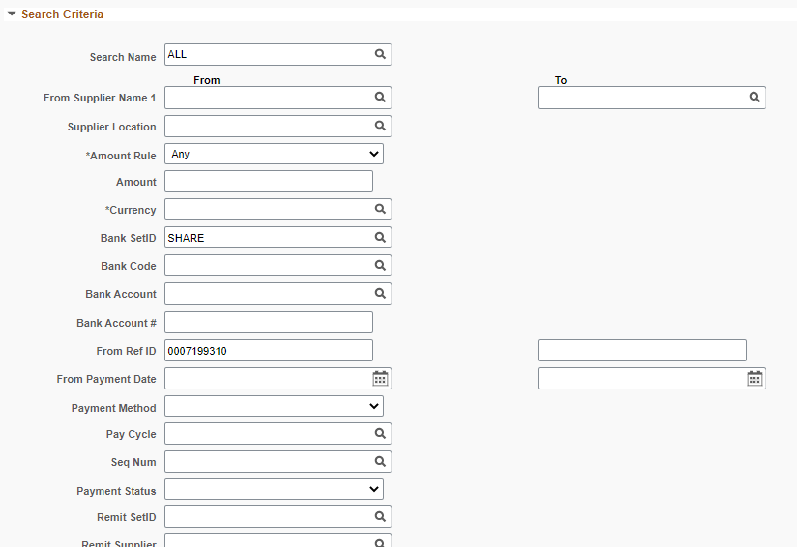

Has a warrant been redeemed?
Navigation: FSCM>Accounts Payable>Review Accounts Payable Info>Payments>Payment. Enter the warrant number and press search box.

Slide 14
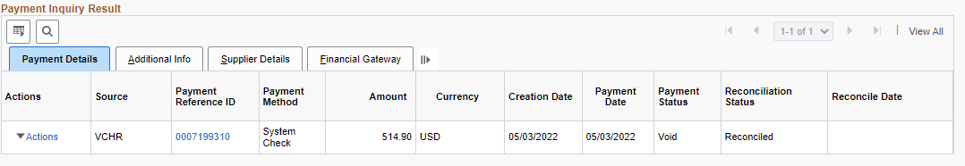
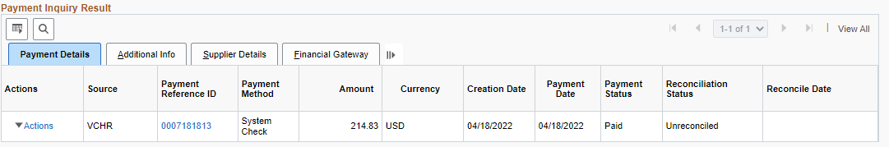


Has a warrant been redeemed?
This warrant has been canceled:
This warrant is still outstanding:
This warrant has been redeemed:

Slide 15
Important Dates for Accounts Payable
July 5th – Cutoff for Accounts receipt of cancellation and reissues from agencies
July 8th – Create/enter and modify AP Vouchers by COB (4:30 PM) for goods/services received in FY22 (any modifications made after this date will be counted late. No exceptions)
July 11th – AP Vouchers greater than $2000 approved by agency
July 13th – AP Vouchers less than $2000 approved by agency
July 13th – AP Vouchers greater than $2,000 approved by Accounts

Slide 16

All FY22 TRICOR invoices must be entered by July 8th.
No accrual allowed!

Slide 17
Helpful Queries to assist in AP Voucher Review
TN_AP_CGRP_REVIEWS_W_VDR_NAME – useful for reviewing vouchers not in a control group or single control group
TN_AP_CGRP_REVIEWS_W_VDR_NAMEB – useful for reviewing multiple control groups.
SHOUT OUT TO DCS FOR REQUESTING THIS QUERY!!!
TN_AP34799_REFD_VCHRS – useful for reviewing single pay vouchers (supplier 184). Includes the name and address entered on voucher.

Slide 18

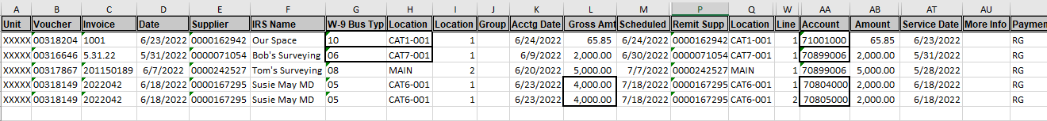

Slide 19
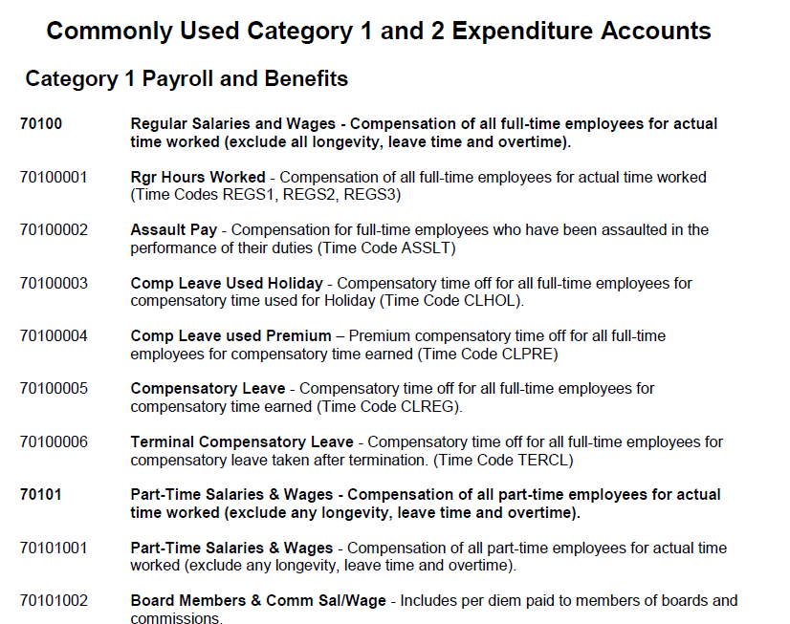

DOA Internet Site
Account?

Slide 20

AP FileNet Attachment Removal
Joshua Bare, Sherita Woods and Mikhel Lindsley

Slide 21

DOA Statewide AP & CM STAFF
We are here to assist you:

Slide 22

?

