Slide 1
1099/1042 Training
Division of Accounts – Supplier Maintenance
Trainers:
Angelo Bruno, Accounting Manager
Katelyn Huckaby, Director
10/25/2023

Slide 2
Important Reminders
1099 Corrections
  2019: 13,000
  2020: 12,600
  2021: 8,320
  2022: 15,740 (increase mostly due to changes in reporting)
Keep in mind when entering vouchers:
  Choose the appropriate Location (1099 reportability and bank account)
    Query: TN_AP33C_VENDOR_SEARCH
  Choose the appropriate Address (Should match remittance address on invoice)
  Do not assume the Default Location or Address is correct

Slide 3
Why We Report
The IRS requires certain payments made to suppliers be reported on an IRS Information Return (Form 1099 series, etc.). Reportable does not mean taxable.
Presentation Topics:
  Form 1099-MISC (Miscellaneous Income – rent, medical services, legal services)
  Form 1099-NEC (Nonemployee Compensation – services, excluding medical)
  Form 1099-G (Certain Government Payments – grants)
  Form 1042-S (Foreign Suppliers)
We will work with agencies to ensure reporting of offline payments (payments not made through Edison) and other types of Information Returns that must be issued

Slide 4
Who We Report
Is the Supplier Reportable?
Edison W-9 Business Type | Business Type Description | 1099-MISC, 1099-NEC, & 1099-G Reportable Supplier?
01 | Individual (not a business) | Yes
02 | Joint Account (two or more individuals) | Yes
03 | Custodian account of a minor | Yes
04 | Trust Account (Revocable Savings Trust/So-Called Trust) | Yes
05 | Sole Proprietorship (SSN) | Yes
06 | Sole Proprietorship (FEIN) | Yes
07 | A Valid Trust, Estate or Pension Trust | Yes
08 | Corporation or LLC (Limited Liability Company) electing corporate status on IRS Form 8832 or 2553 | No, except for medical services, attorney’s fees, or payments to attorneys
09 | Association, club, religious, charitable, educational or other non-profit organization | Yes
10 | Partnership or Multi-Member LLC (Limited Liability Company) | Yes
13 | Tax-Exempt Organizations or Governments | No, except for attorney’s fees or payments to attorneys
15 | Unknown (W-9 not on file) | Yes, regardless if supplier has Inc. or Corp. in the name

Slide 5
What We Report
Examples of Reportable Payments
Reportable Payments | IRS Form Type | CAT in Edison
Rents: Real Property (such as land, buildings, warehouses, direct billed hotel rooms or other facilities), Equipment (office equipment, machinery, etc.) | 1099-MISC | 1
Other income (not compensation for services): Awards, Honorariums (see Non-Employee Compensation for speaker fees), Incentives, certain Independent Living payments, Prizes, Punitive Damages | 1099-MISC | 3
Medical and health care payments: Medical and Dental Services, Ambulance Services, Autopsy Services, Hospitalization, Lab Work, Medical Assistance Benefits (such as payments made by TennCare), Psychological Services, Veterinary Services, Temporary Medical Staffing | 1099-MISC | 6
Gross proceeds paid to an attorney: Generally from settlement payments* | 1099-MISC | 14
Nonemployee compensation (professional services/contractors): Advertising, Appraisal, Construction, Consulting, Court Reporting, Expert Witness Testimony, Attorney’s Fees, Process Servers, Funeral, Waste, Recycle, Home and Community Based Services, Laundry, Janitorial, Maintenance and Repairs, Security, Temporary Staffing, Training, Speaker Fees, Stipends for services provided | 1099-NEC | 7
Taxable Grants (Grants are reportable unless otherwise stated in the legislation of the grant) | 1099-G | G
*We will email a request for a listing of settlement payments paid by your agency

Slide 6
What We Don’t Report
Examples of Non-Reportable Payments
  Materials, products, and supplies
  Medical records (unless they are included on the invoice with a medical service)
  Membership dues
  Prescription drugs
  Subscription (magazines, professional journals, etc.)
  Travel claims
  Utilities (including electricity, gas, propane, phone service (cell or landline) and internet service)
  Foster care, guardianship, adoption assistance, etc.
  These payments should be coded in Edison with a Location type of MAIN or a city name (for example: NASHVI-001).

Slide 7
What is needed from you
Agencies schedule and review four payment queries in Edison to ensure accurate 1099/1042 reporting
Agency reports must be returned by the deadline
Query Name | Query Description
TN_1099_TO_REPORT | Reportable payments made to reportable suppliers
TN_1099 _SLGP_VCHR_PAYMNTS | List of single payment vouchers
TN_1099_RPRT_VDR_NORPRT_PAY | Non-reportable payments made to reportable suppliers
TN_1099_RPRT_VDR_NORPRT_PAY2 | Non-reportable payments made to reportable suppliers

Slide 8
Schedule and Review
Schedule queries in Edison. Instructions can be found on Pages 8-14 of the 1099 and 1042 Reporting Guide.
  If no query results, double check to ensure the correct dates were entered.
Import queries into Excel. Excel 365 import instructions can be found on Pages 14-21 of the 1099 and 1042 Reporting Guide.
Format and review spreadsheet. Instructions can be found on Pages 22-25 of the 1099 and 1042 Reporting Guide.

Slide 9
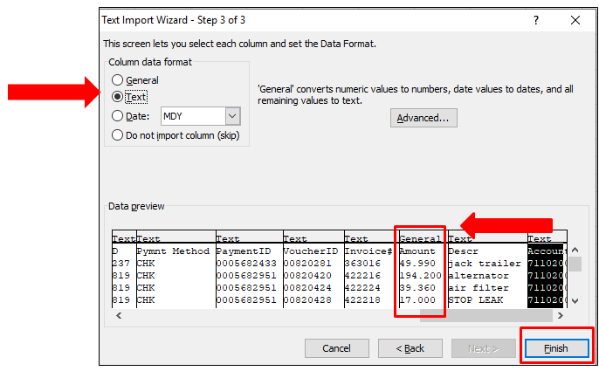
Common Importing Issues
Data must be imported into Excel in “Text” format, except for the Amount columns. Amount columns must be “General”.
  Instructions found on Page 20 of the 1099 and 1042 Reporting Guide

Slide 10
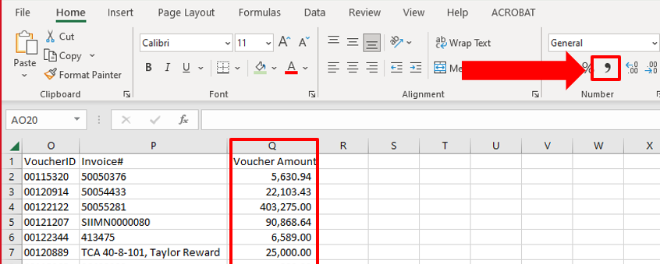
Common Formatting Issues
Once in Excel, amount columns must be formatted in “Accounting” with no symbols and 2 decimal places.
  Instructions found on Page 21 of the 1099 and 1042 Reporting Guide

Slide 11
Common Review Issues
Do not split vouchers
  If part of the voucher is reportable, then the entire voucher is reportable unless the reportable portion is incidental.
    Example: A truck was repaired by a sole proprietor. Labor cost $1,400, parts cost $600. A 1099 is issued for $2,000 to the Supplier.
    Example: Copy paper was purchased for $800; delivery charge was $50. A 1099 is not issued to the supplier because copy paper is a product, and the delivery charge is incidental to the product.
Columns may be hidden, but not deleted
Only add columns to the right side of the spreadsheet
If the spreadsheet is not formatted correctly, it will be returned for correction

Slide 12
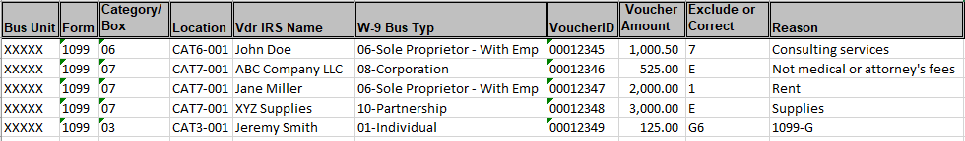
TN_1099_TO_REPORT
All payments on this query will be reported on the appropriate 1099 form unless you tell us to exclude or correct
Add two columns to the right side of the spreadsheet with the headers “Exclude or Correct” and “Reason”

Slide 13
TN_1099_SLGP_VCHR_PAYMNTS
No payments on this query will be reported on a 1099 unless you tell us to report
Add five columns to the right side of the spreadsheet with the headers “Supplier ID”, “TIN”, “Format”, “Type”, and “CAT”. If the payment is reportable, complete these columns as follows:
  Supplier ID: Enter the Edison Supplier ID (leave blank if not applicable).
  TIN: REQUIRED! Enter the Tax ID Number as an SSN or FEIN with the appropriate dashes.
  Format: Enter “S” for SSN or “F” for FEIN.
  Type: Enter “1099” for 1099-MISC or 1099-NEC or “1099G” for 1099-G.
  CAT: Enter the correct category number for the payment.

Slide 14

TN_1099_RPRT_VDR_NORPRT_PAY
TN_1099_RPRT_VDR_NORPRT_PAY2
These queries must be combined and submitted as one report. Save the report as your business unit and “PAY_PAY2”
No payments on this query will be reported on a 1099 unless you tell us to report
Add two columns to the right side of the spreadsheet(s) with the headers “Type” and “CAT”
If payments with CAT Locations are found in the query results, you must include the payments on your submitted report

Slide 15
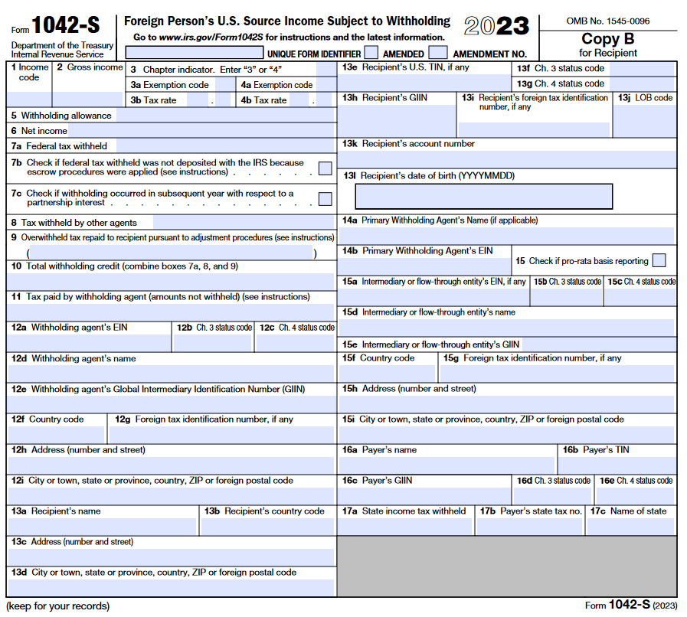
1042 Reporting – Foreign Suppliers
A foreign supplier is a non-resident alien individual or foreign company
The IRS requires certain payments to foreign suppliers be reported on a Form 1042-S
Due to the complexity of 1042-S reporting, all payments to foreign suppliers must be included on the 1042 report to F_A.Accounts@tn.gov

Slide 16

Reporting 1042 Payments
Payments to foreign suppliers may be found on any 1099 query
  If found, copy and paste the 1042 rows to a new Excel worksheet with the same column headings
  If payments to foreign suppliers are found on the TN_SLGP_VCHR_PAYMNTS query, contact F_A.Accounts@tn.gov immediately
Add three columns to the right side of the spreadsheet with the headers:
  “Description of Payment”
  “Where Work was Performed” (only required for payment for services)
  “Number of Days Present in the U.S.” (only required for payment for services)

Slide 17
Preparing Submission of Reports
After reviewing and entering your corrections:
  Unhide all columns and unfreeze all panes
  If corrections are found, filter out the blank data and copy and paste only the data that requires correcting into a new Excel workbook (separate workbooks required for each report except for the PAY/PAY2 queries)
Naming your reports:
  Save your new workbook as your business unit, name of the query, and the period for which the query was ran, for example:
    30101_TN_1099_TO_REPORT_JAN_OCT
    30101_TN_1099_SLGP_VCHR_PAYMNTS_JAN_OCT
    30101_TN _PAY_PAY2_JAN_OCT
    30101_1042_REPORT_JAN_OCT
Don’t wait! Send the workbooks as they are completed rather than waiting until all four queries have been reviewed

Slide 18
Submission Requirements
Email 1099 and 1042 reports to F_A.Accounts@tn.gov
The subject line of the email must contain your business unit and the name of the report, for example:
  30101_TN_1099_TO_REPORT
  30101_TN_1099_SLGP_VCHR_PAYMNTS
  30101_TN _PAY_PAY2
  30101_1042_REPORT
If multiple reports are submitted in one email, the subject line must contain your business unit and “1099_REPORTS” and “1042_REPORT”, for example:
  30101_1099_REPORTS
  30101_1099_REPORTS_1042_REPORT
If you do not have any 1099 corrections to report, you must send an email stating so. You do not have to attach a blank report.

Slide 19
Important Dates to Remember
Majority of 1099/1042 process spans November through March
January through October Reports
  Anticipated Start Date: November 3, 2023
    Email from F_A.Accounts@tn.gov sent notifying agencies to begin running queries
  Anticipated Due Date: November 16, 2023
    Reports must be submitted to F_A.Accounts@tn.gov in accordance with 1099 and 1042 Reporting Guide
    Agency Certification Form (signed by fiscal officer) must be attached to Annual Closing Tasklist (ACT)
November through December Reports
  Anticipated Start Date: January 3, 2024
    Email from F_A.Accounts@tn.gov sent notifying agencies to begin running queries
  Anticipated Due Date: January 10, 2024
    Reports must be submitted to F_A.Accounts@tn.gov in accordance with 1099 and 1042 Reporting Guide
    Agency Certification Form (signed by fiscal officer) must be attached to Annual Closing Tasklist (ACT)

Slide 20
Agency Certifications
Certify:
  All 1099 queries and 1042 payments have been reviewed and formatted in accordance with the 1099 and 1042 Reporting Guide and all corrections have been submitted to Supplier Maintenance
  All settlements, including those paid through payroll, and offline payments, those paid outside of Edison, have been submitted to Supplier Maintenance in accordance with the 1099 and 1042 Reporting Guide

Slide 21
Contact Information
Communication is critical.
Email 1099 and 1042 reports and questions to: F_A.Accounts@tn.gov
  If emailing a question, the Subject must include “1099Q”
Phone contact information for us:
  Angelo Bruno – 615-253-2742; Angelo.Bruno@tn.gov
  Katelyn Huckaby – 615-770-1104; Katelyn.Huckaby@tn.gov

Slide 22
Questions?

Slide 23
THANK YOU

