Slide 1
SEFA Training 2024
SEFA and SIS Reporting
2024

Slide 2
Contact Information
Mark D. White, Funds Coordinator
  Phone: 615-837-5580
  Email: mark.d.white@tn.gov

Slide 3
What is the Schedule of Expenditures of Federal Awards (SEFA)?
Plain language definition: the SEFA is a list of all the federal money that the state spent that year.
More technical definition: The SEFA is a supplemental schedule that is included in the Single Audit Report. It reports the expenditure of federal awards received directly from the federal government or through a third-party.

Slide 4
Why do we need to prepare the SEFA?
The Single Audit and SEFA are required by federal regulations
  2 CFR 200.502 (a) (basis for determining federal awards expended)
  2 CFR 200.510 (b) (also describes what the SEFA must include)
Also see F&A Policy 20.

Slide 5
Determining Federal Awards Expended
CFR 200.502 Basis for determining Federal awards expended.
(a) Determining Federal awards expended. The determination of when a Federal award is expended must be based on when the activity related to the Federal award occurs. Generally, the activity pertains to events that require the non-Federal entity to comply with Federal statutes, regulations, and the terms and conditions of Federal awards, such as: expenditure/expense transactions associated with awards including grants, cost-reimbursement contracts under the FAR, compacts with Indian Tribes, cooperative agreements, and direct appropriations; the disbursement of funds to subrecipients; the use of loan proceeds under loan and loan guarantee programs; the receipt of property; the receipt of surplus property; the receipt or use of program income; the distribution or use of food commodities; the disbursement of amounts entitling the non-Federal entity to an interest subsidy; and the period when insurance is in force.

Slide 6
The SEFA Preparation Process
Each state entity will submit their portion of the SEFA to the assigned Funds Coordinator, who will then compile the submissions into the statewide format for the Single Audit Report.
  The SEFA shells (i.e. templates) are combined and summarized.
  Complete and accurate reporting on the SEFA shells is critical.
Prepare your files using the pre-formatted SEFA and SIS shells.
  Available on the Job Aids page https://www.tn.gov/finance/rd-doa/fa-accfin-swa.html under the Grants Accounting header.

Slide 7
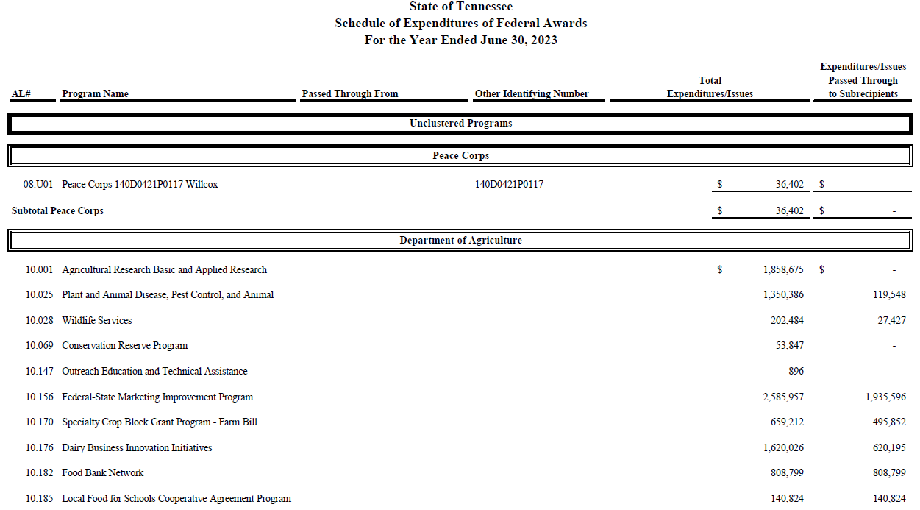

Slide 8
Determining Federal Awards Expended
Important reminder: The SEFA should include both financial and non-financial assistance.
Examples of non-financial assistance:
  Personal Property
  Food
  Medical Supplies
  Labor

Slide 9
SEFA Requirements per CFR 200.510
List individual Federal programs by Federal agency.
For Federal awards received as a subrecipient, include:
  the name of the pass-through entity, and
  identifying number assigned by the pass-through entity.
Provide total Federal awards expended for each individual Federal program and the Assistance Listing Number (ALN)
  or other identifying number when the ALN is not available.
  Note: ALN used to be called CFDA number, and Edison queries still say CFDA.

Slide 10
SEFA Requirements per CFR 200.510
Include the total amount provided to subrecipients from each Federal program.
For loan or loan guarantee programs described in § 200.502(b), identify in the notes to the schedule the balances outstanding at the end of the audit period.
  This is in addition to including the total Federal awards expended for loan or loan guarantee programs in the schedule.
  Note: Send the loan balances outstanding to me along with your other SEFA information. We have provided a worksheet template to help you calculate the balances.

Slide 11
SEFA Requirements per CFR 200.510
Include notes that describe:
  the significant accounting policies used in preparing the schedule, and
  whether or not the auditee elected to use the 10% de minimis cost rate as covered in § 200.414.
  Note: Disclose on the SEFA Shell’s header tab if you use the 10% de minimis cost rate

Slide 12
What is the Supplementary Information Schedule (SIS)?
The SIS includes only expenditures from federal assistance received through another state of TN entity. The SIS is an internal document. It is not reported externally in the Single Audit Report. It supports our preparation of the SEFA. It:
  Helps agencies communicate pass-through grant activity to one another.
  Identifies subrecipients.
  Is used by Financial Oversight to create government-wide entries.

Slide 13
When do you need to prepare a SIS?
Prepare a SIS when your entity receives federal assistance through another TN state entity (pass-through activity within the State of TN).
A state “entity” refers to both state agencies and component units (CUs) like TBR, universities, Vets Home, etc.

Slide 14
Example: State Entity 1 receives federal funds and passes the funds through to Entity 2
State of TN Entity 1
State of TN Entity 2
Entity 1 will report federal funds received on their SEFA
Entity 1 passes federal funds through to Entity 2
Entity 2 report federal funds passed through on their SIS
(Don’t include on Entity 2’s SEFA)

Slide 15
Important Dates
The SIS (Supplementary Information Schedule) should be completed by September 9, 2024 and shared with the grantor agency via email
  cc the Funds Coordinator on correspondence (mark.d.white@tn.gov)
  Grantors adjust SEFA as necessary.
The SEFA (Schedule of Expenditures of Federal Awards) should be completed by September 16, 2024.
  Subsequent adjustment to accruals or other corrections to Federal revenues/expenditures may require restatement of SEFA.

Slide 16
Submitting Files:
If your entity uses the Annual Closing Tasklist (ACT), Attach your documents to the associated task.
  Tip: You can upload multiple files on the ACT task. Upload one file at a time and press “Apply Changes” without signing off. Re-open the task and repeat as many times as necessary.

Slide 17
Submitting Files:
If your entity does not use the ACT (like colleges and universities), submit documents via email to the Funds Coordinator (mark.d.white@tn.gov)

Slide 18
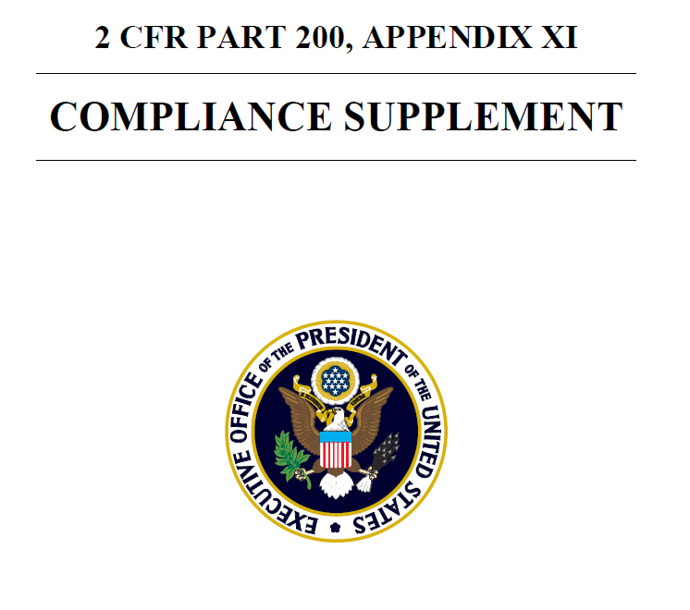
The Compliance Supplement
The Compliance Supplement is an appendix of 2 CFR part 200 and is updated annually on the Whitehouse.gov website.
It governs SEFA requirements.
Website link: https://www.whitehouse.gov/omb/office-federal-financial-management/current-compliance-supplement/

Slide 19
What is New for 2024?
Refer to Appendix V of the Compliance Supplement for changes for the current year.
  Part 1 – Background, Purpose, and Applicability: “Updated for the effective date of Supplement, streamlined language in the Background and Purpose sections and included information regarding 2 CFR 200 update. Updated sections within the Overview of the Supplement, including Part 2, Part 4, Appendix IV Higher-Risk Designation and information on the FAC within the Other Audit Advisories section.”

Slide 20
What is New for 2024?
Refer to Appendix V of the Compliance Supplement for changes for the current year.
  Part 2 – Matrix of Compliance Requirements: “Matrix of Compliance changes and corrections were made for 2024. Changes are shown in yellow highlights.”

Slide 21
What is New for 2024?
Refer to Appendix V of the Compliance Supplement for changes for the current year.
  Part 3 – Compliance Requirements:
  • Updated Introduction for the effective date of the Supplement, Use of Terminology in Part 3, and Improper Payments information. also included information on the 2 CFR 200 Guidance update.
  • Clarified language in B. Allowable Costs/Cost Principles, included Pre-award costs information and included indicator for Taxes within the Selected Items of Cost-Exhibit 1, updated citation references, and updated the Truth in Negotiations Act threshold information.

Slide 22
What is New for 2024?
Refer to Appendix V of the Compliance Supplement for changes for the current year.
  Part 3 – Compliance Requirements:
  • Updated citation references in C. Cash Management
  • Added clarification to the F. Equipment and Real Property Management testing for disposition of real property.
  • Updated citation references, clarified BABA requirement, and included an additional procedure within I. Procurement and Suspension and Debarment.
  • Updated citation references within M. Subrecipient Monitoring.

Slide 23
What is New for 2024?
Refer to Appendix V of the Compliance Supplement for changes for the current year.
  Part 4 – Agency Program Requirements: changes to multiple programs and clusters (too many to list on the slide).

Slide 24
What is New for 2024?
Refer to Appendix V of the Compliance Supplement for changes for the current year.
  Part 5 – Clusters of Programs:
  • Part 5.2 – Removed a FAQ reference.
  • Part 5.3 – Updated for the effective date of Supplement.
  • Part 5.4 – Removed the Community Facilities Loans and Grants Cluster, the Clean Water State Revolving Fund Cluster, the Drinking Water State Revolving Fund, and the Hurricane Sandy Relief Cluster. Removed program 14.182 from Section 8 Project-Based Cluster, and program 20.611 from the Highway Safety Cluster. Added the Tribal Self-Governance and Determination Cluster.

Slide 25
Changes to templates: subprogram alpha
The SIS and SEFA shells now have a column to insert the grant’s subprogram alpha-numeric character (if applicable).
  This is required for 84.425 EDUCATION STABILIZATION FUND (ESF) and other Department of Education funds.
    For example, 84.425E, where “E” is the subprogram alpha.

Slide 26
Changes to templates: subprogram alpha
See Compliance Supplement page 4-84.425-2 Identifying Subawards on the SEFA and Data Collection Form
  For purposes of SEFA and Data Collection Form (Form SF-SAC) reporting, auditees should identify the individual subprogram(s) the funds were expended under, including each separate Assistance Listing Number (ALN) with the applicable alpha character. A total for the ESF [Education Stabilization Fund] in its entirety should also be provided. Auditees may need to determine which subprogram funds were expended through review of grant documents and inquiry of the source agency.

Slide 27
Changes to templates: subprogram alpha
The US Department of Education also prepared this memo dated August 4, 2021:
  …the Department [of Education] requests that grantees include on the Schedule of Expenditures of the Federal Awards (SEFA) page of Form SF-SAC…the subprogram ALN alpha.
Check if other federal grantors have requested this presentation.

Slide 28
Changes to templates: reformatted shells
Changes to the SIS and SEFA shells
  Additional instructions provided in cell comments
  Some columns were re-ordered
  Added columns for subprogram alpha
  Added column to describe the type of noncash assistance on the SEFA shell
  Conditional formatting will help indicate if data is required or missing
  Automatic check figures on the SEFA shell will search for missing data

Slide 29
Changes to templates: SIS recon
New SIS Reconciliation template
  Now similar to the SEFA recon template
  Prompts you to reconcile 1) GL Rev and GL Exp and 2) GL Exp and grants module Exp
  Explain all variances (what caused the variance?)
  Detailed instructions are included in the SEFA and SIS Instructions document.

Slide 30
Changes to templates: other changes
New consolidated SEFA and SIS instructions
  Includes all prior instruction documents and tips sheet
  Provides step-by-step instructions
SEFA shell asks if you use the 10% de minimis rate (required for note disclosures).
Loan calculation worksheet provided for entities with loans (calculation of ending balance is required for note disclosures).

Slide 31
Subrecipient vs Contractor
You should report payments to subrecipients on a separate line on both the SEFA Shell and SIS Shell.
For assistance in determining whether a payee should be considered a subrecipient or a contractor (vendor), see the checklist on the Association of Government Accountants (AGA) website: https://www.agacgfm.org/Resources/intergov/SubrecipientvsContractor.aspx

Slide 32
Characteristics of a Subrecipient
2 CFR 200.331(a)
Determines who is eligible to participate in the Federal program.
Determine how services will be delivered to participants.
Has performance measured based on whether program objectives were met.
Responsible for programmatic decision making.
Is responsible for adherence to program requirements.
Uses the Federal assistance to carry out a program for a public purpose.
Characteristics of a Contractor
2 CFR 200.331(b)
Provide goods or services within normal business operations.
Provides similar goods or services to different purchasers.
Provides goods or services that are ancillary to the operation of a state or Federal program.
Operates in a competitive environment.
Is not subject to compliance requirements.

Slide 33
Subrecipient vs Contractor
Key Differences:
  Subrecipient:
    Determines Eligibility.
    Makes decisions.
  Contractor:
    Provides goods or services.
    Follows the direction of the recipient.
    Often operate at a profit
      Exchange-type transactions
Notes:
One thing to possibly use to distinguish is if the recipient receives profit and is an exchange type transaction, probably not a subrecipient.
If exchange-type transaction (ex: something you would recognize in current services), most likely a contractor.

Slide 34
Subrecipients - Additional Analysis
  The following should be analyzed to identify any transactions that may affect amounts passed through to subrecipients:
  Late accrued liabilities (including prior year reversals)
  Refunds of prior year expenditures (account 68012xxx in Edison)
  Program income
  Reallocation journals
  Awards passed through to other state entities

Slide 35
For Edison users:
INTERFED VS FEDERAL Activity Types
INTERFED Activity types will generally be reported on the SIS.
  INTERFED = Passthrough within the state gov = report on SIS
Federal Activity types will generally be reported on the SEFA.
  Federal = Outside Assistance = report on SEFA

Slide 36
Accruals
Ensure any sub-recipient amounts accrued are properly included or excluded from the SEFA.
Late Accruals or adjustments to Federal activity will require SEFA revision.
  Even if it is after the SEFA deadline.
  Provide as soon as possible.

Slide 37
Reporting COVID-19 awards - Summary
You must report COVID-19 funding separately on the SEFA, as in prior years. (see Appendix VII of the Compliance Supplement)
Some ALNs will be fully funded through a COVID-19 bill.
  For example - 21.027.
Other may be mixed. Report the COVID-19 portion on a separate line of the SEFA shell.
  Mixed funding Assistance Listing numbers (ALNs) may require contacting the grantor entity for clarification of funding source.

Slide 38
SEFA/SIS Shell Formatting
Avoid Shorthand on names.
Names of grants and passthrough grantor institutions should not be shortened.
Example 1:
  “The Ohio State University” – The official name should be used. Recommend Looking up name on website.
  Should not be: “Ohio State” or “Ohio State University.”

Slide 39
SEFA/SIS Shell Formatting
Do not use extra spaces at the beginning or end of the name
Excel will read these as two different institutions when compiling.
You can use the Excel formula =TRIM to cutout any unnecessary spaces
Example: “The Ohio State University” not “ The Ohio State University “

Slide 40
Questions?
Please type your questions over what we have covered so far into the chat.

Slide 41
Reconciliation of SIS/SEFA
What is reported on the SIS/SEFA needs to be reconciled to the accounting records.
Try to keep the reconciliation as straight-forward as possible.
  I should be able to follow your process and get to the same numbers you did.
  Tip: For a “third party” perspective, have a coworker review who is not involved in preparing the reconciliation.

Slide 42
SEFA Reconciliation Objectives
The two main objectives of the SEFA reconciliation process are to ensure:
  All federal revenue is properly recorded on the GL
  All federal expenditures are reported on the SEFA
The SIS reconciliation is similar (for INTERFED activity)

Slide 43
SEFA Reconciliation in Edison
The SEFA Reconciliation template (available on the Job Aids page) is set up to accomplish both objectives.
“Recon 1- GL Rev and GL Exp” tab
  Reconcile federal Revenue and Expenditures per the GL (TN_GL97 query) by Project.
“Recon 2 - GL to Grants Module” tab
  Reconcile the adjusted GL Expenditures balances to the Project Costing GR06_SEFA_EXP query balances.
  Reconcile the GR06_SEFA_EXP query balances to the final reportable SEFA balances.

Slide 44
SEFA Reconciliation in Edison
What does the GR06 query do?
The GR06 returns source transactions that result in automated revenue recognized to accounts 68001000 and 68002000.
Additionally, it returns expenses with analysis type YAE if the following criteria are met:
  Project is setup with Activity Type: ARRA, Fed, F, N, or PTFED
  Journal line processed with Federal Activity

Slide 45
Edison Recon example: Part 1
GL97 Exp to GL97 Rev
Fed Expenditures
Reconciling items
Fed Revenue (“Adjusted” Fed Exp)
This step makes sure federal expenditures = federal revenue in the general ledger, after considering reconciling items.

Slide 46
Edison Recon example: Part 2
GL97 Exp to GR06 Exp
“Adjusted” Fed Expenditures per GL
Expenditures per GR06 (grants module)
Reconciling items
This step makes sure the “adjusted” federal expenditures = federal expenditures on the GR06 (project costing), after considering reconciling items

Slide 47
Edison Recon example: Part 2
GL97 Exp to GR06 Exp
“Adjusted” Fed Expenditures per GL
Expenditures per GR06 (grants module)
Reconciling items
Expenditures per GR06
Non-Cash Assistance
Policy 20 Exceptions
Other reconciling items
SEFA Expenditure amount
This step adds adjustments to the GR06 total which should be reported on the SEFA (reconciling items, non-cash assistance, and Policy 20 exceptions) so that the recon and shell agree.

Slide 48
Common Reconciling Items
Transactions with the wrong analysis type in Edison
Actual GL expenditures may be higher than TN_GR06 amount.
Difference needs to be explained on the reconciliation.

Slide 49
Common Reconciling Items
Program Income
Can be used to meet a matching requirement, to expand spending authority, or as a reduction in expenditure.
  If the grant does not specify, it must be used as a reduction in expenditure
Can reduce federal draw on a grant.
  This can make Federal Revenue ≠ Federal Expenditures.
  Instead, Federal Revenue + Program Income = Federal Expenditures
Notes:
Program income can be used to meet a matching requirement, to expand spending authority or as a reduction in expenditure. If the grant does not specify it must be used as a reduction in expenditure.

Slide 50
Common Reconciling Items
Reimbursement of Prior Year Expenditures
These are funds expensed in a prior year that are returned in the current year.
For situations where the current year federal draw is reduced by the amount of the refund:
  Federal Revenue + Reimbursement of Prior Year Expenditures = Federal Expenditures.
Notes:
Program income can be used to meet a matching requirement, to expand spending authority or as a reduction in expenditure. If the grant does not specify it must be used as a reduction in expenditure.

Slide 51
Common Reconciling Items
Passthrough or other state federal activity that does not appear on the GR06 (Edison grants module)
GR06 query pulls from the grants module for accounts 68001000 or 68002000. If you receive federal funds in a different account, these federal funds won’t appear on the GR06 and should still be reported on the SEFA.
May be set up as PTFED or OTHER instead of FEDERAL
May be Activity Type = PTFED or OSFED
There is a tab on the SEFA reconciliation to enter this information

Slide 52
Policy 20 Exceptions
This refers to any grant expenditures tracked outside of the Edison projects module.
Include these expenditures on the SEFA Shell.
Policy 20 states: “All requests for exceptions to this policy shall be submitted in writing annually to the director of Statewide Accounting, Division of Accounts, Department of Finance and Administration, for approval. The letter of approval or denial from the Division of Accounts shall be maintained on file at the requesting entity.”
  If you need to request an exception, please do so now!
Notes:
Program income can be used to meet a matching requirement, to expand spending authority or as a reduction in expenditure. If the grant does not specify it must be used as a reduction in expenditure.

Slide 53
Reconciliation of SIS/SEFA
For all reconciliations: explain the cause/reason for the reconciling items
In other words, tell me why something is a reconciling item.
  What is causing or “driving” the difference?
Use cell comments, a tab with explanations, etc.

Slide 54
Reconciliation of SIS/SEFA
For more detailed information, see the instructions document on the Job Aids page, Grants Accounting section: https://www.tn.gov/finance/rd-doa/fa-accfin-swa.html
Notes:
Carrie Allen will cover more of the reconciling items

Slide 55
TN_GR06 Queries (Edison Grants Module)
TN_GR06_SEFA_EXP
  Should be the amount reported on the SEFA.
TN_GR06_V_SEFA_DETAILS
  Identifying information for SEFA related to subrecipients
  Expanded with additional fields to help identify subrecipients.
TN_GR06S_SEFA_SUPPL
  Should be the SIS reportable amount.
TN_PR101_PROJECT_COST_DETAIL
  Identifying information for SIS related to subrecipients.
  Used to help identify amounts to be reported.
TN_PR202_ALL_TRANSACTIONS
  More detail than PR101

Slide 56
Helpful Links:
Nonprofit lookup tool:
https://apps.irs.gov/app/eos/
Job Aids:
https://www.tn.gov/finance/rd-doa/fa-accfin-swa.html
Grant Information Sharing:
https://www.tn.gov/finance/grants-information-sharing.html

Slide 57
Reminder: Important Due Dates
September 9, 2024 - SIS
September 16, 2024 - SEFA

Slide 58
Questions?
Please type your questions over what we have covered so far into the chat.

Slide 59
CPO Subrecipient Database: Status
TCA 4-56-110(a) requires the chief procurement officer to “establish a central database of information regarding grant recipients and sub-recipients for monitoring purposes...” This database must be “sufficient for entities to prepare the schedule of expenditures of federal awards…”
TCA 4-56-110(b) states that “All state agencies shall use the central database…and shall provide and update information…”

Slide 60
CPO Subrecipient Database – some notes
It generates forms to subrecipients based on a check box in Edison. If this is not properly (un)checked, it could lead to inaccurate data.
It does not differentiate between federal and state funding for a subrecipient.
It doesn’t differentiate between contractor and subrecipient activity. Both would be included.
Depending on subrecipient year-end, timing issues may exist, which could lead to missing data at FYE reporting.

Slide 61
CPO Subrecipient Database: contact info
For questions about the subrecipient database, the central procurement office can be reached at CPO.grants@tn.gov

Slide 62
CPO Subrecipient Database: Helpful Queries
TN_CPO_VNDR_SUBR_BY_BU
enter BU - returns table with Supplier ID, Supplier Name, CSA BU, and FY
TN_PU_POS_BY_VENDOR_DATE
enter BU, Supplier ID, Date rage - returns Supplier Information , PO Information (PO Number, Contract Number if applicable, etc.)
TN_AP103_PAYMENTS_TO_A_VENDOR
enter BU, Supplier ID, Date Range - returns Supplier Information, Voucher Number, description, etc.
TN_SUPPLIER_USER_BY_SUPPLIERID
enter Supplier ID - returns Access IDs, email IDs, date Access ID created

Slide 64
Frequently Asked Questions
The following slides address questions asked in prior years.

Slide 65
FAQ: Repayments of prior year awards (scenario 1)
Scenario 1: I have repayment of prior year awards, shown as a negative expenditure in the current year. I did not reduce my current year draw for the refund. How do I report this on the SEFA?
For example:
Current year expenditure $1,000
Repayment of PY award (50)
Net expenditure 950

Slide 66
FAQ: Repayments of prior year awards (scenario 1)
Scenario 1: I have repayment of prior year awards, shown as a negative expenditure in the current year. I did not reduce my current year draw for the refund. How do I report this on the SEFA?
For example:
Current year expenditure $1,000
Repayment of PY award (50)
Net expenditure 950
Report the $1,000 on the SEFA

Slide 67
FAQ: Repayments of prior year awards (scenario 1)
When you are required to pay back previously reported expenditures from prior years, you usually should not include that on the SEFA as a negative “expenditure”.
Why? The SEFA covers expenditures incurred and spent on program purposes in the current year being reported. The repayment of previously incurred expenditures would not meet this definition.

Slide 68
FAQ: Repayments of prior year awards (scenario 1)
2 CFR 200.510(b) states, “Schedule of expenditures of Federal awards. The auditee must also prepare a schedule of expenditures of Federal awards for the period covered by the auditee's financial statements.”
Only expenditures that are in the period July 1 - June 30 of the current year would be reported.
If you are adjusting a prior year expenditure in the current year, that adjustment (reduction) is not reported in the SEFA and should not affect the SEFA expenditures reported in the current year, although you probably record it that way in the accounting system.
  This might be a reconciling item on your SEFA reconciliation.

Slide 69
FAQ: Repayments of prior year awards (scenario 2)
Scenario 2: I have repayment of prior year awards and that award is still open. Instead of repaying the funds directly, I reduced my current year draw for that award. How do I report this on the SEFA?
For example:
Current year expenditure $1,000
Reduction in CY draw (for PY refund) (50)
Current year draw 950

Slide 70
FAQ: Repayments of prior year awards (scenario 2)
Scenario 2: I have repayment of prior year awards and that award is still open. Instead of repaying the funds directly, I reduced my current year draw for that award. How do I report this on the SEFA?
For example:
Current year expenditure $1,000
Reduction in CY draw (for PY refund) (50)
Current year draw 950
Report the $950 on the SEFA

Slide 71
FAQ: Repayments of prior year awards (scenario 2)
If you reduced the current year draw for the same type of award, instead of separately refunding the PY award expenditures as a negative “expenditure” in the current year, then report the (reduced) current year draw, as normal.

Slide 72
FAQ: ARPA funding on the SEFA or SIS?
How should I report ARPA funding (American Rescue Plan Act, aka COVID-19 money) on the SEFA or SIS?

Slide 73
FAQ: ARPA funding on the SEFA or SIS?
How should I report ARPA funding (American Rescue Plan Act, aka COVID-19 money) on the SEFA or SIS?
Report ARPA funds on the entity’s SEFA.
For State agencies, ARPA funds in ALN 21.019, 21.023, 21.027 may appear in the query normally used for the SIS (SEFA_SUPPL).
This is because the grant was made from F&A as the administrator of those funds.
Even though the grant shows as INTERFED activity in Edison, the agency should recognize 68001000 revenue and report on the SEFA.

Slide 74
FAQ: Do I report funds for a closed grant and an inactive ALN?
For the SEFA, should I report funds expended in the current year when the grant is closed by the federal grantor and the ALN is inactive? (for example, residual amounts of interest)

Slide 75
FAQ: Do I report funds a closed grant and an inactive ALN?
For the SEFA, should I report funds expended in the current year when the grant is closed by the federal grantor and the ALN is inactive? (for example, residual amounts of interest)
Yes, the expenditures are still federal expenditures and should still be included on the SEFA.
On our SEFA shell template, if the ALN you need is unavailable from the dropdown menu, use the “Other Closed ALN” option and enter the name in a cell comment.

Slide 76
FAQ: Does my ALN need a subprogram letter?
How do I know if I need to include a subprogram letter with my ALN? (called “subprogram ALN alpha” by the Department of Education)
For example: ALN 84.425 or ALN 84.425E?

Slide 77
FAQ: Does my ALN need a subprogram letter?
How do I know if I need to include a subprogram letter with my ALN? (called “subprogram ALN alpha” by the Department of Education)
For example: ALN 84.425 or ALN 84.425E?
Include the letter if the federal grantor has requested it.
For example: The federal Department of Education has requested this effective August 9, 2021.
Also refer to your grant award documentation if it includes a subprogram letter.

Slide 79
THANK YOU

