Slide 1
Statewide Contracts for the Tech Savvy
October 26-27, 2022
Zohreh Hurd and Richard Kotler

Slide 2

Objective
The objective of this presentation is to help you answer the following questions:
What is a technology statewide contract (SWC)?
What is the role of the Technology Category Team?
What statewide contracts are available?
What are the benefits of SWCs and how can I use them?
Notes:
ZOHREH
The purpose of this presentation is to help local government understand the benefits of using technology statewide contracts.
Please hold question until the end.

Slide 3
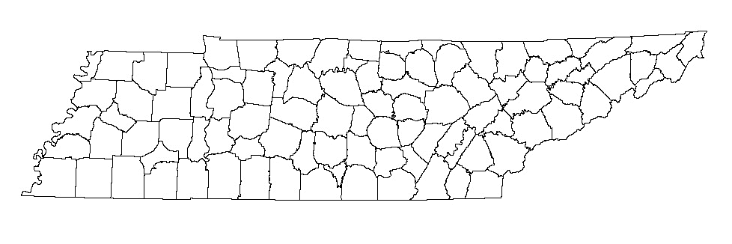
Technology Statewide Contracts
  Technology statewide contracts are procured when multiple agencies (at least 2) within the State have a shared technology related need.
  Technology SWCs can be used by local governments including state, county, and city entities.
  The Technology Category Team manages statewide contracts that pertain to technology.
Notes:
ZOHREH
We manage Statewide contracts that pertain to technology. We do not dictate technology strategy for the State, that is done by STS.

Slide 4


Benefits of Statewide Contracts
Money
Energy
Time
Notes:
ZOHREH
We encourage all local governments, including state, county, and city entities to use statewide contracts.
By using statewide contracts, you capitalize your purchasing power and receive the lowest possible pricing.
This should save you a tremendous amount of time and effort since the contracts have already been negotiated under Tennessee State law.
800+ Software Titles
40+ Software Contracts
SWC technology portfolio is roughly $478 million ($96 million annually)
We are going to run through several SWCs that might be of interest to you.

Slide 5
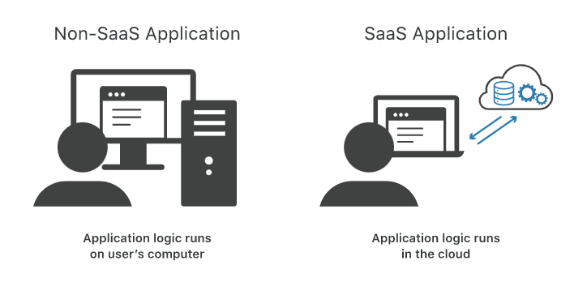

On-Site vs. Software as a Service (SAAS)
What’s the difference? Which do you need—one or the other, or both?
On-Site Software
On-Site Software must be installed on a device, such as a computer, to be used.
Software as a Service (SAAS)
SAAS applications are primarily web-based and are accessed through a web browser.
Notes:
ZOHREH
On-Site software
Software is established within the organization’s internal system along with the hardware and other infrastructure necessary for the software to function.
Installed and runs on computers on the premises of the person or organization using the software, rather than at a remote facility such as a server farm or cloud
Most on-site software is fully purchased up-front.
Examples: Microsoft Office, Adobe Products
Software as a service (SaaS) – think remote
Stored on the supplier’s network. Also known as “cloud” software.
Cloud-based software is usually served via internet and it can be accessed by users online regardless of the time and their location.
Unlike on-site software, cloud-based software users only need to install an application or a web browser in order to access its services.
SaaS licenses are purchased on a recurring basis; such as monthly or quarterly.
SaaS purchases contain extra scrutiny and must be cleared by STS Information Security in order to be purchased (locals are excluded from this requirement).
Examples: Cisco WebEx, Google Workspace
Some applications offer both. For example,

Slide 6
SWC 3999 – NASPO COTS Software
Suppliers: CDW-G, SHI, Insight
Expiration Date: 12/31/22
Notes:
ZOHREH
NASPO Contract
This is a NASPO cooperative contract we have with three resellers: CDW-G, SHI, and Insight.
SWC 3999 is for commercial-off-the-shelf software. Customized software and involved services are not within scope.
Offerings are so vast; we do not maintain a price list.
At times, different suppliers may be able to provide the same item. This encourages even lower prices so be sure to request a quote from as many suppliers as possible.

Slide 7
SWC 3021 – NASPO Cloud Solutions
Suppliers: Carahsoft, SHI, Insight
Expiration Date: 8/31/2023
Notes:
ZOHREH
NASPO Contract
The software available on this contract is more cloud focused. SaaS, IaaS, and PaaS are available, as well as customized services that would require a SOW.
Three resellers on this contract are Carahsoft, SHI, and Insight.
At times, different suppliers may be able to provide the same item. This encourages even lower prices so be sure to request a quote from as many suppliers as possible.

Slide 8
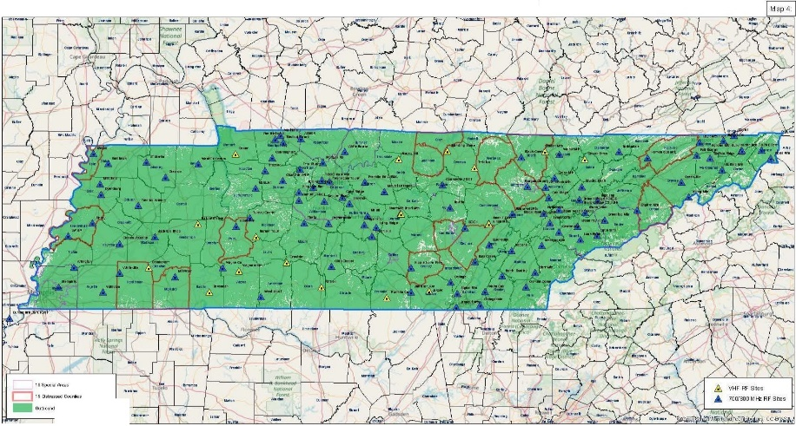



Communications Network
Notes:
RICHARD
Can you think of a time when you or others knew that they just had to get in touch with others? Whether it’s a Tornado in West Tennessee, A Bombing in Nashville, or a Wild-Fire in the Mountains of East Tennessee. People need to know what is Happening!
So, Today I’m going to talk about the communications capability that our SWC’s deliver. Particularly from a First Responder/Public Safety point of view. Across the State we have the tools to connect with those we need to connect with. Radio Network, Cellular Networks, the State’s Telephony Network. Satellite Networks and the messaging software to connect with State Employees and Citizens in emergencies.

Slide 9

Communications Network
NETWORK | PROVIDER | CONTRACT
TACN | Confidential | SWC 425
Radios | Motorola | SWC 424
 | JVCKenwood & BK Tech | SWC 423
FirstNet | AT&T | SWC 911
NETTN | AT&T | Agency
 | CenturyLink | Agency
Satellites | Outfitters | SWC 3838
 | NI Gov Services | SWC 319
Cellular | Verizon & T-Mobile | SWC 811
Messaging | Everbridge | SWC 3017
Notes:
RICHARD
These are the backbones needed to cover the State for various situations. The overall network consists of:
the Tennessee Advanced Communications Network (TACN) that has a lot of radio towers across the State that are being technologically upgraded and additional towers are coming on-line.
To ensure that radios and other equipment are up to date and maintained, two SWC’s are in Place. One with Motorola, and one covering both JVC and BK Technologies.
Then we have AT&T’s FirstNet or First Responder SWC that covers equipment, services, and voice and data Plans. This network itself is separate from AT&T’s public cellular offering and is operable today
The States infrastructure, called NetTN, supporting voice over IP and traditional key systems networks with secondary vendor redundancy.
There are 2 Satellite offerings; one for Iridium phones and services and is global coverage, and the other for MSAT Satellites covering North and South America.
Our Cellular Service Providers T-Mobile and Verizon have Public Safety Voice and Data Plans that are available through their Cellular SWC.
lastly, the software capability to notify 47,000 State employees, and Tennessee citizens in an emergency such as weather, public safety threats, and critical business outages via voice, fax, email, text, and social media.
There will always be that situation where the towers are down and when it happens; AT&T, Motorola, T-Mobile, and Verizon can bring Mobile Towers on site.
There is always a dead spot somewhere and that is one reason we have this number of options.

Slide 10

Public Safety and First Responders SWCs
  SWC 104 Checkpoint & Body Scanners
  SWC 349 Radar and Lidar
  SWC 357 Handguns
  SWC 393 Fingerprint
  SWC 450 License Plate Reader
  SWC 564 Hazmat
  SWC 711 Emergency Notification
  SWC 817 Disaster Recovery
Notes:
RICHARD
On this slide I’ve listed several Statewide contracts that are very much focused on Public Safety and the First Responder community. From Body Scanners to License Plate readers to Disaster Recovery.
Taking these 8 and the 8 Communications SWC’s from the previous slide, the Public safety/First responder SWC’s represent 16% of the total number of Statewide contract SWC’s.
I’m sure that these 16 don’t cover all possible needs both locally and for the State. But the combination offers a solid collection of SWC’s that are used today.

Slide 11
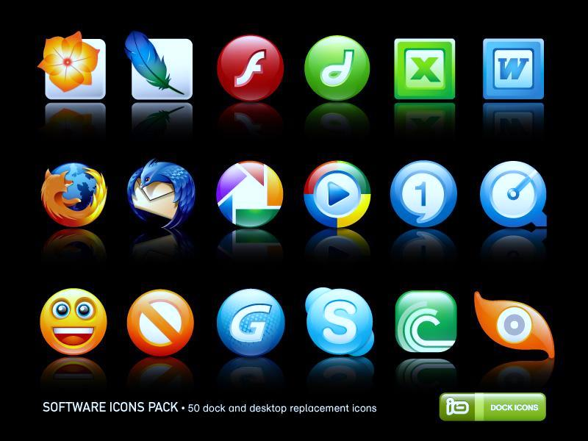
SWC 400 – Multifunction Device, Scanners, and Software
Supplier: Canon
Expiration Date: 4/14/2023
Notes:
RICHARD
Changing gears with this slide. This next slide SWC 400 is for Multifunction Devices and Services. The Supplier is Cannon. I’m probably older than several of you, and I refer to these as copiers with intelligence.
They can be leased or purchased and have a 60 months service agreement that includes all supplies, toner and service. The lease and or purchase can be started anytime during the contract period and would continue until their individual fiv60 months service period is completed.

Slide 12

Confidential Technology Contracts
  SWC 3030 NASPO Data Communications
  Supplier: Confidential
  Expiration Date: 9/30/2024
  SWC 3014 NASPO Computers, Servers, Storage
  Client: Confidential
  Expiration Date: 2/28/2023
  To access these contracts, you must sign a
  Non-Disclosure Agreement (NDA). Please contact any member of the CPO Technology Team
  (see last slide for contact information).
Notes:
RICHARD
Many of you have come across the situation where you are on the Statewide Contract Listing site and click on a contract, such as the two SWC’s on the chart, and when it opens you see the contract name, the beginning and end dates and the contract number or numbers. What you won’t see is a folder icon that let’s you open the documents. that not being able to open the doc’s lets you know that the contract or contracts are Confidential and in order to get them you need to complete an NDA and send it to CPO.
I’ll turn it back to Zohreh who will have more info for you.

Slide 13

How to Use Technology SWCs
List of Statewide Contracts*
https://hub.edison.tn.gov/psp/paprd/SUPPLIER/ERP/c/TN_PUBLIC_SUPPLIER.TN_ACTIVE_SWC_CMP.GBL?Page=TN_ACTIVE_SWC&Action=U&ExactKeys=Y&TargetFrameName=None
SWC Usage Instructions
https://www.tn.gov/generalservices/procurement/central-procurement-office--cpo-/state-agencies-/statewide-contract-instruction--swc-.html
*Please note* CONFIDENTIAL contracts will be listed, but you will not be able to view the related documents. If you would like to access the information, please contact any member of the CPO Technology Team
(see last slide for contact information).
Notes:
ZOHREH
Usage Instructions
Usage instructions are available for every SWC. They provide a basic overview of the contract as well as contact information for state and supplier administrators.
Unless otherwise stated, the best practice for receiving more information about a particular need is accessing the UI and contacting the supplier for a quote.
Confidential Contracts
STS determines whether a contract is confidential or not and the main reason is that they want to protect state information and its technology from potentially harmful intruders. In the Supplier Portal, the titles of confidential contracts will still show up when you are searching for a specific contract but you will not be able to access the documents until you sign a non-disclosure agreement (NDA).
NDAs can be accessed via the Edison supplier portal OR direct contact of the CPO technology team.

Slide 14
Review
The Technology Category Team manages the solicitation and procurement of statewide contracts (SWCs) that pertain to technology.
Technology SWCs can be used by local governments including state, county, and city entities.
The following SWCs may be of interest:
  SWC3999 – NASPO COTS Software
  SWC3021 – NASPO Cloud Software
  SWC3014 – NASPO Computer, Servers & Storage
  RSWC811 – Cellular Devices, Services, and Business Solutions
  Add many more!
Notes:
ZOHREH

Slide 15

Final Questions
Notes:
Common questions:
What if I can’t find the product/service that I need?
What if there’s a discrepancy in the quoted price and the catalog list price?
Who can sign a NDA?
What should I do if I find out the SWC price for a product/service I currently use is better than the price I’m receiving on a local or agency contract?

Slide 16
Final Questions
All statewide contract documents can be found here:
  https://hub.edison.tn.gov/psp/paprd/SUPPLIER/ERP/c/TN_PUBLIC_SUPPLIER.TN_ACTIVE_SWC_CMP.GBL?Page=TN_ACTIVE_SWC&Action=U&ExactKeys=Y&TargetFrameName=None
Usage Instructions can be found here:
  https://www.tn.gov/generalservices/procurement/central-procurement-office--cpo-/state-agencies-/statewide-contract-instruction--swc-.html
Interactive Cell Coverage Map
  https://fcc.maps.arcgis.com/apps/webappviewer/index.html?id=6c1b2e73d9d749cdb7bc88a0d1bdd25b
CPO Technology Team
Josh Gaddy
Josh.Gaddy@tn.gov 615 741-1402
Richard Kotler
Richard.Kotler@tn.gov 615 253-4723
Michael Gross
Michael.D.Gross@tn.gov 615 507-6227
Michael Porter
Michael.Porter@tn.gov 615 741-1192
Melinda Lewis
Melinda.Lewis@tn.gov 615 532-0400
Zohreh Hurd
Zohreh.Hurd@tn.gov 615 741-2026

