Slide 1
HEALTH CARE SURROGATE

Slide 2
HEALTH CARE SURROGATE
HEALTH CARE SURROGATE
How Are They Designated?
T.C.A. 68-11-1806

Slide 3
HEALTH CARE SURROGATE
Surrogate Definition
Individual, other that a patient’s agent or guardian, authorized under this part to make a health care decision for the patient.

Slide 4
HEALTH CARE SURROGATE
Designation of a Surrogate
Adult or emancipated minor may designate an individual to act as surrogate by personally informing the supervising health care provider.

Slide 5
HEALTH CARE SURROGATE
Power/Scope of Surrogate
Can make health care decisions for a patient if:
  Patient determined by physician to lack capacity; and
  No agent or guardian has been appointed or is not reasonably available

Slide 6
HEALTH CARE SURROGATE
Designation of a Surrogate
If individual lacks capacity, has not appointed an agent, not
designated a surrogate, and does not have a guardian, or
whose agent, surrogate, or guardian is not reasonably
available, a surrogate will be identified by the supervising health care provider.

Slide 7
HEALTH CARE SURROGATE
Who Can Be a Surrogate?
Surrogate must be an adult
Those to consider for surrogate in descending order of preference:
  Patient’s spouse, unless legally separated;
  Patient’s adult child;
  Patient’s parent;
  Patient’s adult sibling;
  Any other adult relative of the patient; or
  Any other adult who has satisfied the requirements of subdivision
  (T.C.A. 68-11-1806 (c ) (2)), has exhibited special care & concern for the patient, who is familiar with the patient’s personal values, who is reasonably available, and who is willing to serve.

Slide 8
HEALTH CARE SURROGATE
Criteria for Determining Surrogate
Proposed surrogate reasonably appears to be better able to make decisions in accordance with the wishes of the patient or in accordance with the best interest of the patient
Proposed surrogate’s regular contact with the patient prior to and during incapacitating illness
Proposed surrogate’s demonstrated care and concern
Proposed surrogate’s availability to visit the patient during the illness
Proposed surrogate’s availability to engage in face-to-face contact with health care providers to participate fully in the decision-making process

Slide 9
HEALTH CARE SURROGATE
No eligible surrogate available…
Designated physician may make health care decisions for the patient after
Consults with and obtains recommendations of an institution’s ethics mechanism
Obtains concurrence from second physician not directly involved in the patient’s health care nor having close ties to the designated physician

Slide 10
HEALTH CARE SURROGATE
What Responsibilities do Surrogates have?
Make decisions in accordance with the patient’s wishes, if wishes are known
Make decisions based in the patient’s best interests if the patient’s wishes are not known

Slide 11
HEALTH CARE SURROGATE
Limitations to Physician Appointed Surrogate
A surrogate may not make the decision to withhold or withdraw artificial nutrition/hydration
How Can The Surrogate Make This Decision?
If the designated physician and a second independent physician certify
in the patient’s current clinical record that the provision or continuation
of artificial nutrition/hydration is prolonging the act of dying and the
patient is unlikely to regain capacity to make medical decisions, the
surrogate may make this health care decision on behalf of the patient.

Slide 12
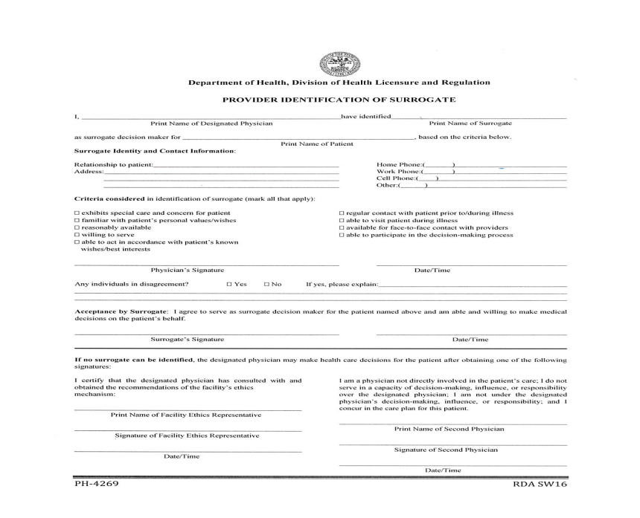
Tennessee Department of Health Resources
Tennessee Department of Health Resources
http://tn.gov/health/article/advance-directives

