Slide 1
Tennessee’s Physician Orders for Scope of Treatment

Slide 2
Tennessee’s Physician Orders for Scope of Treatment
Tennessee’s Health Care Decision Act
  In 2004, the Health Care Decision Act was passed thus revising Tennessee law concerning health care decision making. What does the act do?
  Protects patient’s right to make own health care decisions
  Promotes Advance Directives

Slide 3
Tennessee’s Physician Orders for Scope of Treatment
How did the Physician Orders for Scope of Treatment (POST) form come about?
Physician Orders for Scope of Treatment (POST) is not an advance directive, but a set of specific medical orders that is completed by an individual’s physician or, at the physician’s direction, by another healthcare provider. The document does not have to be signed by the patient but should be reviewed and discussed.
The POST is kept with the individual, and can be used in different health care settings. Emergency personnel – like paramedics, EMS, and emergency room doctors – must follow these orders. Without a POST form, emergency care staff are generally required to provide every possible treatment to keep you alive.
Tennessee needed one form to address DNR and other resuscitative services
Tennessee needed one form utilized by all healthcare entities in the state i.e. EMS, Nursing Homes, Hospitals, etc.
Tennessee needed a universal form which could travel and be recognized across state lines

Slide 4
Tennessee’s Physician Orders for Scope of Treatment
Physician Order for Scope of Treatment, (POST)
Means a written order that applies regardless of the treatment setting and that is signed by the patient’s physician which states that in event the patient suffers cardiac or respiratory arrest, cardiopulmonary resuscitation should not be attempted.
The law also indicated the Board for Licensing Health Care Facilities shall promulgate rules and create forms regarding procedures for the withholding of resuscitative services from patients
POST serves as the DNR order

Slide 5
Tennessee’s Physician Orders for Scope of Treatment
The Physician Orders for Scope of Treatment (POST) form compliments the Advance Care Plan and is not intended to replace it. The POST form is a tool for interpreting patients’ goals of care into medical orders in a highly visible, portable way, and honoring an individual’s end of life wishes.
POST form is always voluntary
For individuals with serious advanced illness to record their choices for current medical treatment
POST is a medical order set, not an advance directive
Guides actions by Emergency Medical Services and Personnel when made available

Slide 6
Tennessee’s Physician Orders for Scope of Treatment
The purpose of a Physician Orders for Scope of Treatment (POST) form:
    Standardized form containing orders by a physician who has personally examined a patient regarding that patient’s preferences for end of life care
    Effective immediately upon order written and when all requirements met
Promote the patient’s autonomy by creating medical orders that reflect the patient’s current treatment preferences
Facilitate appropriate treatment by emergency medical services (EMS) personnel, emergency medicine and other health care professionals, as applicable
Assist parents of minor children, guardians of seriously ill minors, and other persons to express what they believe to be in the patient’s best interests when the patient’s wishes are not known.

Slide 7
Tennessee’s Physician Orders for Scope of Treatment
    Requirements for valid Physician Orders for Scope of Treatment (POST):
    Must be completed by a health care professional based on patient preferences, patient best interest, and medical indications.
    The POST from may be prepared by any health care professional. To be valid, the form must be signed by a physician, or at discharge from a hospital or long term care facility by a nurse practitioner (NP), clinical nurse specialist (CNS), or physician assistant (PA)
    Verbal orders are acceptable with follow-up signature by the physician in accordance with facility/community policy.
    Photocopies/faxes of signed POST forms are legal and valid
Patient or Surrogate Signature
Tennessee is one of a few states that does not require the patient or surrogate to sign the POST form

Slide 8
Tennessee’s Physician Orders for Scope of Treatment
Transferring a Patient with a Physician Orders for Scope of Treatment (POST)
For patients in institutional settings, the original POST should accompany the patient upon transfer from one setting to another
  POST orders remain in effect in receiving facility
A copy of the POST form should be kept in the individual's medical record. HIPAA permits disclosure of POST orders to other health care professionals across treatment settings
Copies of the POST form must be honored by EMS and other health care professionals
Specifically for first responders, the Board for Licensing Health Care Facilities has defined the Emergency Medical Technicians (EMT) and Paramedic Scope of Practice so that Tennessee-certified First Responder or EMT are required to comply with POST forms appropriately executed if signed on discharge from a hospital or long term care facility (by a physician, nurse practitioner, clinical nurse specialist, or physician assistant)

Slide 9
Tennessee’s Physician Orders for Scope of Treatment
Reviewing Physician Orders for Scope of Treatment (POST )
The POST should be reviewed if:
The patient is transferred from one care setting or care level to another
There is a substantial change in the patient’s health status
The patient’s goals of care and/or treatment preferences change

Slide 10
Tennessee’s Physician Orders for Scope of Treatment
Using Physician Orders for Scope of Treatment (POST)
Any incomplete section of POST implies full treatment for that section
No defibrillator ( including AEDs) should be used on a person who has chosen “ Do Not Attempt Resuscitation”
Oral fluids and nutrition must always be offered if medically feasible
When comfort cannot be achieved in the current setting, the person, including someone with “ Comfort Measures Only”, should be transferred to a setting able to provide comfort( e.g. treatment of a hip fracture)
IV medicine to enhance comfort mat be appropriate for a person who has chosen “ Comfort Measures Only”
Treatment of dehydration is a measure which prolongs life. A person who desires IV fluids should indicate “ Limited Interventions” or “Full Treatment”.
A person with capacity, or the Health Care Agent or Surrogate of a person without capacity, can request alternative treatment

Slide 11
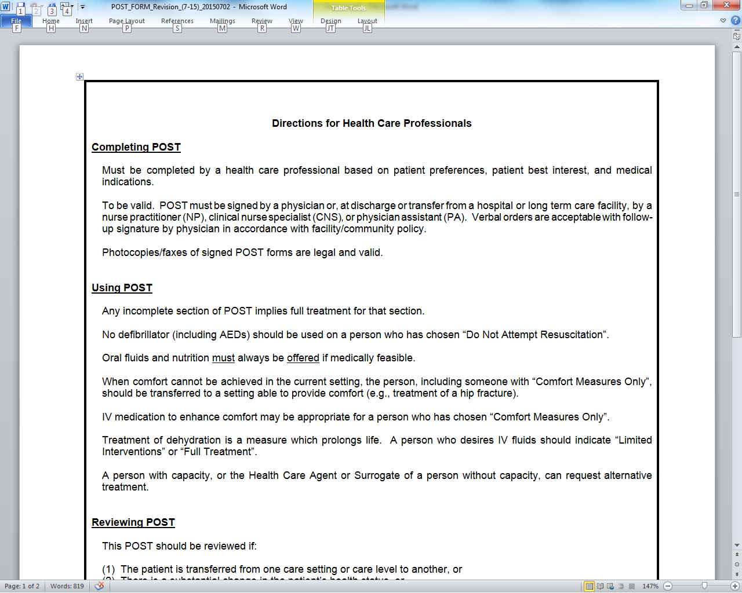
Tennessee Department of Health Resources
Tennessee Department of Health Resources
http://tn.gov/health/article/advance-directives

