Slide 1
Sick Leave Bank (SLB)
Case Management System
Employee Self Service for Coordinators
Office of General Counsel | Employee Sick Leave Bank

Slide 2
Objectives
At the end of this presentation, SLB Coordinators will be able to:
Submit a Withdrawal Request Application on behalf of their agency employees for Sick Leave Bank (SLB) grants via Self Service in Edison.

Slide 3
State of TN Employee Sick Leave Bank (SLB)
PURPOSE: The Sick Leave Bank (the “Bank”) grants paid sick leave to eligible members who are medically certified as unable to perform the duties of their position as a result of a personal or minor child’s illness, injury, accident, disability, medical condition, impairment, or quarantine and who have exhausted all their personal accrued leave balances including sick, compensatory annual, and paid parental (when applicable).

Slide 4
Sick Leave Bank (SLB) Members with limited computer access
If an employee has limited computer access, the employee may download the Withdrawal Request Application paper form from the Sick Leave Bank (SLB) website at https://www.tn.gov/hr/employees1/sick-leave-bank.html
Once the employee completes the form in its entirety, they may send it directly to their agency SLB Coordinator and the SLB Coordinator may submit the form on the employee’s behalf in Edison.
In order for the SLB Coordinator to submit a request on behalf of the employee in Edison, the Coordinator must upload the signed paper form from the employee with the request in order for the request to be considered. Current SLB forms have a revision date of 07.2023.

Slide 5
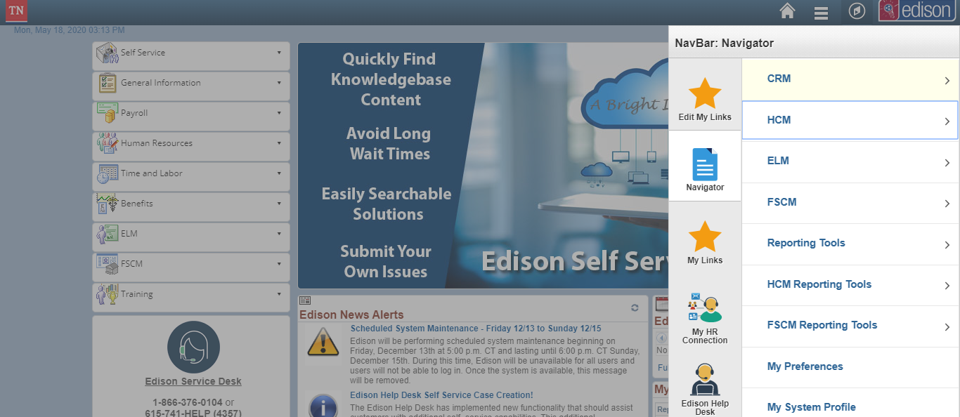
Submitting a Withdrawal Request Application
Log in to Edison and click the Navigator icon and click HCM.

Slide 6
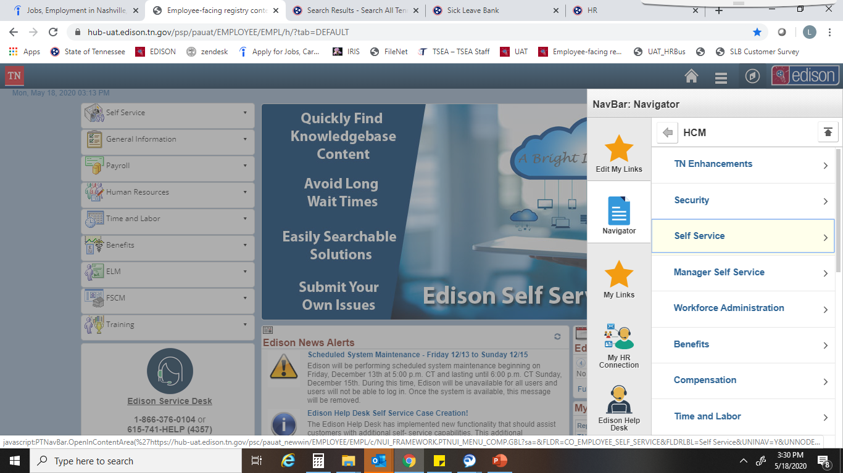
Submitting a Withdrawal Request Application
Click Self Service and then follow the below path:
Manager Self Service> Time Management> Sick Leave Bank
.

Slide 7
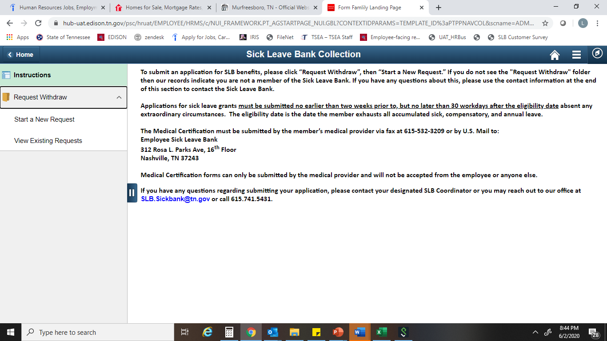
Submitting a Withdrawal Request Application
The Sick Leave Bank Collection page will load. To submit a request, click the “Request Withdraw” and then click “Start a New Request”.
Note: if the employee does not see the “Request Withdraw” folder on this page, then Edison is indicating that the employee is not a Sick Leave Bank member.

Slide 8
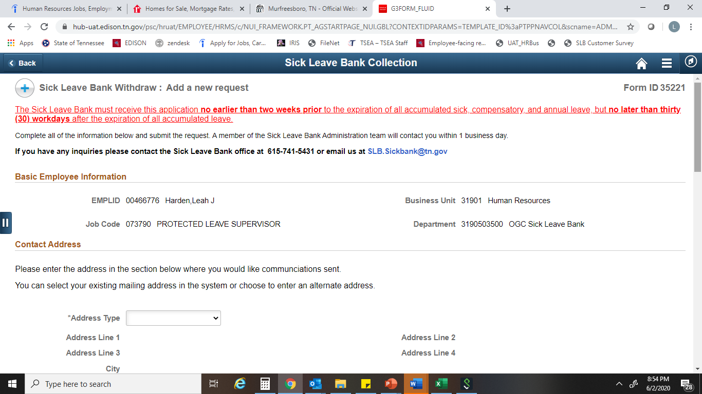

Submitting a Withdrawal Request Application
The Withdrawal Request Form will load with the employee’s information auto-populated and beginning with the Contact Address section, the employee will complete the form in its entirety. The form is an electronic version of the Withdrawal Request Application paper form currently submitted to request SLB grants.
Under Address type, click the drop down menu and the employee’s Home Address listed in Edison will auto-populate when you select Home. If the employee wants to use a different address, you will select “Alternate-SLB only” and the system will allow the Coordinator to manually enter the address the employee desires the SLB determination to be sent to.

Slide 9
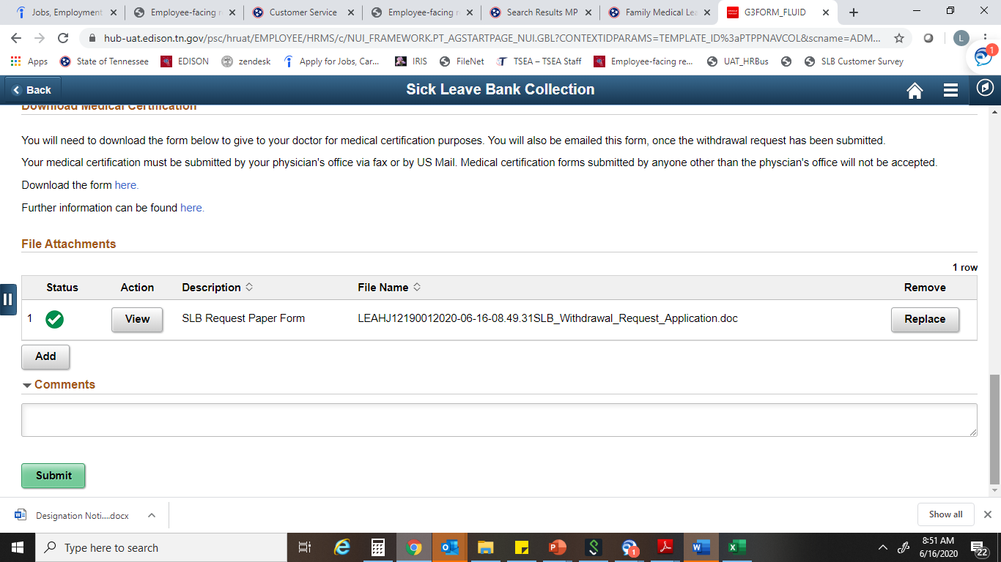
SLB Coordinator Submission
After answering all questions in their entirety, the Coordinator will click Upload and then My Device to browse their computer to upload the document and then click Upload and a green checkmark will appear indicating the upload was successful. There is a Comments box below and the Coordinator may type i.e. “Submitted by <Coordinator Name> on behalf of employee”. (The Add button allows for submission of additional documents if the Coordinator needs to submit additional documents).
Then click the green Submit button.
In order to complete the application submission on behalf of the employee, the SLB Coordinator must upload a complete, signed and dated paper copy of the Withdrawal Request Application from their employee. The system will not allow a Coordinator to submit the Edison application certifying a withdrawal of benefits by the employee without uploading a paper form.
Please note that the Coordinator is able to download and/or print the medical certification form from this page to provide to the employee to give to their medical provider. The Medical Certification form still must be submitted by the medical provider to the SLB Office via Fax at 615.532.3209 or emailed from the provider to SLB.Sickbank@tn.gov.

Slide 10
Notification of the Withdrawal Request
Once the Coordinator submits the Withdrawal Request form, the Edison System will notify the Sick Leave Bank office and send confirmation to the employee and coordinator that the request was submitted via email. The SLB Staff will also notify the employee’s agency SLB Coordinator it was received and what additional information is needed if anything to finalize the application.
Once the Sick Leave Bank office has received both the Withdrawal Request and Medical Certification form from the Medical Provider and any other pertinent documents, the SLB office will have up to 10 days to process and finalize the application for SLB grants and will email the determination to the employee’s email address they indicate on the request form.

Slide 11
State of TN Sick Leave Bank
Open Enrollment
August 1st-October 31st

Slide 12
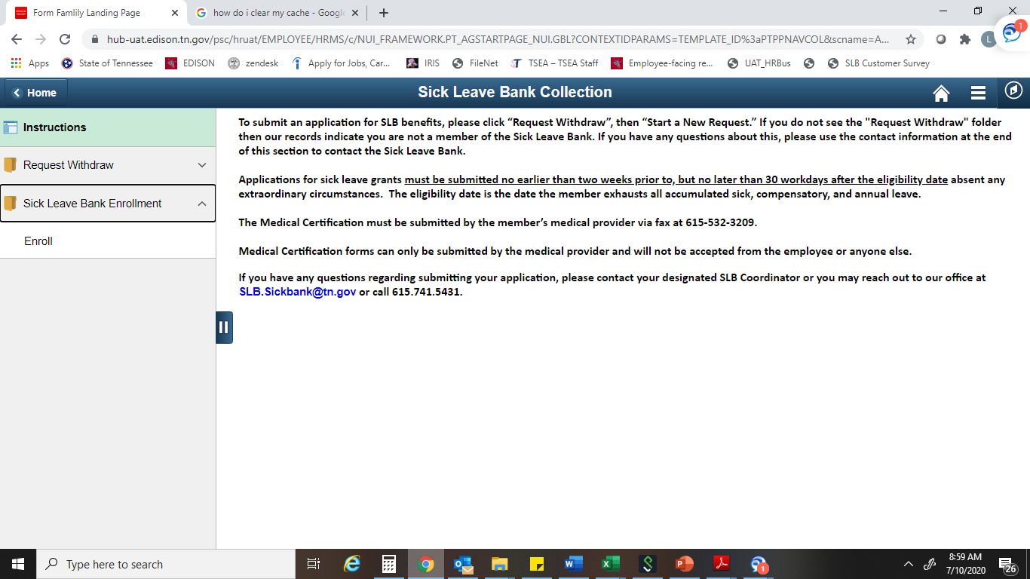
Sick Leave Bank Open Enrollment
For employees who are not SLB Members that want to join the Sick Leave Bank, they will follow the below path:
Navigator> HCM> Self Service> Time Reporting> Sick Leave Bank Enrollment >Enroll
Notes:
Updated 07.01.2023

Slide 13
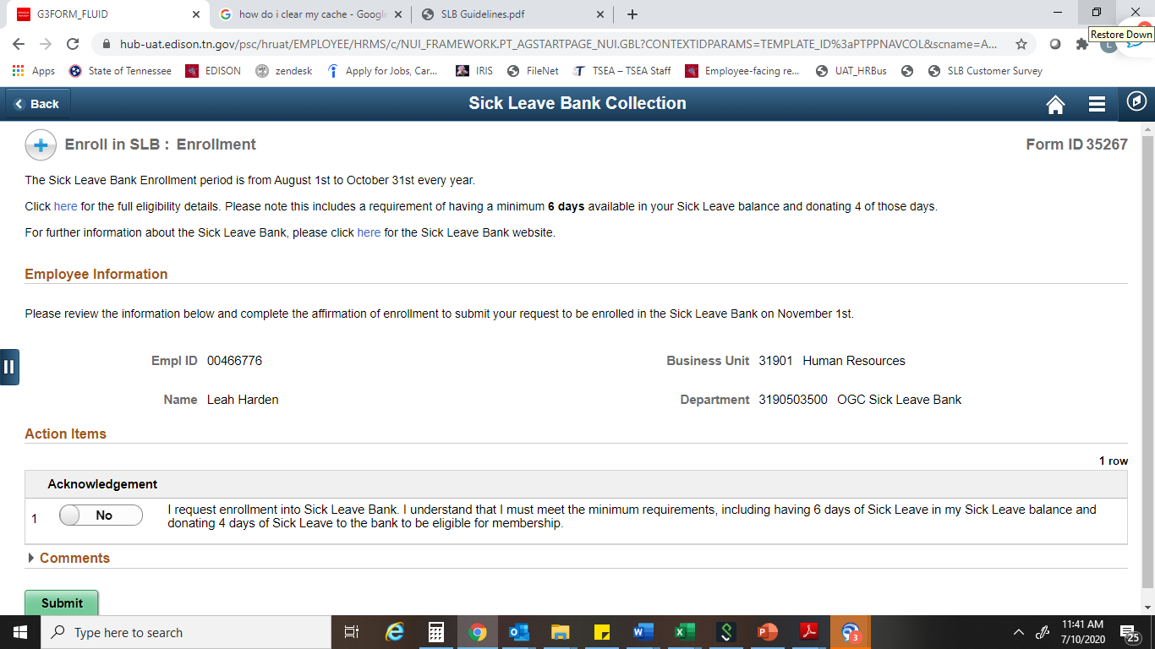
Sick Leave Bank Open Enrollment
The below page will generate and an eligible employee will be able to change the “No” button to “Yes” in the acknowledgement box below confirming their desire to enroll and then will click Submit. The employee will receive an email notification confirming their application for enrollment was submitted
If an employee is not eligible to enroll due to not meeting all of the SLB Membership eligibility criteria, the page will advise the employee that they do not meet the requirements to become a SLB Member and will not allow the employee to submit an application.

Slide 14
Sick Leave Bank Open Enrollment
Pursuant to T.C.A. § 8-50-802, SLB eligibility requirements for enrollment and membership are as follows:
The employee must be a full-time state employee and have 12 full months of continuous employment immediately preceding application for membership.
You must be in leave accruing status at the time of enrollment.
You must have a sick leave balance of at least 6 days by October 31st of the current enrollment year.

Slide 15
Sick Leave Bank Open Enrollment
REMINDERS re: New Enrollees:
Employees who successfully join the SLB will have a membership effective date of November 1st of that year.
Members are eligible to apply for grants of sick leave on January 1st. following enrollment. (SLB Guideline III.1)
Any employee wanting to cancel their membership must submit a written request to the SLB Board of Trustees requesting their membership be canceled. It must include their employee ID and signature. Please be advised that if a new enrollee submits this request at any time prior to 6/30, their membership will not be canceled until 6/30th and they will forfeit the 4 sick days assessed to become a member of the SLB. (SLB Guideline VI.1.d)
Applications for grants from the Bank for pre-existing conditions will be denied until November 1st of the following year. “Pre-existing” means a condition that existed for which a member received treatment or advice during the 12-month period prior to the effective date of initial Bank membership. (SLB Guideline III.2)
Notes:
I will send a communication to all SLB Coordinators regarding their employees who joined successfully

Slide 16

Sick Leave Bank (SLB) Contact Information
For any questions regarding Employee Self Service or any other inquiries, please contact the Sick Leave Bank (SLB) office at the below email, phone number or see our website:
Email: SLB.SickBank@tn.gov
Phone Number: 615-741-5431
SLB Website: https://www.tn.gov/hr/employees1/sick-leave-bank.html

