Slide 1

HOW TO COMPILE DOCUMENTS FOR TNARNG AGR APPLICATIONS

Slide 2

Step 2: FILL OUT ngb form 34-1
Follow link to pull NGB Form 34-1
Fill out your personal information
YOU MUST SIGN AND DATE ON PAGE 3 OF 3
        It can be CAC electronically signed or wet signed
        If you do decide to electronically sign it, print the document to PDF. Otherwise, it’ll wipe out your signature when combining PDF files.

Slide 3
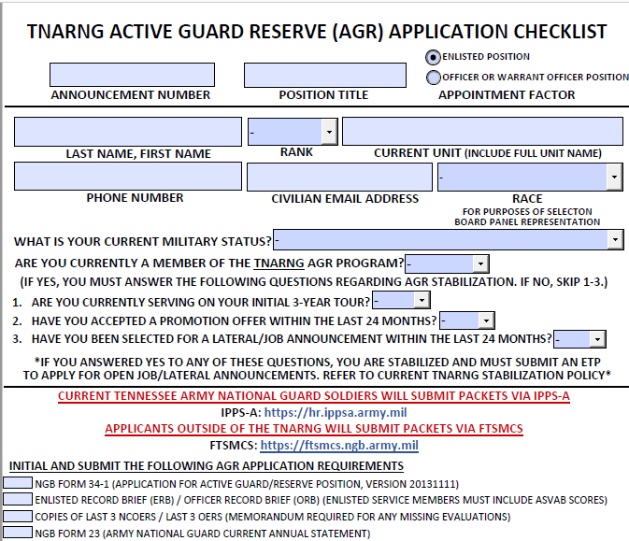
STEP 1: FILL OUT AGR APPLICATION CHECKLIST
[ngtn-hro-am form 004]
Fill out announcement number
        Ex: 24-000(JA or L)
Fill out position title
        Ex: DET Admin/Supply NCO
Select whether you are applying for an enlisted or officer/warrant officer position
Fill out your personal information
Initial and submit the following AGR application requirements

Slide 4
Step 3: pull erb/orb
Go to Self Service (army.mil)
Click My Record Brief
Click Re-validate Current Record Brief
Download validated Record Brief
Hit save and convert to PDF
*Note* If Service Member is unable to pull ERB/ORB, they may provide talent management profile from IPPS-A.
Link to IPPS-A Homepage (army.mil)
Click on My Soldier Talent Profile Tile
Hit print button and print as Microsoft PDF
Save file

Slide 5
Step 4: PULL last 3 ncoers OR OERS
Go to iPERMS RMA (army.mil)
Click EAMS-A Login
Log in with DS Logon or CAC
Click on “Documents” at the very top
Search “NCO Evaluation” OR “Officer Evaluation” in the search bar
Save your last 3 NCOERs or OERs

Slide 6
Step 5: how to download ngb form 23
Go to iPERMS RMA (army.mil)
Click EAMS-A Login
Log in with DS Logon or CAC
Click on “Documents” at the very top
Search “NGB 23A” in the search bar
Save your last NGB Form 23
*Service Members not currently serving in the National Guard should provide a memorandum for missing document*

Slide 7
Step 6: how to download dd214/215
Go to iPERMS RMA (army.mil)
Click EAMS-A Login
Log in with DS Logon or CAC
Click on “Documents” at the very top
Search “DD Form 214/215” in the search bar
Save a copy of all DD Form 214s/215s
*Service Members that do not currently have any DD Form 214s should provide a memorandum for missing document ex: Currently serving on active-duty & are about to ETS*

Slide 8
Step 7: how to download dtms acft/htwt
Contact Unit Readiness/Training NCO OR S1 for a copy of DTMS screenshot.
*ACFT/HT & WT MUST be dated within 6 months of packet submission*

Slide 9
Step 8: imr
Go to Portal (army.mil)
Click on IMR Record
Hit save
Convert to PDF

Slide 10
if applicable
Provide a memorandum to reasonably explain packet deficiencies
For example: Missing NCOER
Follow link for example memorandum:
AGR PACKET DISCREPANCIES EXAMPLE MEMO.pdf (tn.gov)
*Use AR 25-50 for guidance on military correspondence*

Slide 11
Only applicable to rrnco (enlisted) positions
Applicant who applied for RRNCO position must provide HRR Form 600 and DD Form 369
To download HRR 600 & DD 369, go to TN Guard Jobs
Click on both HRR 600 & DD 369
For HRR 600, you fill out block #1 to 33 AND YOU MUST SIGN AND DATE AT THE BOTTOM
For DD 369, you fill out block # 1 to 10
        It is required for you to take this form to the police department to run your background check
        Police department needs to fill out block #11 to 16
        Please ensure police department provide final signature

Slide 12
Only applicable to officer positions
Applicant who apply for officer positions are required to provide letters of reference, military biography, or resume (resume is required).
*The AGR office does not supply format resumes, please include personal resume with application. For assistance with writing your resume, contact Military & Family Readiness Operations (J9)*

Slide 13
Only applicable to current tnarng agr soldiers
AGR stabilization ETP must be attached and has been signed off by Soldier’s full-time chain of command
*If you are submitting an ETP for stabilization, let the AGR office know by including a remark in the IPPS-A notes.*
*Use AR 25-50 for guidance on military correspondence*

Slide 14
Only applicable to enlisted service members applying for officer positions
Need to submit approved pre-determination letter, DD 2808, and DD 2807-1

Slide 15
Follow instructions on job announcement
Once packet is compiled, follow instructions on Job announcement for submission.
TNARNG Soldiers will submit via IPPS-A
Service Members outside the TNARNG will submit their packet via FTSMCS

