Slide 1
Module 4
Learning Spaces & Activities
Early Literacy Matters

Slide 2
Module 4: Learning Spaces & Activities
Module 4 at a Glance
In Module 3, you considered the important role teachers play in developing children’s oral language and increasing their vocabulary.
In this module, you will:
Discover how to create book-and-language rich learning spaces that invite children to explore, inquire, create, problem-solve, and share learning.
Explore the “I do…you watch, I do…you help, You do…I help, and You do…I watch” strategy for modeling and practicing early language and literacy skills.
Gain a better understanding of how to use learning spaces and activities to provide increased opportunities for children to build conceptual knowledge.

Slide 3
Learner Outcomes for Module 4
Learner Outcomes:
LO1: Learners will describe developmentally and age-appropriate learning spaces which are book-and-language rich learning spaces and invite children to explore, inquire, create, problem-solve, and share learning.
LO2: Learners will explore the “I do…you watch, I do…you help, You do…I help, and You do…I watch” strategy for modeling and practicing early language and literacy skills.
LO3: Learners will examine how to use learning spaces and activities to provide increased opportunities for children to build conceptual knowledge.

Slide 4
Connections to the “Read to be Ready” Campaign:
This module aligns to the current Read to be Ready Campaign’s following key beliefs:
Early Literacy Matters:
Teachers are critical:
It takes a community:
Video link to “Early Literacy Matters” from Read to be Ready Website:
https://www.youtube.com/watch?v=60J8qRjRPkE

Slide 5
Module 4 Overview
Overview: Module 4 will consist of 3 instructional presentations. These presentations will help you reflect on the special role a book-and-language rich classroom environment plays in providing opportunities for children to interact with and learn from one another, teachers, and materials.
In Presentation 1, you will learn more about how to create book-and-language rich learning spaces that invite children to explore, inquire, create, problem-solve, and share what they learn. In addition, you will explore how learning is enhanced when books are included in all areas of the classroom.
In Presentation 2, you will learn the benefits of using the “I do, We do, and You do” strategy for modeling and practicing early language and literacy skills. Emphasis is placed on scaffolding learning and providing opportunities for repeated practice.
In Presentation 3, you will learn how to learning spaces and activities can be designed as opportunities to build conceptual knowledge.
Following each presentation, you will apply your learning through Application Activities included in the Learning Guide.

Slide 6
Suggested Timeline for Completing Module
Modules contain 4 short presentations that are designed to be completed during relaxed ratios or other times as set by your school or agency. Your director or program coordinator may suggest or establish a timeline for each presentation to be completed within the module. Please take a moment to confirm your site’s requirements while noting the submission deadline for the final Learning Application Assignment that you will submit electronically to your literacy coach for feedback and support. All other completed activities will remain in your participation guide and available for your coaches review.
Section 1: Start at beginning of module and complete Presentation 1 and Practice Activity 1.
Section 2: Complete Presentation 2 and Practice Activity 2.
Section 3: Complete Presentation 3 and Practice Activity 3.
Section 4: Complete Learning Application Assignment for Module 4 and submit it electronically to your literacy coach for feedback and support.
Please refer to your Learning Guide for a detailed Module 4 timeline and checklist.

Slide 7
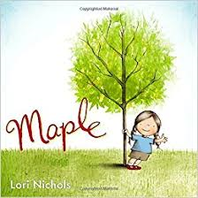
Let’s begin with a Read Aloud
Before we dive into our Module 4 Presentations, let’s start with a Read Aloud of Maple by Lori Nichols. As you listen, consider new vocabulary words and concepts for knowledge building introduced with the story.
Maple Read Aloud: https://www.youtube.com/watch?v=MweIo5dmlaM&t=8s
After hearing the book read aloud, briefly respond to these questions in the Learning Guide:
What learning space of the classroom would you add the book to?
What new words and concepts children would be introduced to.
How does the text inspire lively questions and observations?

Slide 8
Next, Let’s look at your books…
Let’s look again through the books you received in your Early Literacy Matters start-up bag. This time, you are looking for books to add to specific learning spaces in your classroom that contain rich vocabulary words and new concepts to build children’s knowledge around.
After looking through the book set, select one book that you think contains new vocabulary words and descriptive language. Read the story aloud to yourself and briefly respond to these questions in the Learning Guide:
Which book did you select?
What learning space of the classroom would you add the book to?
What new words and concepts would children be introduced to?
How does the text inspire lively questions and observations?

Slide 9
Presentation 1: Creating Book-and-Language Rich Learning Spaces
Ages 3 - 5
Presentation 1: Creating Book-and-Language Rich Learning Spaces
Let’s begin with a video clip which highlights creating book-and-language rich learning spaces for infants, toddlers, and young children, and the important role the teacher plays in supporting this development.
https://www.youtube.com/watch?v=R18w3AlDGtU

Slide 10
Creating Learning Spaces…
As you just heard in the video clip, the adult plays a critical role in developing children’s early language and literacy skills by designing spaces which provide repeated opportunities for children to:
Listen and respond to stories and conversations
Speaking, interacting, expressing, and sharing ideas with others
Explore and investigate
Imagine and create
Think and problem-solve
Let’s look at each of these strategies more closely so you can reflect and on how you can use them to foster your children’s oral language.

Slide 11
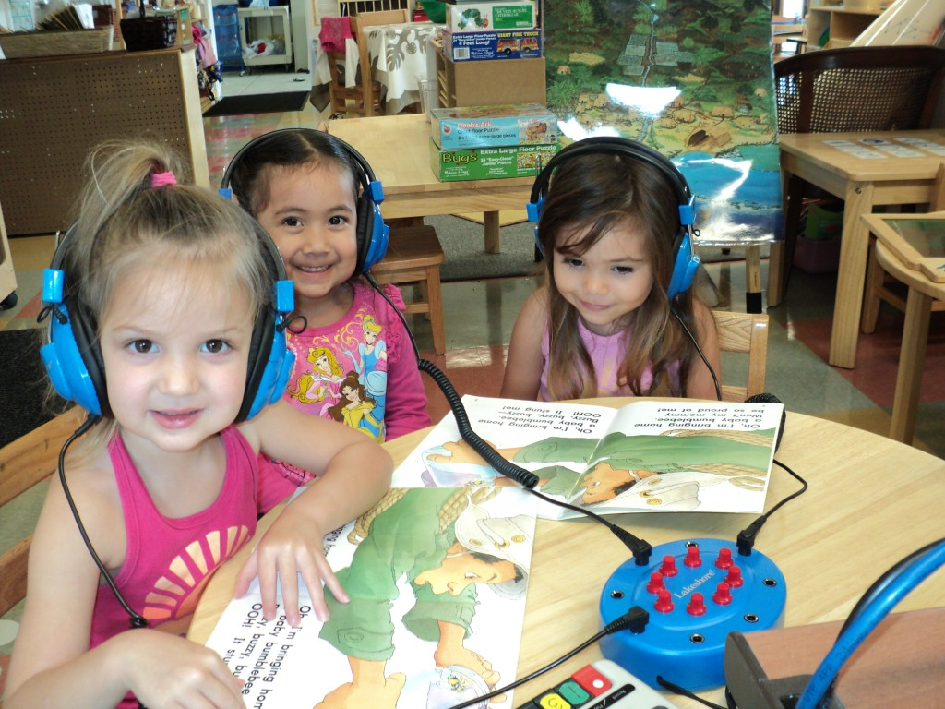
Spaces to Listen and Respond to Stories
Ages 3-5
For children ages 3 to 5, you can set up a listening table with headphones and books to listen to on CD. Children enjoy following along as they listen to the book read. At first, children heavily rely on the pictures to move through the story. Five year old children pay closer attention to the print on the book pages. In addition to books, children enjoy listening to poems, nursery rhymes, and their own class created stories recorded on CD.

Slide 12
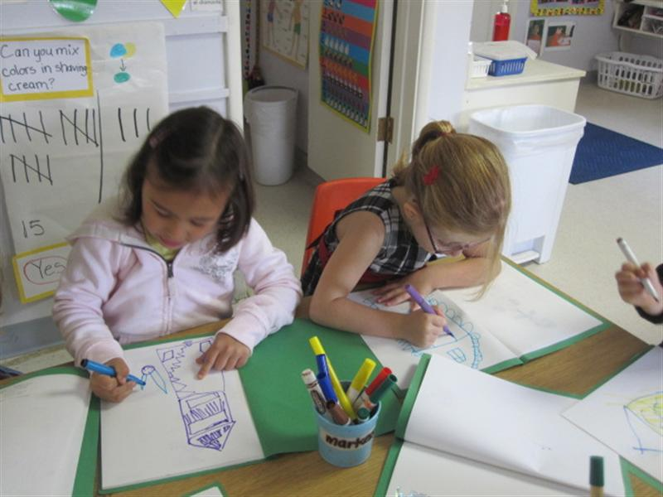
Spaces to Listen and Respond to Stories
Ages 3-5
After children finish listening to a story read, provide space and materials for them to respond to a favorite part of the story. They can draw pictures and add “writing” if desired.
During whole group circle time, allow children to share these story responses with others. Younger children enjoy talking about the picture they created.
As you can see, this one listening & responding to stories learning space allows children to develop listening and speaking skills that are important to oral language development in a meaningful and celebrated way.
What other types of learning spaces and materials would provide opportunities for children ages 3 to 5 to listen and respond to stories and songs? Record your ideas in the Learning Guide.

Slide 13
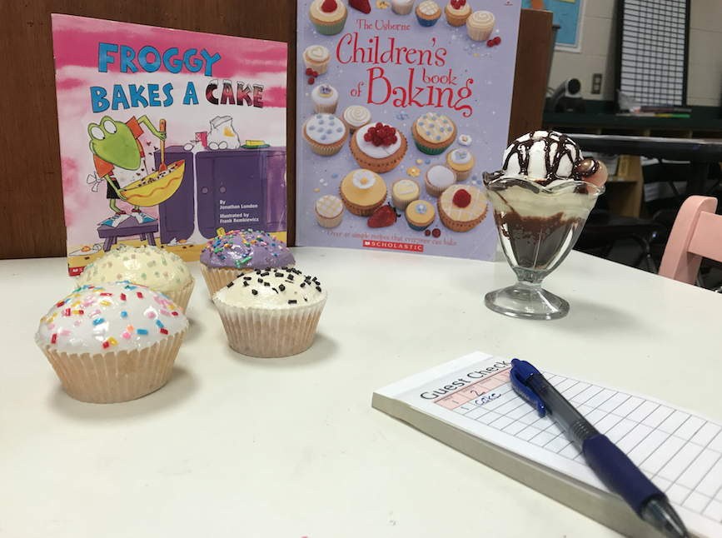
Spaces to Interact and Share with Others
Ages 3 to 5
When designing learning spaces, it’s important to create areas which encourage interaction with others. When you look at the learning spaces within your environment, are there spaces that invite children to speak, express, and share ideas with others?
Dramatic play spaces offer children the opportunity to role play and re-enact stories. Most programs provide a home-living play area equipped with kitchen furniture, props, dress-up clothes, dolls, and cleaning tools. Adding books about family life, cooking, and cleaning would provide children with more information to talk about and incorporate into their play. Including books to read to “babies” would allow children to take on the role of family members “reading to babies.”

Slide 14
Spaces to Interact and Share with Others
Ages 3 to 5
How might books be added to these learning spaces to create richer interactions?
Block Center: equipped with blocks of various sizes and textures, and added props
Building and Connecting Center: equipped with loose parts and connectors to build and invent
A Sink/Float Center: equipped with water, floating and non-floating objects, and tub
Art Center: equipped with open-ended materials to create art pieces
Sensory Table Center: equipped with various textured objects, tub, and pouring/scooping cups

Slide 15
Spaces to Explore and Investigate
Children learn best through exploration using their five senses. Employing all five senses, allows children to investigate new objects and concepts and to make meaningful, connections between what is known and new.
Even non-mobile infants should be “moved periodically throughout the day to give them different perspectives and a reasonable variety in what children are able to look at and explore” (Copple & Bredekamp, 2013, p. 81).
Toddler play and learning areas should be “organized into interest or activity areas, including areas for concentrated small-group play, solitary play, dramatic play, and construction” (Copple & Bredekamp, 2013, p. 97).
Notes:
Copple, C. & . Bredekamp, S. (2013). Developmentally appropriate practice in early childhood programs serving children from birth to age 8. Third Edition. Washington, DC: National Association for the Education of Young Children.

Slide 16
Spaces to Explore and Investigate
Preschool children need “extended time periods in learning centers (at least 60 minutes) so that children are able to get deeply involved in an activity and sustain dramatic play, construction, and other activities at a complex level. Children need ample time and opportunity to investigate what sparks their curiosity” (Copple & Bredekamp, 2013, p, 153).
Looking at your own classroom space for infants, toddlers, or preschoolers, what opportunities do children have to explore and investigate using their five senses?
Notes:
Copple, C. & . Bredekamp, S. (2013). Developmentally appropriate practice in early childhood programs serving children from birth to age 8. Third Edition. Washington, DC: National Association for the Education of Young Children.

Slide 17
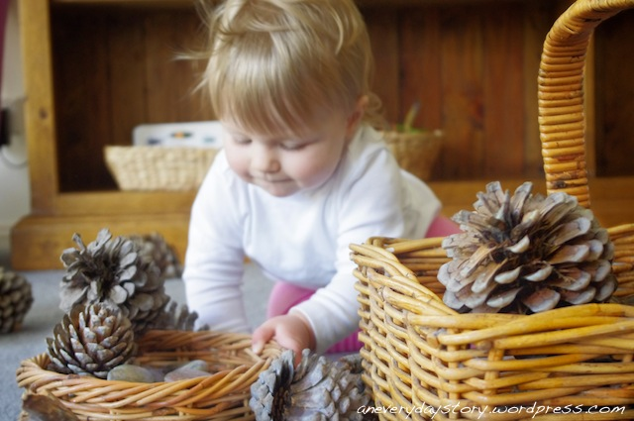
Spaces to Imagine and Be Creative
The inclusion of open-ended learning materials in various learning spaces provide children with endless opportunities to imagine and be creative.
Learning can also extend to outdoor spaces. Children are very curious about objects found in nature. They enjoy the freedom that comes with exploring the outdoor environment. Children love to lay in the grass and look at clouds passing by in the sky. They try to interpret cloud shapes and relate them to familiar things. Even infants enjoy watching clouds from the stroller. The outdoor environment allows children to be creative in their movement and play.
What kinds of learning do your children experience in the outdoor environment of your program?

Slide 18
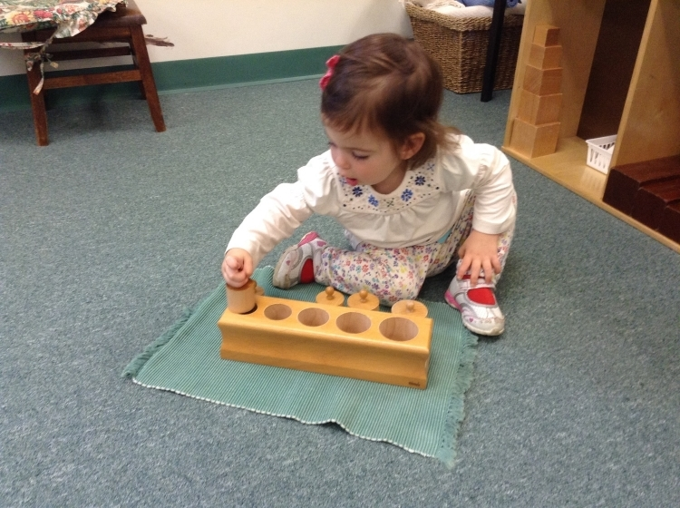
Spaces to Think and Problem-Solve
Learning spaces should also provide children opportunities to think and problem solve.
Infants and young toddlers problem-solve as they learn to push or pull toys to get them to move. They enjoy finding hidden objects in boxes and other containers. They are quick to learn how to push buttons to make noises, light up objects, and make toys pop up.
The addition of age-appropriate puzzles can promote thinking and problem-solving. Puzzle sizes and pieces can increase as children get older.

Slide 19
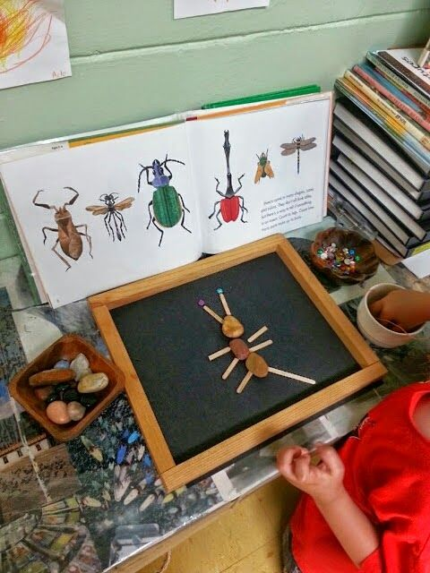
Spaces to Think and Problem-Solve
For preschoolers, teachers provide “many opportunities for children to learn to collaborate with others and work through ideas and solutions, as well as develop social skills such as cooperating, helping, negotiating, and talking with other people to solve problems” (Copple & Bredekamp, 2013, p. 155).
What other kinds of learning materials or spaces provide children with opportunities to think and problem-solve?
How can the addition of books enhance children’s thinking and problem-solving?

Slide 20
Learning Centers and Spaces are Catalysts
Early literacy expert, Dr. Janet Nadine Mort, believes that learning centers [spaces] should “serve as catalysts for thinking, problem-solving, exploring, and creating. “
Dr. Mort also encourages teachers to design learning spaces and activities that incorporate children’s interests, learning styles, and curiosity.
It’s also important to include cultural books, photos, objects, and props for children to explore.
Notes:
Source:
Mort, J. (2014). Joyful interventions part one: Early learning classroom essentials. CreateSpace, An Amazon.com Company.

Slide 21
Adding books in all learning spaces
Books should be added to all learning spaces of the classroom. They should also be accessible and available for children to engage with.
When books are included in all areas of the classroom, there are increased opportunities for teachers to read to individual or small groups of when children spend time in learning centers and as they show interest.
What areas of your classroom currently include books? Are there areas books can be added to? Provide your answers to these questions in your Learning Guide.

Slide 22
A photo gallery of learning spaces…
Take a few minutes and view the following photos of learning spaces. As you look at the photos, consider what opportunities there are for children to:
Listen and respond to stories
Interact, speak, and share with others
Explore and investigate
Imagine and create
Think and problem-solve
Record your observations in the Learning Guide.
Additionally, consider how added books could create a more language-rich experience for children.

Slide 23
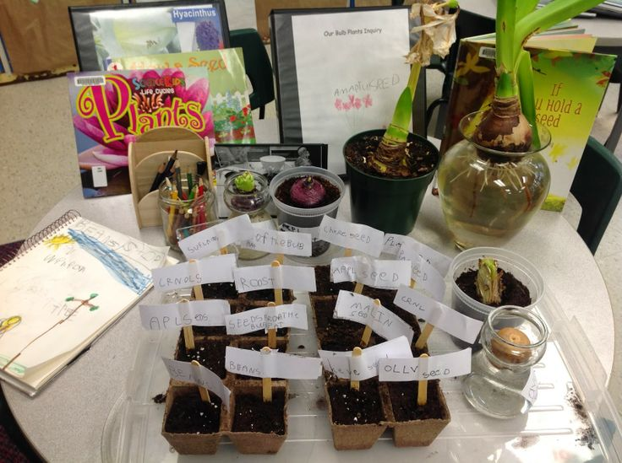
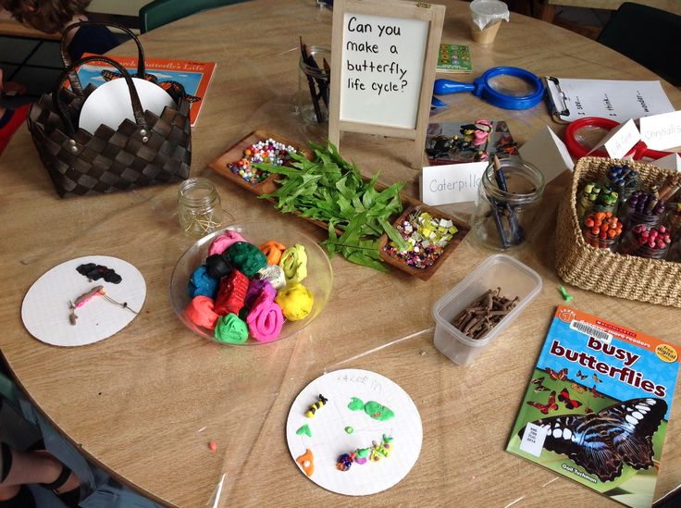
Photo Gallery of Learning Spaces
Ages 3 - 5

Slide 24
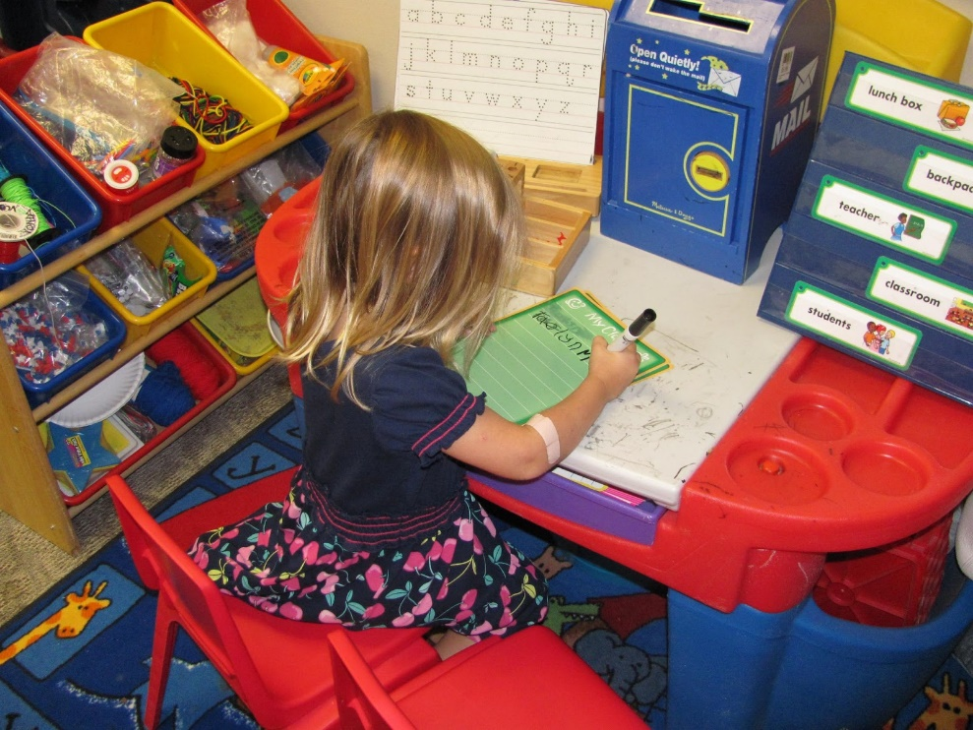
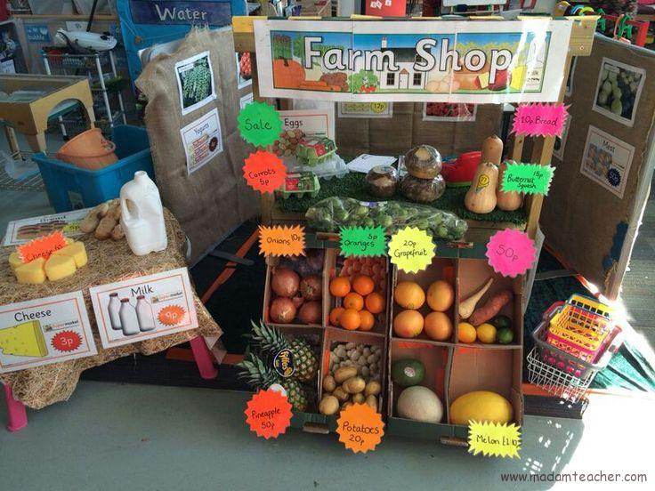
Photo Gallery of Learning Spaces
Ages 3 - 5

Slide 25
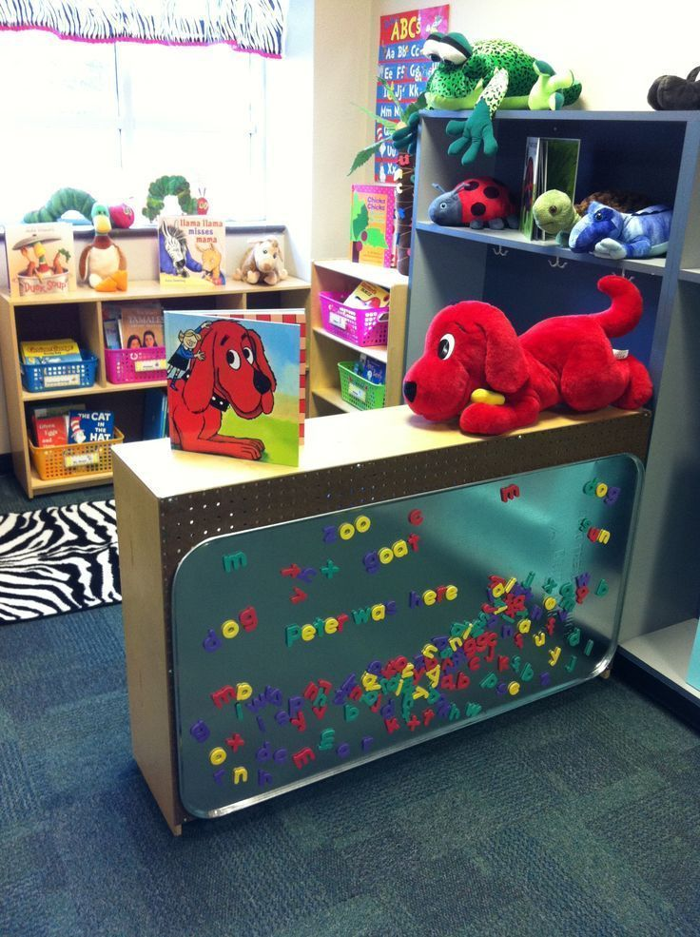
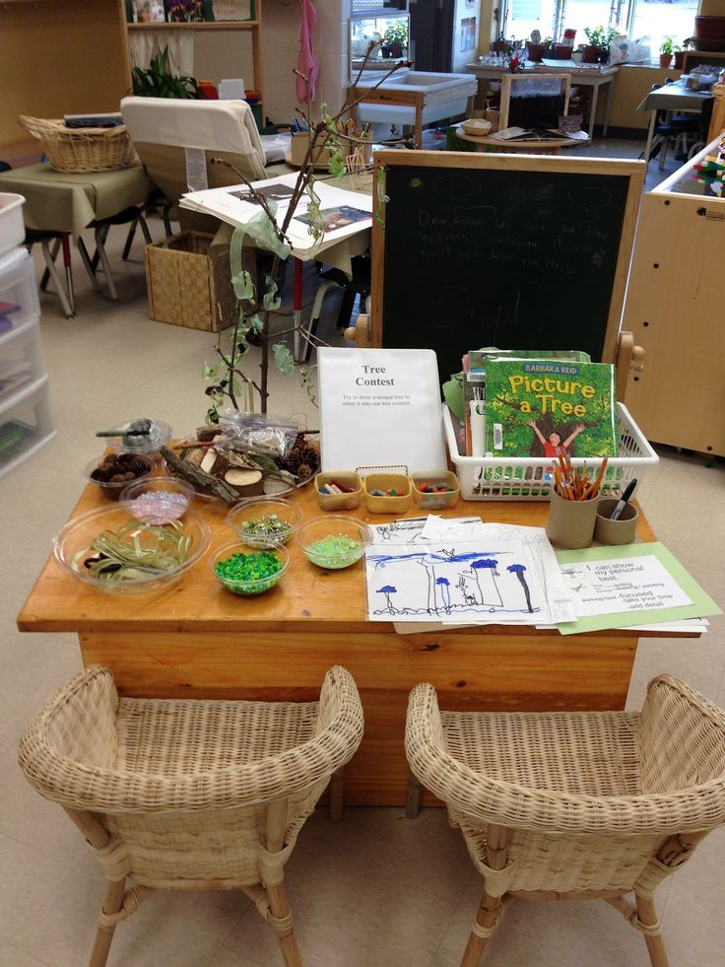
Photo Gallery of Learning Spaces
Ages 3 - 5

Slide 26
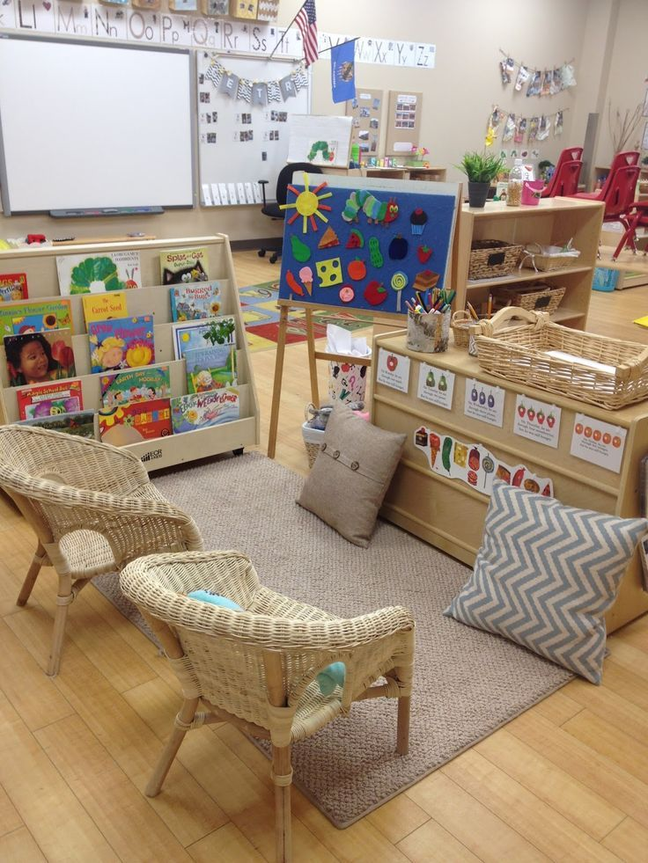
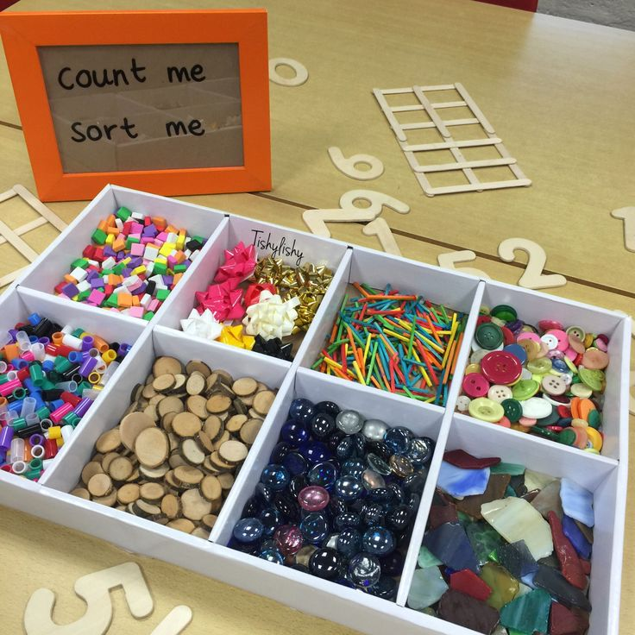
Photo Gallery of Learning Spaces
Ages 3 - 5

Slide 27
Practice Activity 1: “Thinking About Learning Spaces”
For this Practice Activity, you will examine the learning spaces you currently have in place in your classroom.
Spend some time really thinking about the purpose and the materials included in the learning spaces.
Complete the “Thinking About Learning Spaces” chart included in the Learner Guide and describe opportunities children have to:
Listen and respond to stories
Interact, speak, and share with others
Explore and investigate
Imagine and create
Think and problem-solve

Slide 28
Reflection on the “Thinking About Learning Spaces” Activity
After completing the “Thinking About Learning Spaces” activity, briefly reflect on these questions:
What changes are you considering making?
How would the changes increase opportunities for children to listen, speak, interact, imagine, create, think, and/or problem-solve?
How might children respond to the changes made?
Include your responses in the Learner Guide.

Slide 29
End of Section 1
Congratulations, you just completed Section 1 of Module 4.
Be sure you have completed Section 1 activities in the Learning Guide.
When ready, move on to the presentation for Section 2.

