Slide 1
Module 6
Interactive Read Alouds
Early Literacy Matters
8-1-2017 launch

Slide 2

Module 6 at a glance
In Module 5, you learned the importance of modeling writing, preparing for writing along the way, and creating opportunities for children to write.
In this module, you will:
Discover why choosing the right text matters for read alouds.
Explore the rich ways interactive read alouds enhance children’s language development and their interest in books.
Examine the different ways children can engage with literature and
informational text.

Slide 3
Learner Outcomes:
LO1: Learners will describe why reading aloud and selecting the right book sets matter.
LO2: Learners will explore the ways interactive read alouds can support language development and learning for children birth to five.
LO3: Learners will build a unit of study including a text set and listening, speaking, reading, and writing opportunities to engage children with text and to help build knowledge around a big idea concept.

Slide 4
This module aligns to the current Read to be Ready Campaign’s following key
beliefs:
Early Literacy Matters: early language and literacy development must begin at birth because of its direct impact on later success in reading and in life.
Reading is more than sounding out words: reading is thinking deeply
about a texts meaning and how it builds knowledge of the world around us.
Teacher knowledge and practice are critical: educators must have a deep understanding of the art and science of literacy instruction in order to develop lifelong learners.
It takes a community: we each hold a piece of the puzzle, and we must do our part to improve literacy in Tennessee.
Video link to “Early Literacy Matters” from Read to be Ready Website: https://www.youtube.com/watch?v=60J8qRjRPkE

Slide 5

Overview: Module 6 will consist of 3 instructional presentations. These
presentations will help you reflect on Read Alouds.
In Presentation 1, you will learn more about choosing the right literature text to read to children for optimal language and literacy development.
In Presentation 2, you will focus on read-aloud strategies and supports
for informational texts.
In Presentation 3, you will examine the steps for building units of study and how to use a read aloud to introduce children to the unit of study.
Following each presentation, you will have the opportunity to apply your learning through Application Activities included in the Learning Guide.

Slide 6

Modules contain 4 short presentations that are designed to be completed during relaxed ratios or other times as set by your school or agency. Your director or program coordinator may suggest or establish a timeline for each presentation to be completed within the module. Please take a moment to confirm your site’s requirements while noting the submission deadline for the final Learning Application Assignment that you will submit electronically to your literacy coach for feedback and support. All other completed activities will remain in your participation guide and available for your coaches review.
Section 1: Start at beginning of module and complete Presentation 1 and
Practice Activity 1.
Section 2: Complete Presentation 2 and Practice Activity 2.
Section 3: Complete Presentation 3 and Practice Activity 3.
Section 4: Complete Learning Application Assignment for Module 6 and submit it electronically to your literacy coach for feedback and support.

Slide 7
Before we dive into our Module 6 Presentations, let’s start by having you look again through the books you received in your Early Literacy Matters start-up bag. This time, you are looking for books to read aloud to children which contain rich vocabulary words and new concepts to build children’s knowledge around.
After looking through the book set, select one book that you think would be a good choice to read aloud to your children. Read the story aloud to yourself and briefly respond to these questions in the Learning Guide:
Which book did you select?
Why would this book be a fit for a read aloud?
How does the text inspire lively questions and observations?
What new words and concepts children would be introduced to?
How would you introduce children to new words and concepts when reading the book aloud?

Slide 8
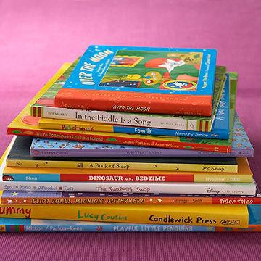
Mark Twain was quoted saying, “The man who does not read good books has no advantage over the man who can’t read books.”
This quote aligns with the work of TDOE Read to be Ready initiative aimed at “Building Thinkers” and helping kids to know truth for themselves, to be strong thinkers, and to be able to synthesize and analyze information read about.

Slide 9

Presentation 1:
Reading Aloud to Children Early and Often
The Read to be Ready initiative also
advocates that:
Children should spend a large portion of their day engaged in listening to, reading, thinking, talking, and writing about texts.
The amount of time children spend reading and listening to text is a major contributor to improvement in students’ vocabulary and comprehension.
Children must develop skills- based and knowledge-based competencies at the same time.

Slide 10
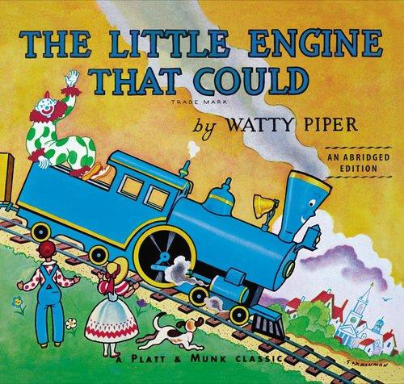
Before we dive further into our Module 6 Presentations, let’s start by viewing a read aloud story.
Click on the links to enjoy a read aloud of the book, The Little Engine That Could by Watty Piper read by Darlene Abernathy-Neely.
Part 1: https://youtu.be/3MY2fS-v2Hc
Part 2: https://youtu.be/P1wQ66HdXN0
Part 3: https://youtu.be/z0fPQke85IQ
Part 4: https://youtu.be/VSSkjgpp55A
Part 5: https://youtu.be/126AhrCC9Rs
After listening to the story read, briefly describe in the Learning Guide:
Why reading to children is important.
Why reading aloud matters.
How did the teacher engage the children with the text?
What concept was the teacher emphasizing with the text reading?
10

Slide 11


As seen in the video clip, the adult plays a critical role
in fostering children’s response to the book by:
Choosing the right book
Being responsive during an interaction
Intentional planning read-aloud sessions
Let’s look at each of these strategies more closely so you can reflect and on how you can use them to encourage your children’s responses when reading to them.

Slide 12
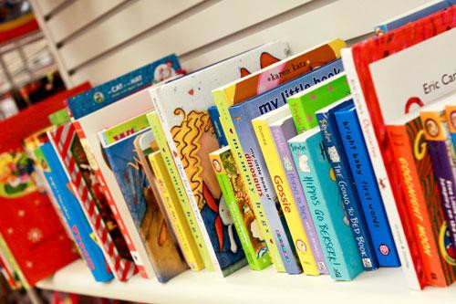
When choosing the right type of books to read aloud to children, be sure books selected are:
two grade levels or ages above the child’s actual age. (Keep in mind that children comprehend more than they are able to verbally express).
balanced between literature and information books— books that are imaginary or story-like as well as books that provide factual information on a topic. For infants and toddlers, these also include but should not be limited to concept books to teach names of shapes, family members, body parts, animals, and such.

Slide 13

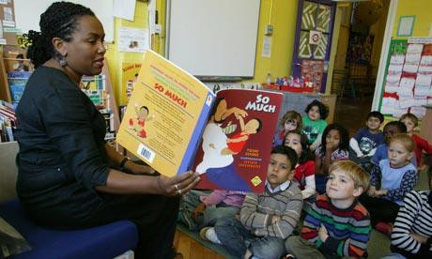
Using voice and body (vary voice levels…add sound effects, use body to add expression, encourage children to mimic your voice and motions.)
Proximity matters: Can all children see the book? Are they in reach to interact with the pages? Are you sitting a their eye level?
Read aloud in smaller groups to decrease wait time for responding to text and increasing level of engagement.
Plan ahead for parts of the book you will engage children in.

Slide 14

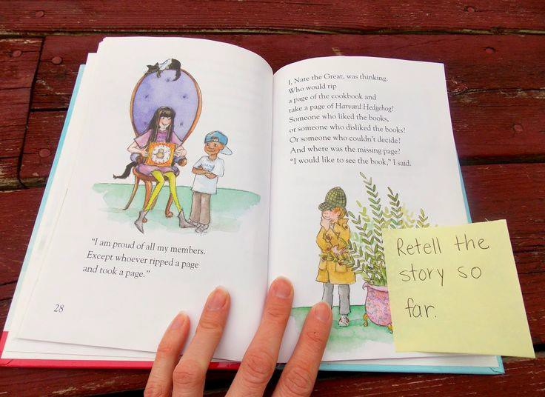
Plan ahead about places in the book you would encourage children to interact and respond. Mark it with a sticky note to remind you.
What concepts or new words do you plan to emphasize in the reading?
How might you connect the book to children’s personal experiences or interests?
For the literature book you selected, what type of informational book might you read aloud next to encourage more learning on the topic?

Slide 15
Click on the appropriate video link for the age you work with and watch a video of a Literature Read-Aloud and respond to the questions that follow the listed links:
  Infant Read Aloud Link: https://www.bing.com/videos/search?q=READING+TO+BABY&&view=detail&mid= 50CA4566F7F5C8A8361C50CA4566F7F5C8A8361C&&FORM=VRDGAR
  Toddler Read Aloud Link: https://www.bing.com/videos/search?q=reading+aloud+to+your+2+year+old&&vi
ew=detail&mid=3FE2D8D22FA76E3F6FA63FE2D8D22FA76E3F6FA6&&FORM=VRDGA
R
  Preschooler Read Aloud Link:
https://www.bing.com/videos/search?q=interactive+read+aloud+preschool&&vie w=detail&mid=018F5E6EA09E6299F7C1018F5E6EA09E6299F7C1&&FORM=VRDGAR
As you watch the video consider:
  Was the selected book appropriate for engaging children of this age with text?
  How did the teacher encourage responsiveness or interaction?
  How was the teacher intentional in her interactions? Were these planned interactions?
  What skills were being supported?

Slide 16
For this practice activity, you will intentionally plan and conduct a literature read aloud with one of the books provided in your Early Literacy Matters book bag at the beginning of this literacy pilot.
Record your plans on the Literature Read Aloud Planning Sheet included in the Learner Guide as well as your reflections on how the read aloud activity went.

Slide 17

After completing the Literature Read Aloud Planning Sheet and carrying out the read aloud, briefly reflect on these questions:
How did planning ahead help you think about places in the book you would encourage children to interact and respond?
How did the child(ren) respond to the places you selected in the
book to encourage interactions?
Were there any concepts or new words you emphasized in the reading?
For the literature book you selected, what type of informational book might you read aloud next to encourage more learning on the topic?
Include your responses in your Learner Guide.

