Slide 1
Module 6
Interactive Read Alouds
Early Literacy Matters
8-1-2017 launch

Slide 2

Module 6 at a glance
In Module 5, you learned the importance of modeling writing, preparing for writing along the way, and creating opportunities for children to write.
In this module, you will:
Discover why choosing the right text matters for read alouds.
Explore the rich ways interactive read alouds enhance children’s language development and their interest in books.
Examine the different ways children can engage with literature and
informational text.

Slide 3
Learner Outcomes:
LO1: Learners will describe why reading aloud and selecting the right book sets matter.
LO2: Learners will explore the ways interactive read alouds can support language development and learning for children birth to five.
LO3: Learners will build a unit of study including a text set and listening, speaking, reading, and writing opportunities to engage children with text and to help build knowledge around a big idea concept.

Slide 4
This module aligns to the current Read to be Ready Campaign’s following key
beliefs:
Early Literacy Matters: early language and literacy development must begin at birth because of its direct impact on later success in reading and in life.
Reading is more than sounding out words: reading is thinking deeply
about a texts meaning and how it builds knowledge of the world around us.
Teacher knowledge and practice are critical: educators must have a deep understanding of the art and science of literacy instruction in order to develop lifelong learners.
It takes a community: we each hold a piece of the puzzle, and we must do our part to improve literacy in Tennessee.
Video link to “Early Literacy Matters” from Read to be Ready Website: https://www.youtube.com/watch?v=60J8qRjRPkE

Slide 5

Overview: Module 6 will consist of 3 instructional presentations. These
presentations will help you reflect on Read Alouds.
In Presentation 1, you will learn more about choosing the right literature text to read to children for optimal language and literacy development.
In Presentation 2, you will focus on read-aloud strategies and supports
for informational texts.
In Presentation 3, you will examine the steps for building units of study and how to use a read aloud to introduce children to the unit of study.
Following each presentation, you will have the opportunity to apply your learning through Application Activities included in the Learning Guide.

Slide 6

Modules contain 4 short presentations that are designed to be completed during relaxed ratios or other times as set by your school or agency. Your director or program coordinator may suggest or establish a timeline for each presentation to be completed within the module. Please take a moment to confirm your site’s requirements while noting the submission deadline for the final Learning Application Assignment that you will submit electronically to your literacy coach for feedback and support. All other completed activities will remain in your participation guide and available for your coaches review.
Section 1: Start at beginning of module and complete Presentation 1 and
Practice Activity 1.
Section 2: Complete Presentation 2 and Practice Activity 2.
Section 3: Complete Presentation 3 and Practice Activity 3.
Section 4: Complete Learning Application Assignment for Module 6 and submit it electronically to your literacy coach for feedback and support.

Slide 7


In this presentation, we will discuss the difference between literature and informational books, and why it’s important to read both kinds of books with children birth to five.
More specifically, you will explore:
Benefits of informational text read alouds
Challenges of informational
text read alouds
Criteria for choosing text (book)
Strategy for introducing the
text (book)

Slide 8

Informational books help children grow as thinkers as they build knowledge and make deeper connections to the world around them.
Information can be presented in “chunks” to allow children to think about and apply the new knowledge presented.
Informational books can be strategically selected and read in a particular order to continually build knowledge and deepen understandings.

Slide 9

“Reading aloud opens the door to learning, giving children a special kind of access to the power of story and the experience of what reading is all about. Asking questions during read alouds fosters opportunities for children to discuss big ideas about themselves, the lives of others, and their world. Asking questions during read alouds provides a chance to connect
and talk together in a meaningful
way. Children not only fall in love with books and reading but also learn to think deeply, consider other points of view, and listen” (Strasser & Bresson, 2017, p. 57).

Slide 10
Some typical challenges teachers and teacher assistants face when reading aloud informational books to young children are:
Keeping children interested and engaged due because of a large amount of text compared to little to no pictures.
Reading the book in its entirety takes too long and has too much information for children to grasp at once.
Trusting children to care for books during independent
exploration.
To meet these challenges, it’s important to choose the right book and plan ahead on what part of the book will be read aloud and emphasized.
10

Slide 11
Select books with appropriate topics that align to child’s interests and to developmental standards.
TN ELDS Developmental Standards:
https://www.tn.gov/content/dam/tn/education/standards/tnelds/std_t nelds_birth-4yo.pdf
Consider the size of the book (amount of text) and how
information is presented. Realistic pictures are preferred.
Remember, you do not “read” every word on the page or the book from cover to cover during an informational read aloud.
Plan ahead to decide which part of the book will be read to increase the child’s knowledge about the topic. Make some photo cards to supplement the reading section (picture vocabulary cards) to allow the child to hold and interact with.

Slide 12
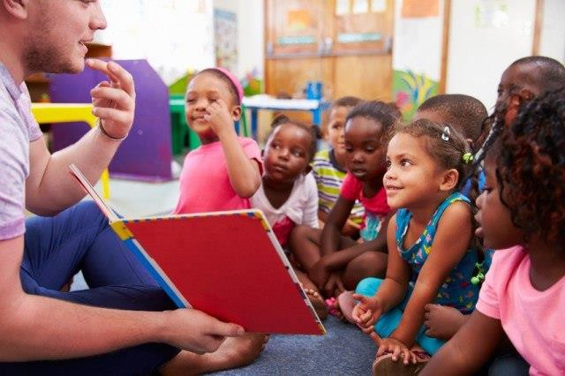
Invite child(ren) to come to “read” the book with you.
Build interest by talking about the book cover, connecting the book to other books read on topic, and predicting what the story might be about.
Take a “picture walk” through the book to preview the story.
Help children identify story
structures:
  Setting (when and where the story takes place)
  Characters (who the story is about)
  Theme (what the story is about)
  Plot (what happens during the story)
  Resolution (how the story ends)

Slide 13
“Reading the same story over multiple days supports moving from lower- to higher-level thinking” (Strasser & Bresson, 2017, p. 58).
The second reading of the book could be a picture walk allowing children to retell the story through pictures. Focus questions asked on details found in pictures.
During additional readings, you can select a couple of pages to spend more time discussing.
Avoid asking all questions in one read-aloud session as it breaks the flow of the story and children become disengaged.

Slide 14
Click on the appropriate video link for the age you work with and watch a video of an Informational Read-Aloud and respond to the questions that follow the listed links:
  Infant Read Aloud Link:
https://www.youtube.com/watch?v=ekeLgFPooaQ
  Toddler Read Aloud Link: https://www.bing.com/videos/search?q=Reading+about+things+that+go&&view=detail
&mid=CB93E0C3672EEE259849CB93E0C3672EEE259849&&FORM=VRDGAR
  Preschooler Read Aloud Link:
https://www.bing.com/videos/search?q=video+reading+informational+text+with+presc hoolers&&view=detail&mid=205198C34DDE2CF9C92F205198C34DDE2CF9C92F&&FORM= VRDGAR
As you watch the video consider:
  Was the selected book appropriate for engaging children of this age with text?
  How did the teacher encourage responsiveness or interaction?
  How was the teacher intentional in her interactions? Were these planned interactions?
  What skills were being supported?

Slide 15
For this practice activity, you will intentionally plan an informational read aloud of your choosing that relates in some way to the literature read aloud book you selected to read for Practice Activity 1.
Record your plans on the Informational Read Aloud Planning Sheet included in the Learner Guide.

Slide 16

After completing the Informational Read-Aloud Planning Sheet and carrying out the read aloud, briefly reflect on these questions:
How did planning ahead help you think about what section of the book you would read?
What places in the text read did you plan to encourage children to interact and respond?
How did the child(ren) respond to the places in the text section
read?
Did you create any supplemental materials such as picture cards for children to interact with?
For the informational book you selected, what type of literature book might you read aloud next to encourage more learning on the topic?
Include your responses in your Learner Guide.

