Slide 1
State of Tennessee
Regional Water Supply Planning
Pilot Studies
07 February 2011
Benjamin L. Rohrbach, P.E.
Chief, Hydrology and Hydraulics
U.S. Army Corps of Engineers
Nashville District

Slide 2
Project Overview
Two Pilot Areas - Drought of 2007
  North Central Tennessee
  South Cumberland Plateau
Source Water Development Focused
Stakeholders and Communities Involved
  5 Pilot Area Specific Meetings to Date
Robust Planning Team
  State, Federal, NGO, Academia

Slide 3










Regional Planning Partners
Tennessee Advisory Commission on
Intergovernmental Relations
Tennessee Association
of Utility Districts
Notes:
COE – General contractor
USGS – water demand projections / technical subgroup lead
TACIR – Population and financial assessments / Lead on the reports for the two pilot areas
TNC – natural resources expertise
3

Slide 4
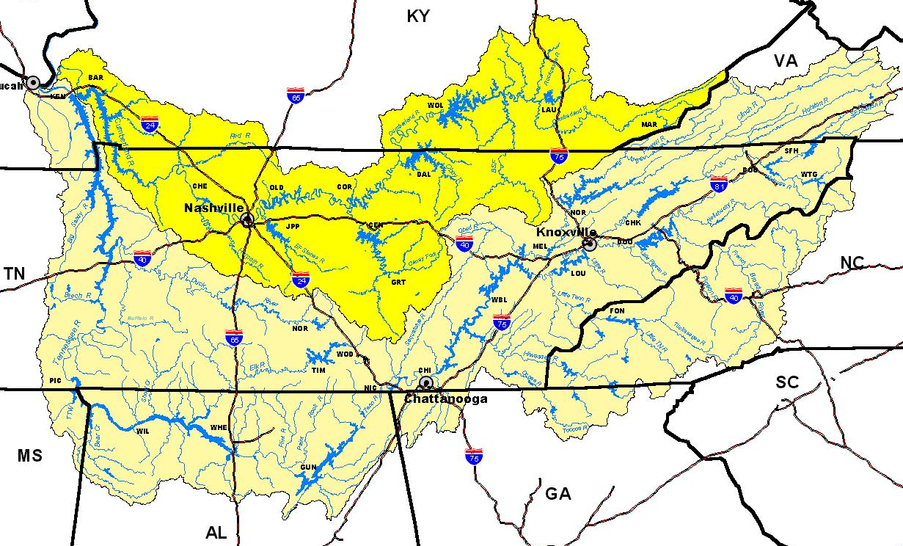
Pilot Areas
Portland North Central TN
South Cumberland Plateau TN

Slide 5
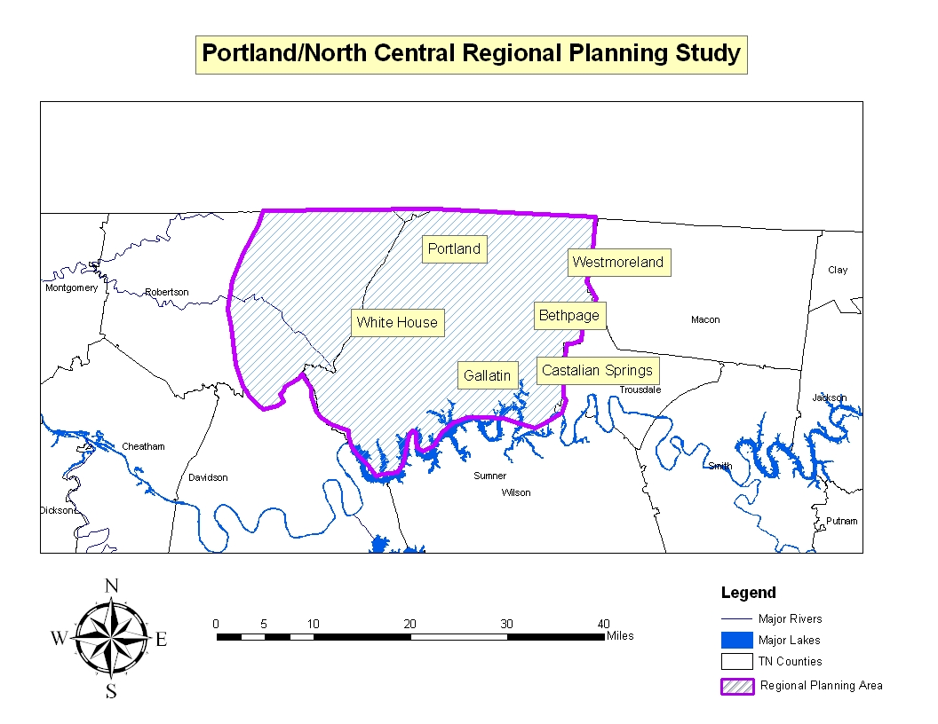
Pilot Areas

Slide 6
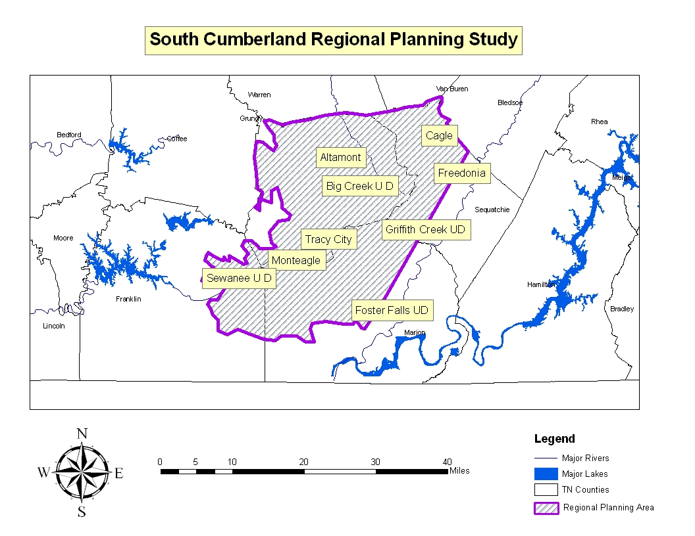
Pilot Areas

Slide 7
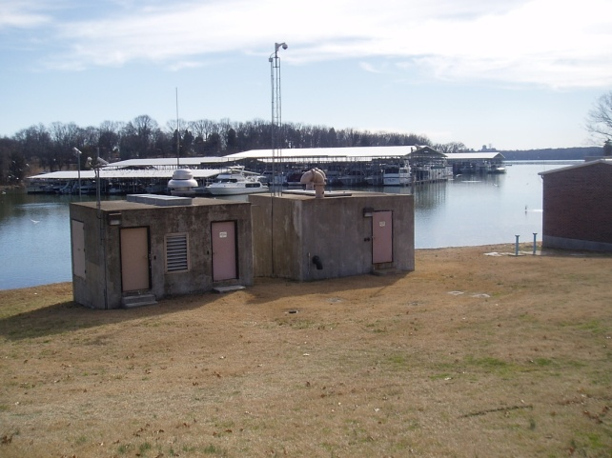
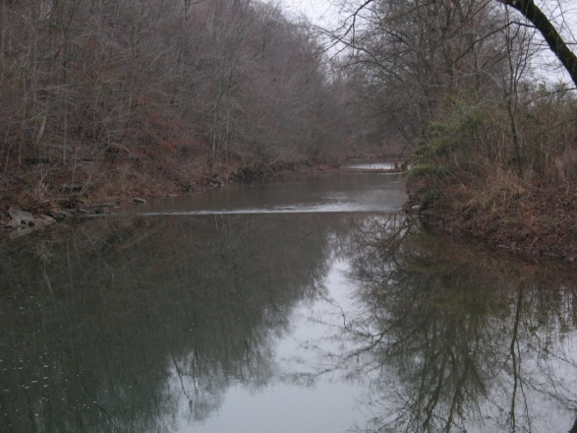
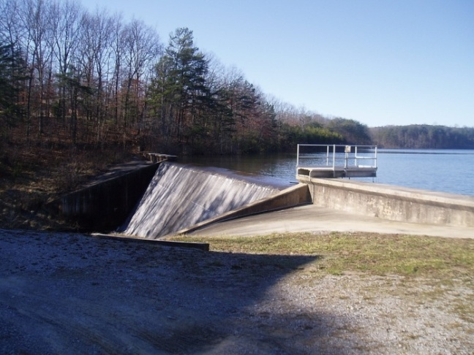
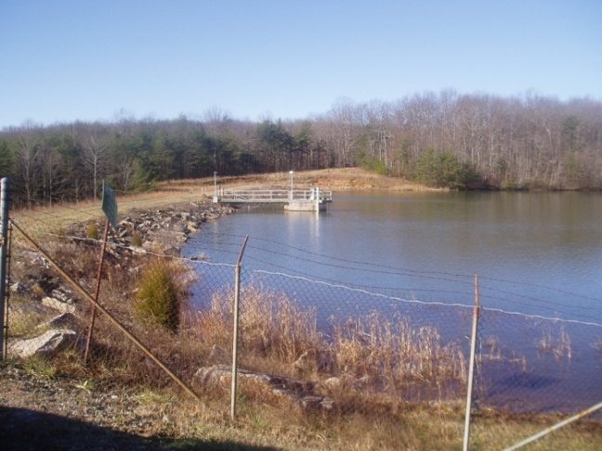
Regional Water Supply Planning
Sustainably match water sources with current & future needs
Regional approach and multi-utility focus
Collaborative effort
Model for statewide regional resource planning
White House
Portland
Big Creek
Monteagle

Slide 8
Project Review
Study Area Description
Existing Water Source Yields
Water Demand Projections
Study Area Needs – Need Statements
Alternatives and Evaluations
Alternative Screening Protocol
  Tier 1 Results
  Tier 2 Protocol

Slide 9
Pilot Area Need Statements
North Central
  Principle water source is Old Hickory Lake
    Provides 90% of study area existing demand
  Portland
    Existing small sources not sufficient
    Purchases finished water as needed
    No formal contracts: security is not provided
  Pilot area demand projected to increase from 21 MGD to 30 MGD by 2030
    Sufficient raw water in Cumberland system

Slide 10
Pilot Area Need Statements
South Cumberland Plateau
  Raw water supply strained in 2007
    Monteagle managed drought by purchasing from adjacent utilities and establishing temporary sources
  Utility interconnections well established
    Paramount to region’s ability to manage drought
  Pilot area demand projected to increase from 2.1 MGD to 2.2 MGD by 2030
    Composite yield of existing sources barely sufficient
    Indicate need for source development

Slide 11
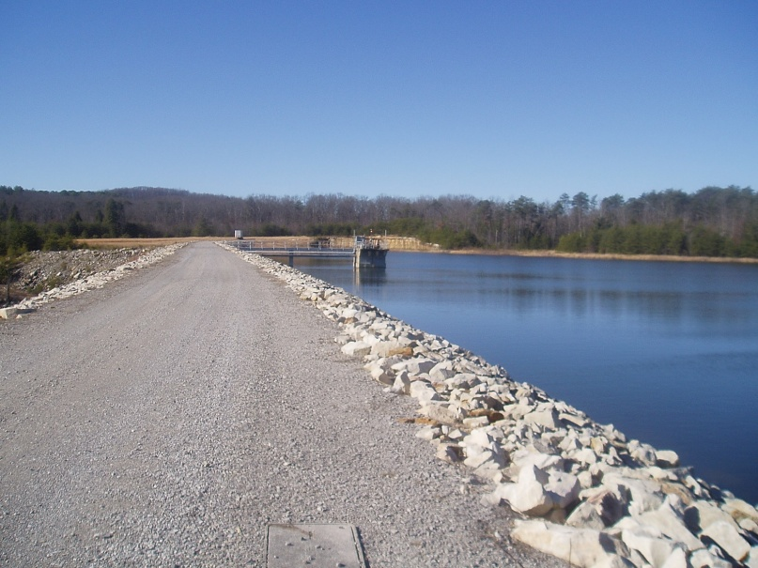
Water Source Alternatives
  North Central
    Interconnection – White House to Portland
    Caney Fork Creek Dam – New Reservoir
    Groundwater – Wells
    Pipeline – Cumberland River
  South Cumberland
    Interconnections - Regional
    Big Creek Dam – New Reservoir
    Ramsey Lake – Purchase Existing Lake
    Big Fiery Gizzard – Raise Existing Dam
    Pipeline – Tennessee River
Big Fiery Gizzard Dam

Slide 12
Alternative Screening Protocol
    Tier 1:
      Reliable Capacity
        Need met with minimal risk
      Project Cost
        Feasibility, Design, Construction, Operation and Maintenance
      Implementability
        Permitting, Public Acceptance, Property Acquisitions, Constructability
      Flexibility
        Phased Implementation, Drought Resistance
    Principle factor in Tier 1 evaluations is Reliable Capacity

Slide 13
Alternative Screening Protocol
    Tier 2:
      Storage Remaining (South Cumberland)
        Drought Resistance
      Cost
      Water Quality
        Raw and Finished
      Environmental
        Benefits and Impacts
      Other Factors
    Principle factor in Tier 2 evaluations is Cost

Slide 14
Tier 2 Screening Results
North Central
* Does not include rate that would be charged by WHUD, which must be negotiated
Alternative | Cost (in millions) | Finished Water Quality | Environmental Benefits or Impacts | Other Factors
Interconnection – WHUD to Portland | $4.5* | Potential Improvement | Slight impacts from infrastructure construction | Requires Cooperation Between Entities
Caney Fork Creek Reservoir | $13.2 | No Change | Substantial alteration of aquatic resources | Conflicts with Clean Water Act Compliance
Portland Raw Water Pipeline to Cumberland River | $13.0 | No Change | Slight impacts from pipeline construction | Treatment plant operations

Slide 15
Tier 2 Screening Results
South Cumberland Plateau
  (1) Above 20% Reserve Storage
  (2) Relies on Tennessee River; highly drought resistant
  (3) Includes a range of potential routing options, real estate costs, and costs to improve spillway
Alternative | Storage Remaining ¹ (million gallons) | Cost (millions) | Water Quality | Environmental Benefits or Impacts | Other Factors
Raise Big Fiery Gizzard Dam w/Modified Release Schedule | 5.4 | $3.9 | No Change | Release study required | Study could increase existing release requirements
Ramsey Lake | 70.4 | $10 to $15 ³ | Additional treatment may be needed | Release study required | Dam safety classification will change
Phase I South Pittsburg Finished Water Pipeline | N/A ² | $22 | Long transmission could cause problems | None known | High energy use/costs could increase cost to consumers more than other alternatives

Slide 16
Recommended Alternatives
North Central – Interconnection from WHUD to Portland
  Cheapest and most economically feasible alternative
  Potential for phased implementation
  Can be expanded to meet needs beyond 2030

Slide 17
Recommended Alternatives
South Cumberland – Raising Big Fiery Gizzard Dam and Reservoir with Modification of Downstream Releases
  Provides adequate supply for region through 2030
  Least expensive alternative by significant margin
  Can be accomplished relatively quickly
  Additional studies required to determine downstream flow requirements
    Balance ecological needs with water supply requirements

Slide 18
Next Steps for Implementation
North Central
  Regional Conservation and Demand Management Efforts
  Drought Management
    Formal coordination plans between utilities in the region
    OASIS Statewide License
  Community Engagement
  Engineering Studies
    Water purchase frequency
    Implementation phasing
    Refined Cost Estimates

Slide 19
Next Steps for Implementation
North Central
  Rate Studies
  Water Purchase Contract
    Model after Simpson Co., KY?
  Project Financing Options
    USDA
    USACE
    DWSRF Watershed Enhancement
    Pay-as-you-go

Slide 20
Next Steps for Implementation
South Cumberland Plateau
  Regional Conservation and Demand Management Efforts
  Drought Management
    Formal coordination plans between utilities in the region
    OASIS Statewide License
  Community Engagement
  Commitment to Regional Approach
    Inter-local Cooperation – T.C.A., Title 12, Chapter 9
  Engineering Studies
    Modified Release Schedule
    Interconnections - Distribution
    Refine Cost Estimates

Slide 21
Next Steps for Implementation
South Cumberland Plateau
  Permitting
  Rate Studies
  Project Financing Options
    Pay-as-you-go Joint Financing
    USDA Rural Development
    USACE
    ECD CDBG

Slide 22
Questions??

