Slide 1
Airport Emergency Plans
(AEPs)

Slide 2
Purpose of This Course
The purpose of this course is to help airport managers/sponsors learn:
  What is an AEP?
  Who is involved in an AEP
  Why every airport needs an AEP
  How to develop an AEP

Slide 3
Introduction
“Airports differ in complexity, but each has unique features. Some are small, uncomplicated facilities serving a more rural environment, while others represent a good-sized community complete with residential, industrial, and commercial installations serving major metropolitan areas. Airports are operated by the local government such as a city or county; or by an Authority representing multiple local governments; and some are operated by the State. However, one thing they all have in common is that they are all subject to emergencies and incidents.”
  FAA AC 150/5200-31C

Slide 4
Introduction
General aviation (GA) airports are typically found in smaller communities and have limited resources for staff, equipment, supplies, mutual aid resources, and training. Acknowledging this and compensating for it in emergency preparedness planning is imperative for providing essential services.
Ultimately, it is the owner’s responsibility to ensure that an airport is safe and well managed. Since most GA airports are publicly owned, that responsibility typically falls on the city, county, or airport authority. Generally, a full-time manager, contracted person, or public official with part-time airport management duties oversees the airport’s daily operations. It is this person’s job to prepare and use an emergency preparedness plan that ensures all involved parties are aware of their role in the plan. An annual assessment of the facilities and plan should identify limited resources so that a strategy can be implemented to meet as many shortfalls as possible.

Slide 5
What is an Airport Emergency?
An airport emergency is any occasion or instance, natural or man-made that warrants action to save lives and protects property and public health.
An airport incident can occur anywhere, at any time - day or night, under any weather condition, and in varying degrees of magnitude; it can occur instantaneously or develop slowly; it can last only a few minutes or go on for days. It can be natural, such as a hurricane or earthquake, or it can be “man-made”, such as a hazardous materials spill, civil unrest, terrorism, major fire, or power outage. Moreover, emergencies of the same type can differ widely in severity, depending on factors such as degree of warning, duration, and scope of impact. The important thing to remember is that, while emergencies can seldom be exactly predicted, they can be anticipated and prepared for.

Slide 6
Incident or Accidents?
Accident
  An occurrence associated with the operation of an aircraft that:
    Results in death or serious injury
    Causes substantial damage to the aircraft
Incident
  an occurrence – other than an accident (no intention of flight) – associated with the operation of an aircraft that affects or could affect the safety of operations.
Why know the difference?
  Level of severity (High or Low Impact)
  An emergency plan can help your workers know how to respond to either of these situations

Slide 7
What is an Airport Emergency Plan?
“An airport emergency plan (AEP) is meant to support airports in defining roles and responsibilities of stakeholders during emergencies, identifying specific threats that could affect airports, and establishing communication protocols for the airport community.”
Airport emergency planning (AEP) is the process of preparing an airport to cope with an emergency occurring at the airport or in its vicinity. The object of airport emergency planning is to minimize the effects of an emergency. Particularly in respect of saving lives and maintaining aircraft operations.

Slide 8

Building Blocks to AEPs

Slide 9
Components
Because an AEP must address many types of emergencies, it may be helpful to develop a basic plan that also covers the functions common to most emergency situations. This process involves conducting a careful airport hazard analysis that identifies all the common tasks that must be performed; assigning responsibility for accomplishing each function; and preparing standard operating procedures and checklists.
FAA AC 150/5200-31C lists the components in this functional approach as:
  A. Basic Plan
  B. Functional Areas
  C. Hazard-Specific Sections
  D. Standard Operating Procedures (SOPs) and Checklists

Slide 10
Basic Plan
The basic plan provides an overview of the airport’s approach to emergency operations. It includes a general introduction section and addresses the organizations tasked within the plan and their basic roles and responsibilities. The sections of the plan and what they include are:
  Introduction
  Situation and Assumptions
  Organization and Assignment of Responsibility
  Administrative Review

Slide 11
Basic Plan : Introduction
Revision date.
Table of contents.
Name of the legal authority for emergency operations and of who has approved the plan.
Name of the emergency coordinator, such as the airport manager or emergency management officer, responsible for administration of the plan and review processes.

Slide 12
Basic Plan : Situation and Assumptions
List of characteristics of the airport considered during preparation of the AEP and the airport hazard analysis.
Discussion of the airport structure and factors that may affect response activities.

Slide 13
Basic Plan : Organization and assignment of responsibility
List of each agency tasked within the AEP, by position and organizational responsibilities as well as tasks to be performed. Examples of individuals and agencies include:
  Airport manager
  Fire department
  Police department
  Health and medical services
  Communications officer
  Public information officer
  Air traffic control
  Airport maintenance
  Airport tenants
  Mutual aid agencies
List of basic responsibilities in this section, including more detailed information to be found in functional areas and hazard-specific tabs.

Slide 14
Components: Functional Areas
FAA AC 150/5200-31C lists the components in this functional approach as:
  A. Basic Plan
  B. Functional Areas
  C. Hazard-Specific Sections
  D. Standard Operating Procedures (SOPs) and Checklists

Slide 15
Functional Areas
Functional areas are tasks and core responsibilities that may be applied to all airport emergencies. Detailed information particular to a specific emergency can be found in the standard operating procedures for hazard-specific areas, and FAA AC 150/5200-31C describes functional sections. Typical functional areas and their corresponding tasks are:
  Command and Control
  Communication
  Alert Notification and Warning
  Emergency Public Information
  Protective Actions
  Law Enforcement/Security
  Firefighting and Rescue
  Health and Medical
  Resource Management
  Airport Operations and Maintenance

Slide 16
Components: Hazard-Specific Sections
FAA AC 150/5200-31C lists the components in this functional approach as:
  A. Basic Plan
  B. Functional Areas
  C. Hazard-Specific Sections
  D. Standard Operating Procedures (SOPs) and Checklists

Slide 17
Hazard-Specific Sections
The hazard-specific section provides additional information regarding the response to a particular hazard or emergency situation. This detailed information is typically stand-alone and should be easily located within the AEP for quick reference. It may be helpful to provide tabs to quickly identify hazard-specific sections. In the AEP, hazard-specific emergencies include but are not limited to:
  Aircraft Accidents/Incidents
  Landside Emergencies
  Natural Disasters
  Fires Electrical Power Failures
  Hazardous Materials
  Wildlife Management
  Security/Criminal Activities

Slide 18
Components: Standard Operating Procedures (SOPs) and Checklists
FAA AC 150/5200-31C lists the components in this functional approach as:
  A. Basic Plan
  B. Functional Areas
  C. Hazard-Specific Sections
  D. Standard Operating Procedures (SOPs) and Checklists

Slide 19
Standard Operating Procedures (SOPs) and Checklists
Standard operating procedures (SOPs) and checklists provide detailed instructions that individuals or organizations tasked within the AEP may use to ensure all assigned responsibilities are being performed. They should be easily located within the AEP and should allow the user to provide detailed information useful later for insurance or investigation purposes, if needed.

Slide 20
Airport Emergency Plan Development Tools

Slide 21
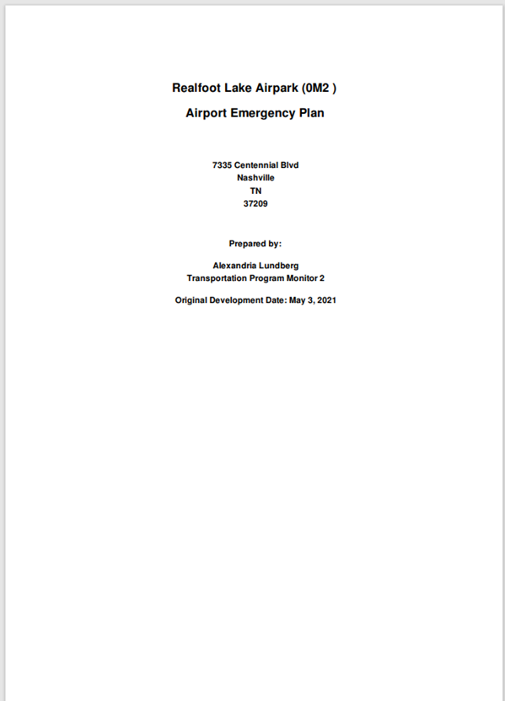
Overview
The online Airport Emergency Plan (AEP) Development Tool produces airport-specific AEPs in a format consistent with the Federal Aviation Administration’s Advisory Circular 150/5200-31C titled, Airport Emergency Plan (AEP).
The tool provides a user-friendly, sequential, and interactive format to create the plan, and includes introductory videos and question-specific help to enable accurate responses.
The tool was developed under ACRP Projects 04-19 and 04-19A.

Slide 22
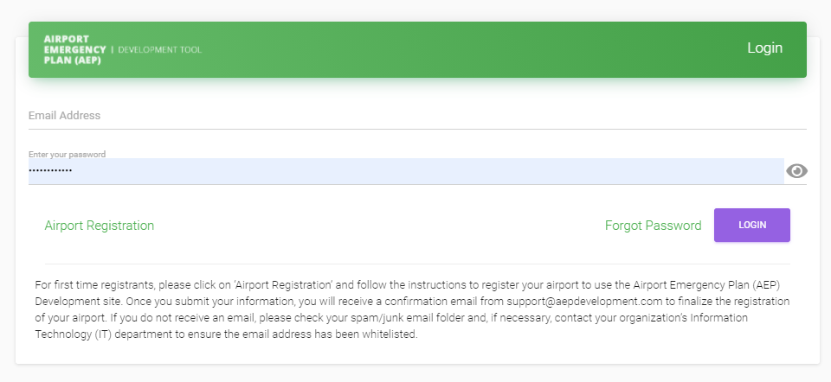
AEP Development Tool
To use the development tool to create your AEP, click on the link provided and create a log in to access the tool
Once an airport has created a log in, you will be taken to this login page to access your AEP Development page
This website is free for all to use
Airport Emergency Plan | Login (aepdevelopment.com)

Slide 23
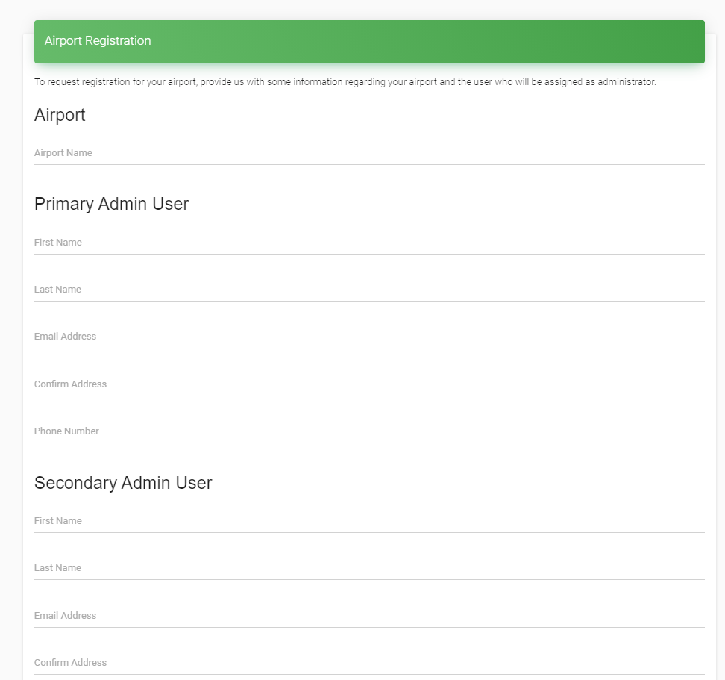
Tips and Tools
User must make a log in for their airport with a primary and secondary user.
Once you submit your information, you will receive a confirmation email from support@aepdevelopment.com to finalize the registration of your airport.
If you do not receive an email, please check your spam/junk email folder

Slide 24
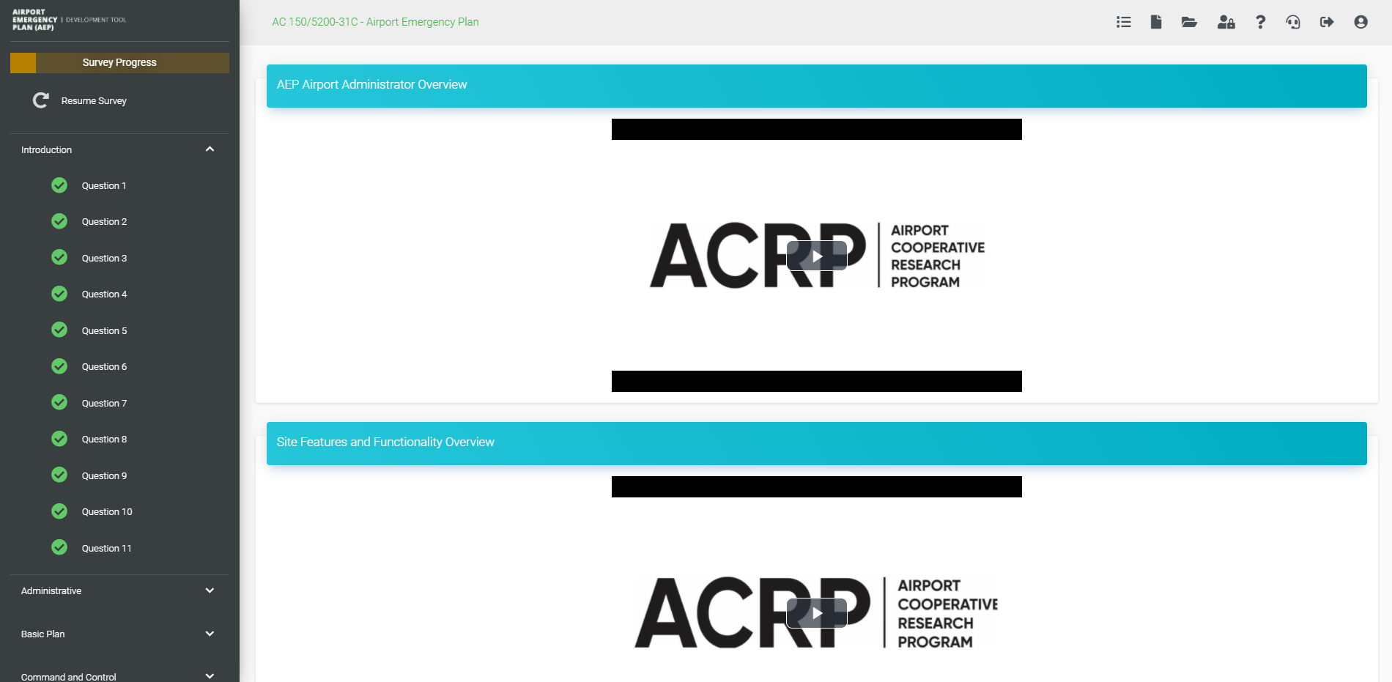
AEP Development Tool
Once logged in this is the home screen one will see. On the left-hand side is the topics and what questions have been completed, at the top is your navigation panel.
Direction Icons
Survey Progress and resume survey
Question bank, green = answered
yellow = unanswered

Slide 25








Direction Icons
Resume Survey
Preview
Plans
Admin Dashboard
Training Videos
Technical Support
Log Out
My Account
* Found in the upper right-hand corner of window *

Slide 26
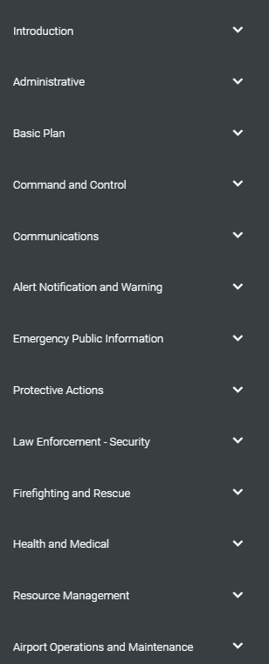
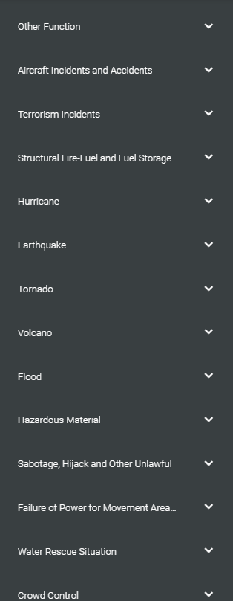
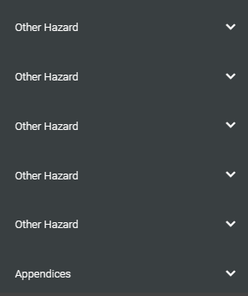
AEP Development Tool
Topics that are covered within the AEP Development tool.

Slide 27
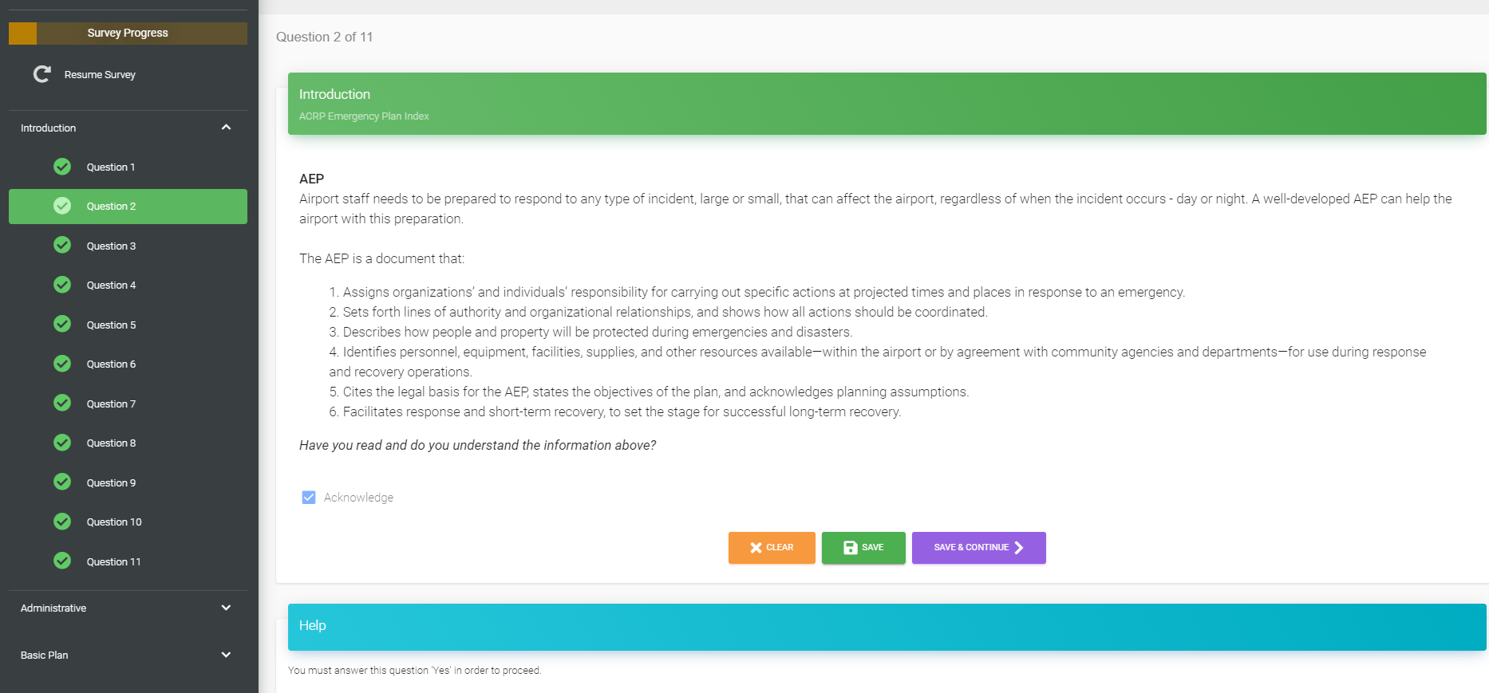
Airport Emergency Plan Development (Survey)
Once you begin, on the top left you will be able to track your survey progress, see what questions you have answered, and will be able to resume where you left off in the survey.

Slide 28
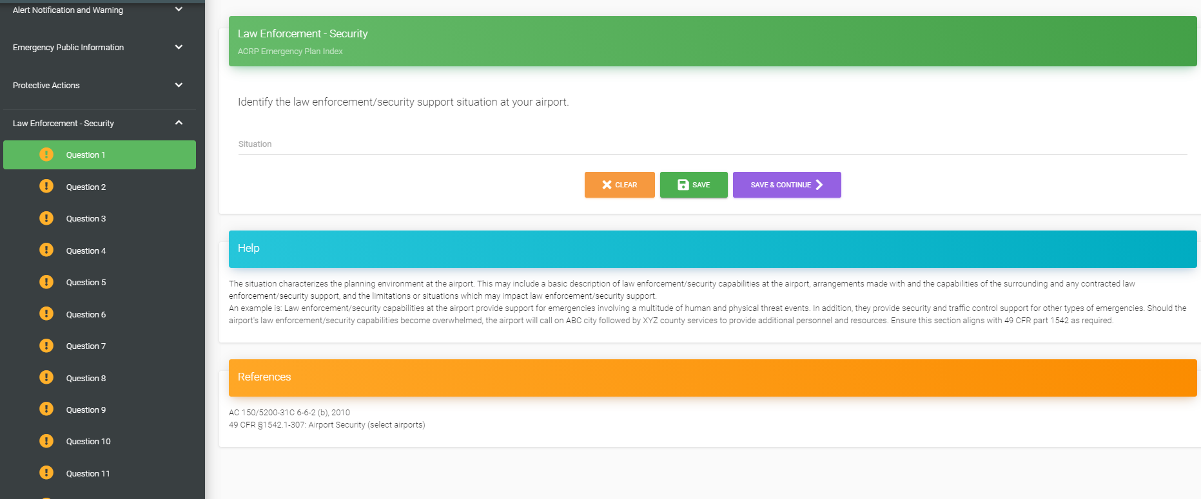
AEP Survey
Each question within the survey has three components to it. The green box is the question to be answered, the blue box is guidance on how to answer the question, and the orange box is reference to the Advisory Circular (AC) or the Code of Federal Regulation (CFR) that the question draws from.

Slide 29
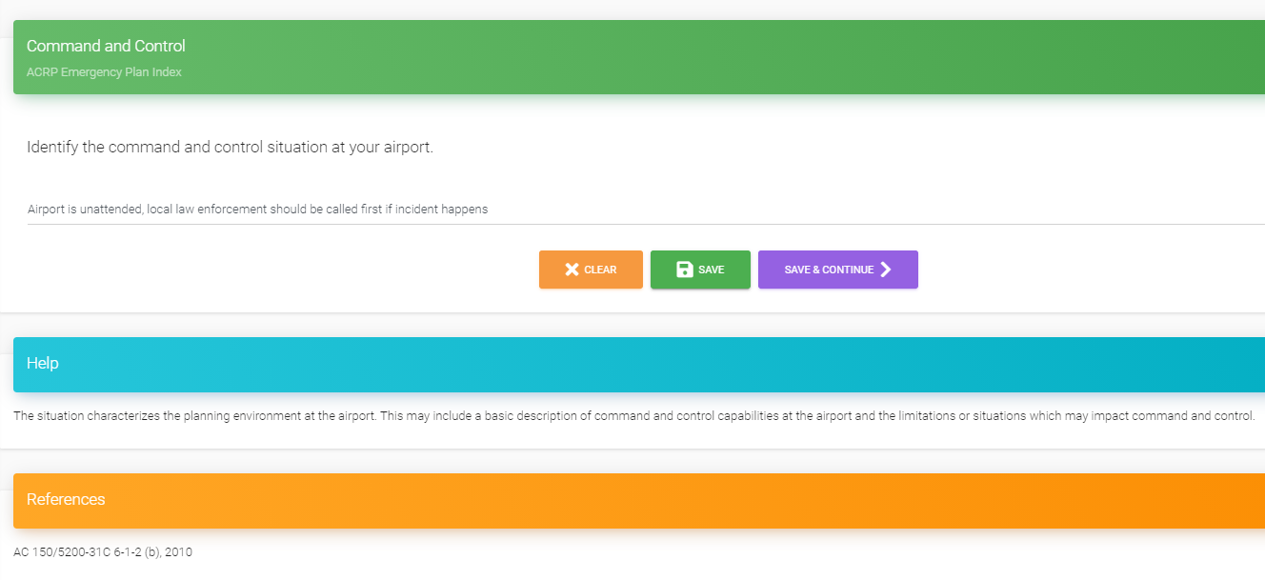
AEP Survey Continued
Question to be answered
Put Answer to question here
Save and move on to the next question
Clear your answer
Save your answer
This section offers helpful tips on how to answer each question
This section, if applicable for the question, provides the reference for the question to look up more information

Slide 30

Save and Continue Later
If at any point you must end and come back to the survey later, you can save your question and log out. The program will remember were you left off and when you log back in, you click resume survey and it will take you back to the last place you left off on.

Slide 31
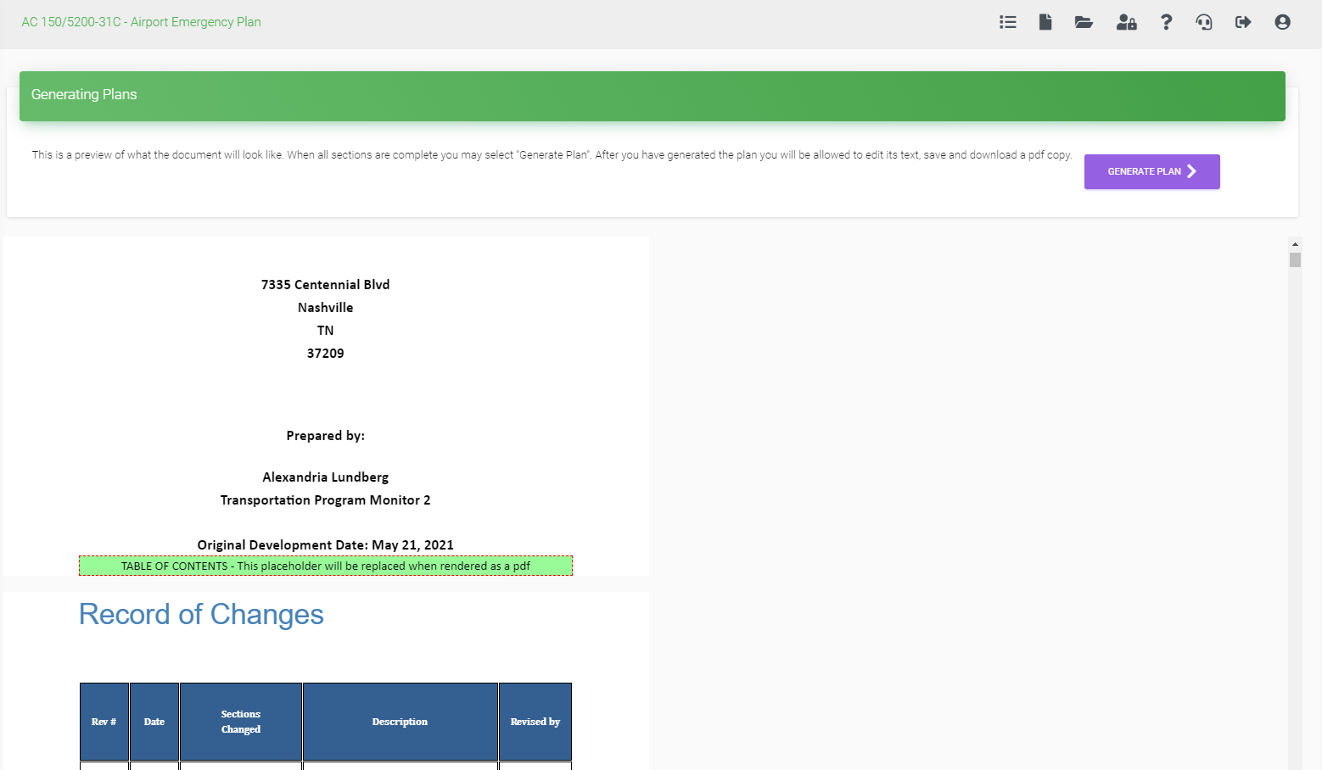
Generating Your Plan
When you think you have completed developing your AEP, by clicking this icon in the upper right-hand corner, you will be able to preview the document you developed at any time. You will than be able to generate a PDF version of the plan from here.

Slide 32
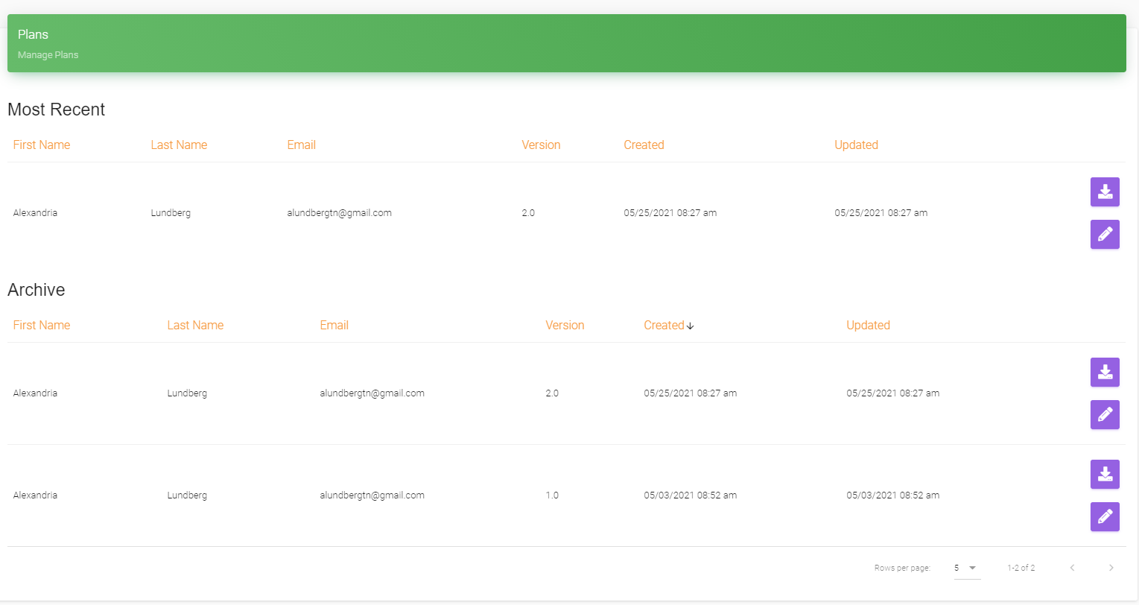
Archived Plans
The primary user can see all the plans that have been generated at any time. They can see who generated them, what version, when, and when it was last updated.

Slide 33
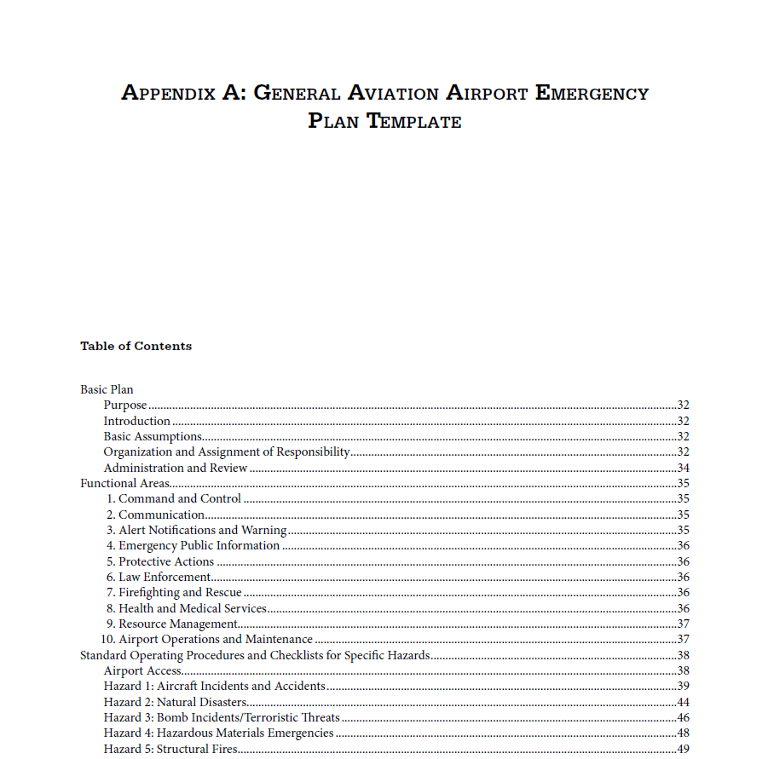
AEP Template from MN AirTAP
The MnDOT and AirTAP Program has also come out with an airport emergency plan template that anyone can download and fill out with their airport’s information. Link provided in the links slide.

Slide 34
Links
Airport Emergency Plan | Login (aepdevelopment.com)
Blank Emergency Guide by MnDOT
  emergency_guidebook.pdf (umn.edu)
AC 150/5200-31C - Airport Emergency Plan (Consolidated AC includes Change 2) – Document Information (faa.gov)

