Slide 1
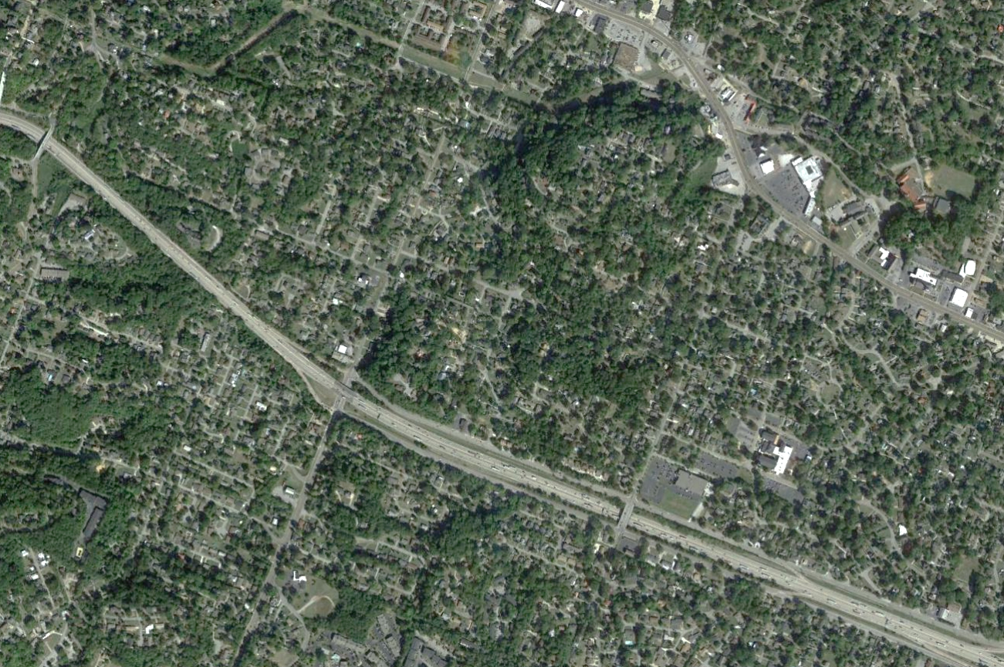
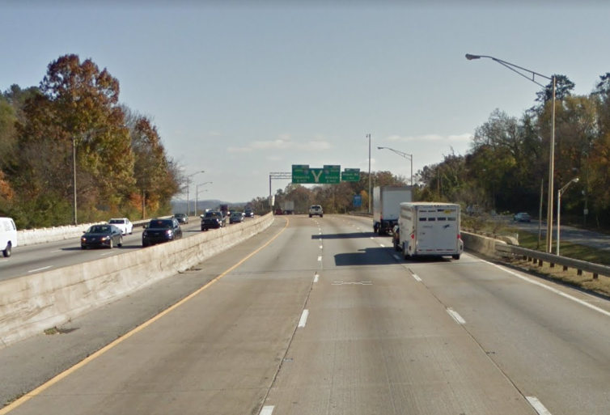
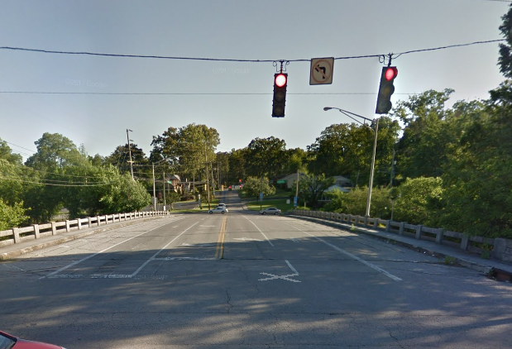
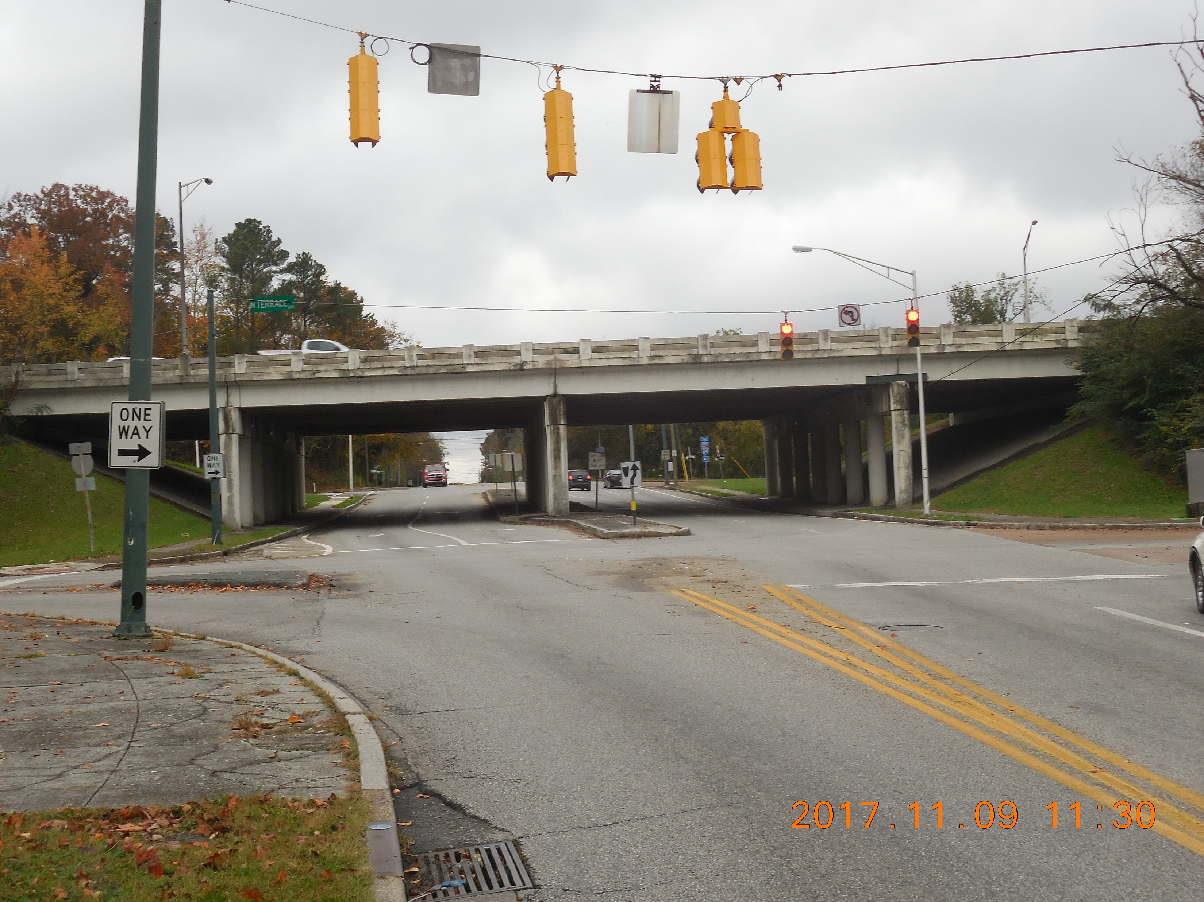


I-24 CM/GC Project
CONTRACTOR PREPROPOSAL
December 18, 2018

Slide 2
Pre-Proposal Agenda
Contractor Sign-In
Introductions and Opening Comments by TDOT
Purpose and Need
General Information
Project Overview
Roadway Bridges
South Germantown Road
Ramp Widening
TDOT Project Website
Questions

Slide 3
Purpose and Need
Improve bridge
along I-24
Wider roadway for wider shoulder widths
Build substructure to accommodate future road widening
Widen I-24 eastbound exit ramp at
South Germantown Road to accommodate two (2) lanes
Improve bridge over I-24
Replace Belvoir Avenue Bridge
Intersection improvements at
both bridges
Maintain or improve horizontal and vertical clearances
Minimize construction time and impacts by using Accelerated Bridge Construction (ABC)

Slide 4
General Information from the RFP
SEE THE RFP FOR ALL THE DETAILS ON TRAFFIC CONTROL
Full closure of I-24 will be limited to up to 3 weekends
Maintain a minimum of 2 – 11’ lanes on I-24 in each direction on weekdays

Slide 5
General Information from the RFP
CM will be a key part of the Integrated Project Team (TDOT, Design Consultant and Contractor)
As part of the Project Team see Section 1.1 of the RFP for skills and knowledge the CM agrees to provide during the design phase
Early procurement or construction work may be considered for long lead items or early tasks
All work shall occur within existing ROW

Slide 6
General Information from the RFP
Section 1.22
Section 1.24
Section 1.26
Section
2.1
Section
2.5
DBE Goal is 10.5%
Prohibited Contact
Bonding Requirement
Minimum Statement of Interest (SOI) /Proposal Requirement
Written Questions Only
Official Answers by QR Form

Slide 7
Proposed Schedule
TAKEN FROM SECTION 2.3 OF RFP
PHASE | ACTION | DATE
Public Notice Phase | First Advertisement of RFP | 11/30/18
 | Mandatory Pre-Proposal Meeting | 12/18/18
 | Last Submission of Questions/ Requested Clarifications | 01/07/19
 | Final RFP Addendum Deadline | 01/18/19
Selection Phase | Submittal of Statement of Interest (SOI)/Proposal | 01/25/19 2:00 PM(CST)/ 3:00 PM (EST)
 | Selection Panel Meetings (Interviews) | TBD
 | Contractor Notification of Selection | 02/22/19
 | Contract Approval/Execution | 03/22/19
ANTICIPATED CONSTRUCTION COMPLETION |  | OCTOBER 2020

Slide 8

The Design Team
Project Lead
Roadway, Structural, Public Involvement, CM/GC Process, ITS, Utility Coordination, Traffic Control Design
Subconsultant
Geotechnical Engineering
& Investigation

Slide 9
Transportation Investment Report
TIR status
Approved
On the website
High level planning document
What does the TIR provide for the CM?
Good background
Constraints, needs,
and desires
Initial stakeholders
Ideas to consider or build upon

Slide 10
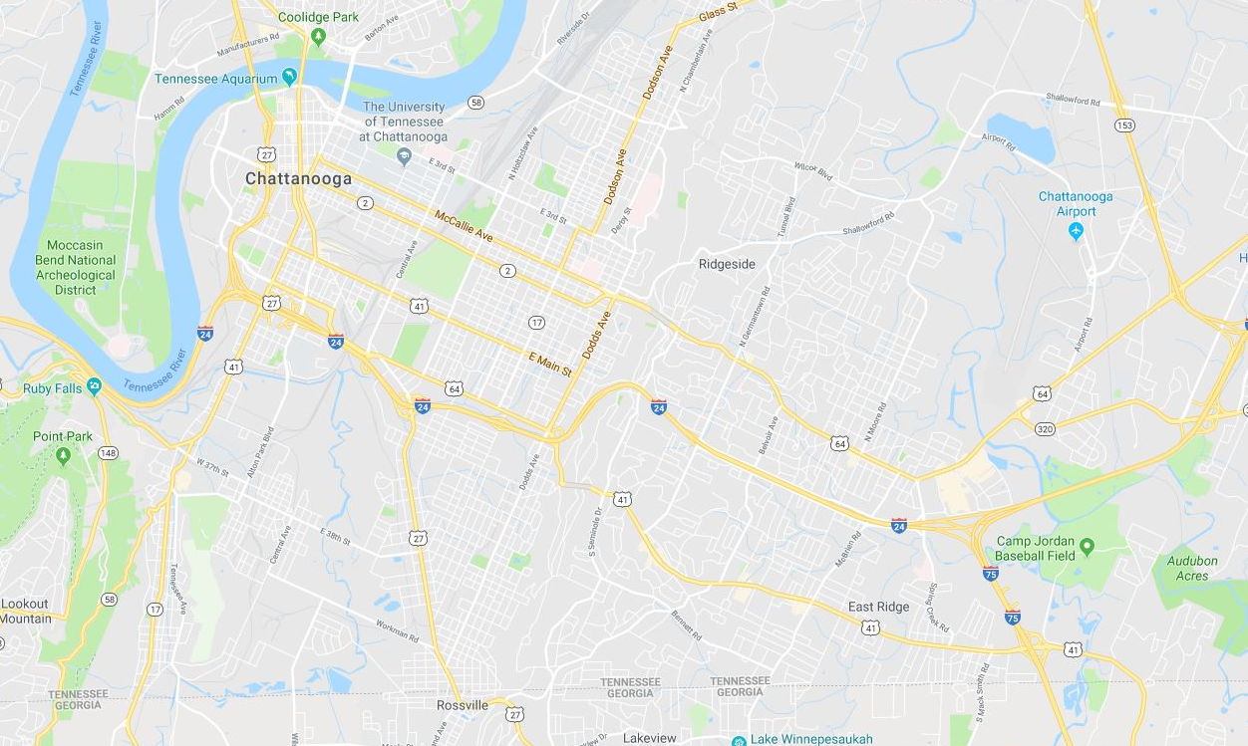
Traffic and Regional Impacts
US 27 Reconstruction
Broad St & Market St Interchange
70,349
119,177
113,090
120,655
132,293
28,255
I-24 CM/GC Project
I-75/I-24 Design Build

Slide 11
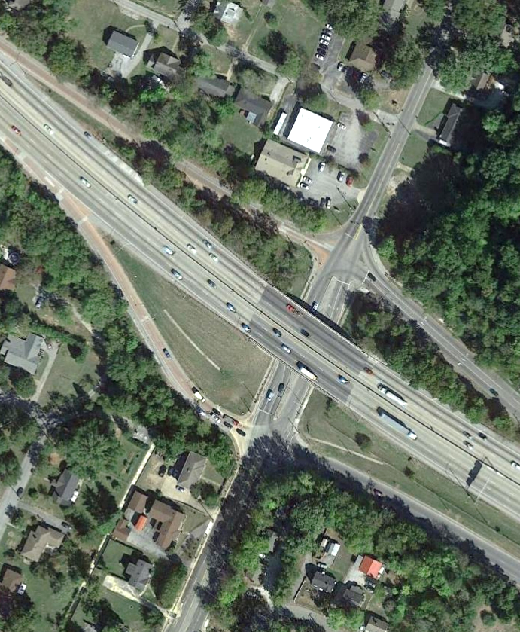
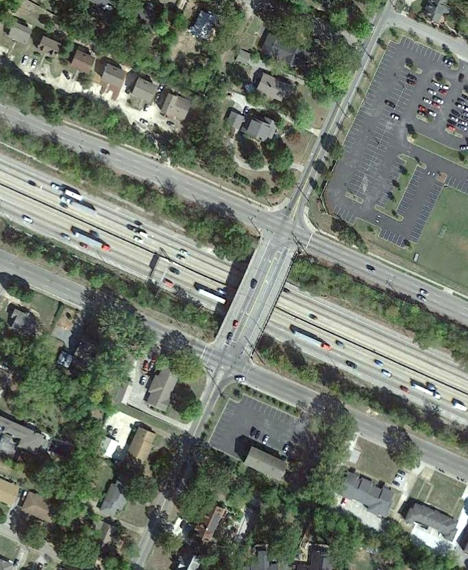

Project Overview
South Germantown Road Improvements
Interstate 24 Bridge Widening
Belvoir Avenue Bridge Replacement
INTERSTATE
24
INTERSTATE
24
South Germantown Road Exit Ramp Widening
Intersection Improvements
Intersection Improvements

Slide 12
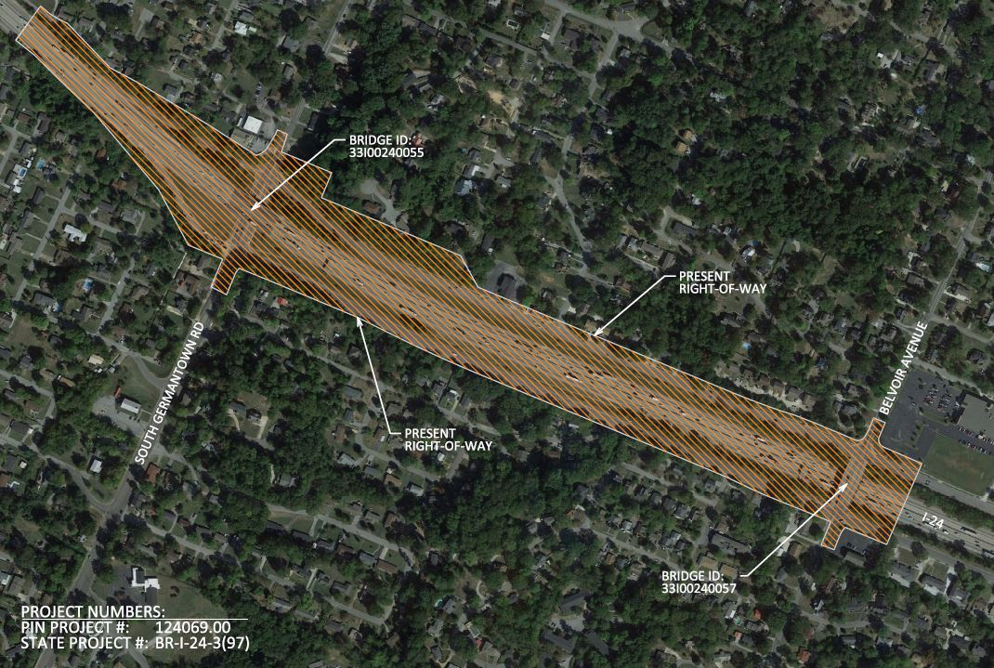
Environmental Boundary

Slide 13
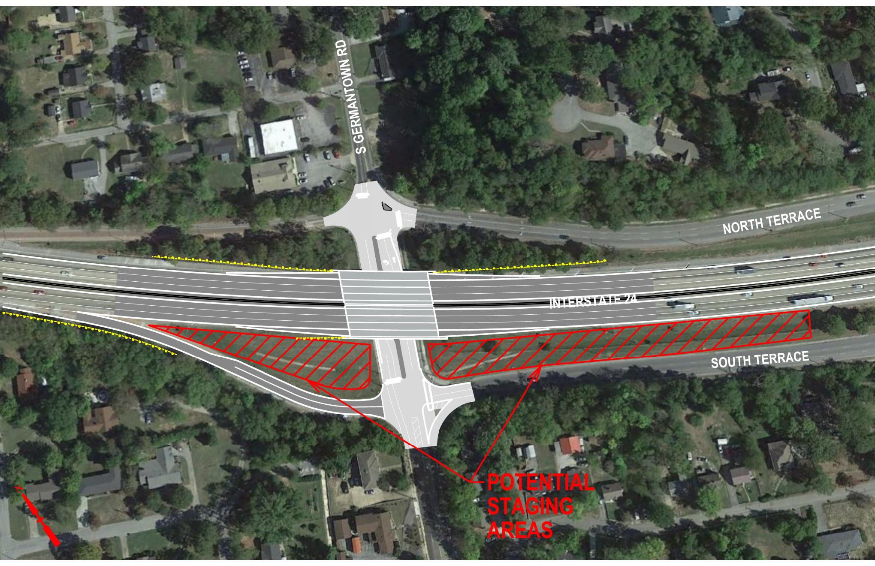
Potential Staging Area

Slide 14
Utilities Survey
What is on the Bridges
What is adjacent to the Bridges
Elevation to OH Power Lines (on profiles)
Relocations are anticipated and will need to be identified early and coordinated
SEE SURVEY FOR:

Slide 15
Utilities Owners
Telephone
AT&T Southeast
611 Chestnut Street
Chattanooga, TN 37450
Tim Manley
(423)752-9181
Cable
Comcast
537 Market Street
Chattanooga, TN 37402
Tom Bailey
(423) 855-3900
Gas
Chattanooga Gas Company
6125 Preservation Drive
Chattanooga, TN 37416
Jana Papa
(423) 490-4315
Power
E.P.B.
10 West M.L. King Boulevard
Chattanooga, TN 37402
Melvin Baumgarner
(423) 648-3524
Water
TN American Water
1500 Riverside Drive
Chattanooga, TN 37406
Grady Stout
(423) 771-4713
Sewer
Hamilton County WWTA
1250 Market Street
Suite 3050
Chattanooga, TN 37402
(423) 209-7842

Slide 16
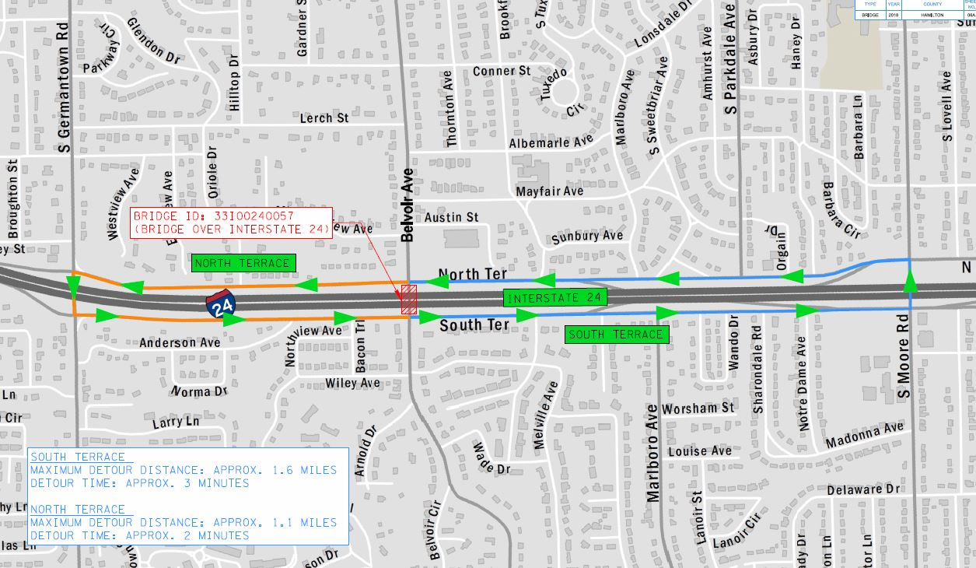
Alternate Routes

Slide 17
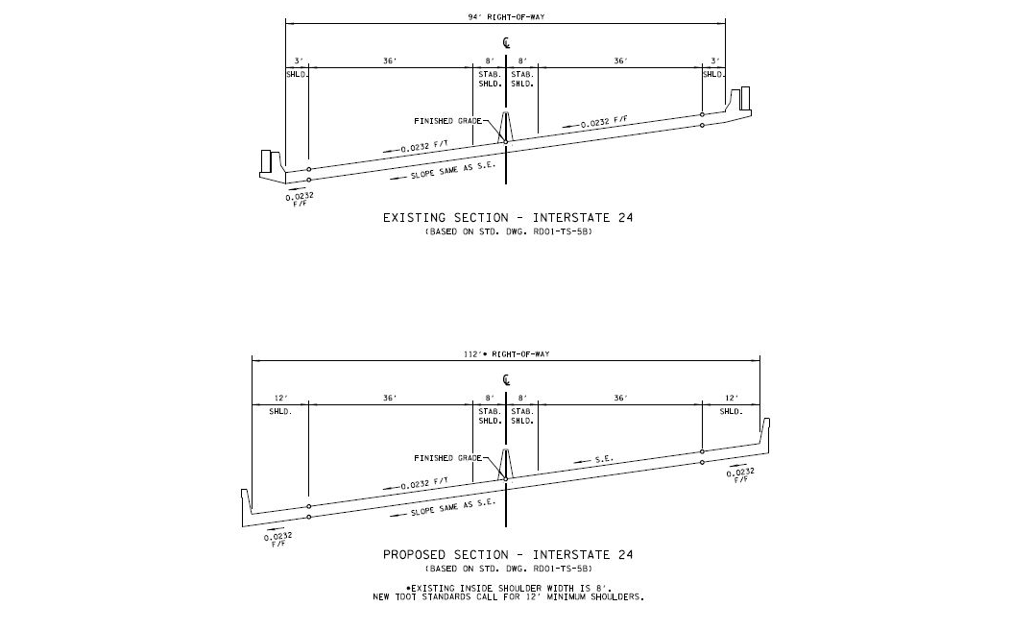
Existing & Proposed I-24
Typical Section

Slide 18
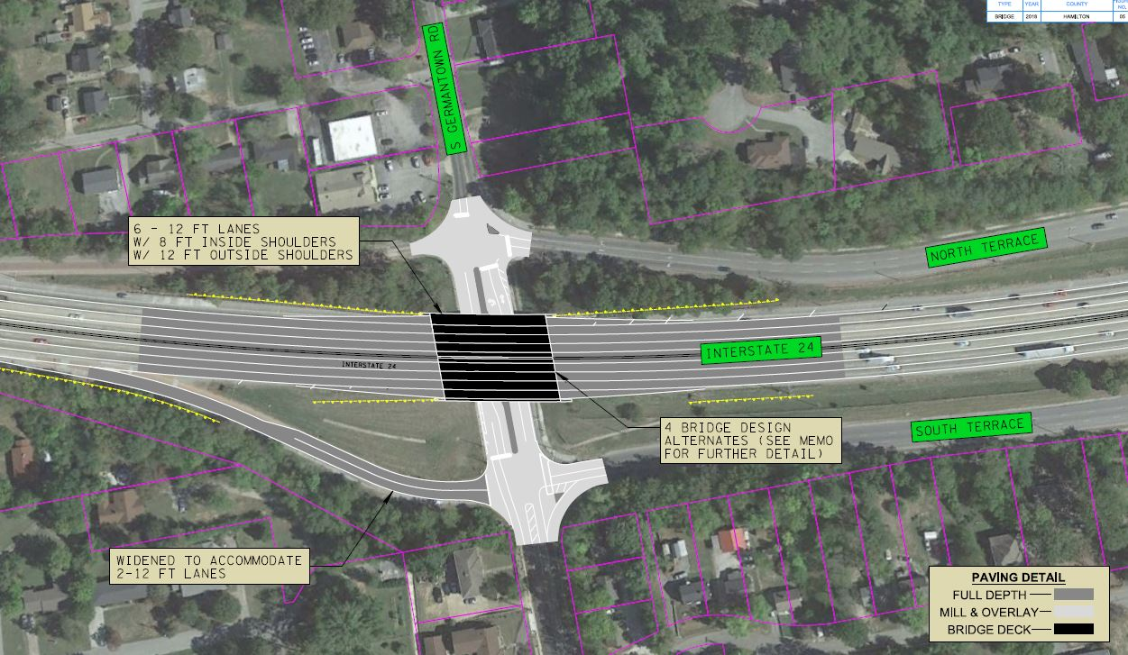
Bridge 1: I-24 Over South Germantown Road

Slide 19
Existing I-24 Bridge
166' – 4 span | 94’ existing width | Min. vert. clearance 14.44'
Tangent | 8' interior shoulders | 55mph speed limit
Concrete beams | Six 12' wide lanes | Underground culvert
79˚ skew | 3' exterior shoulders

Slide 20
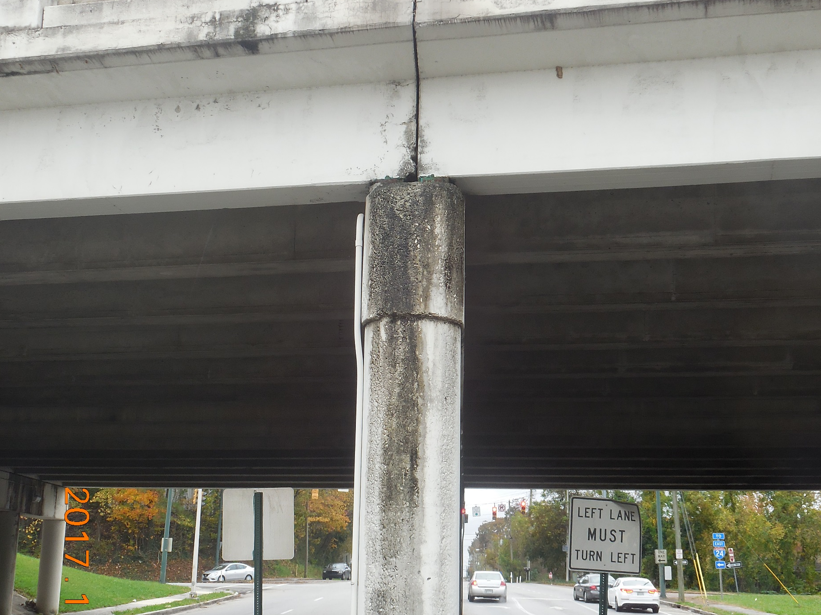
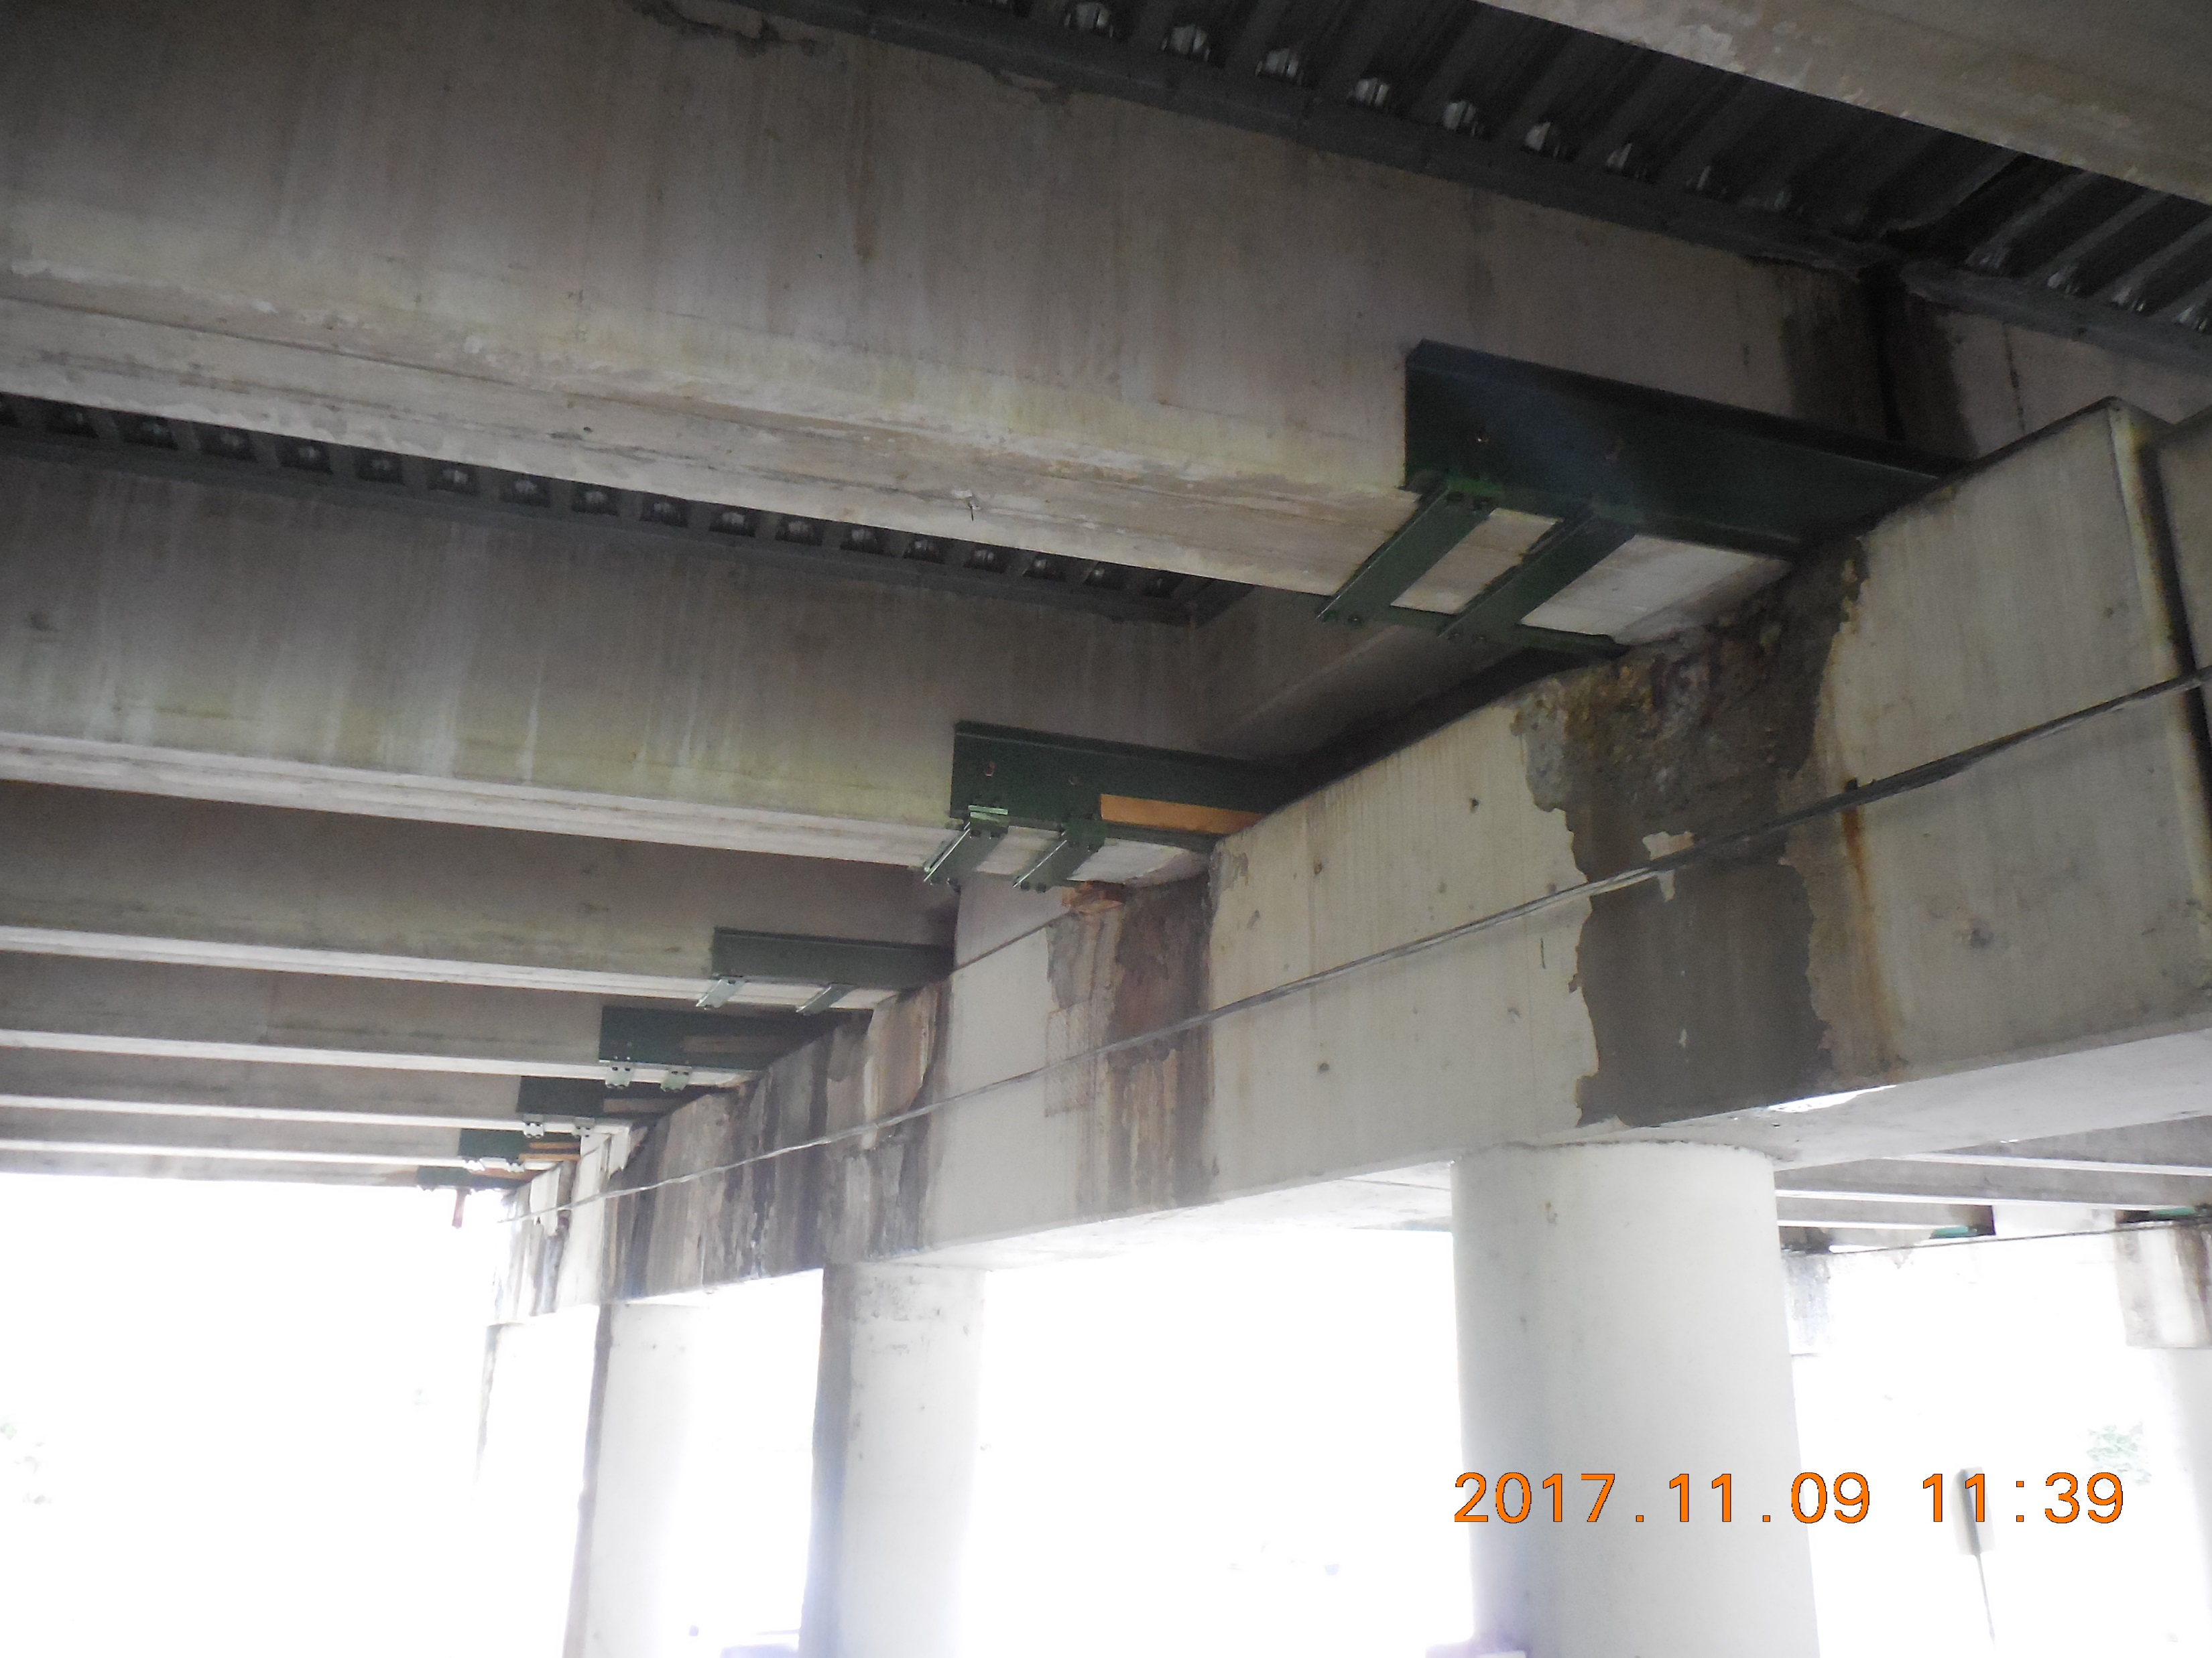
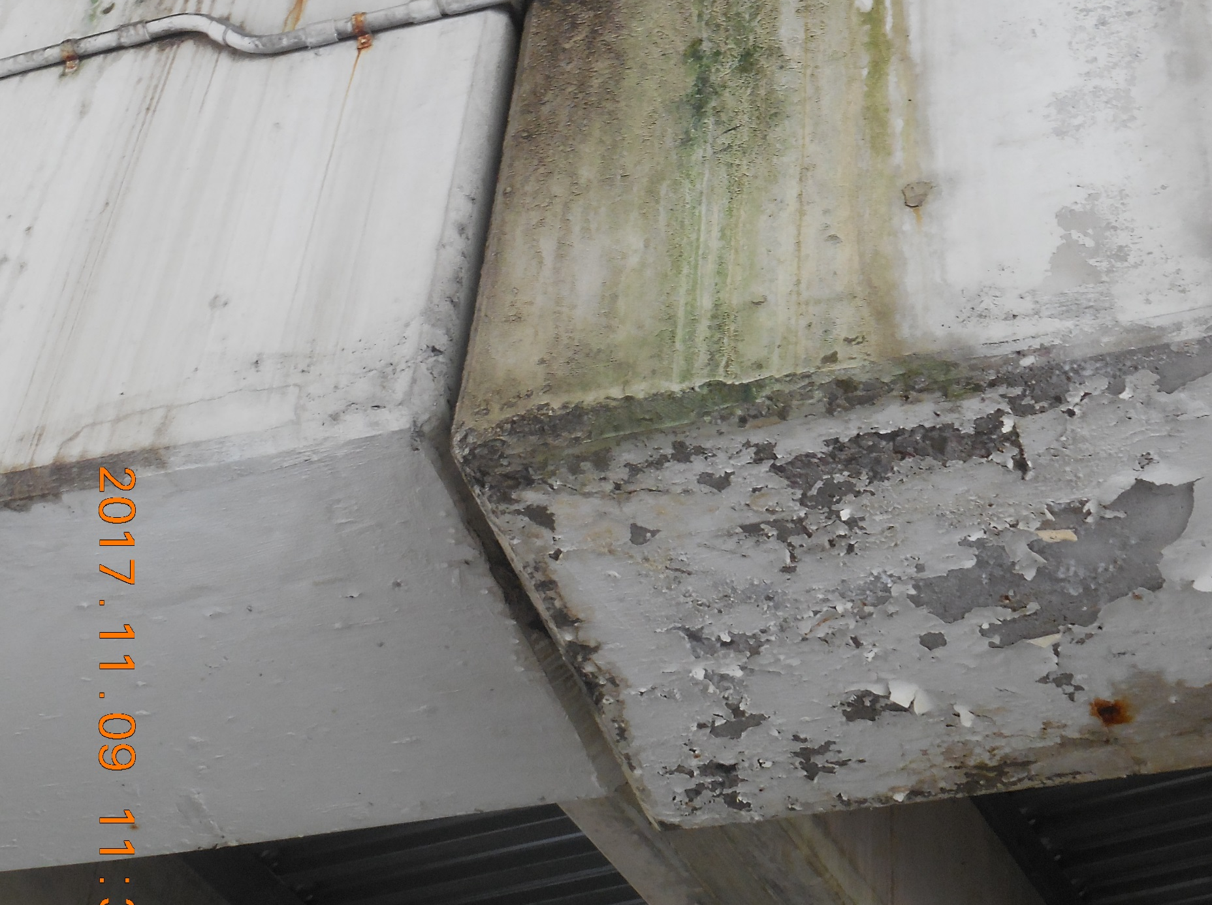
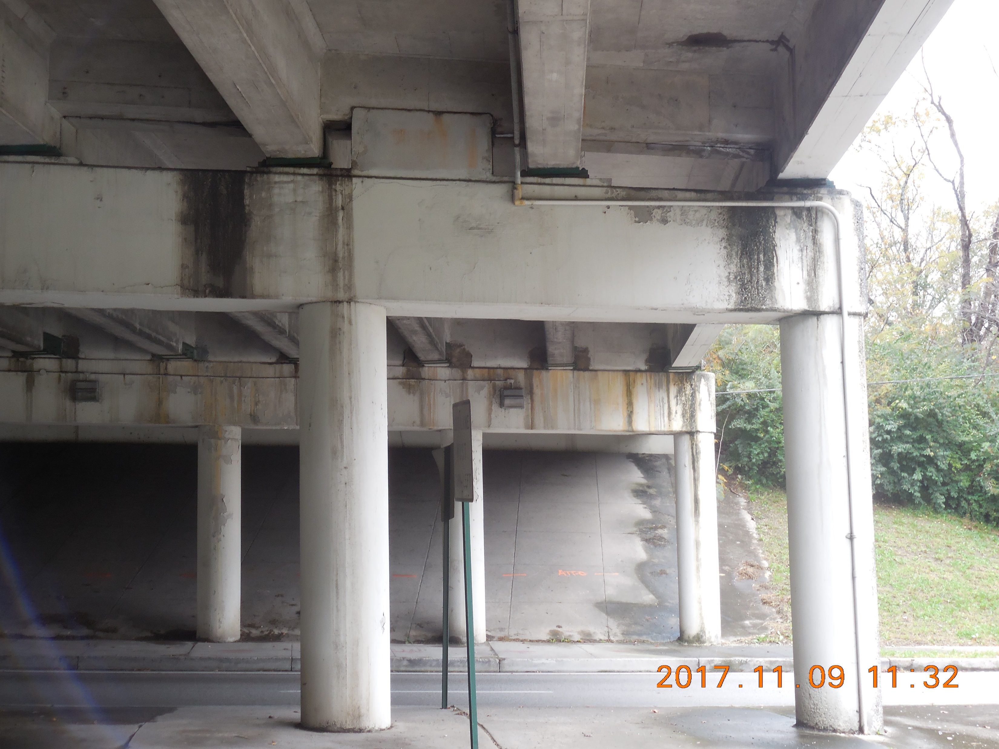
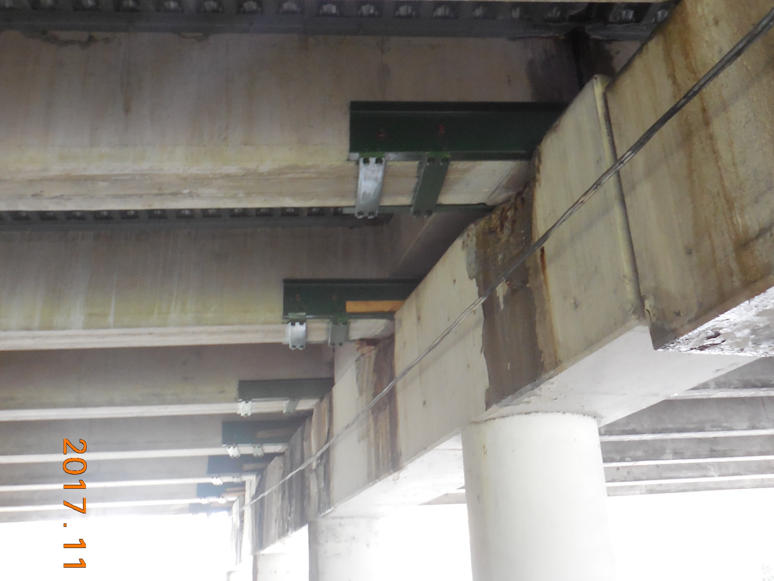
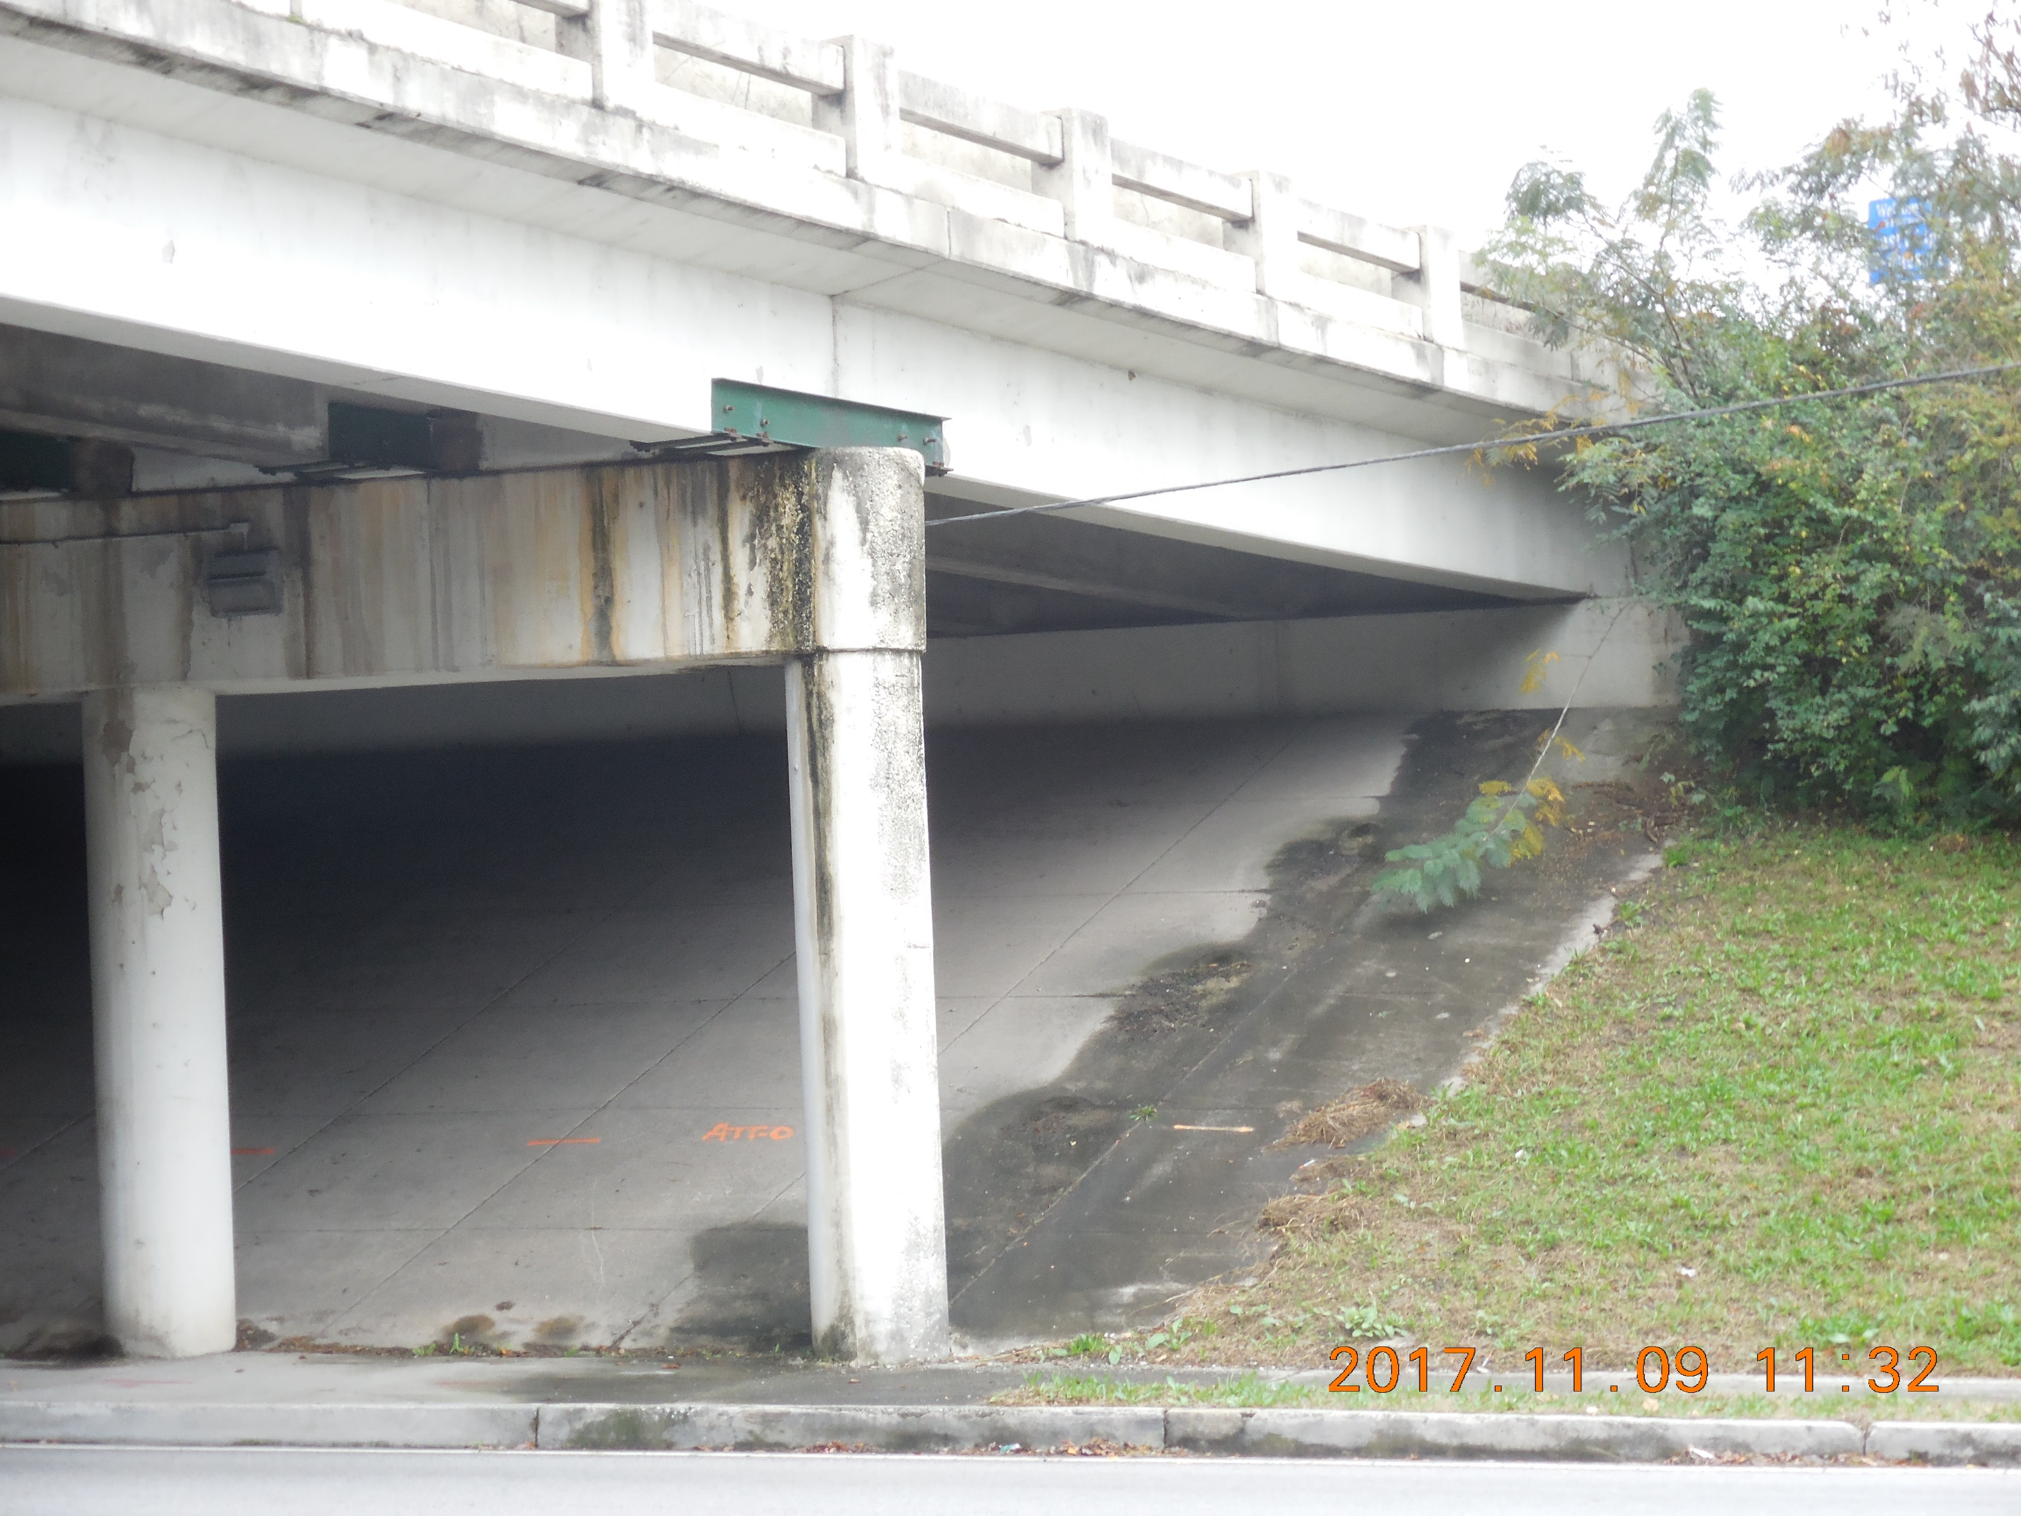
I-24 Existing Bridge Conditions
Looking North at Bent No. 2
Looking at Bent & Beam Support
Widened Bent Caps
Looking at Bents No. 1 & No. 2
Looking at Underside of Deck
Looking at Abutment No. 1

Slide 21
I-24 Roadway Impacts
Minor approach work to I-24
roadway bridge
On South Germantown Road, additional road work needed at South Terrace intersection to improve sight distance
Adjust signage for new widening
Update traffic signals at interchange entrance/exit
Maintain positive drainage on all lanes and shoulders
Replace removed median barriers
Full depth pavement on shoulders or lanes excavated during construction
Full depth pavement on exit ramp widening during construction

Slide 22
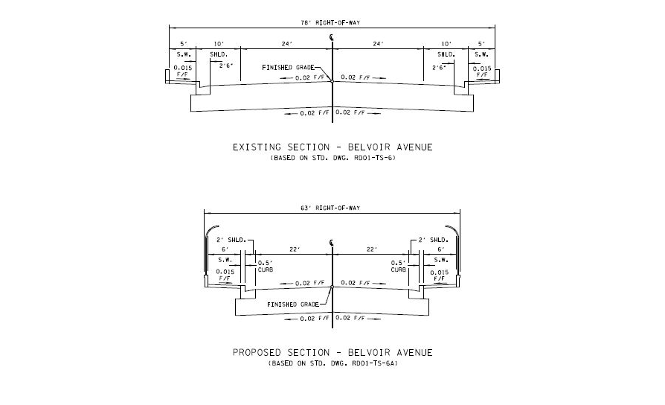
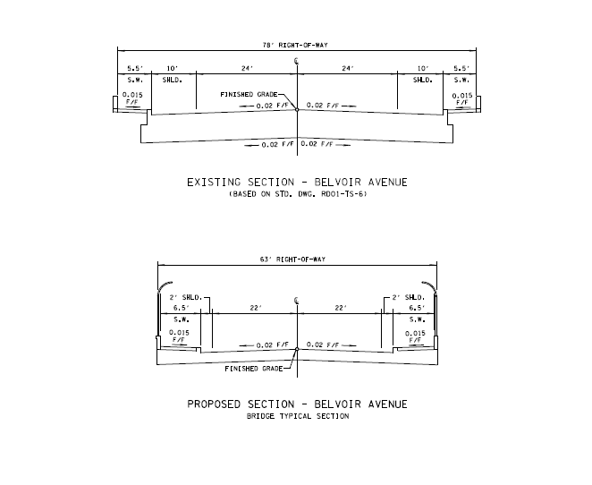
Existing & Proposed Belvoir Typical Section

Slide 23
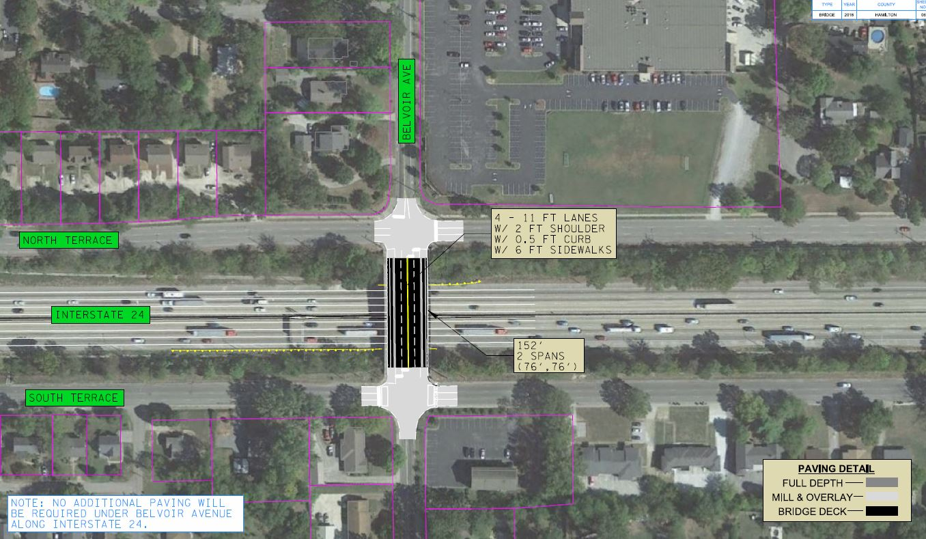
Bridge 2: Belvoir Avenue Bridge over I-24

Slide 24
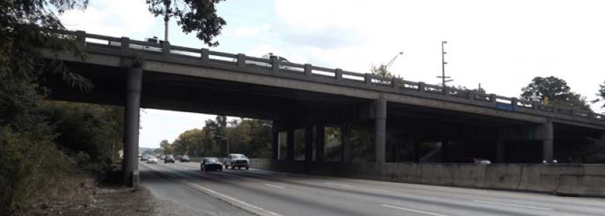
Existing Belvoir Bridge
190.5' – 4 Span | 78' Existing Width | Min. Vert. Clearance 16.33'
Normal | 4, 10' wide Lanes | 30 mph Speed Limit
Concrete Beams | 10' outside Shoulders | Electronic Message Board on I-24
90˚ Skew | 5' Sidewalks

Slide 25
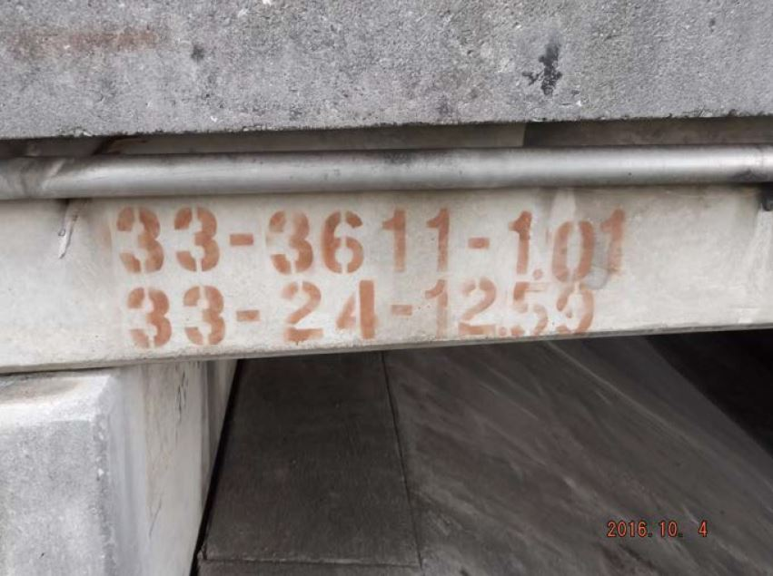
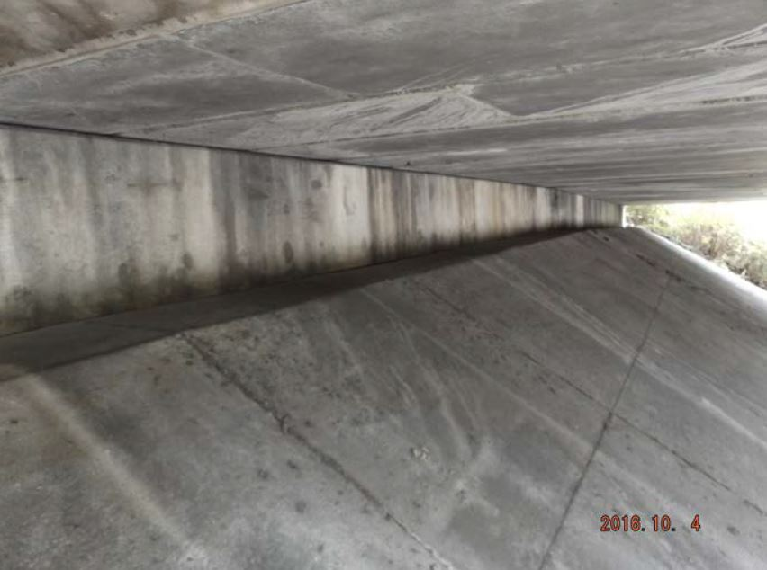
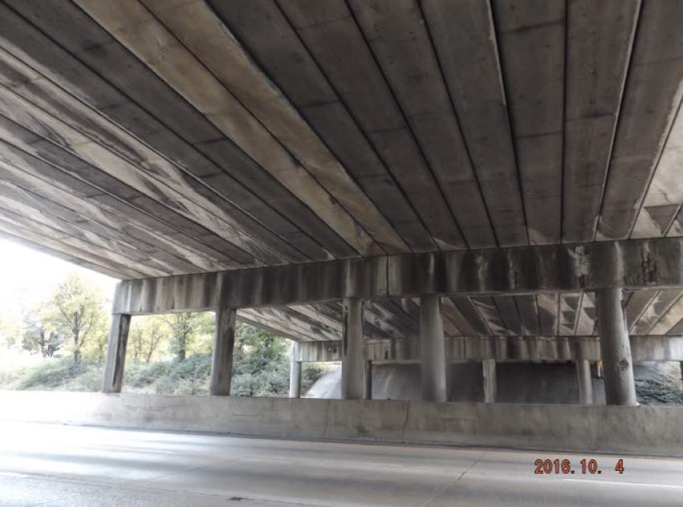
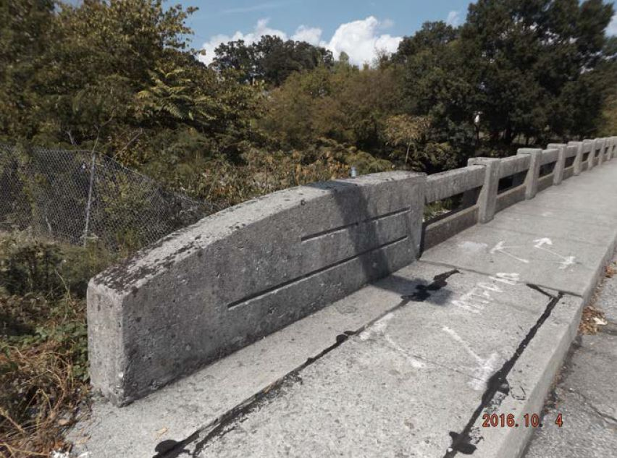
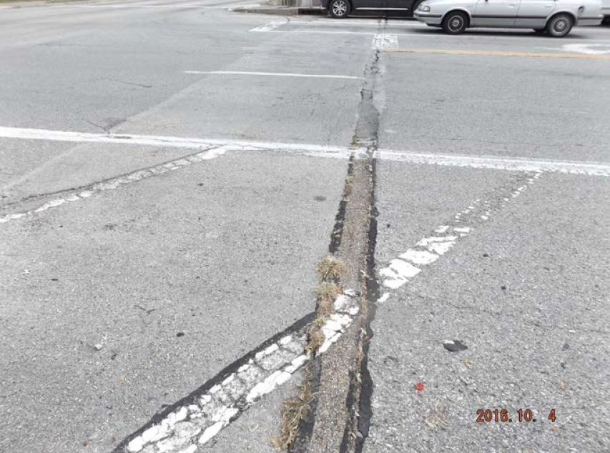
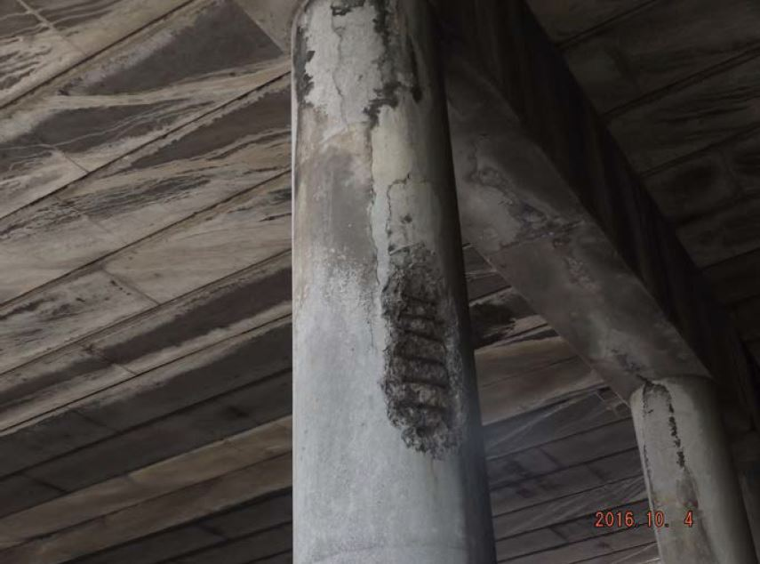
Belvoir Existing Bridge Conditions
No. 1 Right Side
Abutment No. 2
Span No. 3/Bent No. 2
Bridge Rail
Approach No. 2
Bent No. 3

Slide 26
Belvoir Roadway Impacts
Minor approach work to Belvoir Avenue roadway at bridge
Mill, overlay, and stripe the Belvoir Avenue work zone
Adjust signage as needed
Update traffic signals on either side of bridge
Full depth pavement on shoulders or lanes excavated during construction

Slide 27
Next Steps…
Initial Idea Development/ Technical Study
Continue Refinement of Concepts
CM and designer on-board
Additional stakeholder
input
Develop Solution
Begin Construction

Slide 28




Agency Stakeholders

Slide 29
TDOT Project Website
Only “Official Answers” to questions will be in writing
Additional Items will be placed on the website
  Current Survey
  Inspection Reports
  Previous Roadway and Bridge Plans
  Present Layouts, Profiles, Typical Sections and Property Maps
SOURCE OF ALL OFFICIAL DOCUMENTATION

Slide 30
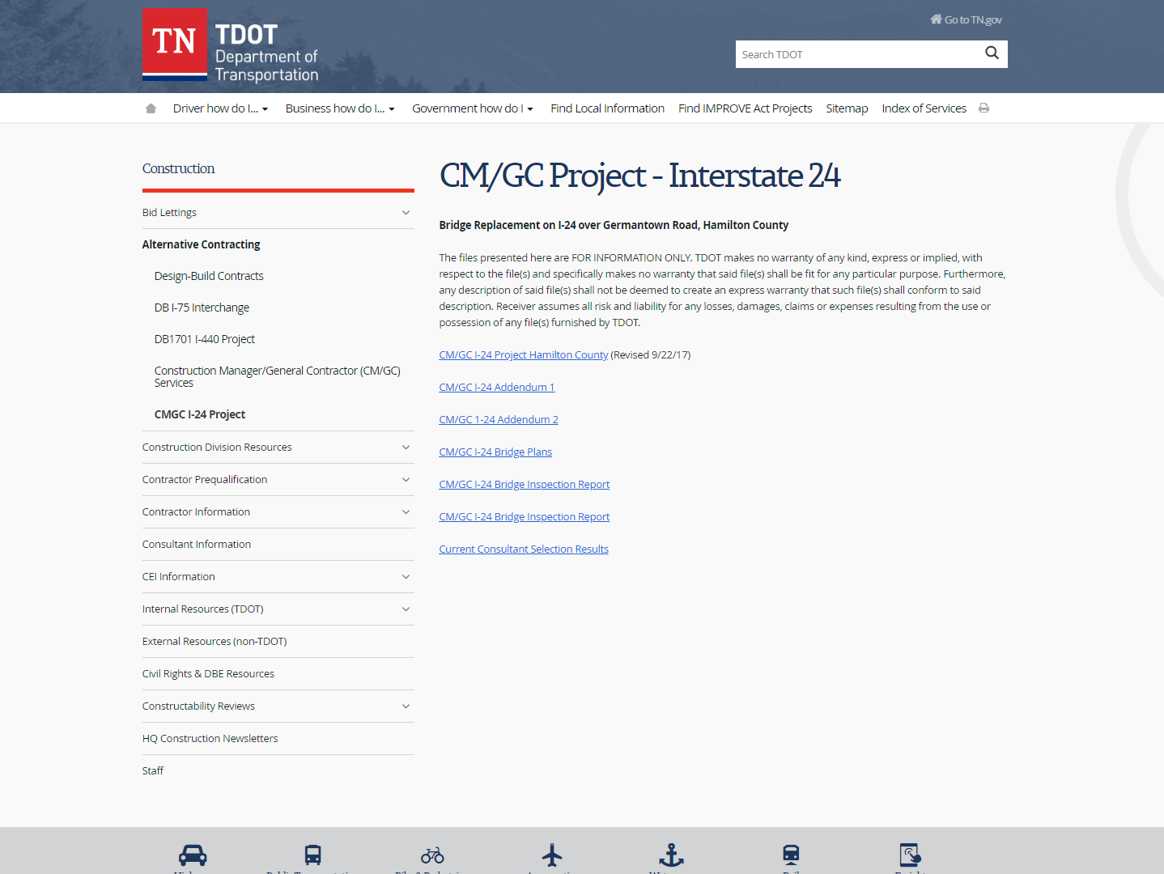
https://www.tn.gov/tdot/tdot-construction-division/transportation-construction-alternative-contracting/cm-gc-project---interstate-24.html

Slide 31
Proposed Design Build Schedule
ACTION | DATE
Anticipated NTP | 01/18/19
Begin Construction | 10/16/19
ANTICIPATED CONSTRUCTION COMPLETION | JUNE 2021

Slide 32
Closing Comments
Thank you for your attendance
Questions?
Contact: Lia Obaid, PE
615.532.7522
Lia.Obaid@tn.gov

Slide 33
Thank You!

