Slide 1
PRE-BID MEETING
CNV 176
Maury County I-65 Interchange at SR 99 (US 412) in Columbia
PIN 115786.00
4/21/2021

Slide 2
Meeting Facilitators
TDOT Region 3 Project Development
TDOT HQ Construction
TDOT HQ Structures

Slide 3
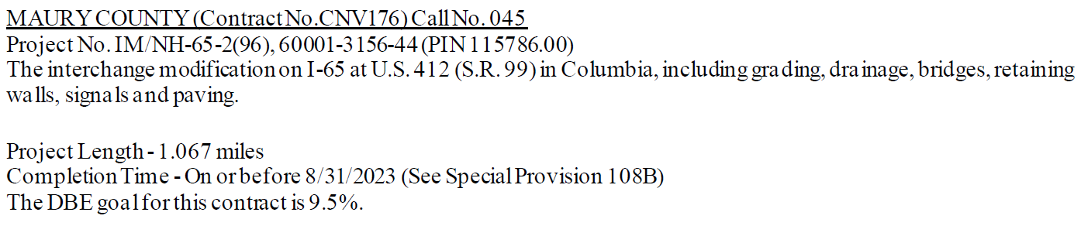
CNV 176 Maury County
Letting Date: May 7, 2021
Completion Date: August 31, 2023

Slide 4
Contract Requirements
Prequalification Requirements
Mandatory Pre-Bid Attendance
Standard Prequalification Applies
Make sure your TDOT prequalification is currently valid
Contractors with an expired prequalification that has surpassed the 90 days grace period will not be authorized to bid.
Prospective bidders must have filed their standard prequalification questionnaire at least 14 days prior to the date of the letting.

Slide 5
Contract Requirements
Meeting attendance does not guarantee bid authorization.
All prime/joint venture contractors pre-qualified by the Department must obtain authorization to bid through the standard bid authorization procedure. BID AUTHORIZATION MUST BE OBTAINED PRIOR TO 4:00 P.M. CST ON THE DAY PRECEDING THE LETTING.
Review the Instruction to Bidders to ensure you meet all qualification/requirements.

Slide 6
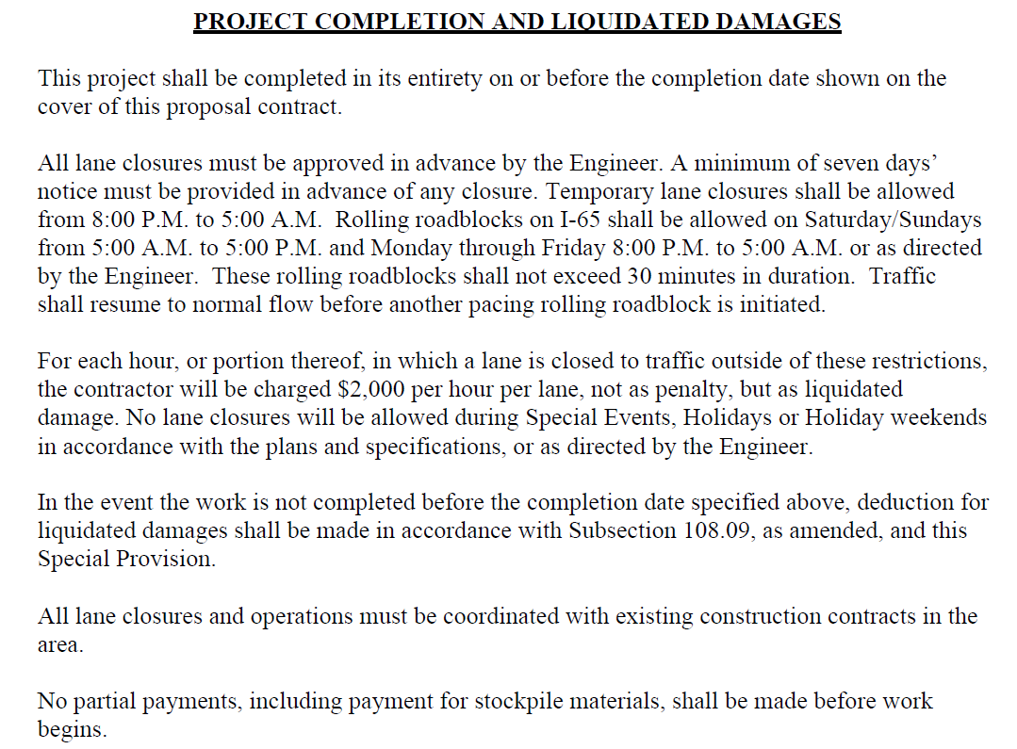
CNV 176 Maury County – SP108B

Slide 7
Purpose and Need of Project
To improve safety and traffic operations of the existing interchange of Interstate 65 at State Route 99 (U.S. 412/Bear Creek Pike).
Increase capacity to accommodate anticipated traffic growth due to proposed future industrial developments.
Reconfigure interchange geometrics to provide adequate acceleration and deceleration lanes onto and exiting the interstate.

Slide 8
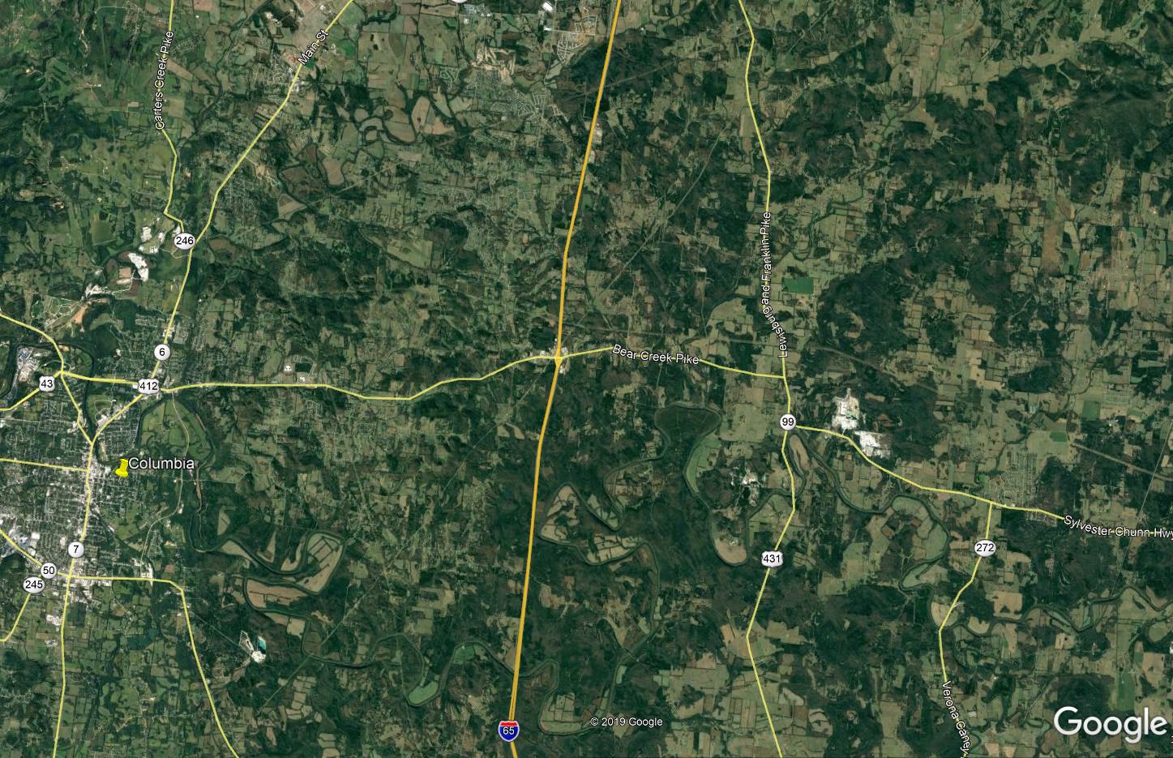



Project Location Map
Columbia

Slide 9
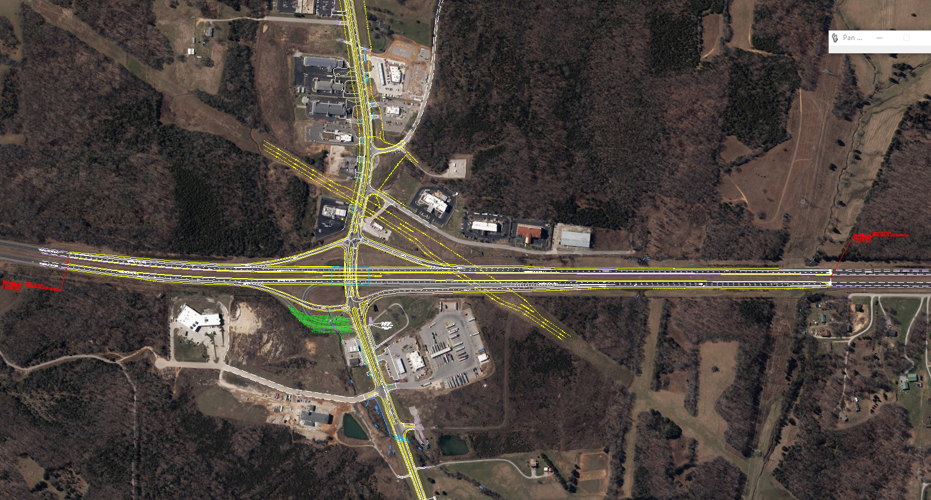
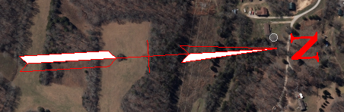


Proposed Project Layout
Ramp 2
Ramp 1
Ramp 3
Ramp 4

Slide 10
Proposed Improvements
Provide standard diamond interchange
  Provide new 2 lane I-65 NB entrance ramp.
  Remove existing I-65 NB entrance loop ramp.
  Widen SR 99 (US 412/Bear Creek Pike) from a 3 lane section to a 5 lane section (2 in each direction with center turn lane).
  Replace bridges on I-65.
  Add signals at ramp terminals on SR 99 (US 412/Bear Creek Pike).
  Provide additional acceleration and deceleration lengths on I-65 where necessary.
  Replace and upsize one box culverts under SR-99.
  Relocation of STR-1 in southeast quadrant.
  Add lighting to all 4 ramps.

Slide 11
Construction Challenges
  Raising the grade for I-65 by 3’ and lowering SR-99 one foot to achieve minimum vertical clearances.
  Demolishing both I-65 bridges and replace with one full bridge.
  Constructing three major retaining walls.
  Avoid impacting 30” gas line crossing I-65. Coordination completed with Enbridge prior to letting. Casing extension completed – no conflict (9/03/2020).
  Adding Ramp 4.
  Remove existing I-65 NB entrance loop ramp.

Slide 12
Construction Challenges
  Relocation of STR-1 in southeast quadrant
  Replacing and upsizing one of the Box culverts on SR-99.
  Widen SR 99 (US 412/Bear Creek Pike).
  Add signals at ramp terminals on SR 99 (US 412/Bear Creek Pike)
  Provide additional acceleration and deceleration lengths on I-65 where necessary.
  Coordination with Local Businesses.

Slide 13

Project/Challenges Overview Map
Retaining
Wall #1/Gas Line
Ramp 2
Ramp 1
Ramp 3
Ramp 4
Retaining
Wall #1
Retaining
Wall #3
Retaining
Wall #2
Box Under SR-99 to be Replaced
Stream Relocation

Slide 14
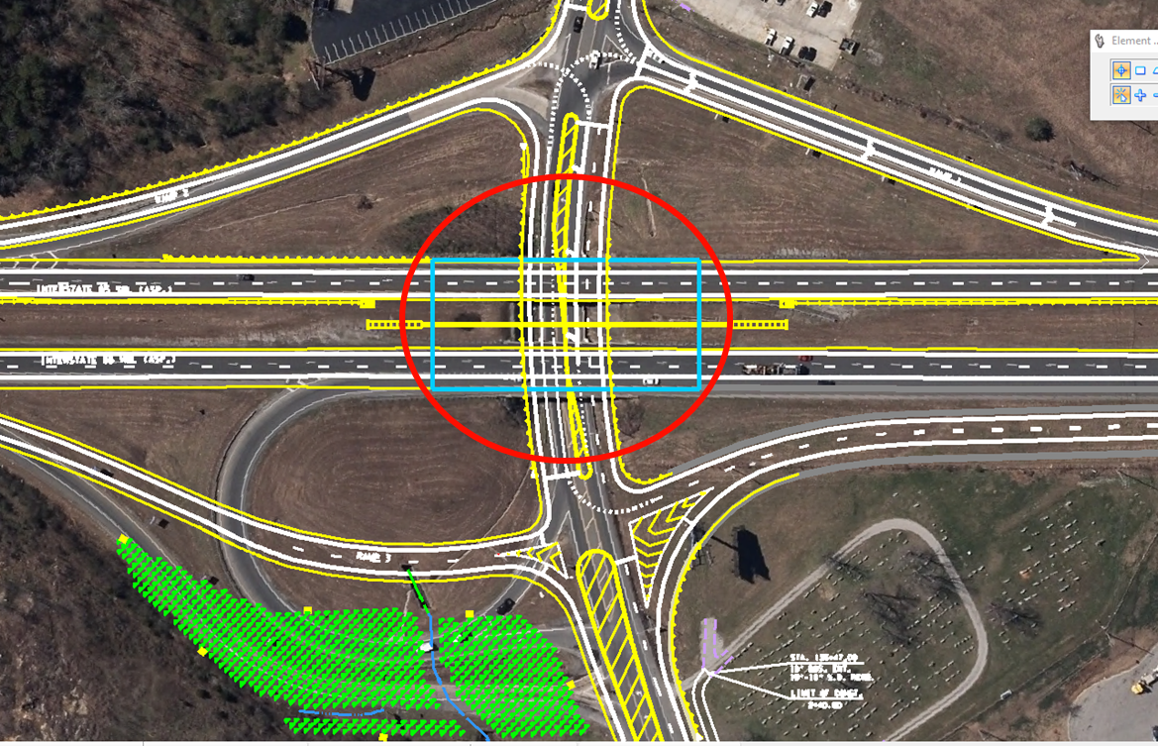

Raising the grade for I-65 by 3’ and lowering SR-99 one foot to maintain the bridge clearances.
Demolishing both I-65 bridges and replace with one full bridge.

Slide 15
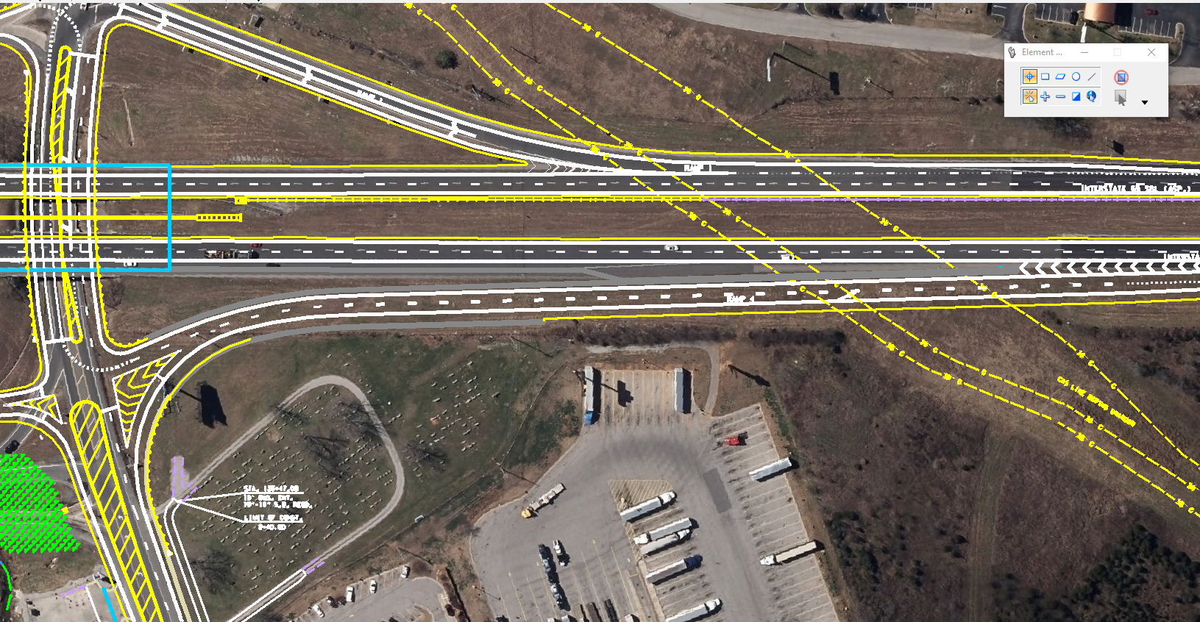
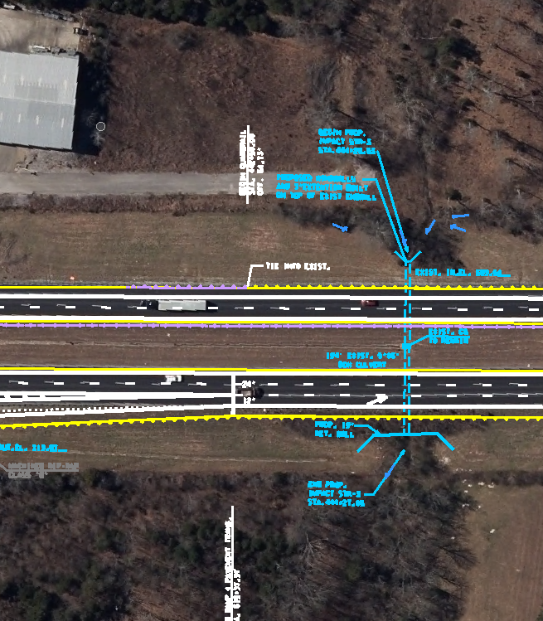

Constructing three major retaining walls.
Avoid impacting 30” gas line crossing I-65.

Slide 16
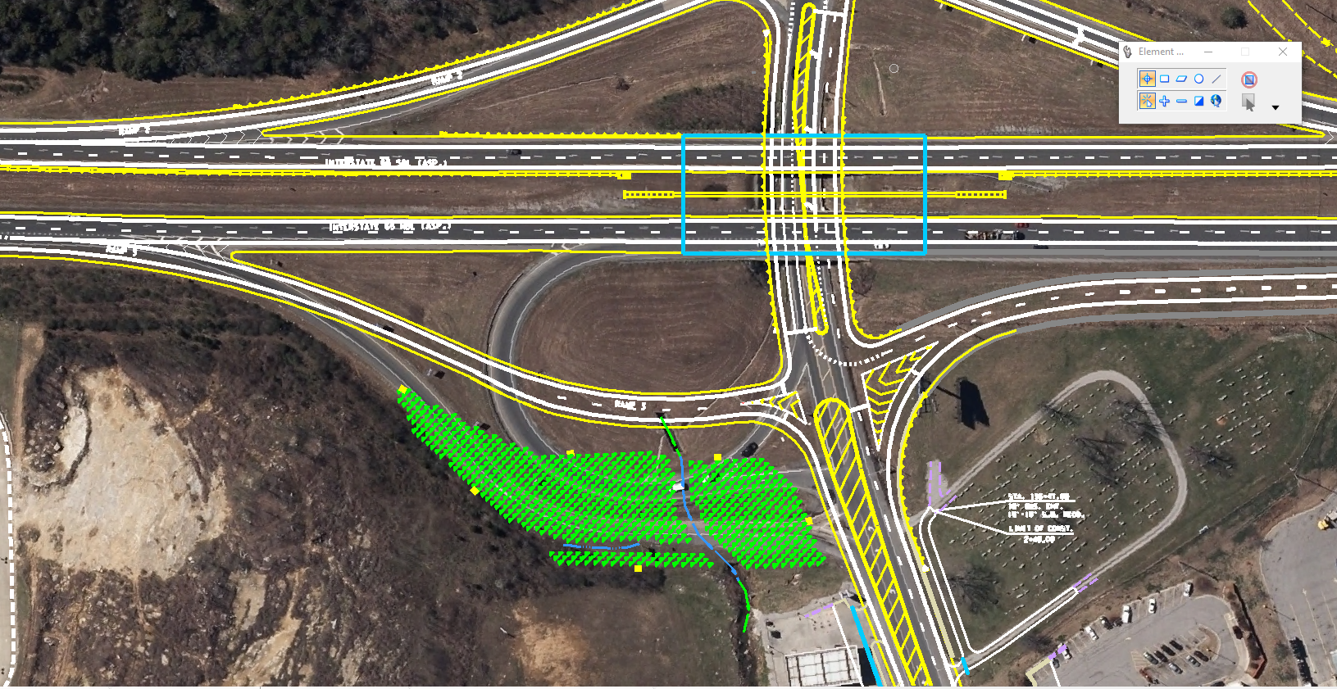


Adding Ramp 4.
Remove existing I-65 NB entrance loop ramp.
Relocation of STR-1 in southeast quadrant.

Slide 17
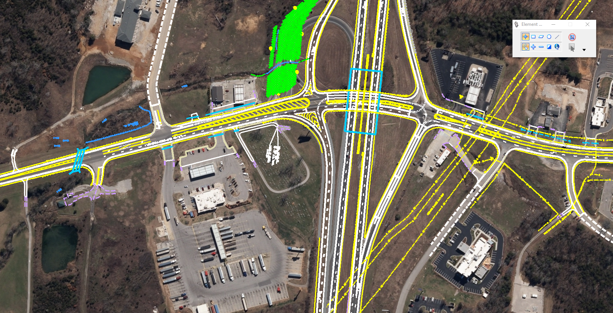


Replacing and upsizing one of the Box culverts on SR-99.
Widen SR 99 (US 412/Bear Creek Pike).
Add signals at ramp terminals on SR 99 (US 412/Bear Creek Pike)

Slide 18
Utility Information
Move in State:
  AT&T Communication
  Atmos Gas
  Columbia Water
  Duck River Electric
Move Prior:
  AT&T Fiber Optics (In conflict with Ramp 3)
  Charter Communication (Used their own forces – no contract)
Utility poles and lines will need to be relocated due to the widened roadway
Enbridge Gas – No conflict

Slide 19
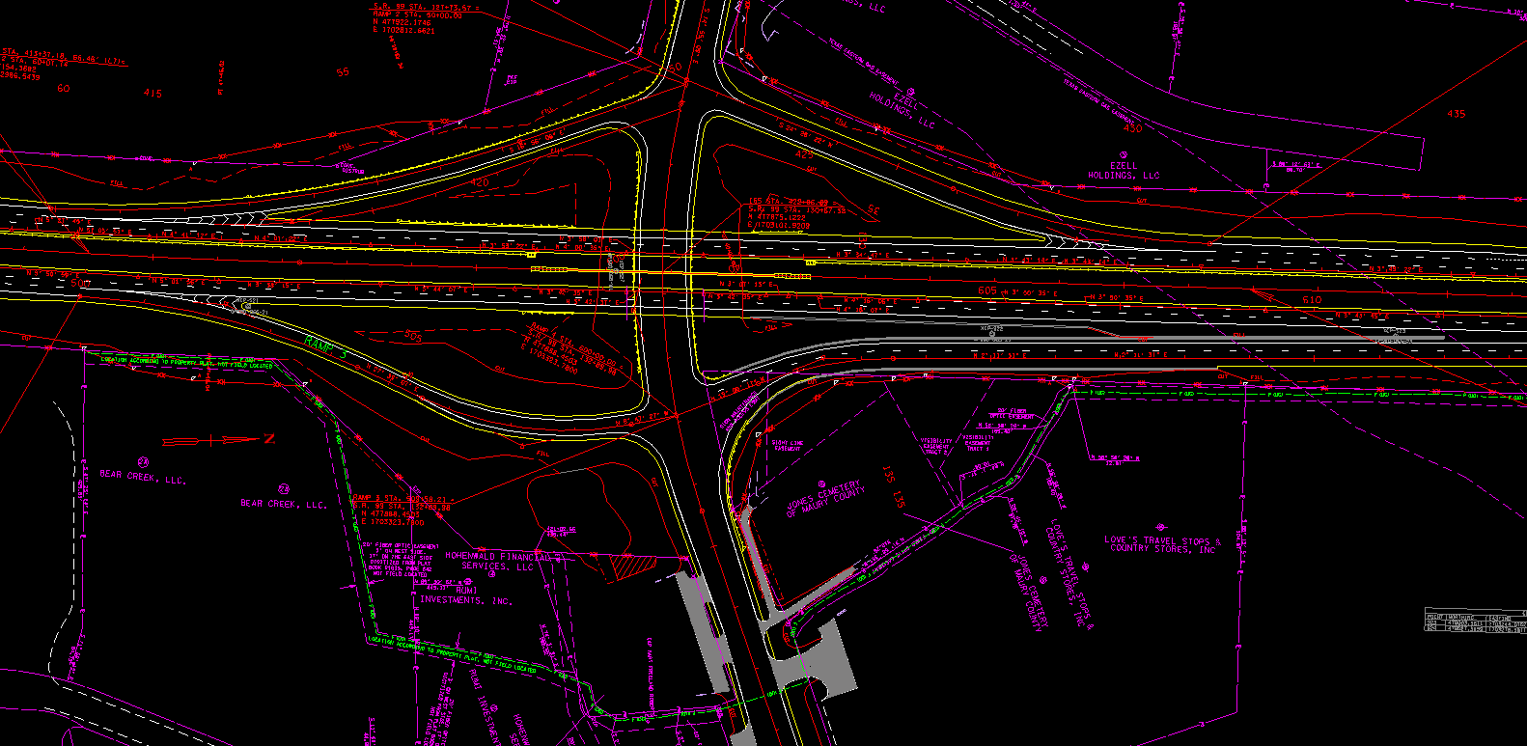
AT&T Fiber Optic Relocation at Ramp 3
RAMP 3
This area is not available until AT&T completes relocation
No longer in conflict with AT&T

Slide 20
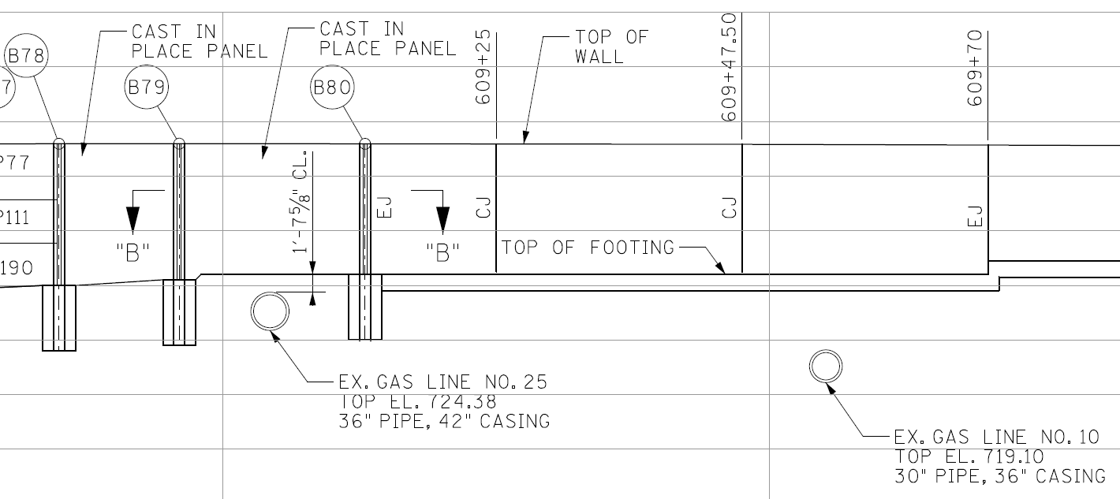
Retaining Walls in close proximity to Gas Lines
Gas Line 25 (36” dia. – 42” cased) is centered between the last two soldier piles of Wall No. 1. Approx. clearance is 6 feet on each side.
Gas Line 10 (30” dia. – 36” cased) is located approx. 5 feet below bottom of wall footing.

Slide 21
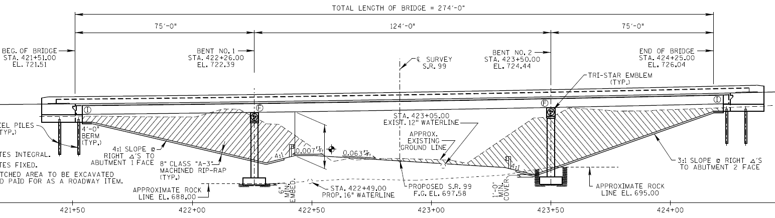
Temp. Shoring for Bridge Phased Construction
Temporary Shoring will be required for the hatched area.
Shoring heights will approach a maximum of 25 feet.
Working room between Phases is narrow.

Slide 22
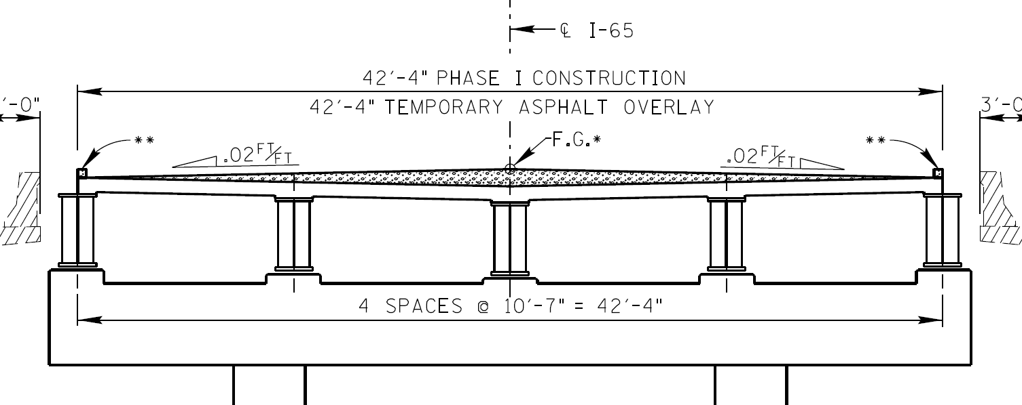
Temporary Asphalt at Median Bridge Section
Temporary Asphalt Overlay will be necessary at the bridge median section built in Phase I.
In the final bridge construction phase, the asphalt will need to be removed without damaging the new deck slab.

Slide 23
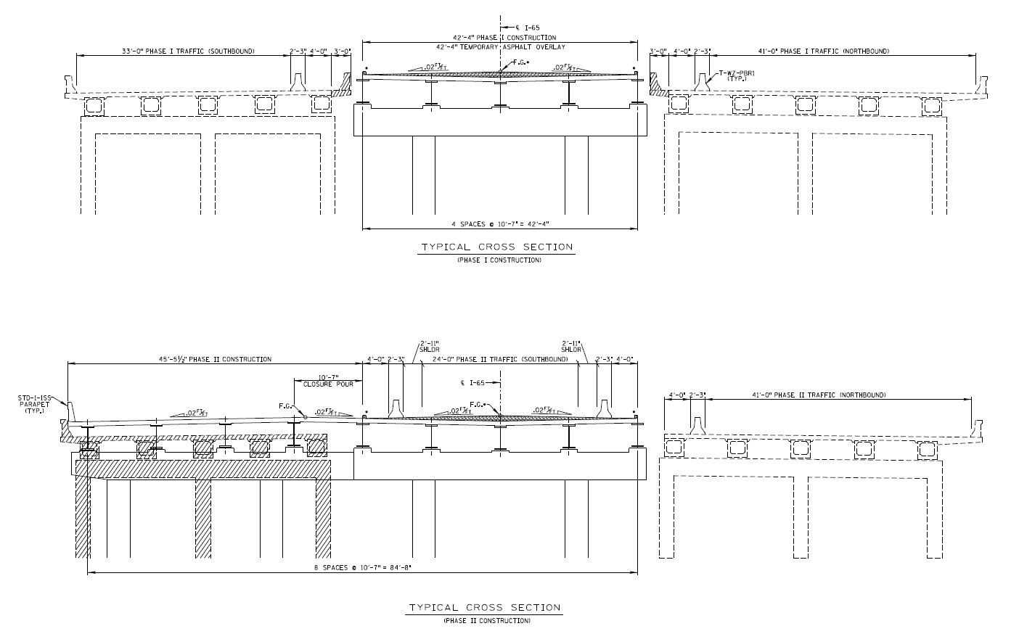
I-65 Bridge Construction Phasing
Southbound
Phase 1
Northbound
Southbound
Phase 2
Northbound

Slide 24
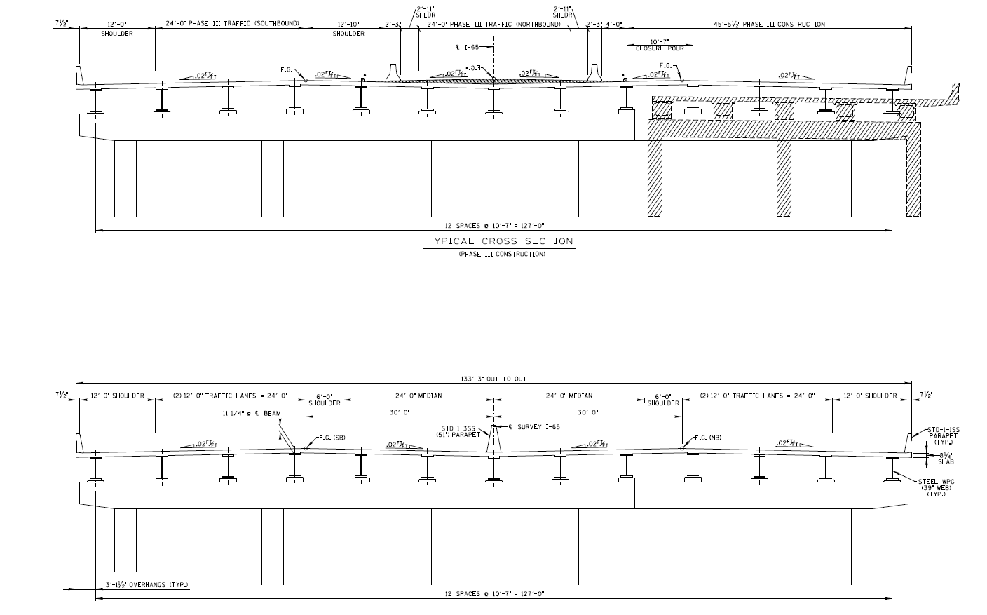
I-65 Bridge Construction Phasing
Southbound
Phase 3
Northbound
Southbound
Phase 4 - Final
Northbound

Slide 25
Traffic Control (Phase 1 of 5)
Phase 1:
  Construct I-65 Median Bridge.
  Maintain I-65 NB and SB Lanes.
  Construct south widening on SR-99 (excluding under the bridge).
  Construct Southern half of box culvert under SR-99.
  Maintain SR-99 existing lanes and turn lanes.
  Construct Proposed Ramp 4 including retaining walls.
  Maintain all existing ramp traffic.

Slide 26
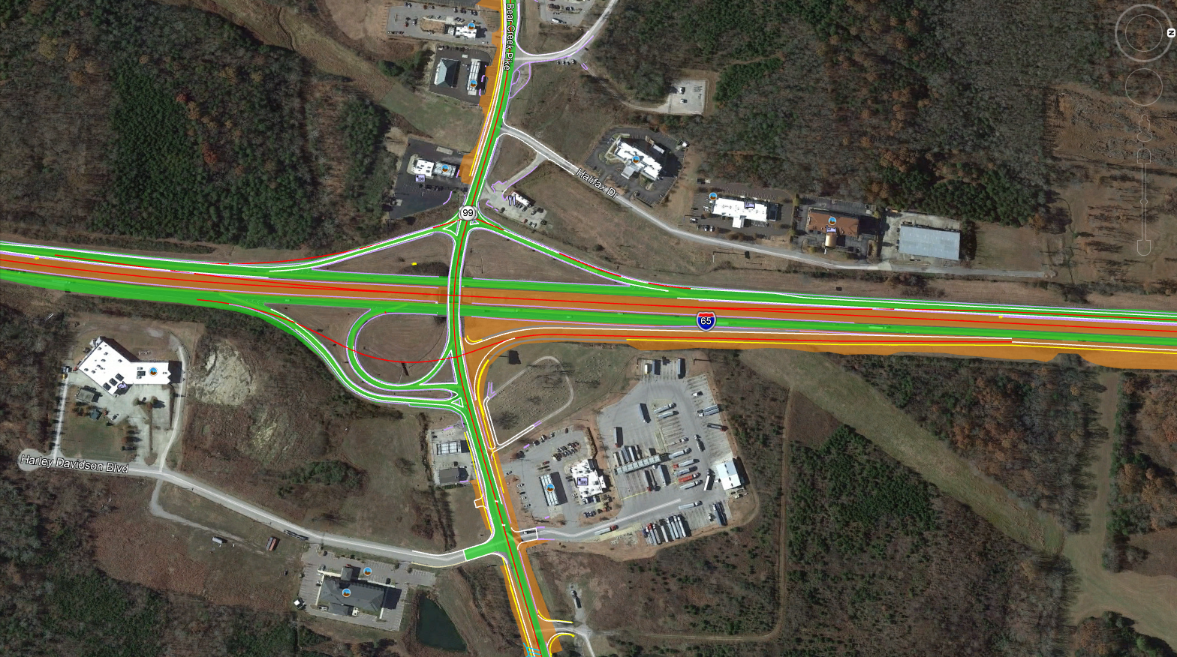
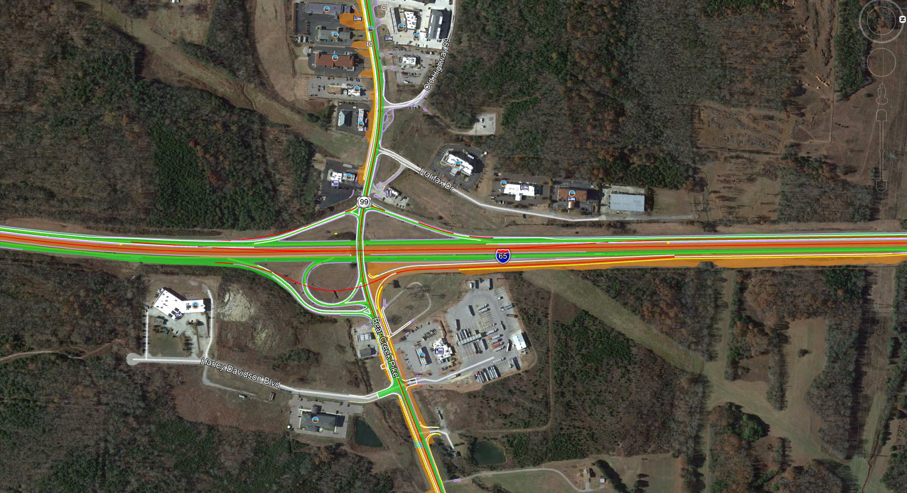
Traffic Control (Phase 1 of 5)
WORK ZONE
TRAFFIC

Slide 27
Traffic Control (Phase 2 of 5)
Phase 2:
  Construct I-65 SB Bridge and Prop. Grade.
  Maintain I-65 NB and SB Lanes (using median bridge)
  Construct north widening on SR-99 (excluding under the bridge).
  Construct Northern half of box culvert under SR-99.
  Maintain SR-99 existing lanes and turn lanes.
  Construct Ramps 1 and 2.
  Maintain existing Ramp 1 and 2 traffic with shifts as needed.

Slide 28
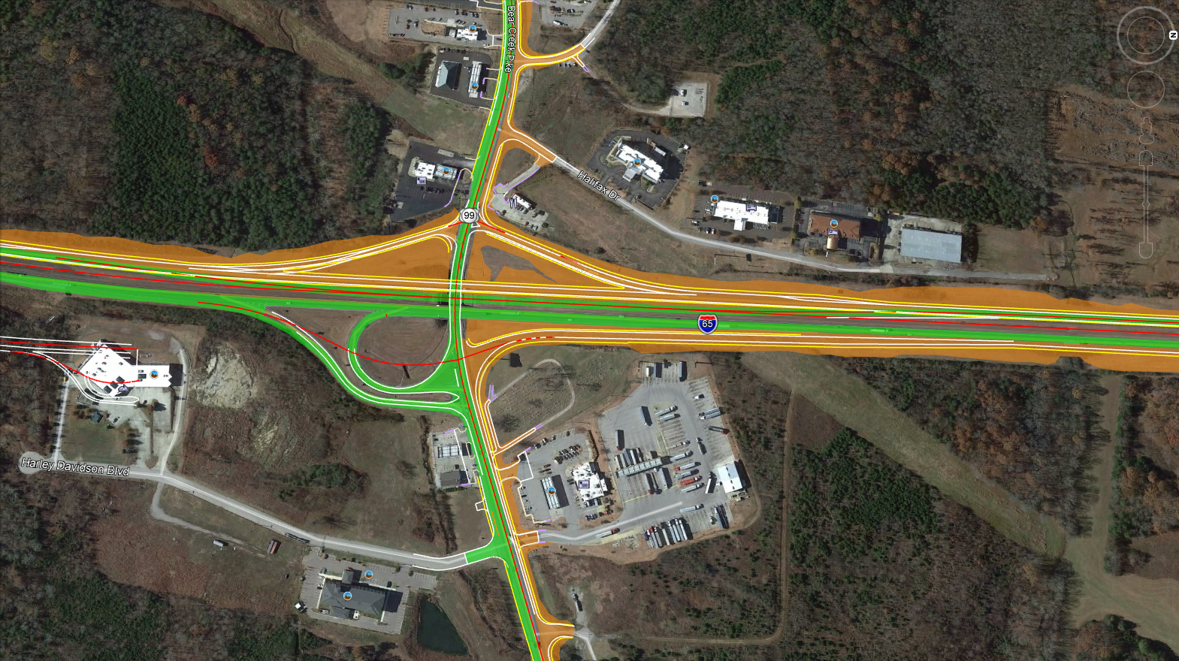
Traffic Control (Phase 2 of 5)
Insert phase 2 graphic here
WORK ZONE
TRAFFIC

Slide 29
Traffic Control (Phase 3 of 5)
Phase 3:
  Construct I-65 NB Bridge and Prop. Grade.
  Maintain I-65 NB and SB Lanes (using median bridge)
  Re-stripe area under the bridge to provide left turn onto Prop. Ramp 4, I-65 NB on-ramp.
  Maintain SR-99 existing lanes and turn lanes.
  Open Ramp 4 to traffic.
  Construct Ramp 3.
  Remove existing Ramp 4 (Loop Ramp).
  Maintain existing Ramp 3 traffic with shifts as needed.

Slide 30
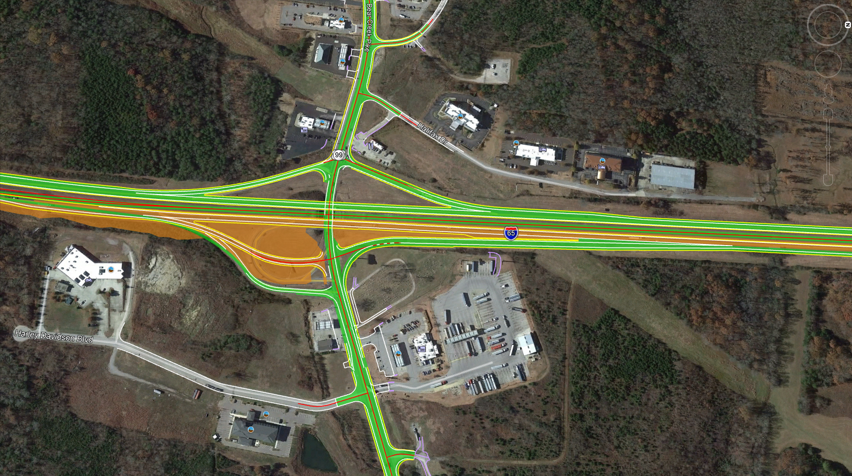
Traffic Control (Phase 3 of 5)
Insert phase 3 graphic here
WORK ZONE
TRAFFIC

Slide 31
Traffic Control (Phase 4 of 5)
Phase 4:
  Construct I-65 Final Median surface and drainage.
  Maintain I-65 NB and SB Lanes.
  Construct north half of permanent widening under the bridge while using temporary signals to maintain traffic.
  Maintain SR-99 existing lanes and turn lanes (using temporary widening to the south under the bridge)
  Remove any remnants of ramp
  Construct stream relocation in southeast quadrant of the interchange.
  Maintain all ramp traffic on newly constructed ramps.

Slide 32
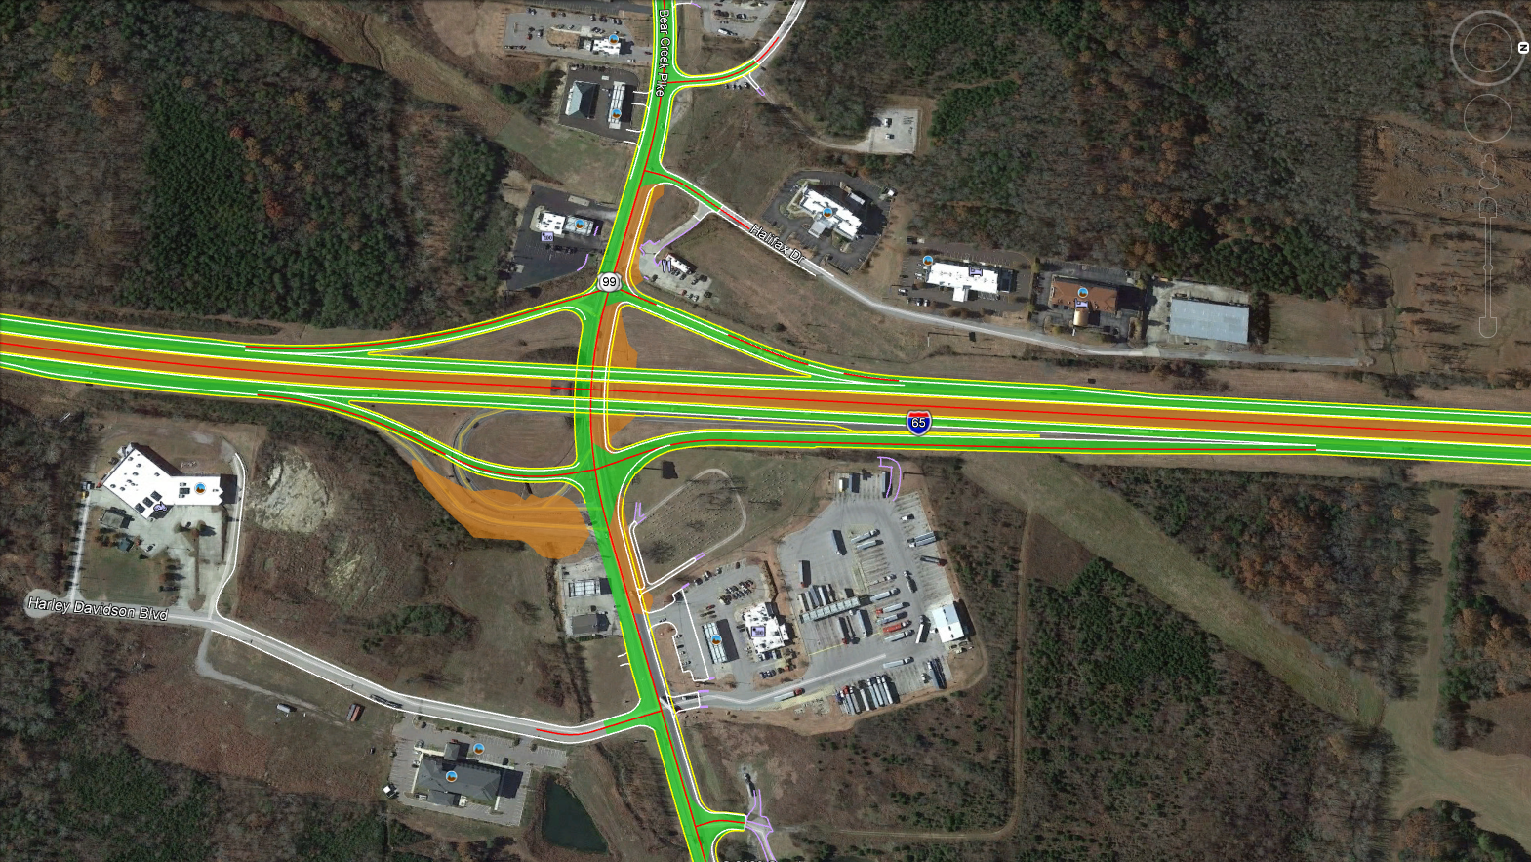
Traffic Control (Phase 4 of 5)
Insert phase 4 graphic here
WORK ZONE
TRAFFIC

Slide 33
Traffic Control (Phase 5 of 5)
Phase 5:
  No work on I-65 in this phase.
  Maintain I-65 NB and SB traffic in proposed lanes.
  Construct south half of permanent widening under the bridge while using temporary signals to maintain traffic.
  Maintain SR-99 existing lanes and turn lanes (using permanent widening to the north under the bridge)
  Perform final paving/striping on all ramps.
  Maintain all ramp traffic on newly constructed ramps.

Slide 34
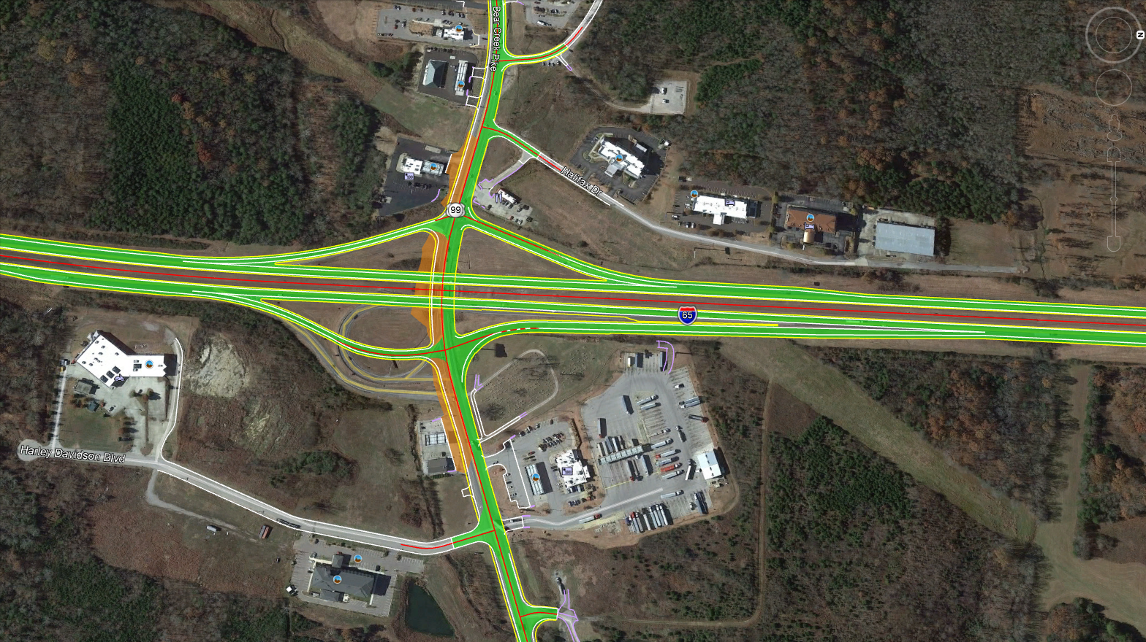
Traffic Control (Phase 5 of 5)
Insert phase 5 graphic here
WORK ZONE
TRAFFIC

Slide 35
THANK YOU

