Slide 1
Davidson County CNR048
I-24 ABC Mandatory Pre-Bid Meeting
Letting Date: March 3, 2017
*Updated 1/27/2017

Slide 2
Pre-Qualification Requirements
Standard Pre-Qualifications still apply.
  Please check to make sure your TDOT Pre-qualification is not expired
  Contractors with an expired prequalification that has surpassed the 90 day grace period will not be authorized to bid
  Prospective Bidders must have filed their standard prequalification questionnaire at least 14 days preceding the date of letting.

Slide 3
Pre-Qualification Requirements
Special Pre-Qualification
  Special Pre-qualification Packages are due to HQ Construction no later than Friday, January 27, at 10:00 a.m. CST
  Contractors will be notified of Qualification Status by Wednesday, February 1, 2017 at 4:30 p.m.
  Contractors must still request bid-authorization by 4:00 p.m. CST on Thursday, *March 9, 2017 to be able to bid.

Slide 4
Pre-Qualification Requirements
Questions:
RFI forms can be copied from the website. Please complete RFI forms and submit by email to Jamie.Fitzpatrick@tn.gov.
RFIs will be accepted up until Friday, *February 24, at 4:00 p.m. CST.
Responses will be posted on TDOT Construction webpage.

Slide 5
Scope and Overview of Project
2.063 mile section of Interstate 24 from north of Spring St to south of Silliman Evans Bridge including ramp bridges.
ADT: 132,340
Designer: Gresham, Smith, and Partners
Replace superstructure in bridges over Spring St and Oldham St/CSXT. Mill and install Sandwich seal on Silliman Evans Bridge, perform bridge repairs, and resurface I-24.

Slide 6
Scope and Overview of Project
Completion date is June 30, 2018.
A + B bidding
  A weekend is considered both directions of the interstate from 8:00 p.m. Friday until 5:00 a.m. Monday.
Road User Cost: $949,161.00 per weekend ($16,650.00 per Hour)
Contract 108B to define “B” component of bid.

Slide 7
Scope and Overview of Project
Lane Closures allowed nightly from 8:00 p.m. to 5:00 a.m.
Weekend closures in addition to contractor’s “B” bid will be subject to LD’s at Road User Cost Rate.

Slide 8
Worth Noting
  Project is an FHWA Project of Division Interest (PoDI).
  Railroad: Approximately 30 trains per day. Contractor shall coordinate with STV and CSXT. CSXT must approve plans for demo of old bridge and setting beams over the tracks.
  Soil from the surface to 10 foot depth at Bent 1 required to be disposed under a TDEC Special Waste Permit (see Project Commitment sheets)

Slide 9
Worth Noting
  No weekend closures will be allowed during weekends with events at Nissan Stadium or East Nashville, including Titans home games, concerts, Tomato Fest, etc. (or as directed by the Engineer)
  Contractor will be required to provide a representative to participate in community relations events.
  Precast deck panels may be manufactured on-site.

Slide 10
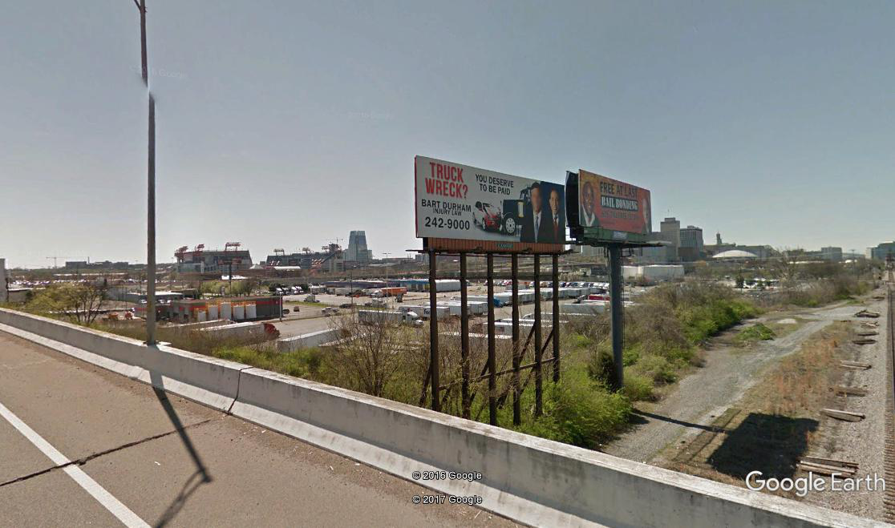
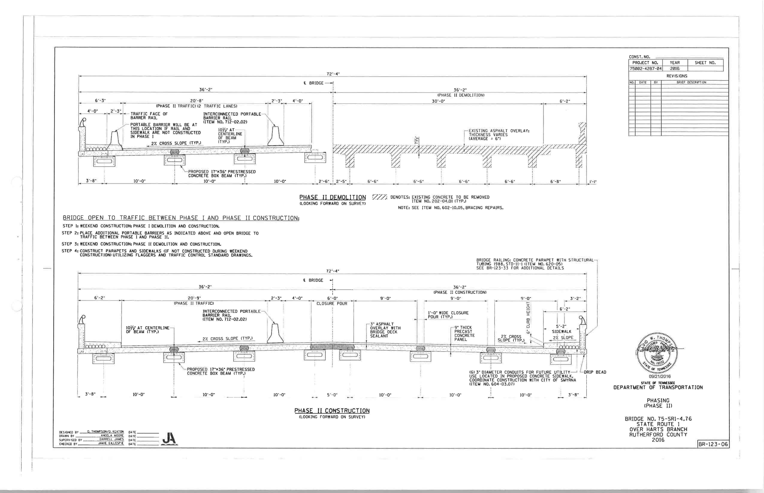
  Billboards cannot be removed and replaced!

Slide 11
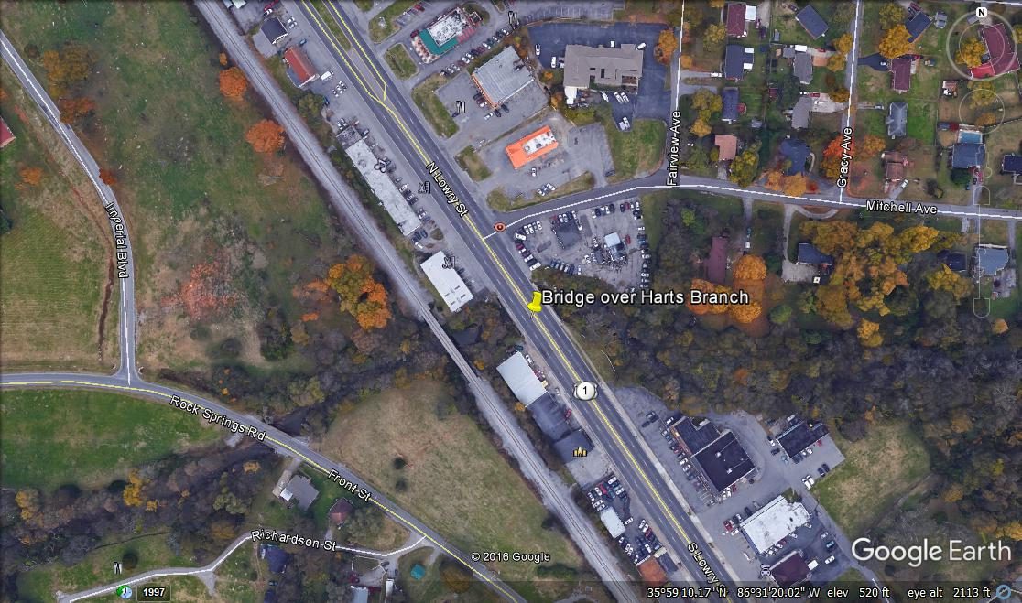
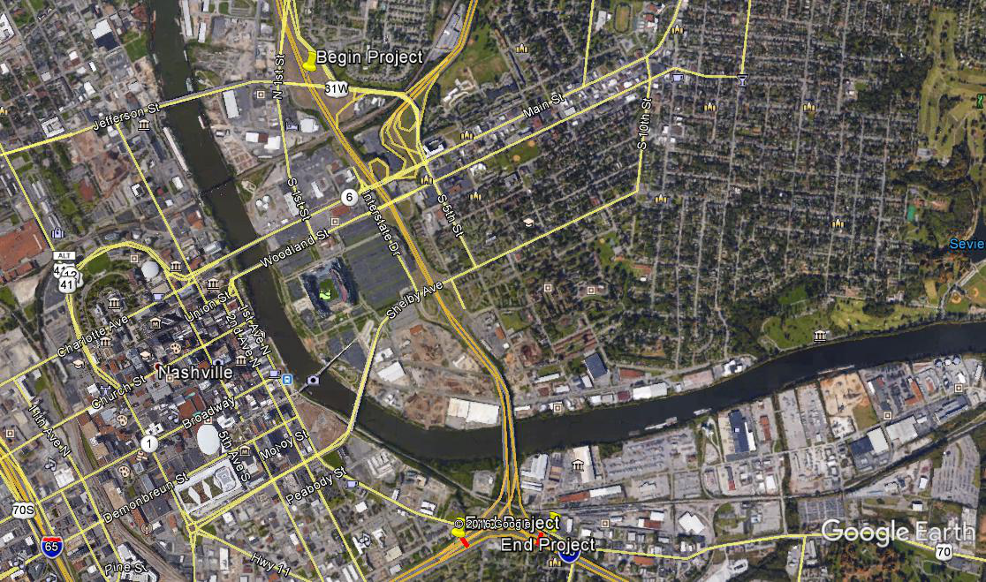
Scope and Overview of Project

Slide 12
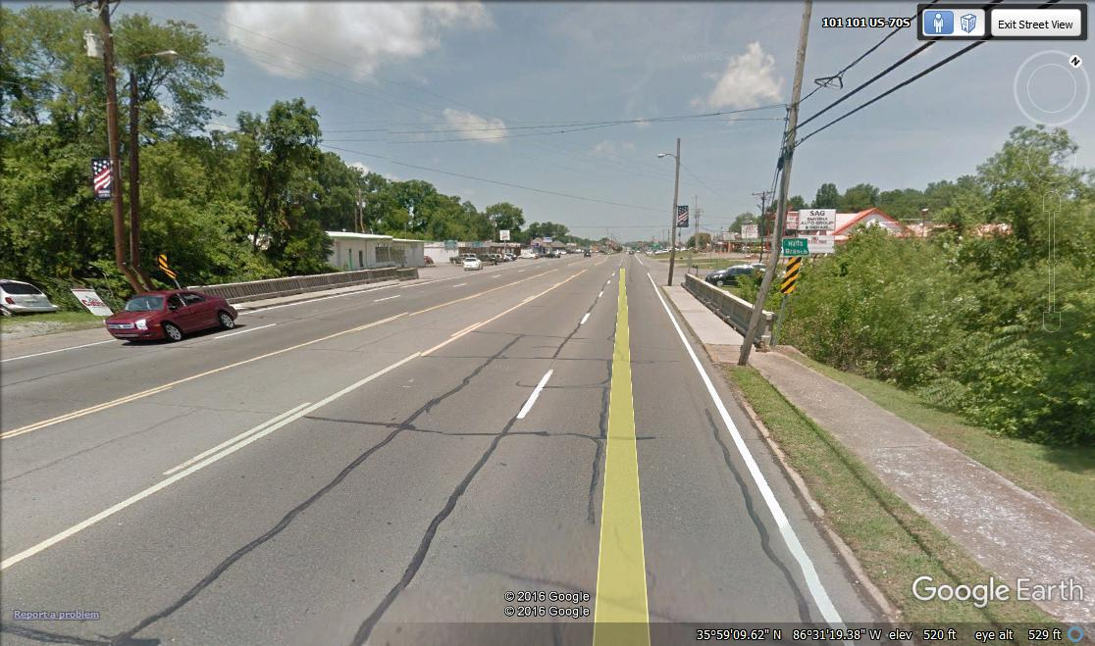
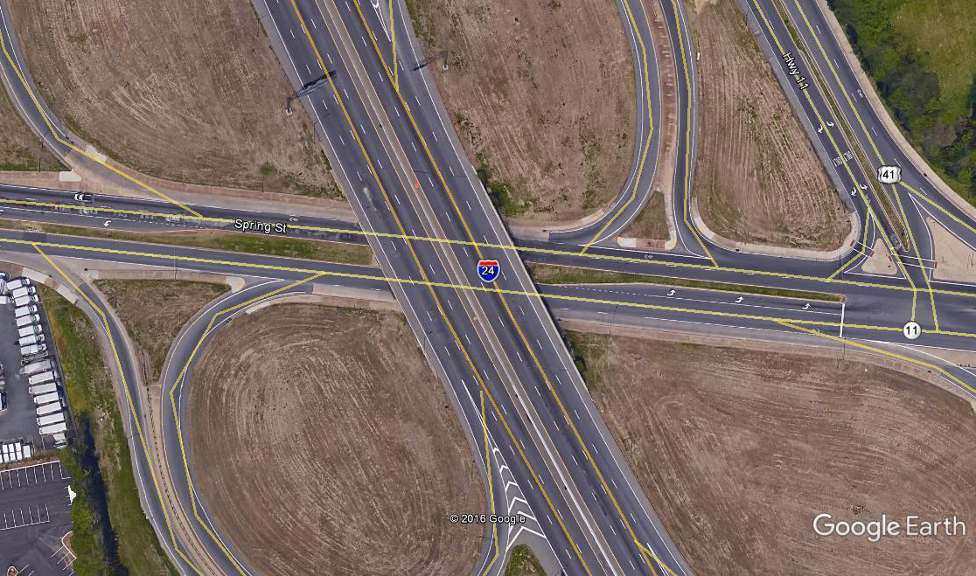
Scope and Overview of Project

Slide 13
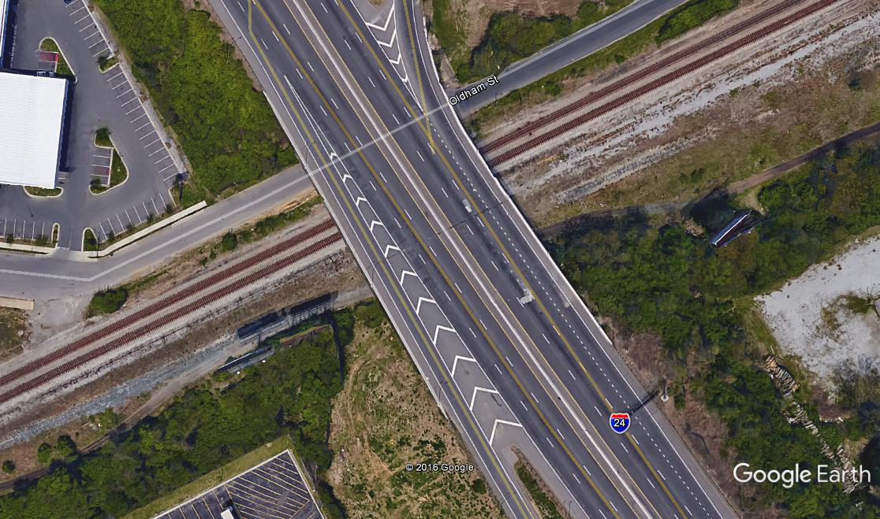
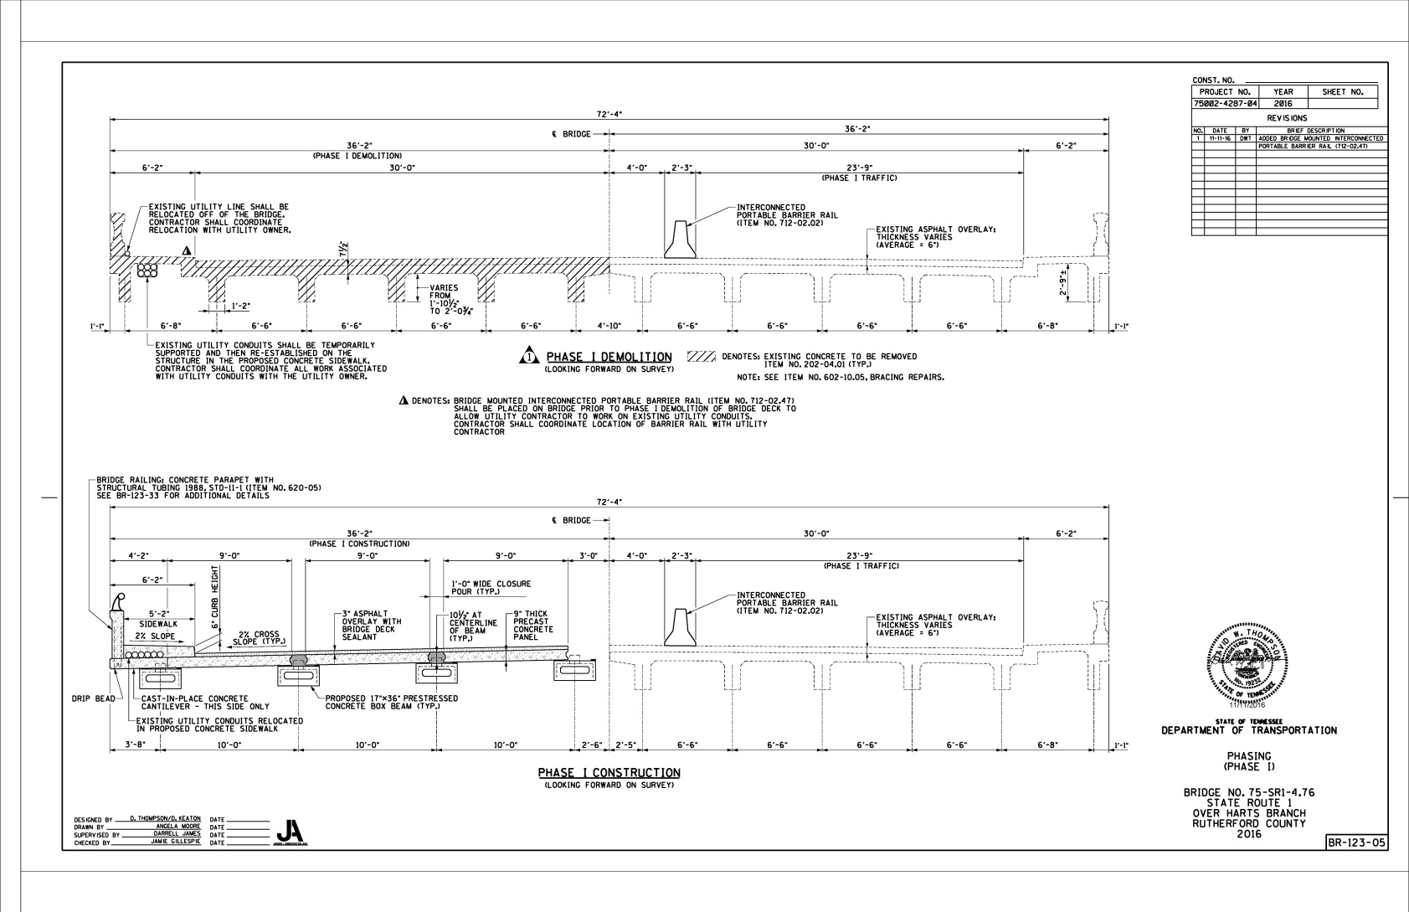
Scope and Overview of Project

Slide 14
Questions
Please submit RFI’s no later than *February 24, 2017.
Responses will be posted on TDOT’s website.

