Slide 1
TRBA Spring 2017
Changing the way we do business.
April 2017

Slide 2
Agenda
Specialty Item Update
Pre-Ride Date Change
Waste & Borrow Update
CUF’s
Adobe Sign

Slide 3
Specialty Items
Add to Definitions in 101.03:
Specialty Item: A Contract item designated as a “Specialty Item” in the Specifications or Proposal that requires highly specialized knowledge, abilities, craftsmanship, or equipment not ordinarily provided by contractors prequalified to bid on the Contract as a whole. Specialty Items are usually limited to minor components of the overall Contract.
Revise 108.01 Subletting of Contract
…… the Contractor shall self-perform work amounting to not less than 30% of the total original Contract cost…..
As stated above, unless there is a Special Provision 108A in the proposal, the following items are designated as Specialty Items:

Slide 4
Specialty Items
Effective 6/23 Letting: Special Provision 108A’s will only be included in contracts that have different specialty items than what is listed in 108.01.
Majority of these will be Safety and Maintenance Contracts

Slide 5
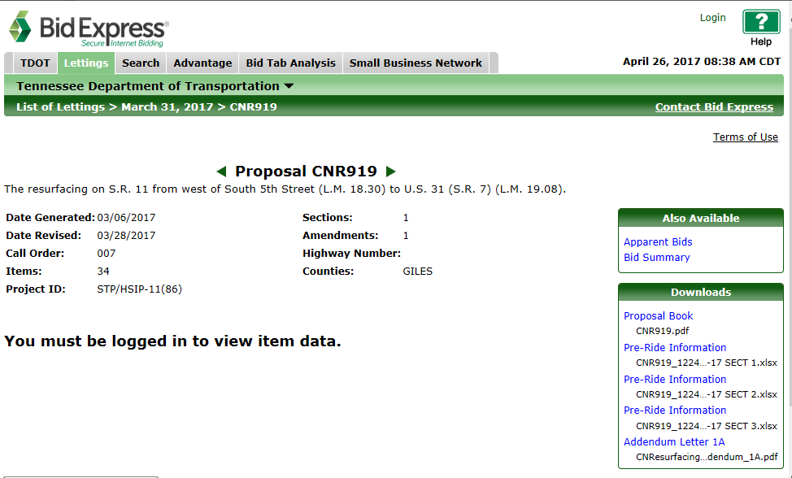

Slide 6
Waste & Borrow Update
Effective 6/23 Letting:
TDOT compliance and inspection forces will no longer be inspecting waste and borrow sites.
Provide Certification at Pre-Con: NPDES and any Water Quality Permits, Geotech Report, and any landowner agreements.
Updated Procedure will be posted 5/15.

Slide 7
CUF Update
CUF’s must be filled out the first time a DBE shows up to work on Contact (On or Off site)
No CUF = Work doesn’t count toward Goal

Slide 8

Electronic Signatures with Workflows
Speed
Tracking
Mobile Device friendly
Contract Books will no longer be printed effective 5/12 Letting

Slide 9



Slide 10
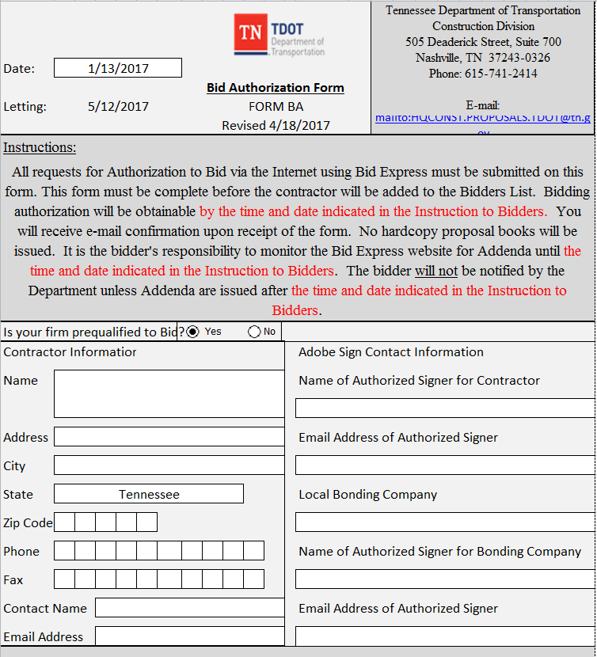

Slide 11
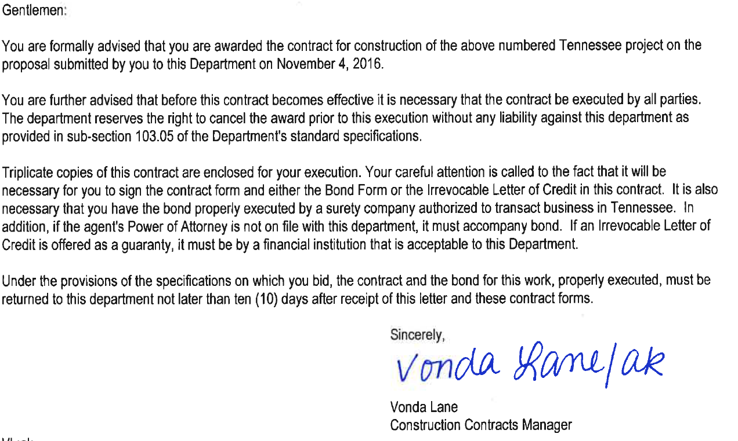
Contract Award Letter
Notes:
The Contract Award Letter will go away and be replaced by the email on the next slide.

Slide 12
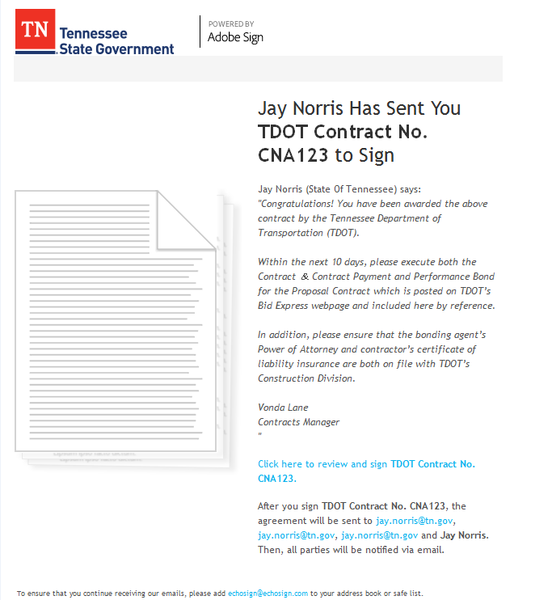

Slide 13
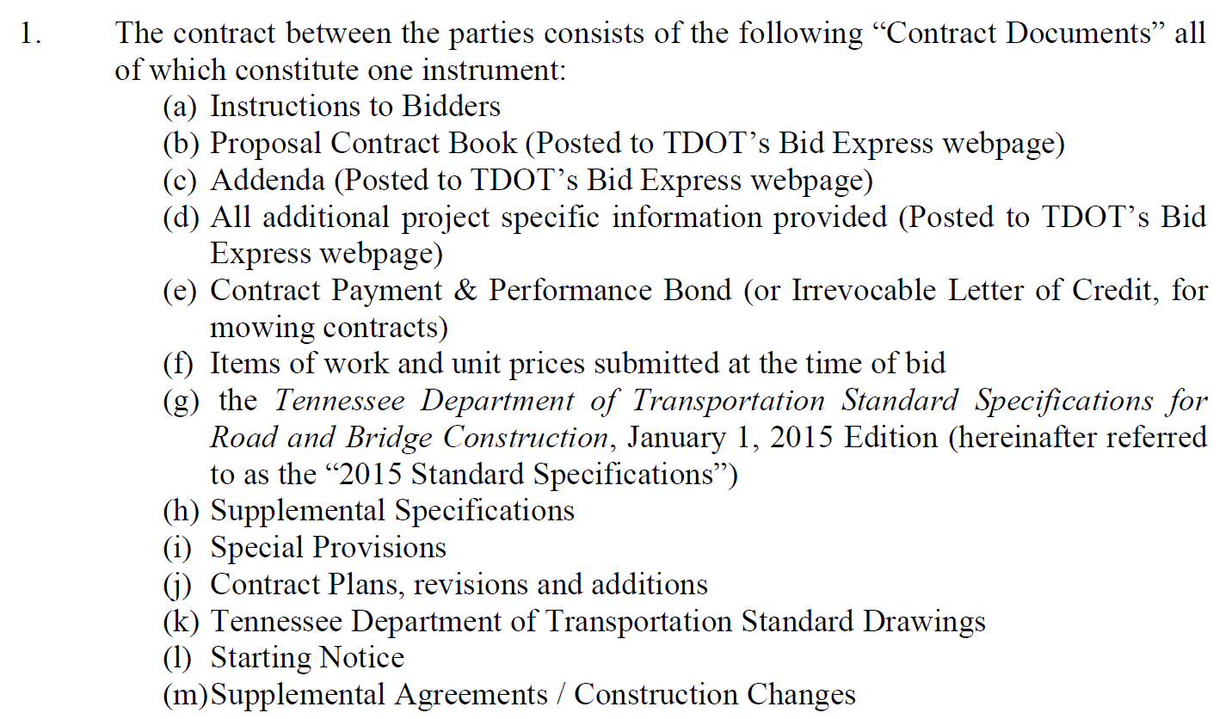
Summary of Changes
Only the actual Contract (Pages 6-10) will be passed around in Adobe Sign (Contract Book is Referenced)
Contract Book will be assembled by HQ Construction and put on Bid Ex website

Slide 14
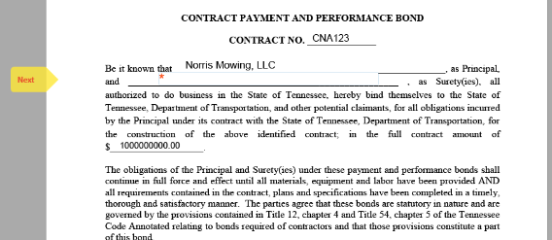
Follow the Yellow Boxes!

Slide 15
Proposal and Guarantee
Since 2007…….
Proposal (Pages 1-3): Digitally Signed in Expedite
Proposal Guaranty Bond (Pages 4-5): Digitally Signed in Expedite
Proposal Guarantee (Check for 5% or Irrevocable Letter of Credit)(Page 6): Handled outside Expedite prior to letting.
Change: Signature pages going away

Slide 16
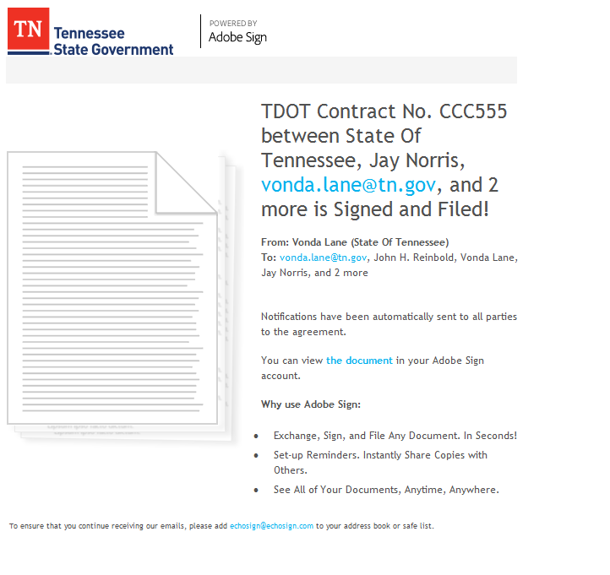
Contract Book will be assembled and consolidated by HQ Construction and put on Bid Ex website

Slide 17
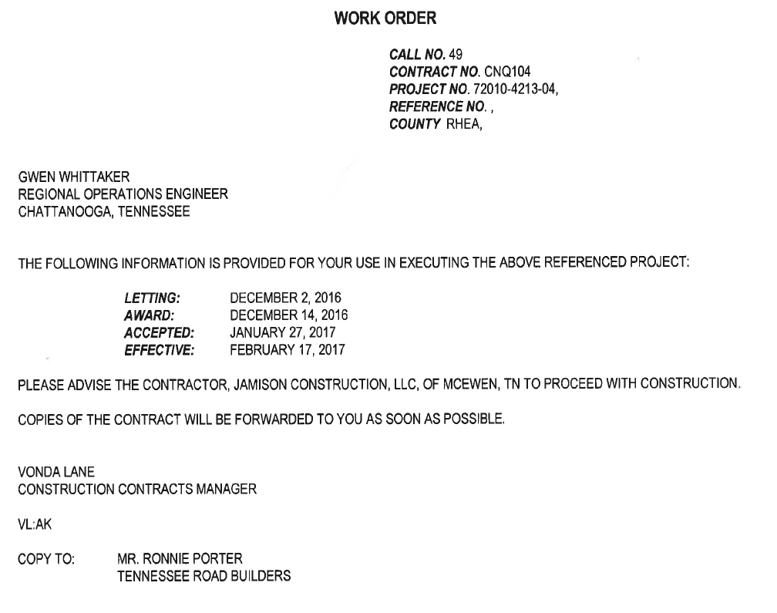


Slide 18
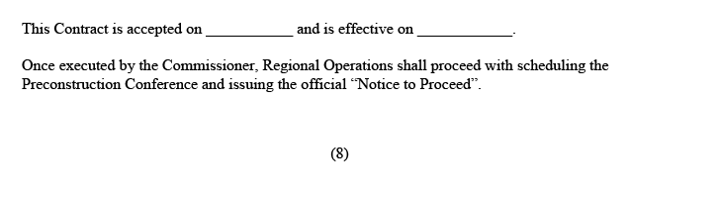
Summary of Changes

Slide 19
Power of Attorney & Certificate of Liability Insurance
Homework:
Bonding Companies: Send Blanket POA
Liability Insurance: Send on Annual Cycle

Slide 20
Change Orders
  Coming Summer 2017
  Adobe Sign Templates for each category (1-4) and workflow (PODI vs Non-PODI)

Slide 21
On the Horizon….
E Plans
E-Plans File Room for Contractor access during Letting
  (Will no longer print plans for external parties)
Once Contract is awarded, plans would be loaded to App for Field Use

Slide 22
E-Plans and PlanGrid Benefits
Single Up-to-date Set of Drawings
Connects Field, Office, Regions, HQ
Administrative Time Savings
“Keeps Teams updated with real time information, anywhere, any time”

Slide 24
On the Horizon….
AASHTOWare Project/ CRL
AASHTOWare Project
  External Access for Contractors
Civil Rights and Labor Module
  Payrolls loaded by Contractor
  Prompt Payment Loaded by Contractor
  DBE Goals Tracked

Slide 25
Questions?

