Slide 1

Environmental Division
Guide to Submitting Payable Invoices
3/18/2021
Notes:
Good afternoon, my name is Natalie Lee and I’m the Contracts Projects Supervisor. Today I’ll be sharing the Environmental Division’s guide to submitting payable invoices.

Slide 2
Two Types of Invoice Templates
Consultant Assistance
AND
Single Project
Notes:
To assist firms in submitting approvable invoices and to increase efficiency and speed in invoice reviews and approvals, the Environmental Division developed two types of templates for invoice submittals—Consultant Assistance and Single Projects. These templates include embedded instructions to assist the preparer.

Slide 3
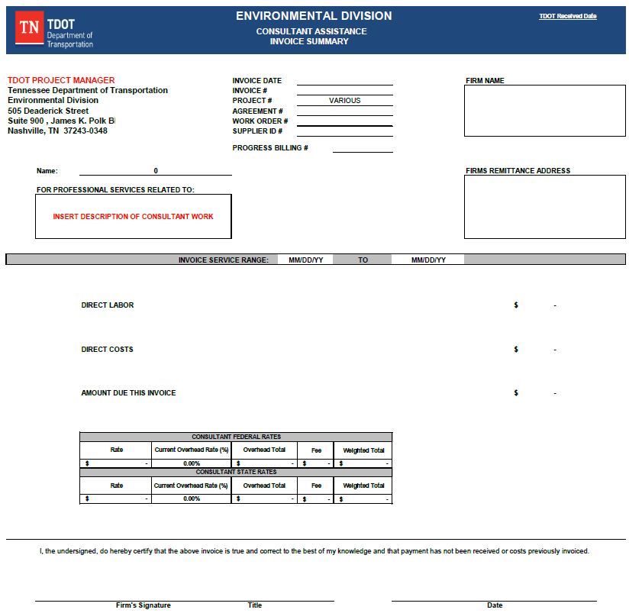
Consultant Assistance
Invoice Templates
Are used when an embedded consultant from a firm will be performing many different tasks for a section within the Environmental Division.
3/18/2021
Notes:
For Consultant Assistance related questions, please contact Teresa Rippetoe directly. Her contact information can be found on the Environmental Division’s website under the Contracts Projects Section.

Slide 4
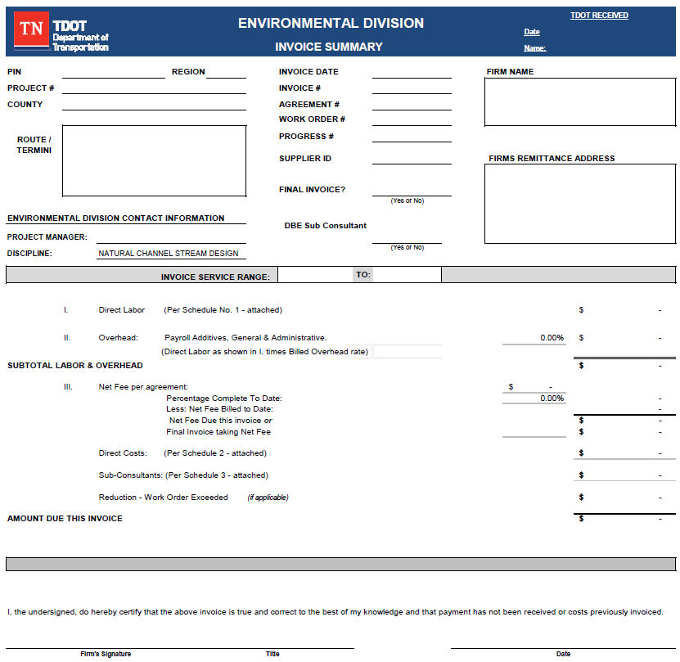
Single Project Invoice Templates
Are used when a firm is billing for deliverables against one specific project.
3/18/2021
Notes:
The Single Project invoice template is the main template used by all the firms, and the one we will be reviewing for the remainder of the presentation.

Slide 5
Invoice Guidance
The Key to Accuracy
Notes:
The items outlined in the presentation are in addition to, not instead of, the instructions embedded in the Environmental Division invoice templates. The invoice guidance provided is not an exhaustive list, but compliance with the template instructions and the instructions listed here should be sufficient to ensure an invoice is approvable in most cases. The templates can be found on the Environmental Division website and firms are encouraged to check that site periodically to ensure the most up-to-date template is being used. Links to the website will be provided at the end of the presentation.

Slide 6
General Guidance
Rounding – All figures must be rounded to 2 decimal places.
PPI – All Personal Private Information (PPI) must be removed or redacted from all supporting documentation.
  Examples include social security numbers, tax ID numbers, personal tax information, bank acct/routing numbers, EFT/ACH forms and credit card information.
Sheets Submitted – If one or more tabs/sheets from the invoice template are not relevant and/or are not used in the generation of a firm’s invoice, those sheets should be removed before the invoice is submitted to TDOT.
The final digital invoice, including all attachments, must be clear and legible, including any scanned attachments.
Notes:
General guidance for invoices includes:
- all figures must be rounded to 2 decimal places
PPI must be removed or redacted from all supporting documentation. Examples of PPI include, tax ID numbers, bank account and or routing numbers, EFT/ACH forms, and credit card information.
Any tabs or sheets not relevant and or not used in the generation of the firm's invoice, should be removed before the invoice is submitted to TDOT.
The final digital invoice, including all attachments, must be clear and legible.

Slide 7
Travel Expenses & Supporting Documentation
Consultant must obtain written authorization from the TDOT PM before purchasing airfare for which reimbursement will be requested.
Airfare reimbursement requires an itemized receipt and a copy of the written pre-authorization for air travel provided to the firm by the appropriate TDOT project manager.
Car Rental requires a $0.00 balance receipt.
Parking receipts are required if parking fees exceed $8.00 per day. However, separate parking receipts are not required for parking listed and paid for as part of a hotel receipt.
Notes:
Travel guidance states the:
Consultant must obtain written authorization from the TDOT PM before purchasing airfare for which reimbursement will be requested.
Airfare reimbursement requires an itemized receipt and a copy of the written pre-authorization for air travel provided to the firm by the appropriate TDOT project manager.
Car Rentals require a $0.00 balance receipt.
Parking receipts are required if parking fees exceed $8.00 per day. However, separate parking receipts are not required for parking listed and paid for as part of a hotel receipt.

Slide 8
Travel continued…
Per diem can only be requested if travel requires an overnight stay. A travel day is 75% of the full day per diem rate on the first and last day of travel.
Lodging – requires a hotel receipt that clearly shows:
  The traveling consultant’s name
  The duration of the stay (date to date)
  Itemization of charges (including room rate)
  If room rate exceeds allowable rate per State Travel Regs, reduction math must be shown on the lodging receipt.
  A $0.00 balance receipt
  Which nights are to be charged to the current invoice, and include relevant math (for lodging receipts that can be charged to more than one project).
  If the overnight stay was in a home (i.e. staying with friends/family) – provide a statement noting the city and state where the traveler stayed and noting that no lodging charges accrued due to staying with friend/family/etc.
Notes:
Per diem can only be requested if travel requires an overnight stay. And a travel day is 75% of the full day per diem rate on the first and last day of travel.
Lodging receipts must clearly show:
The traveling consultant’s name
Check-in and Check-out dates
Itemization of charges
Room rate per day
And a $0.00 balance receipt
If multiple projects were worked during the stay, the relevant project for the specified billing should be clearly stated on the lodging receipt.
If the overnight stay was in a home – provide a statement on firm's letterhead noting the city and state of the stay and that no lodging charges accrued due to staying with friend/family/etc.

Slide 9
The Invoice
Notes:
Next, we will discuss the information needed within the Single Project invoice template.

Slide 10
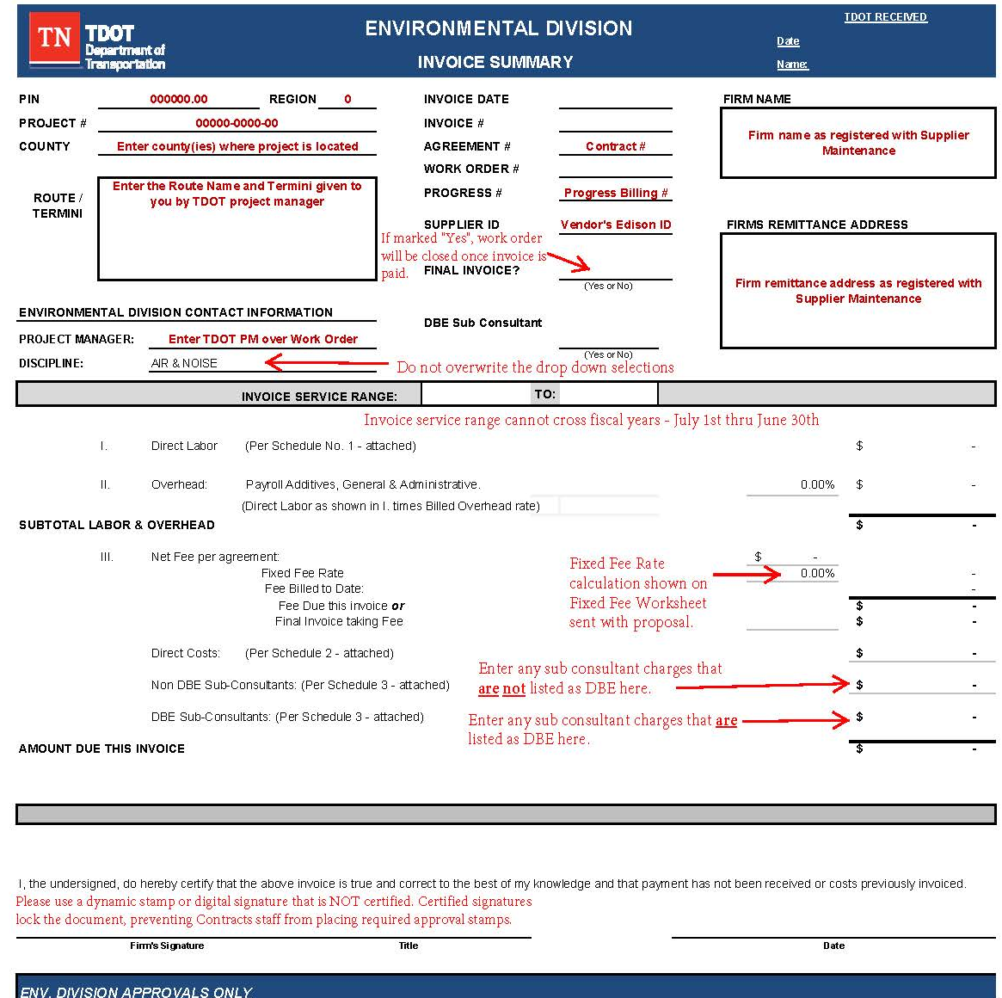
Notes:
On the Invoice Summary page:
The PIN # provided to you by the TDOT PM will be shown here (on the appropriate line). At times you may have two PIN #s: a Financial PIN or FPIN, and a Tracking PIN or TPIN. When this occurs, both PINs should be provided.
State Project Number - All invoices must note the appropriate TDOT state project number. The federal project number is not required.
County
Route/Termini – as given by the project manager or referenced on the work order letter.
Project Manager is the TDOT Project Manager overseeing the work order. They should be listed as a CC on the bottom of the work order letter.
Discipline – Choose the Discipline associated with the contract from the drop-down menu. Please do not overwrite the drop-down selections.
The firm name and remittance address listed must match exactly as registered with Supplier Maintenance.
Invoice # - must be unique. A # cannot be duplicated within a company and must be more than a single digit.
Agreement # is the contract #. Such as (E2301)
Work Order # will come from the work order letter sent to the firm authorizing work to begin.
Progress # is the progress billing sequence.
Supplier ID is the firms Edison ID.
Final Invoice - Choose yes or no from the drop down.
DBE Sub Consultant – Choose Yes or No from the drop-down list based on whether DBE sub consultant charges are included in this billing.
Invoice Service Range –
TDOT’s fiscal year starts July 1st and ends June 30th . An invoice service range cannot cross fiscal years.
All charges must be within the service range shown on the invoice, or the invoice must include a memo on firm letterhead explaining the charge that is outside the service range.
For Direct Costs, the date that the services or goods were provided, must be within the service range of the invoice. If the supporting documentation does not note the date the services or goods were provided, then the date on the receipt/invoice/bill for those goods or services is considered the date of service, and that date must be within the service range of the invoice to which the Direct Costs are charged.
Overhead - The firms OH rate is issued by the External Audit Division. The OH rate listed should be current as of the invoice date.
Fee per agreement is the total fee listed on the work order letter.
Fixed Fee Rate is a manual entry cell based on the rate calculation from the Fixed Fee Worksheet submitted with firm’s proposal.
Fee Due this invoice is calculated based on entries in Subtotal Labor & Overhead and Fixed Fee Rate.
- If Final Invoice is marked “Yes”, the remaining amount of fee should be shown on “Final invoice taking fee” line.
Direct Cost is autopopulated based on entries in Schedule II.
List Sub-Consultant charges from Schedule III tab, on the appropriate line indicating the use of a Non DBE Sub-Consultant or DBE Sub-Consultant.
Signature Line – Please use a dynamic stamp or digital signature that is not certified. Certified signatures lock the document, preventing Contracts staff from placing required approvals.

Slide 11
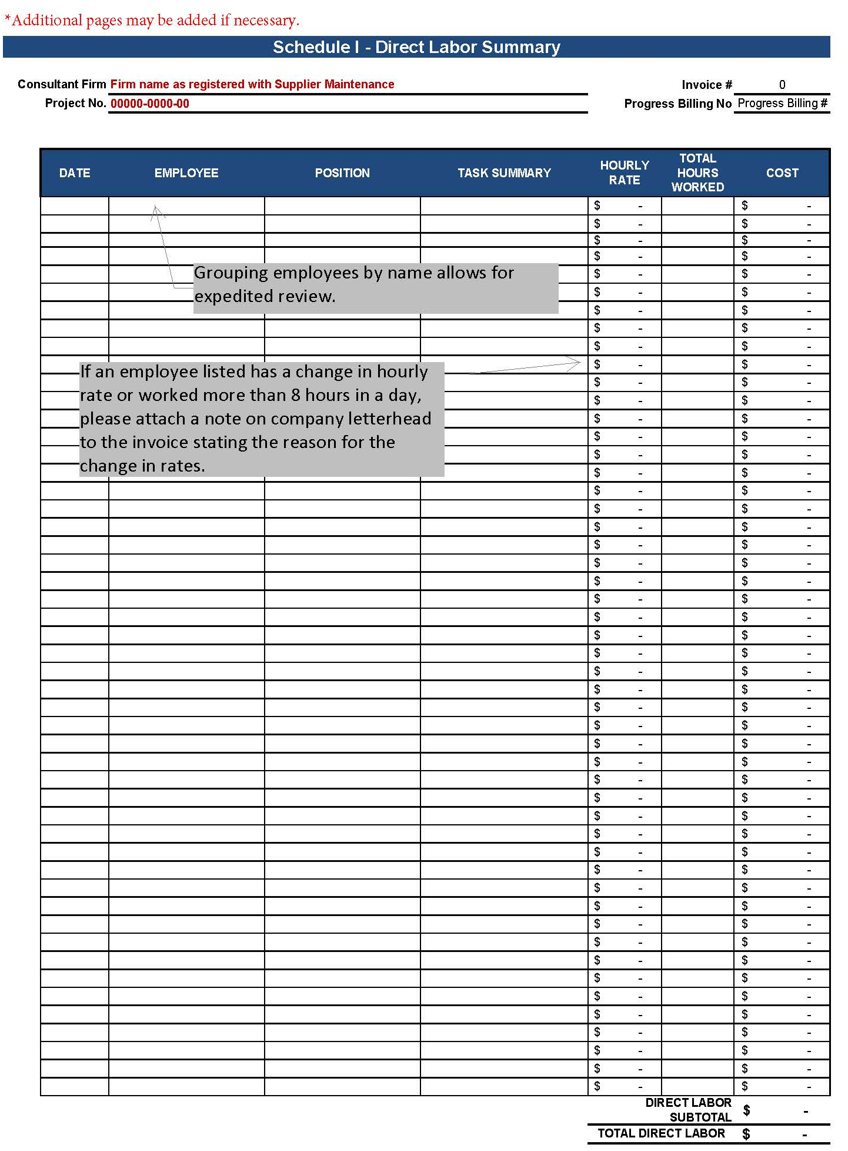
Notes:
Schedule I – Direct Labor
Consultant Firm, Project #, Invoice #, and Progress Billing No. cells are all autopopulated from cells on the Invoice Summary Sheet.
Finance and Administration requires daily labor be listed for each employee.
Grouping employees by name allows for expedited review. If an employee listed has a change in hourly rates or works more than 8 hours in a day, please attach an explanatory memo on firm letterhead to the invoice
stating the reason for the change in rates or extended hours.
*Additional pages may be added if necessary.

Slide 12
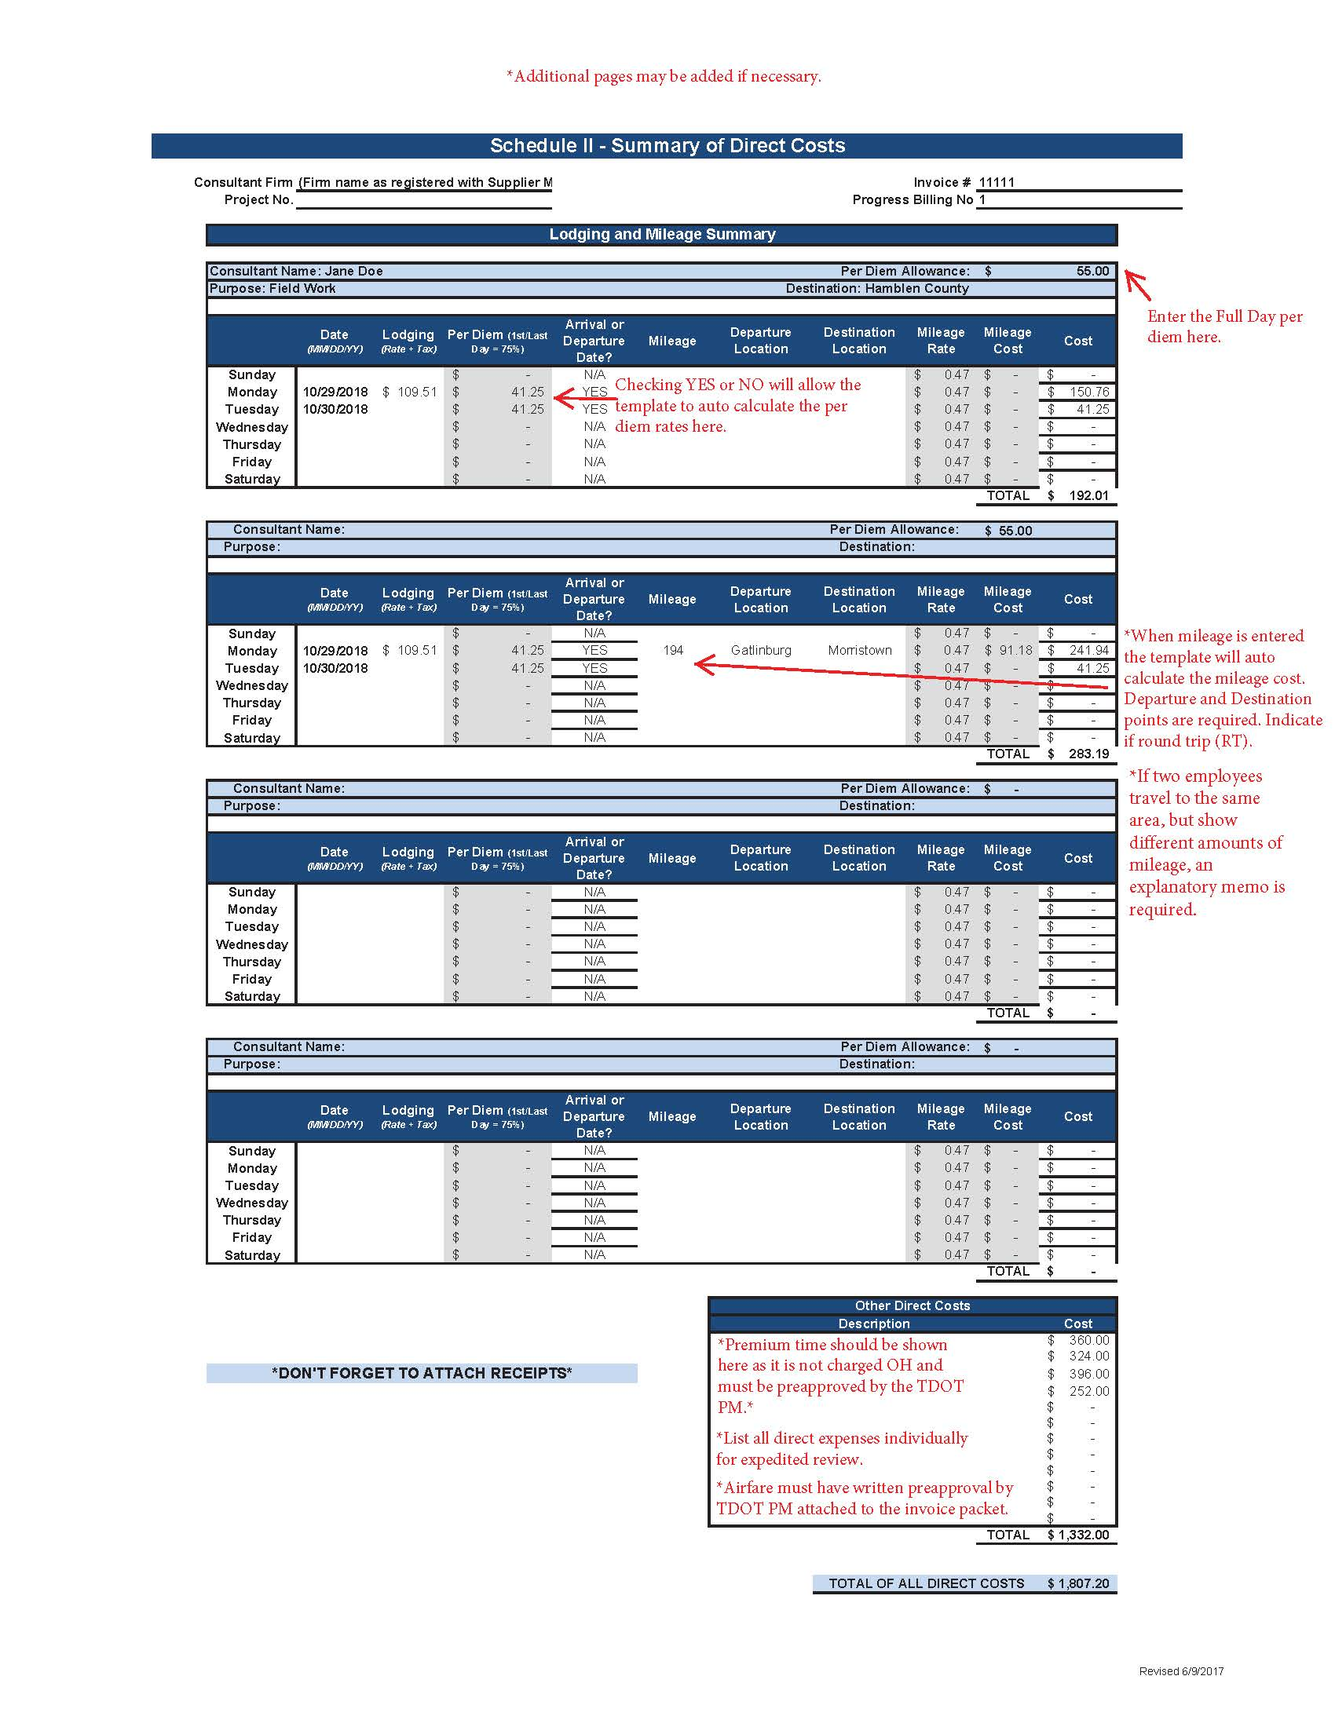
Notes:
Schedule II – Includes the Summary of Direct Costs and the Lodging and Mileage Summary
Mileage rates are set in the State of Tennessee Travel Regulations. Requests for mileage reimbursement must include:
Traveling employee’s name
Purpose of travel
Destination Point
Enter Full Day Per Diem allowance
Date(s) of travel
Lodging rate + tax
Checking YES or NO under Arrival or Departure Date column will allow the template to autocalculate the per diem rates based on the amount listed for Full Day Per Diem Allowance.
Number of miles (indicate if round trip)
If the mileage reported from the departure point to the destination is different than the return mileage from the destination back to the original departure point, then an explanation for the difference must be provided.
Beginning and end location

Slide 13
Notes:
Schedule II - Direct Costs and all Supporting Documentation (the bottom of Schedule II)
All Direct Cost charges should be listed in the box marked “Other Direct Costs”
To the extent possible, supporting documentation should be in the same order that the charges appear in the invoice.
Printing – requires a receipt from any printing service used. However, if reimbursement for in-house printing is requested, no receipt is required but the invoice must note the number of copies made, whether the copies were color or black and white, and the per page rate.
Airfare – requires an itemized receipt and a copy of written pre-authorization for air travel provided by the appropriate TDOT project manager to the Consultant.
Where a receipt includes multiple charges, the charges applicable to the invoice must be clearly marked.
Where any notes or markings are needed to clarify the charges, highlighting should not be used. Highlighting obscures data if the invoice is later copied.

Slide 14
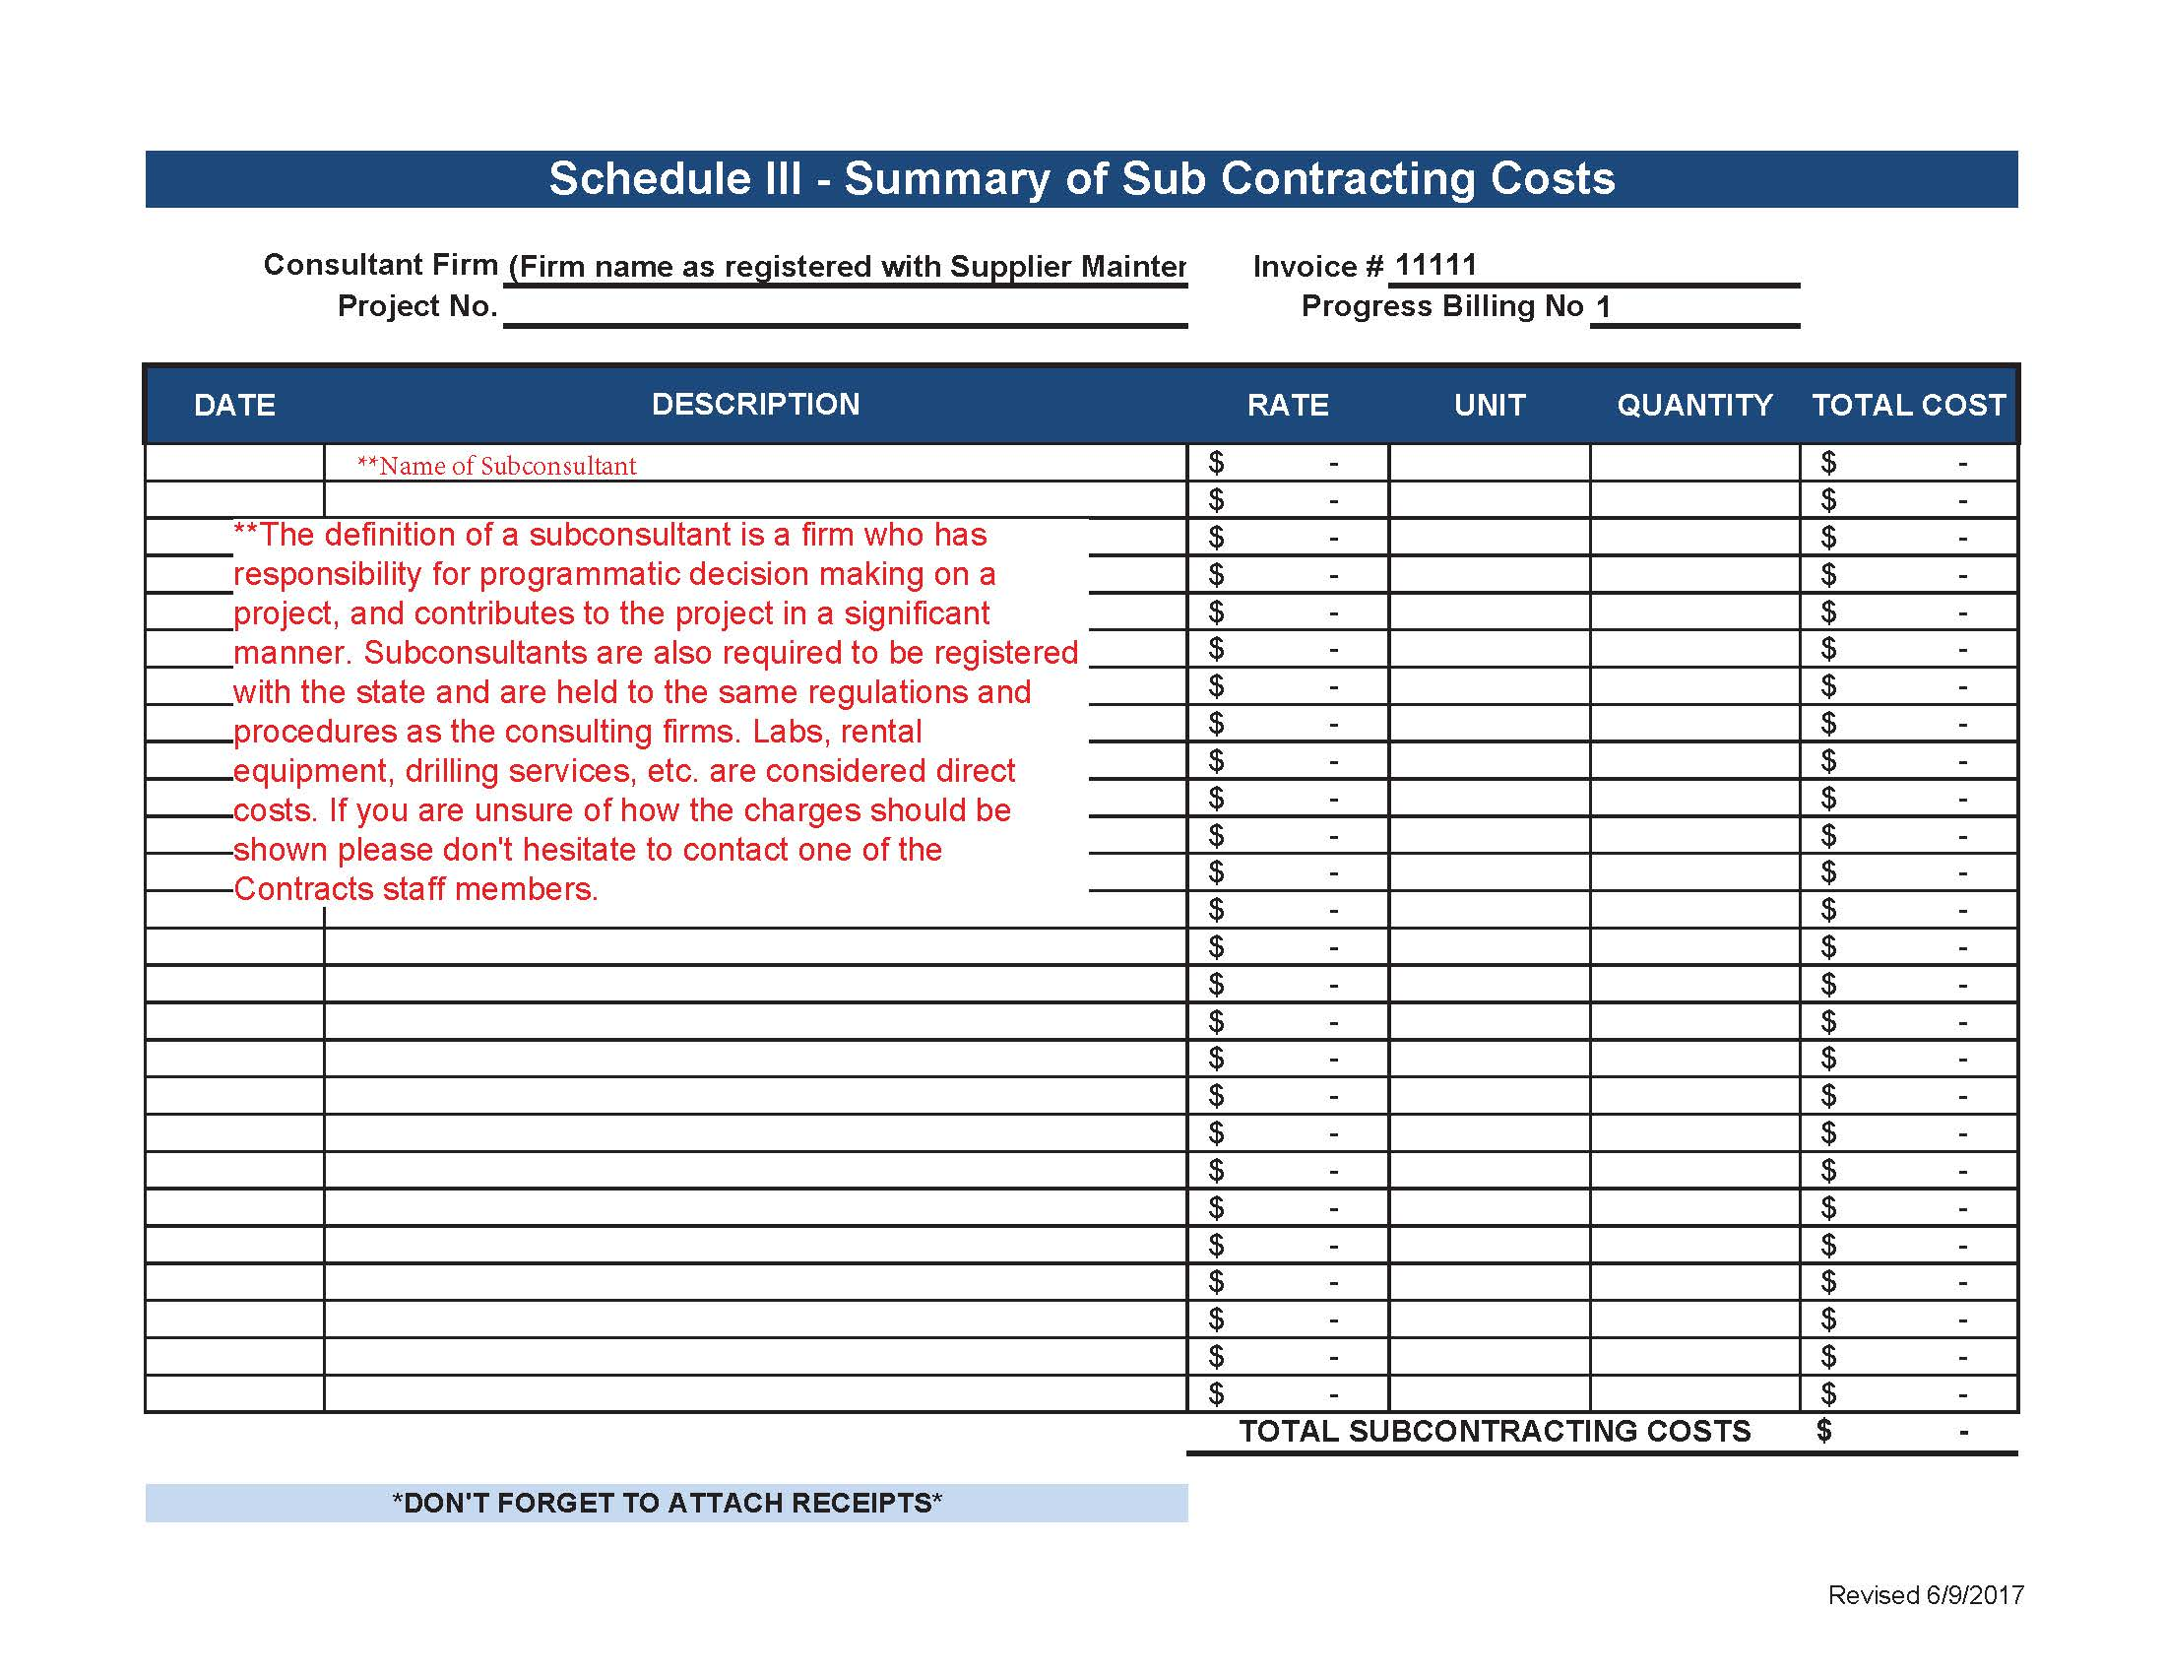
Notes:
Schedule III
The terms sub-contractor and sub-consultant are used interchangeably within the Environmental Division. Any reference made to sub-contractor costs would also fall under this guidance.
• Sub-Consultant charges must be supported and described in the same manner and detail as described herein for a prime. The same information and categorization of expenses as provided in the invoice template should be provided for sub-consultant charges, but sub-consultant charges should not be submitted on the Environmental Division invoice template unless the header for each page of the template is changed.
• Sub-Consultants total costs should be entered as either a Disadvantaged Business Enterprise (DBE) Sub-Consultant, or Non DBE Sub-Consultant on the Invoice Summary tab.
• If the Agreement between TDOT and the Prime Consultant does not specify the potential for lump sum work orders and the agreement between the Prime and the Sub-Consultant is a lump sum agreement, then each invoice that includes charges for the Sub-Consultant must include a full copy of that lump sum agreement.

Slide 15
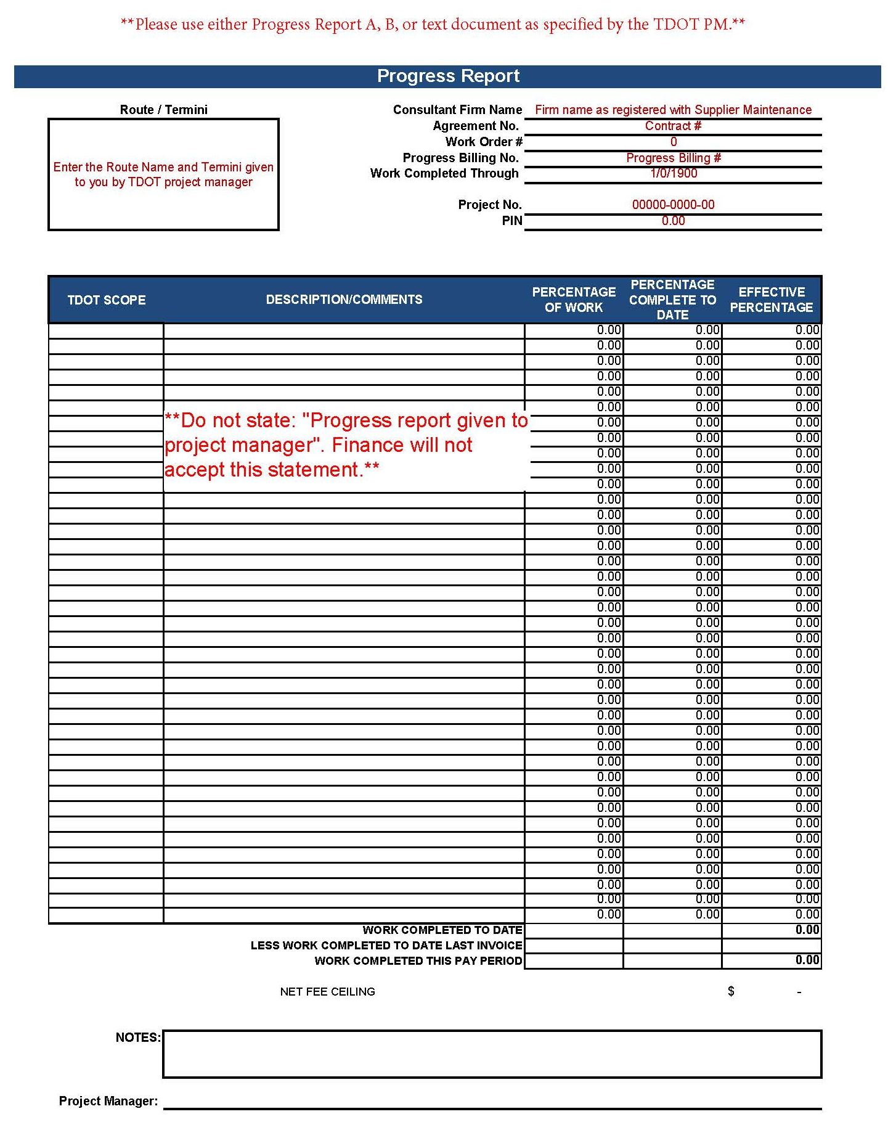
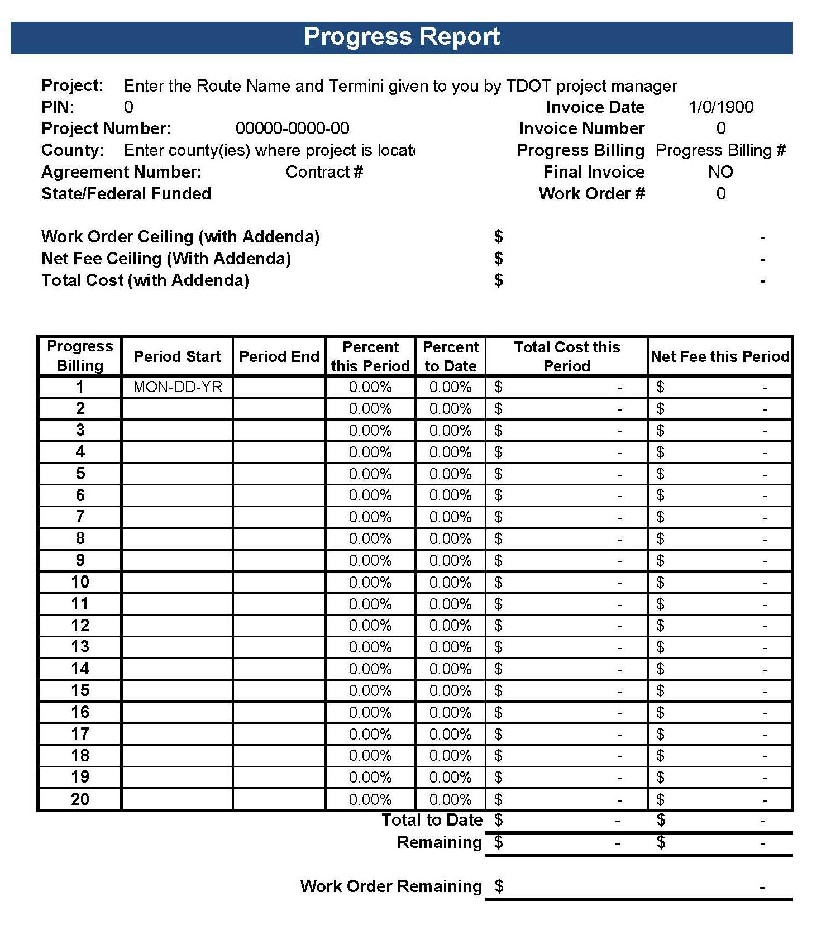
Template Progress Report Options
Notes:
Progress Reports
The invoice template includes two options for progress reports.
Firms need not complete both reports unless requested by the TDOT project manager.

Slide 16
Links
All guidance documents, including this slideshow and instructions for submitting completed invoices, can be found on the Environmental Division website under the Business Office - Contract Projects Section. Firms are encouraged to check that site periodically to ensure the most up-to-date information is being used.
Environmental Division’s main page
Contract Projects Section page
Notes:
Thank you for your time, and we look forward to working with you!

