Slide 1
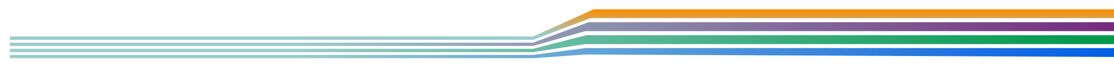







I-55/75/26
Multimodal Corridor Study
Public Involvement Meeting. May 9, 2019
Notes:
TDOT staff member welcomes everyone to the public meeting and introduces project staff.

Slide 2
Welcome & Agenda
Study Purpose
The Corridors
Study Schedule and Process
Anticipated Study Outcomes
Existing Conditions
Opportunities to Get Involved
Notes:
AECOM team begins presentation

Slide 3

Study Purpose

Slide 4
Corridor planning
is a process that comprehensively
assesses the ability of a transportation corridor to manage travel needs
brought about by current development and anticipated growth
over the next 20 years.
The plan will:
Evaluate existing and future conditions
Identify potential improvements and management strategies
4
Notes:
The plan will:
Evaluate existing and future conditions
Identify potential improvements and management strategies
Promote the safe and efficient movement of people, goods, and services.
Provide opportunities for public, local government, and agency participation
Fill the gap between the statewide modal plans for highways, public transportation, rail, aeronautics, and bicycle/pedestrian, and the project selection process.
Furnish a link between land-use planning and transportation planning.
Provide an opportunity to direct future development, and minimize environmental, social, and economic impacts.

Slide 5
The Corridors

Slide 6
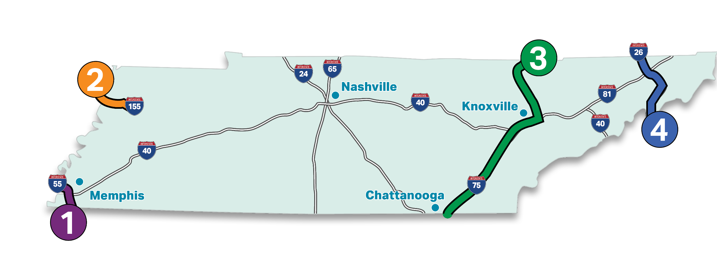
Study Corridors and Limits
I-55 | I-155 | I-75 | I-26
13 miles | 16 miles | 162 miles | 54 miles
Study website: www.tn.gov/tdot/government/g/planning-studies/i-55-75-26-multimodal-corridor-study.html
6
Notes:
We are studying four corridors across the state.
These corridors are important connections between centers of economic activity and are strategic and highly traveled routes for working, shopping, freight, and other activities.
The I-26 study area includes I-26 from Kingsport to the North Carolina state line, including the urbanized areas around Kingsport and Johnson City.
The data presented tonight is focused on the I-26 corridor. You can find more information on the other corridors on the study website.

Slide 7
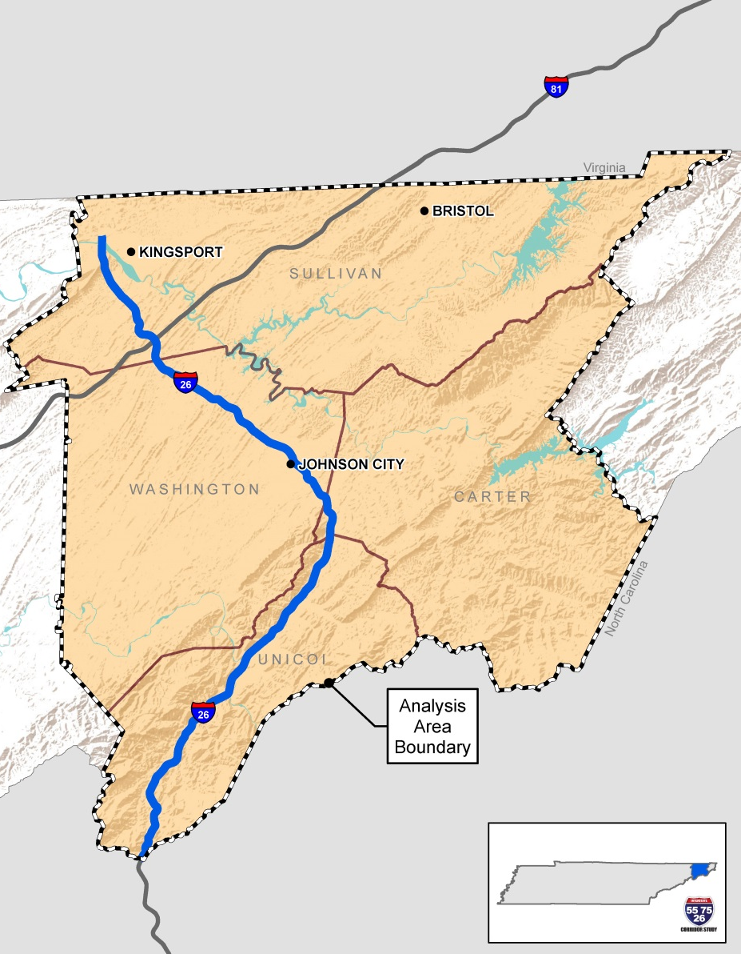

I-26
Begin: Kingsport
End: North Carolina State Line
54 miles
Counties: Carter, Sullivan, Unicoi, Washington
Notes:
The I-26 corridor stretches for 54 miles from US-11W in Kingsport to the North Carolina state line and is the second longest of the 4 corridors we are studying.
The study area includes 4 surrounding counties and the urban areas of Kingsport and Johnson City.

Slide 8
Study Schedule
and Process

Slide 9
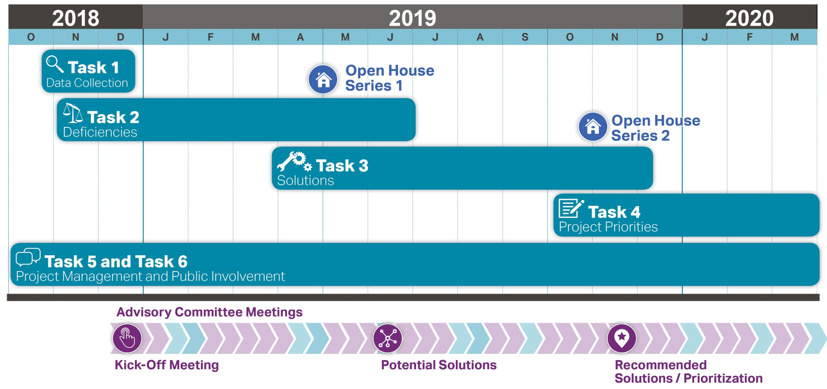
Study Schedule
We are here!
9
Notes:
We started this study in the fall of 2018.
Since then, we have been gathering data and analyzing the existing conditions of each of the 4 study corridors.
We’re looking at traffic operations, safety, multi-modal accommodations, existing and future land use planning, and freight operations.
We’re here today to share information on the existing conditions of the I-26 corridor and gather your feedback.
We’re planning to hold another round of public meetings in the fall to discuss potential improvement solutions for the 4 study corridors.
In addition to meeting with the public, we’re also holding meetings with an Advisory Committee made up of representatives from various Metropolitan Planning Organizations, Rural Planning Organizations and Development Districts around the state.

Slide 10
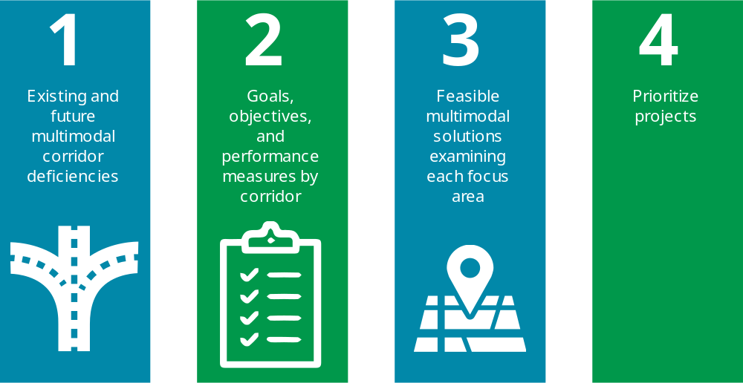
Anticipated Study Outcomes
Notes:
Our first task, which we are here today to share information about, was to analyze the corridor for existing and future multimodal deficiencies.
The study will discuss several different types of deficiencies including:
Capacity and congestion
Operations and maintenance
Safety and more.
The next phases of the study include:
Goal setting for each corridor
Development of feasible multimodal solutions
And prioritizing the solutions

Slide 11

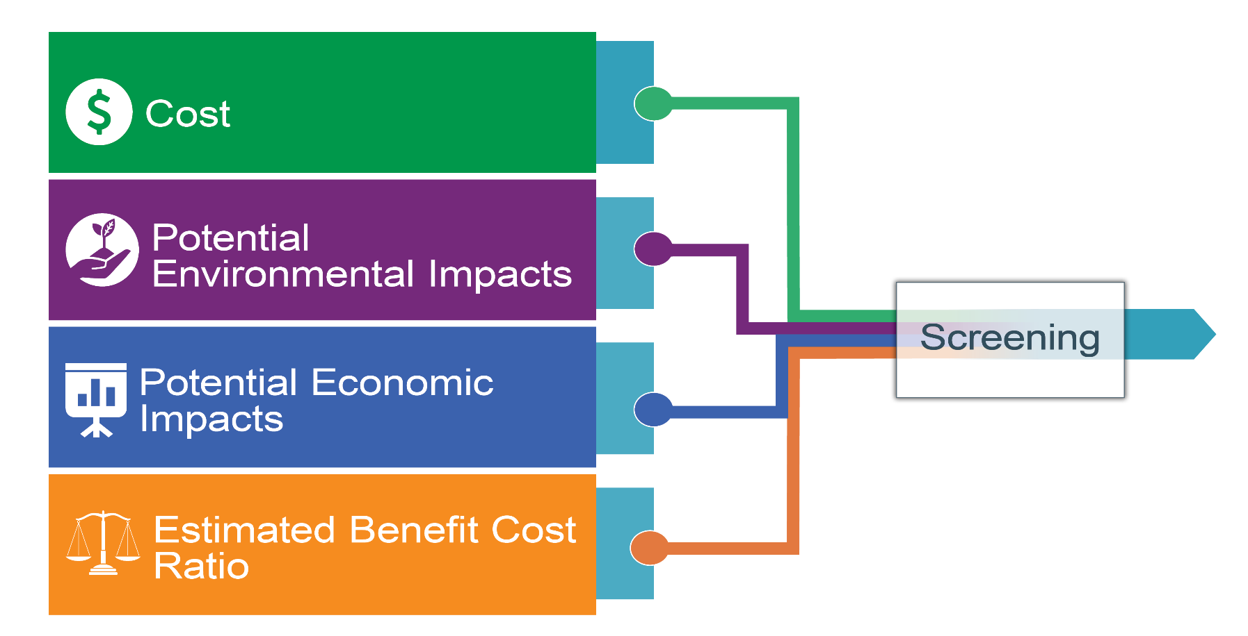
Prioritization Process Details
11
Notes:
After we develop a range of solutions for each corridor, we will prioritize the solutions by using a prioritization process that will consider:
Cost
Potential environmental impacts
Potential economic impacts
Estimated benefit cost ratio

Slide 12
Existing Conditions
Notes:
The study team’s work over the past several months has centered around gathering information on the existing conditions in each corridor as well as the anticipated conditions in 2040.
We’d like to share some of this information with you now. Additional information can be found in the exhibits on display today and in the first Technical Memo prepared for the study. This memo, which documents information related to the existing highway network, multimodal facilities, safety, freight operations, land use and economics for each corridor, is available on the study website.

Slide 13
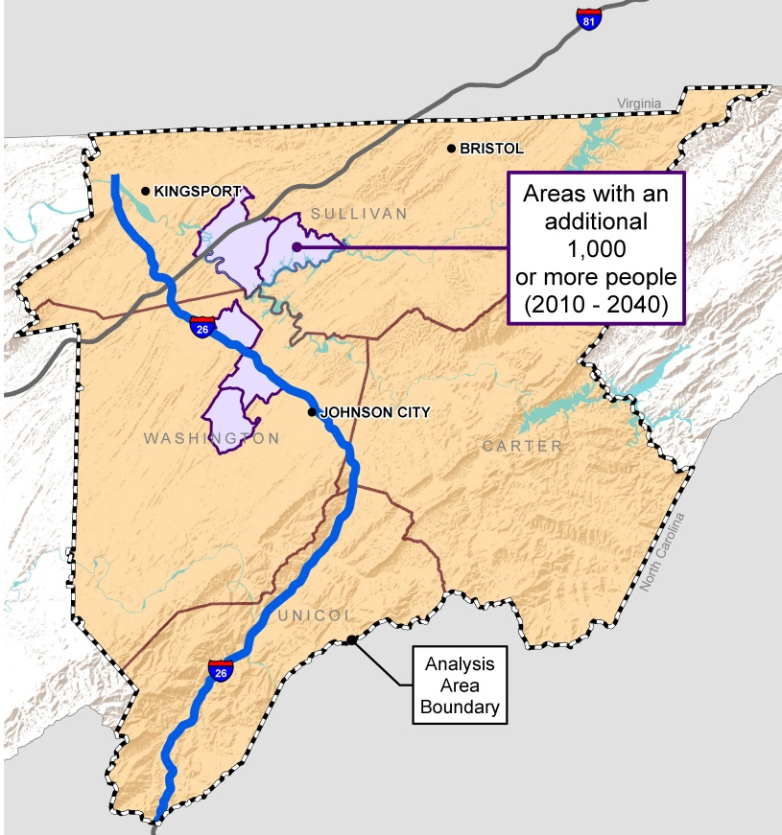
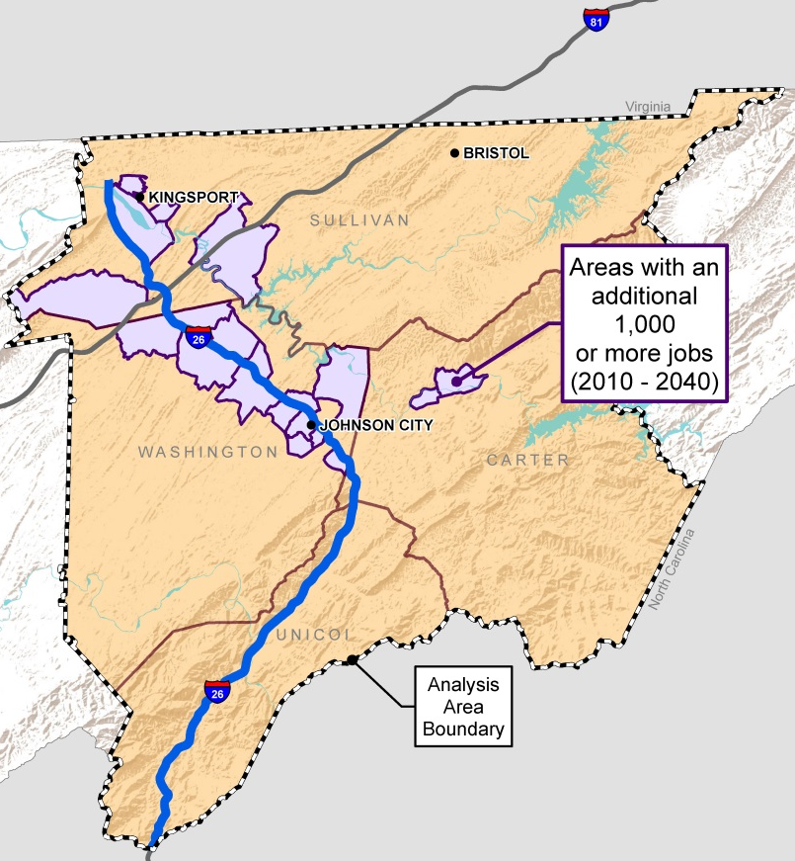
Existing Conditions: Population and Employment
Population
Employment
13
Notes:
Population and employment change in the corridor both drive and reflect transportation needs.
The area between Jonesborough and I-26 and the area around Gray, Oak Grove and Spurgeon are anticipated to experience significant population growth.
The purple areas shown on the map on the left indicate areas where the population is anticipated to grow by more than 1,000 people.
The map on the right identifies areas where significant job growth is predicted within the next 20 years. Most of the job growth is anticipated to occur along I-26 in between Kingsport and Johnson City.

Slide 14



Existing Conditions: Population and Employment
Visit Station 1 tonight for more information about:
Population and employment growth along the I-26 corridor
Presence of minority and low income populations
Tell us where YOU live, work and travel. How do YOU use I-26?
14
Notes:
After the presentation, please visit Station 1 (point to it in the room) to view more information on:
Population and employment growth along the I-26 corridor
Areas with minority and low-income populations
We also want to know how you use I-26. We have a map set up for you to place a sticker where you live, work and travel frequently.

Slide 15
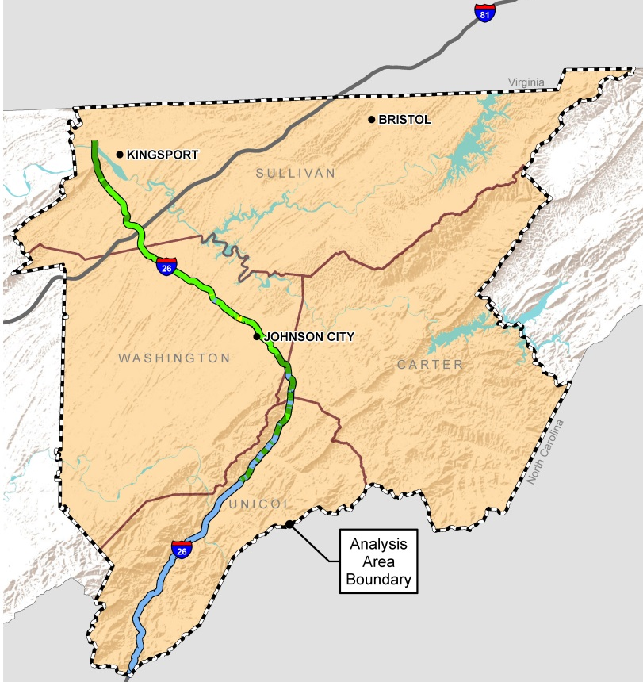
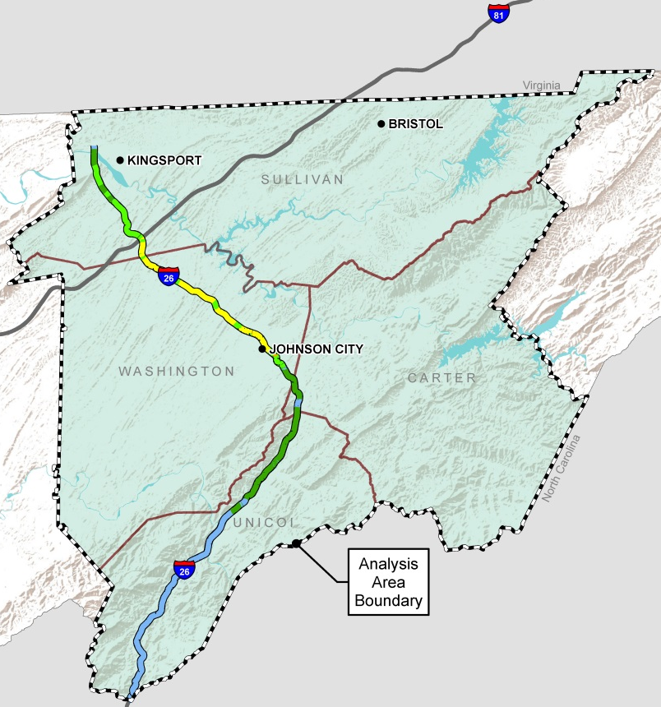
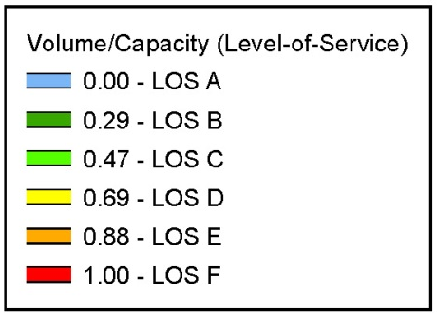
Existing Conditions: Traffic Congestion
2010
2040
projection
15
Notes:
These two maps compare existing congestion levels in 2010 with anticipated congestion levels in 2040.
Level of Service, or LOS, is an A through F scale used to describe how congested a roadway corridor is. LOS A represents free flow conditions with no delay. LOS F represents near gridlock with significant delay.
Areas of traffic congestion stretch from Kingsport to Johnson City, with the area around SR-381 and I-26 having the highest level of congestion. Traffic volumes in this portion of the corridor exceed 64,000 vehicles per day in some areas.
By 2040, congestion is anticipated to increase in the metro areas.
Congestion impacts not only your commute to and from work, but also the movement of goods throughout the state by freight carriers. Truck traffic on the I-26 corridor ranges from 6% in urban areas to 24% around the Tennessee/North Carolina state line.

Slide 16
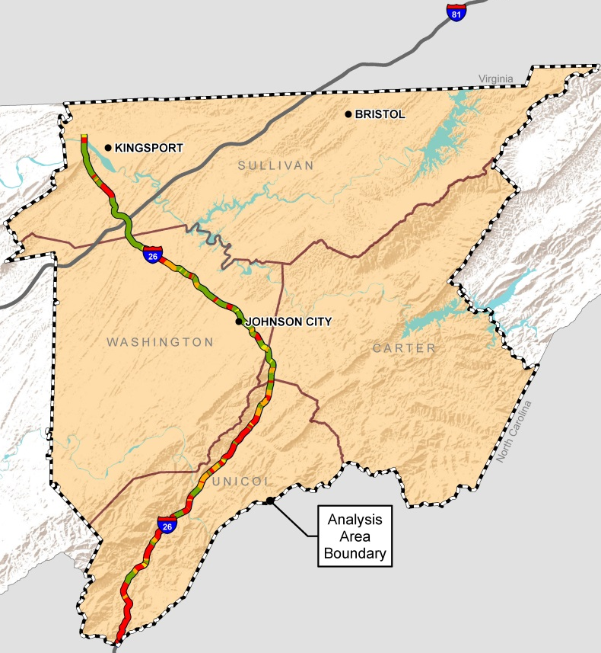
Existing Conditions: Safety
2014 – 2018 Crash Rates
How do corridor crash rates compare to statewide averages for similar facilities?
42% of corridor
Below Average
3% of corridor
Average
15% of corridor
Above Average
40% of corridor
Significantly Above Average
16
Notes:
58% of the I-26 corridor has a crash rate at or above the statewide average for similar routes.
Areas with higher crashes rates appear more frequently south of Johnson City. The increase in crash rates in this area is likely due to the terrain which results in poor sight distance and narrow or no medians

Slide 17
Existing Conditions: Traffic Congestion + Safety
Visit Station 2 tonight for more information about:
Traffic volumes and congestion
Safety
Put a sticker on the map to tell us where YOU experience travel delay.
17
Notes:
After the presentation, please visit Station 2 (point to it in the room) to view more information on:
Traffic volumes and congestion
Areas with safety concerns
We also want to know where you experience travel delay or perceive there to be safety concerns in the corridor. Place a sticker on the map so we know what you think.

Slide 18
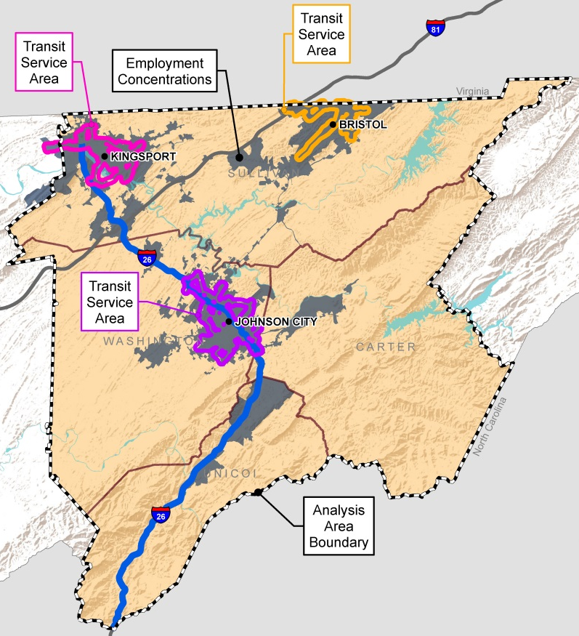
Existing Conditions: Multimodal Connections
Transit service exists in
Kingsport, Bristol and Johnson City.
This map shows transit service areas and how they relate to areas of employment concentration.
18
Notes:
Transit service currently exists in Kingsport, Bristol and Johnson City.
This map shows how the existing transit service areas relate to areas with the highest concentrations of employment.
In Johnson City, the transit service area is pretty well aligned with the areas with the highest concentrations of employment.

Slide 19
Existing Conditions: Multimodal Connections
Visit Station 3 tonight for more information about:
Transit coverage areas
Park and ride locations
Car and van pool
State bicycle routes
Indicate YOUR desired multimodal connections in the corridor.
19
Notes:
After the presentation, please visit Station 3 (point to it in the room) to view more information on:
Transit coverage areas
Park and ride locations
State bicycle routes
We also want to know which multimodal options you like best – bus, rail, ride share or bicycle.

Slide 20
Opportunities to
Get Involved

Slide 21




Opportunities to Get Involved
Website | Online Survey | Interactive Map | Public Meetings
21
Notes:
At the heart of corridor planning is effective public involvement, beginning with a broad understanding of community needs. This is the first opportunity for us to hear from the general public, but we will be providing others throughout the study.
You can visit our website
Take an online survey accessible via the website or the computers we have available today
Let us know where you think there are problem areas or give us ideas for solutions via the interactive map on the website
Attend the next public meeting this fall to let us know what you think of the potential solutions we’ve identified for the corridor.

Slide 22
How to Share Your Input Today
Talk to the court reporter
Complete the online survey
Speak with a member of the study team
Fill out a comment sheet
22

Slide 23
Thank You!
Study website:
https://www.tn.gov/tdot/government/g/planning-studies/i-55-75-26-multimodal-corridor-study.html

