Slide 1


Information for
First Responder Activities
Tennessee DOT Median Cable Barrier
Don’t Cut the Cable
Contact TEMA & TDOT
Options for Vehicle Removal
Safely Reducing Cable Tension

Slide 2

Why Use Median Cable Barrier (MCB)
Prevent median cross-over crashes
MCB is more forgiving than other barrier types (concrete, steel beam)
MCB is cheaper to install and repair
Median cross-over crashes are many times catastrophic

Slide 3
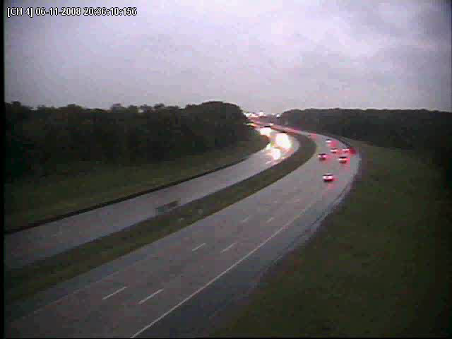
No MCB

Slide 4
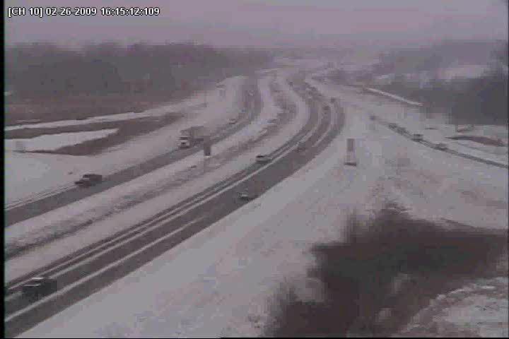
MCB at Work

Slide 5
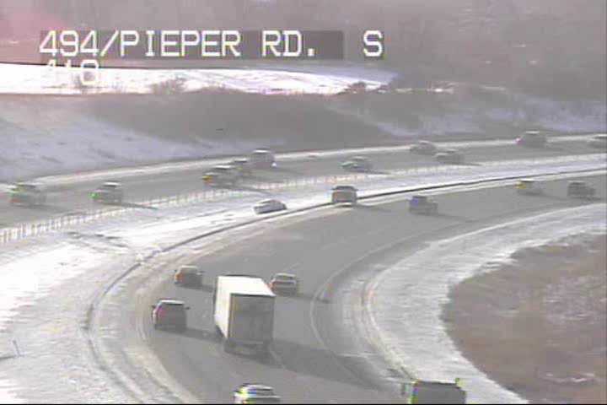
MCB at Work

Slide 6
Email from Robert VanHorn
Region 2 HELP Coordinator
…occurred during morning rush hour 9-8-2010 on I-24 at MM 78. The Comcast truck was traveling EB when the driver had a medical emergency, became incapacitated and went into the median. The truck struck the cable rail on the WB side and was stopped. …The traffic was fast and heavy & had it not been for the cable rail, I feel a tragedy would certainly have occurred, with almost certain loss of life. …Please note there is no evidence of braking and the rear wheels actually dug into the ground even after the rail stopped the truck. I truly believe that had it not been for the rail, the truck would have entered oncoming WB traffic under power and at speed.

Slide 7
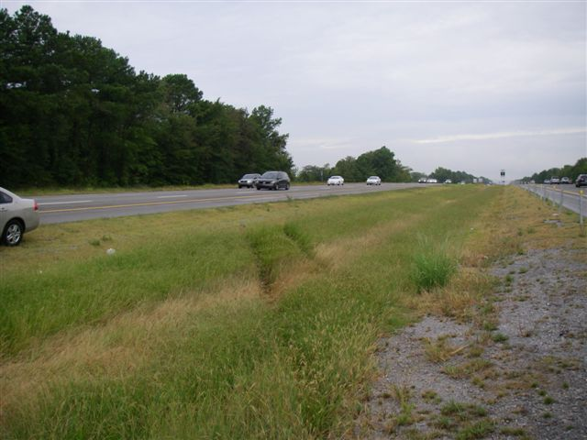
Trajectory of Vehicle

Slide 8
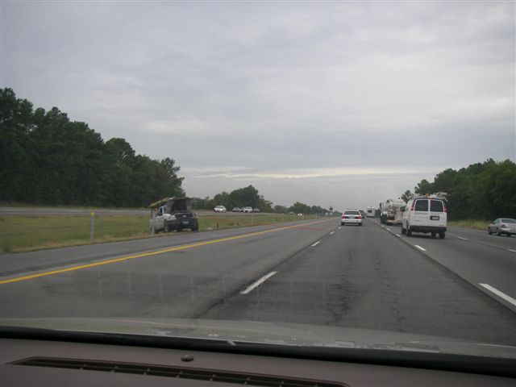
Trajectory of Vehicle

Slide 9
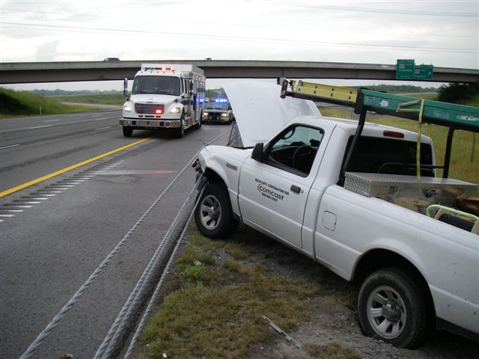
Final Position of Vehicle

Slide 10
Training for Emergency Response
To provide emergency responders with best practices in dealing with vehicles engaged with median cable barriers
Provide safety to public and responders
To minimize damage of barrier

Slide 11
Don’t Cut the Cable!
Cutting cable is life/death decision
Cable is difficult to re-splice - sometimes entire section must be replaced
Cable repair/replacement can take several weeks
During that time the entire section of barrier between anchors is not functioning

Slide 12
First Choice
If cable is under tension because vehicle has pushed it out of center line try to tow vehicle back the direction it entered the cable to get slack.

Slide 13
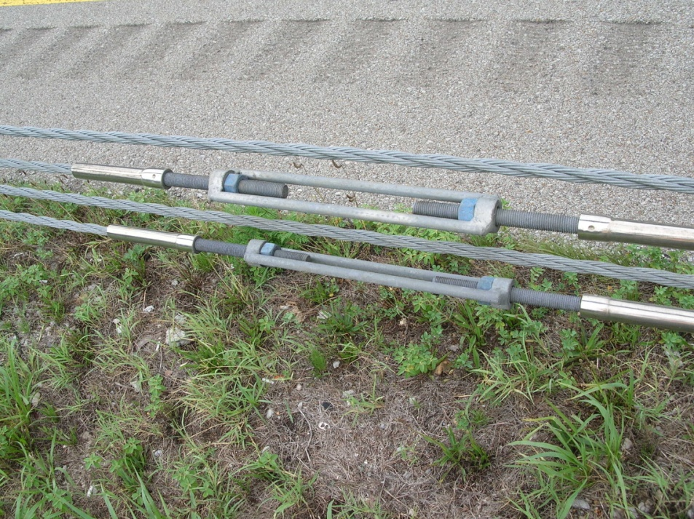
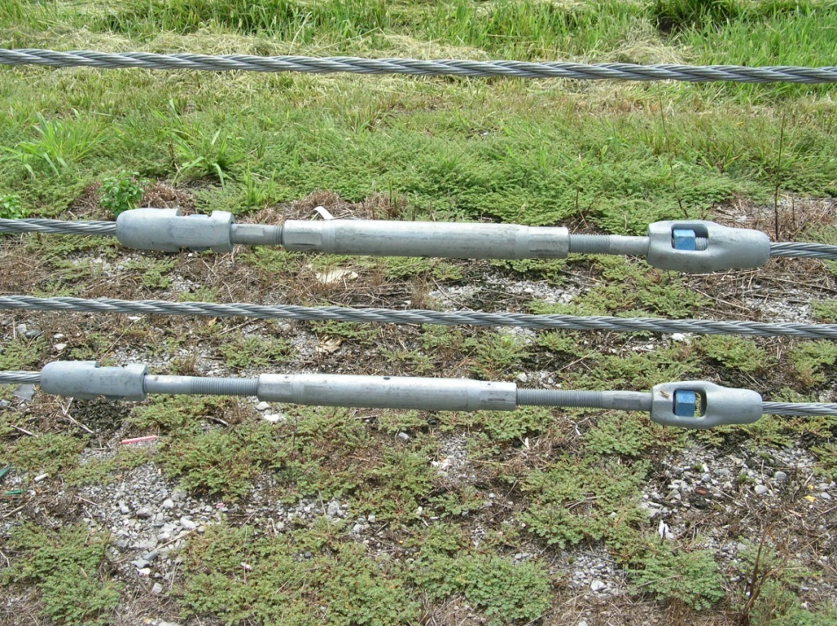
Second Choice
Loosen turnbuckle

Slide 14
Turnbuckle Loosening
Find the closest metal turn-buckle which are located every 1,000 feet
Loosen the turnbuckles with a wrench to release tension
Take care not to completely disconnect cable without proper precautions (cable tension could be several thousand psi)

Slide 15
Third Choice
Remove posts:
This may be difficult in woven systems or in icy conditions
Some crashes may remove enough posts that cable slack is produced

Slide 16
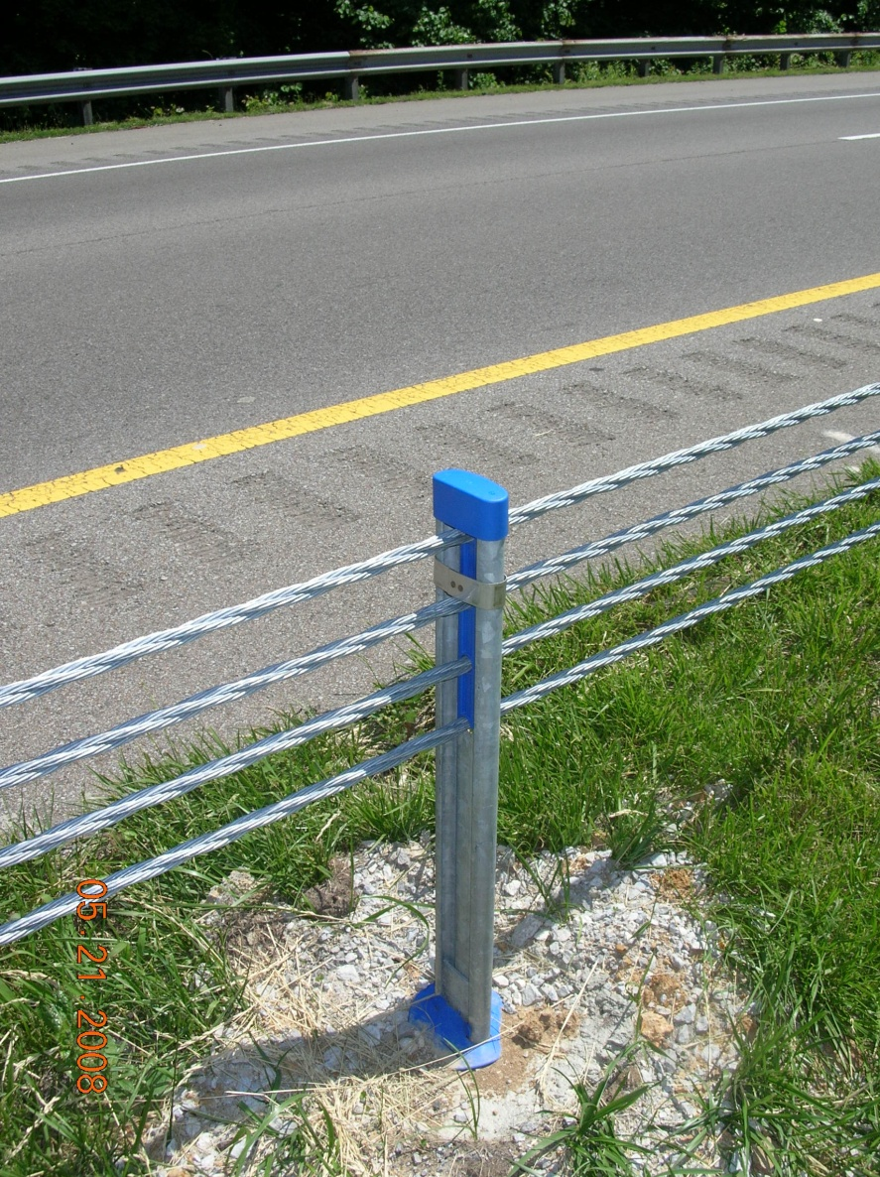
Post Types
Cable Through Posts

Slide 17
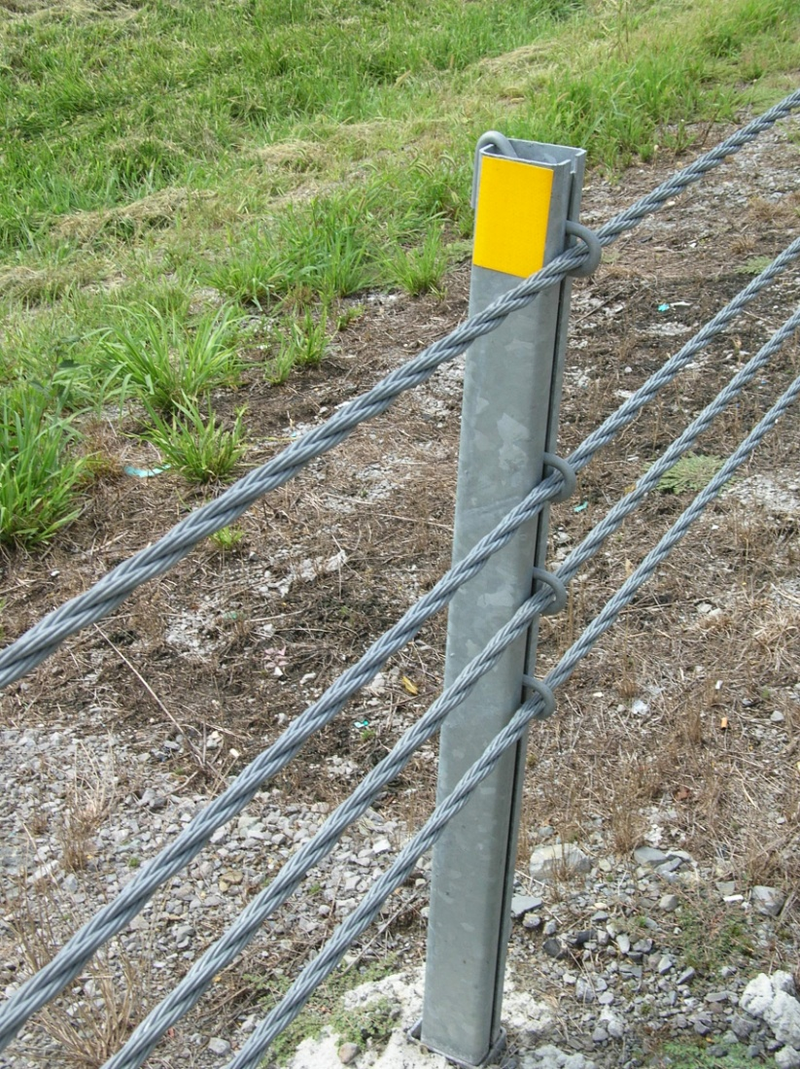
Post Types
Cable Suspended by Hangers
One Side of Post

Slide 18
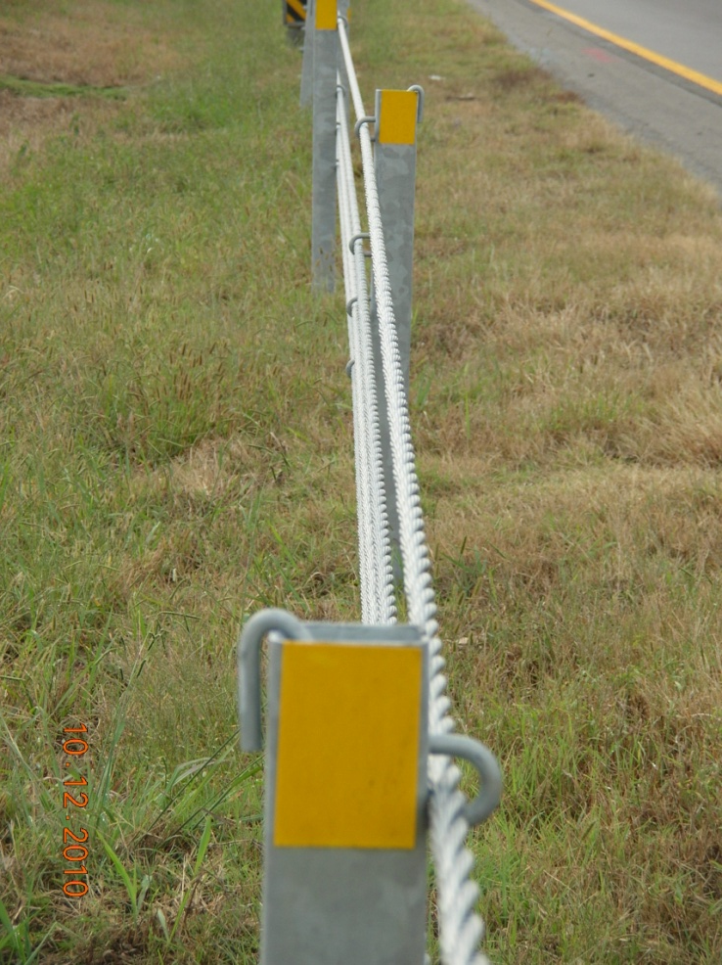
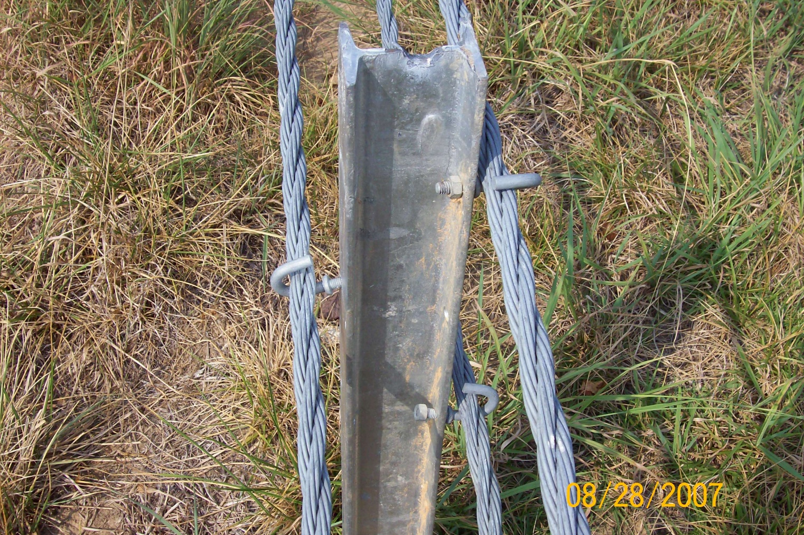
Post Types
Cable Suspended by Hangers
Both Sides of Post

Slide 19
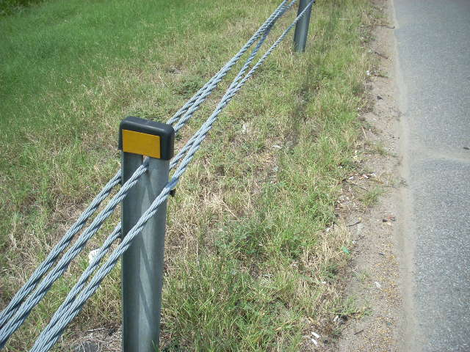
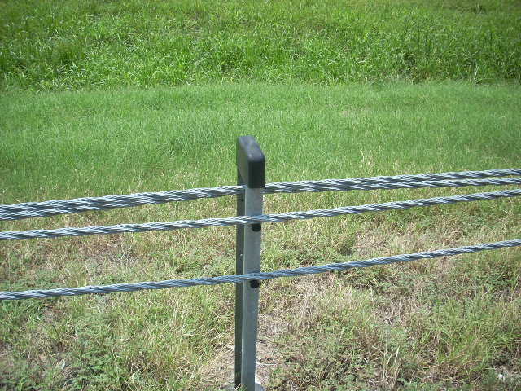
Post Types
Cable Suspended by Studs
Two Cable Weave

Slide 20
Fourth Choice
Cutting posts:
Any suitable cutting tool is fine
Don’t cut posts flush with ground, leave enough post protruding to be removed by maintenance
If removing posts be aware of vertical, as well as lateral forces

Slide 21
Fifth Choice
Cut Turnbuckle – They are located about every thousand feet. Required personal protective equipment MUST be used.

Slide 22
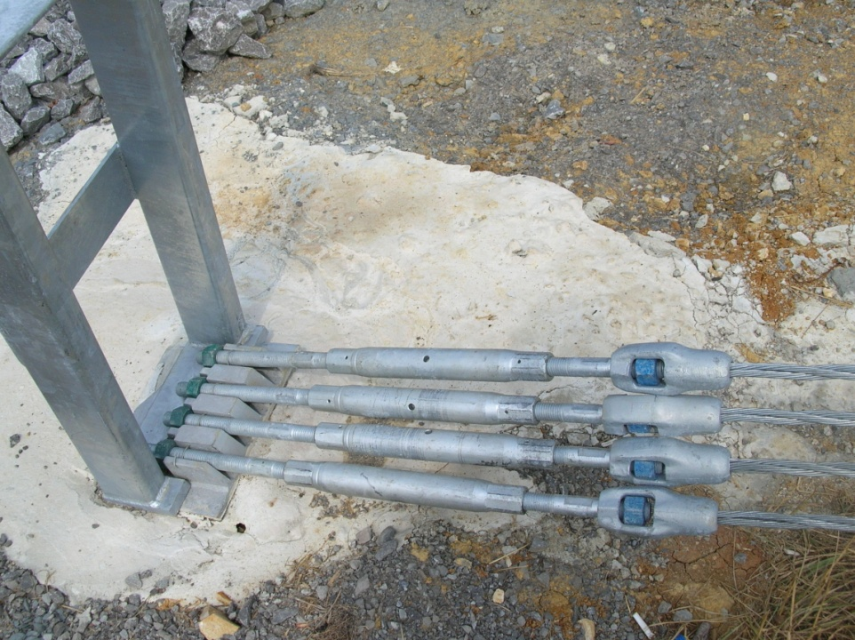
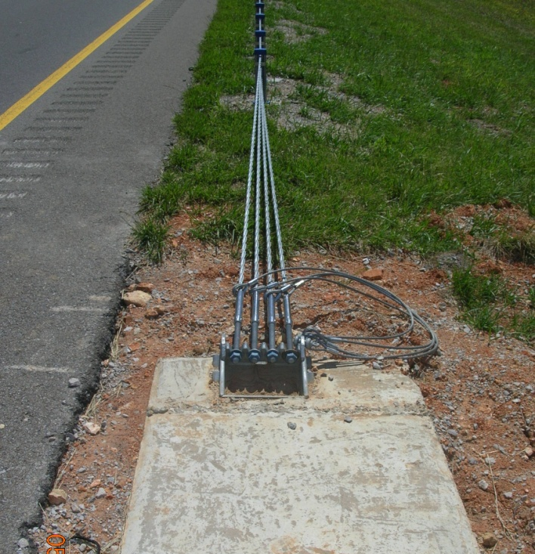
Next to Last Resort
Cut or shear bolted cable connections at anchor. (This may render entire section of cable inoperable until reconnected by maintenance.)

Slide 23
Last Resort
If it is a matter of life and death cable may be cut. This is dangerous and will render the entire section of barrier inoperable until the cable can be replaced – usually several weeks.
Go to an area between two undamaged posts and wrap cable on either side of proposed cut with tape.

Slide 24

Cable Cutting Demo

Slide 25
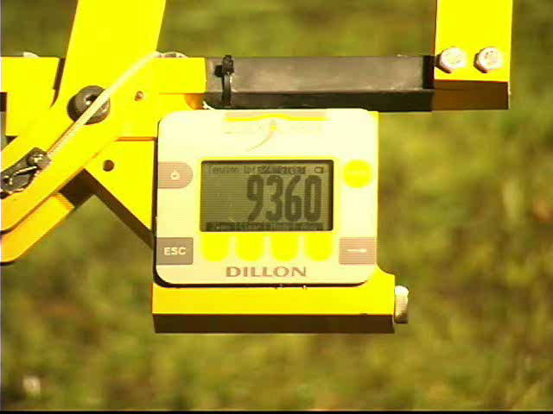
Cable Cutting Demo

Slide 26
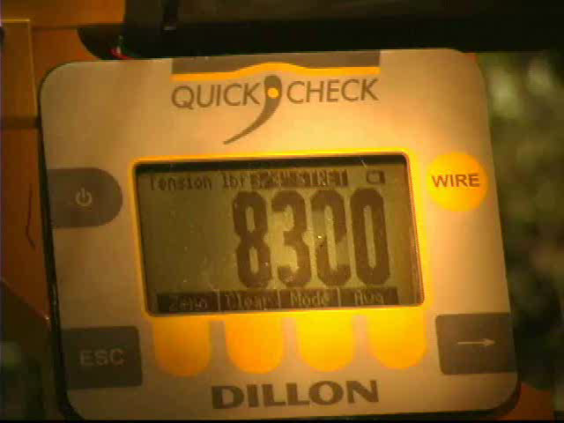
Cable Cutting Demo

Slide 27
TDOT Required
Personal Protection Equipment
Hardhat
Face/Eye Protection
Class 3 Vest
Welders’ Gloves
Chainsaw Chaps
Steel-Toed Boots
Turnout Gear if Available

Slide 28
Suggested Tools
Pipe Wrenches
Friction Saw
Hydraulic Cutter
Duct Tape

Slide 29
Summary
Notify TEMA and Local TDOT District
Try and remove vehicle from direction it entered
Loosen Turnbuckles
Remove Posts
Cut Posts
Cut Turnbuckles
Cut Bolts at Anchor Terminal
If LIFE or DEATH – Cut Cable

Slide 30
Thanks!
Always wear your
personal protective equipment.
Thank you for your
attention, participation, and efforts.
Thanks to the DOTs of Maine, Michigan, Missouri and Minnesota.

Slide 31
FOR CONTACT INFORMATION
Josh Brown
Transportation Manager 2
TDOT Traffic Operations
James K Polk Bldg, 18th Floor
505 Deaderick St.
Nashville, TN 37243
615-253-4541
joshua.brown@tn.gov

