Slide 1
Tennessee T.E.S.T Program
Tabletop Exercise Series
Education Scenario #1: Customizable Scenario

Slide 2
Welcome
Introductions
Name?
Organization?
What is your role in today’s exercise?
Housekeeping
Sign-in Sheets
Emergency Exits
Restrooms
Phones/radios
Breaks
Refreshments
Feedback Forms

Slide 3

Exercise Agenda
Pre-Exercise (15 minutes)
Welcome and introductions
Purpose & objectives
Roles & guidelines
Exercise (1-2 hours)
Module 1- Initial Notification
Module 2- Response
Module 3- Short-Term Recovery
Module 4- Long-Term Recovery
Post-Exercise (20 minutes)
Hotwash/Take-away discussion

Slide 4
Exercise Purpose and Scope
The purpose of this exercise is to provide participants an opportunity to exercise current plans, procedures, and capabilities to respond to an active aggressor event.
  Tabletop exercises are intended to test plans and procedures, not individuals.
The exercise will focus on the roles, responsibilities, and response aspects of personnel and emergency partners necessary to protect human health and safety.
The focus will be on processes and decision-making abilities rather than minute details.

Slide 5




Roles and Responsibilities
Participants
Represent your agency & discuss your planned response to the scenario.
Evaluators
Record strengths, note areas of improvement, and capture lessons learned
Facilitators
Moderate the flow of discussion and keep the TTX moving and on-track.
Observers
Here to gain insight from the exercise, refrain from interjecting during the exercise.

Slide 6
Guidelines
This is an open, low-stress, no-fault environment
The scenario is plausible, the events occur as presented
There is no hidden agenda or trick questions
Don’t fight the scenario
Be a respectful and active participant
Base your response actions on the current plans and capabilities of your department
Decisions made during the exercise do not set policy
Consider different approaches & suggest improvements
Participants are encouraged to discuss issues in depth

Slide 7
Functional Content Areas
What you Want to Test
Descriptions of the expectation
What you Want to Test
Descriptions of the expectation
What you Want to Test
Descriptions of the expectation

Slide 8
Exercise Participants
List the specific participants or stakeholders that will be participating in the exercise today
Recommended participants include:
  School Administration
  Various School Staff, including health officials
  School Security
  School maintenance or janitorial staff
  Local Law Enforcement
  Local Fire and Emergency Medical Service
  Local Emergency Management
  Dispatch Center (911)
  Anyone else who may have a role in response or recovery

Slide 9
Setting the Stage
Consider including the following information:
Date and Time
School Name
Number of students
Number of staff
Weather conditions (simulate or real world)
Current events in the area
Maps, floor plans, diagrams, etc.

Slide 10
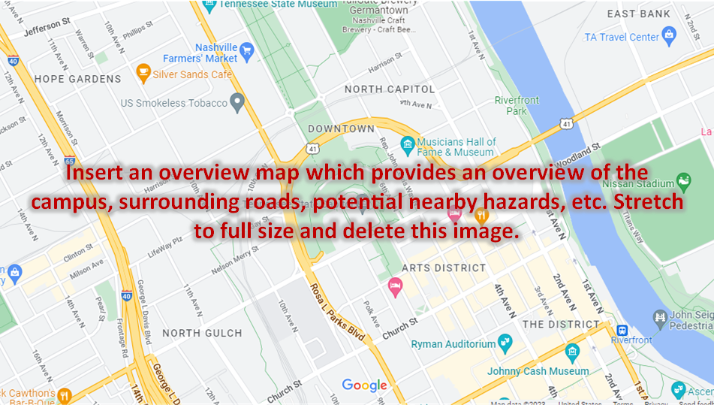
Overview Map

Slide 11
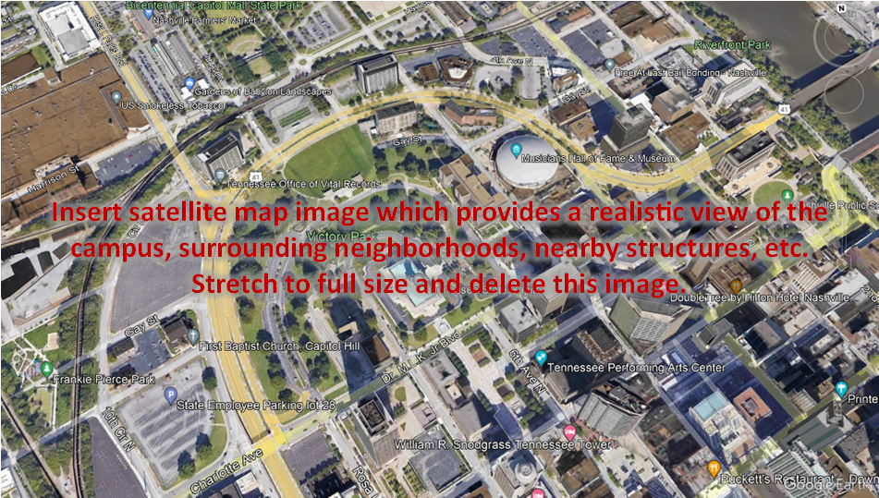
Satellite Map

Slide 12
Module 1 – Initial Notification
This is the slide to describe where the school day has transitioned from a typical school day into one requiring an emergency response.
  Describe the storyline, scene, time and location which will help drive the exercise
  What happened?
  How did the school become aware?
  Who is involved?
Based on this information, what initial actions are taken?
Notes:
Facilitator Questions:
*Note: These are generic questions, tailor discussion questions to your needs and around the topics you wish to be discussed during the exercise.
*Note: The facilitator questions should only be used as a guiding tool for the facilitator to engage the group is not discussing these topics naturally.
Operations/Coordination
What plans, policies, and procedures does your school have in place to respond to an active shooter event?
What are your school’s initial response priorities?
What does the first (after notification) 30-seconds for a staff member look like?
What does the first (after notification) 30-seconds for a student look like?
What are the teachers trained to do in response to this type of information?
Are substitute teachers, volunteers, and other transient staff trained in the school’s response measures?
What is the process for notifying the School Resource Officer (if staffed)?
Who calls 911 and when?
What are your initial actions and the actions of the staff?
What are the immediate concerns?
What resource gaps could limit your school’s ability to respond?
Security, Protection, and Law Enforcement
What agencies are notified to respond and how are these agencies notified?
In terms of securing the scene, what are the immediate priorities?
Given the situation, what protective measures would you adopt at this point, if any?
Has the school trained or exercised with local first responders?
Public Information and Warning
How does your school issue warnings, alerts, and other emergency messaging?
What plans, policies, and procedures does your school have in place to guide your internal and external communications strategies?
What individual (or position) coordinates and delivers your school’s public messaging?
Community Resilience
How does your school encourage students, staff, and families to take individual steps to identify and address threats, suspicious activity, and potential messages of self-harm?
How does your school/district encourage staff, students, and the community to report suspicious activity/threats?
What method does the school/district use to allow staff, students, and the community to report suspicious activity/threats?

Slide 13
Module 2 – Response
Add some more information to advance the incident.
This helps move from the notification phase of the incident into the response phase of the incident.
  Who has been contacted? Who has arrived?
  What new information exists, what is still needed?
Based on this information, what actions are taken at this time?
Notes:
Facilitator Questions:
*Note: The facilitator questions should only be used as a guiding tool for the facilitator to engage the group is not discussing these topics naturally.
Operations/Coordination
Who is the lead agency on this incident?
What plans, policies, and procedures does your school have in place to guide response efforts at this point?
How do key decision-makers collect information to assess the extent of the situation?
What resources are currently available?
Security, Protection, and Law Enforcement
What actions do the responders on-scene take? What kind of response is needed?
What response plans and protocols would your school activate at this point?
What additional protective measures would be implemented at this time based on your earlier decision to either evacuate, shelter-in-place, or lock-down the school?
Are any additional agencies or resources needed?
Public Information and Warning
Who at the school is taking lead on communication with outside agencies?
How does your school ensure consistent, coordinated public messaging throughout this phase of response operations?
How and when does your school activate its crisis communications plan?

Slide 14
Module 2 – Response (continued)
Add some more information to advance the incident, moving towards the end of the incident/exercise.
  The next slide should wrap-up the incident.
Who has been contacted? Who has arrived?
What new information exists?
Based on this information, what actions are taken at this time?
Notes:
Facilitator Questions:
*Note: The facilitator questions should only be used as a guiding tool for the facilitator to engage the group is not discussing these topics naturally.
Operations/Coordination
Who is the lead agency on this incident at this point, has that changed?
What plans, policies, and procedures does your school have in place to guide response efforts at this point?
How would your school coordinate efforts to support the student?
What resources are currently available?
Who are the key external partners that could support response efforts?
Security, Protection, and Law Enforcement
What actions do the responders on-scene take? What kind of response is needed?
What response plans and protocols would your school activate at this point?
What additional protective measures would be implemented at this time based on your earlier decision to either evacuate, shelter-in-place, or lock-down the school?
Are any additional agencies or resources needed?
Medical/Mass Care
Is medical support requested at this point?
Placed on stand-by/staged?
Public Information and Warning
Is there a notification system used to alert families/all staff?
Does social media have a part in the school systems response to the public?

Slide 15
Module 3 – Short-Term Recovery
Wrap-up the incident, this slide should transition into the immediate recovery efforts of the school.
  Support to staff and students.
  Media on-scene/public messaging and communications with the school community.
  Parental reunification.
  After the emergency is over, what steps does the school do to recover?
Based on this information, what actions are taken at this time?
Notes:
Facilitator Questions:
*Note: The facilitator questions should only be used as a guiding tool for the facilitator to engage the group is not discussing these topics naturally.
Operations/Coordination
How does your school coordinate the transition from response to short-term recovery efforts?
Who has the authority to end protective actions? How is this communicated and what is the process?
Are students moved out of the area?
Parents?
What is next?
What plans, policies, and procedures guide your school’s short-term recovery process?
What resource gaps could limit your school’s ability to meet these priorities?
Security, Protection, and Law Enforcement
What plans or procedures are in place to manage and secure the scene following the incident?
What partners would be engaged to assist with these efforts?
Public Information and Warning
What information is being pushed out to media, and how? Is there a public information officer (PIO) at your school?
How does your school ensure consistent, coordinated public messaging throughout the recovery period?
How does your school provide internal and external partners with information?
With families, students, staff, and alumni?
Do your recovery communications methods include the capability to communicate with students and staff who have language or access and functional needs requirements?
Community Resilience
What plans or policies are in place to support affected populations with counseling and behavioral health resources?
What additional resources, if any, would be needed to support students, staff, and families?
Has your school and your community thought about the aftermath of this type of incident and what the priorities, needs, and expectations are of the students, staff, families, and community?
What district resources are we deploying and where? (for short-term recovery goals)
Psychological/Mental Health
Reunification
Security
Maintenance
Medical
Social Workers
Transportation

Slide 16
Module 4 – Long-Term Recovery
Topics of Discussion
  Mental Health and Supports
  Threat Monitoring
  Public Information and Rumor Control
  What happens the next day at school? What do we tell students? How?
  What proactive measures can we put in place for the future?
Notes:
Facilitator Questions:
*Note: The facilitator questions should only be used as a guiding tool for the facilitator to engage the group is not discussing these topics naturally.
Continuity of Learning
Does this incident cause a period of school closure? What plans exist to facilitate this?
Operations/Coordination
How does your school coordinate the transition from short-term to long-term recovery efforts?
Are other resources/locations needed are needed?
Victims
Students/staff present during the incident
Parents of victims
Parents of multiple students (one victim)
Site Security
Mental Health
Non-English speaking parents/guardians
What plans, policies, and procedures guide your school’s long-term recovery process?
What resource gaps could limit your school’s ability to meet these priorities?
Security, Protection, and Law Enforcement
What plans/procedures exist to monitor threats and suspicious activity?
Could an incident such as this spur similar threats from other students?
Public Information and Warning
What information is being pushed out to media, and how?
Community Resilience
Does your school/district have the ability to support long-term behavioral health needs for students and staff? If not, are there public or private resources that can support these requirements?
What actions, if any, have been identified to help the community heal?
What district resources are we deploying and where? (regarding long-term recovery goals)
Psychological/Mental Health
Security
Maintenance
Medical
Social Workers/Guidance Counselors

Slide 17
Hotwash
What went well?
What are some areas for improvement?
Any additional comments/questions?
Please remember to fill out your feedback form!

Slide 18
State of Tennessee Resources

Slide 19
Thank You!

