Slide 1
Exploring the Value of General Education for the Student Experience or
Why do I have to take this stuff???
Dr. Stephen Biscotte
Director of General Education, Virginia Tech

Slide 2
Agenda
What is General Education?
  To You?
  To Us?
What is General Education Good For?
  To Employers?
  To Higher Ed?
  To Students?
  To You?
A Recommitment to the Mission
  The Metaphors of Gen Ed
  Next Steps

Slide 3

A Peek Out From the Weeds Before Diving Back In

Slide 4
What is General Education?

Slide 5
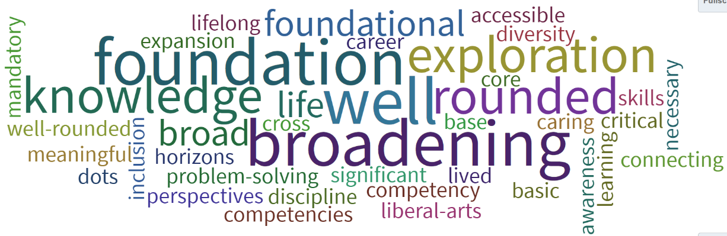
Poll the Audience: What is General Education?
Notes:
Poll Title: What is general education? Define general education using 3 words or phrases.
https://www.polleverywhere.com/free_text_polls/Qq3Z0c5oPWuqrtPrTvf9F

Slide 6
What is General Education Nationally?
“The part of a liberal education curriculum shared by all students. It provides broad exposure to multiple disciplines and forms the basis for developing important intellectual and civic capacities. General education can take many different forms.”
– AAC&U
Association of American Colleges and Universities. (2002). Greater expectations: A new vision for learning as a nation goes to college. Washington, D.C.: Association of American Colleges and Universities.

Slide 7
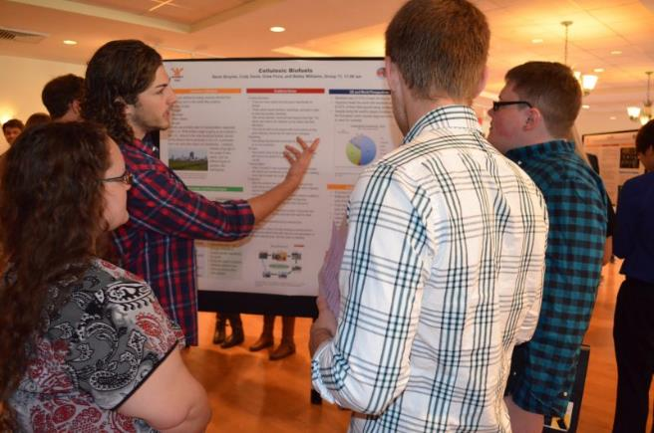
General Education Is…
The shared academic experience and requirements of all students, regardless of major.

Slide 8
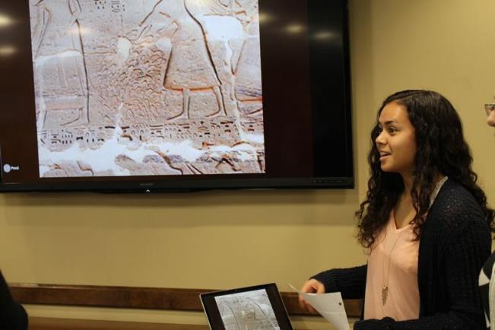
General Education Is…
A complement to the deep disciplinary dive of the major(s).

Slide 9
What is General Education Good For?

Slide 10
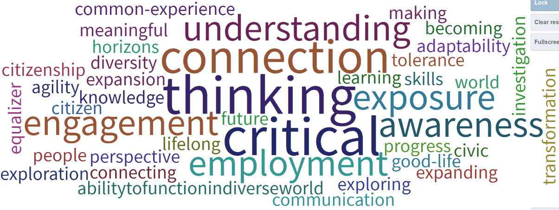
Poll the Audience: What is Gen Ed Good For?
Notes:
Poll Title: What is General Education Good For? List 3 words or phrases.
https://www.polleverywhere.com/free_text_polls/S3IGXmGLOgPRFNj9rq2Xm

Slide 11
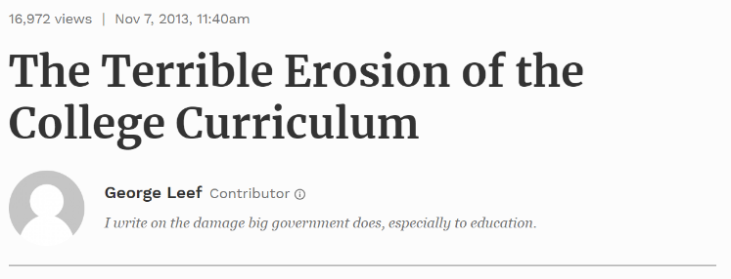
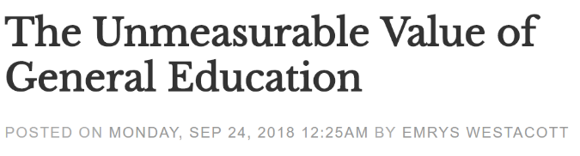
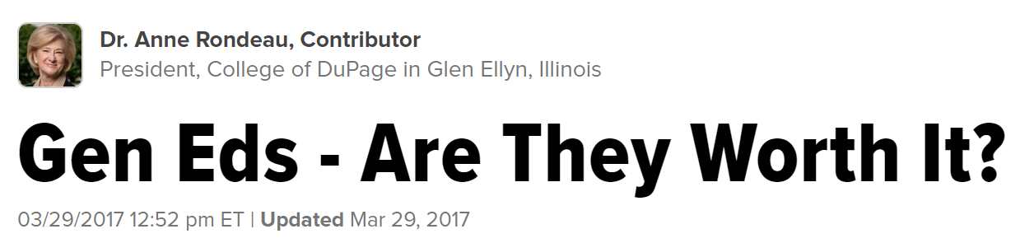
Gen Ed In the News

Slide 12
According to Employers:
What is General Education Good For?

Slide 13
Employers: Cross-cutting Capacities vs Major
“a demonstrated capacity to think critically, communicate clearly, and solve complex problems is more important than [a candidate’s] undergraduate major.”
93%
Hart Research Associates (2013). It Takes More Than a Major: Employer Priorities for College Learning and Student Success. Liberal Education, 99 (2), 22.

Slide 14
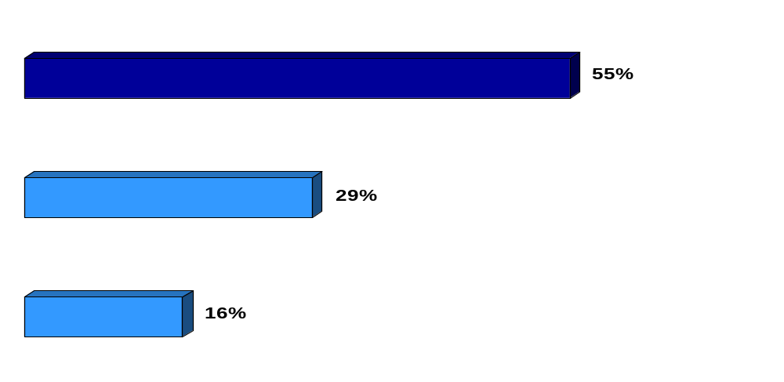
Employers: Broad Skills vs Specific Expertise
Which is more important for recent college graduates who want to pursue advancement and long-term career success at your company?
Having both field-specific knowledge and skills AND a broad range of skills and knowledge
Having a range of skills and knowledge that apply to a range of fields or positions
Having knowledge and skills that apply to a specific field or position
84%
Hart Research Associates (2013). It Takes More Than a Major: Employer Priorities for College Learning and Student Success. Liberal Education, 99 (2), 22.

Slide 15
Employers: Learning Priorities
Hart Research Associates (2018). Fulfilling the American Dream: Liberal Education and the Future of Work. Washington, DC: AAC&U.
Notes:
Q.10

Slide 16
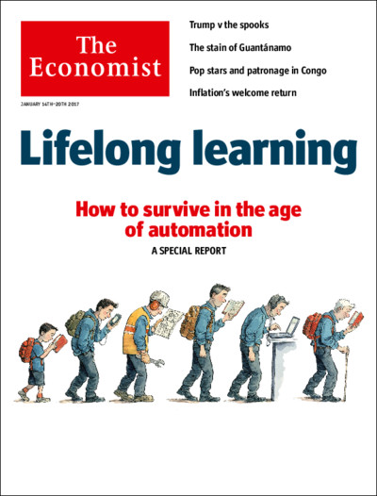
The Economist Special Report on Lifelong Learning

Slide 17
According to Higher Ed:
What is General Education Good For?

Slide 18
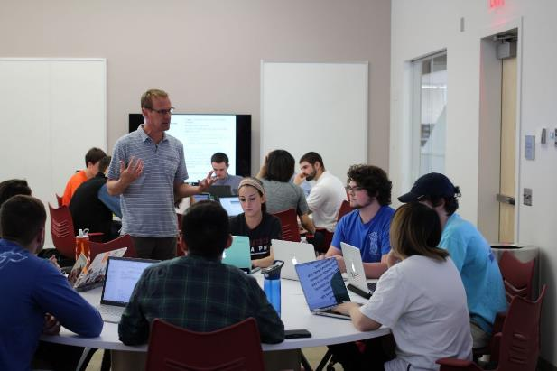
General Education Is Good For…
Making sense of the world from multiple perspectives, fields, and with various tools.

Slide 19
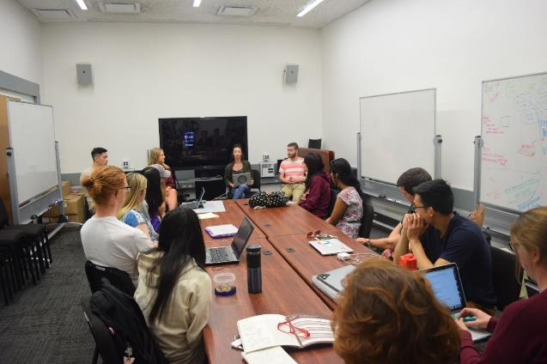
General Education Is Good For…
Considering world issues alongside students from different backgrounds, majors, and perspectives.

Slide 20
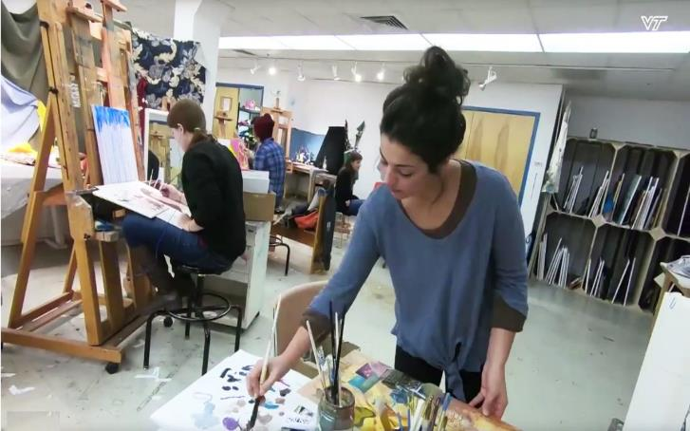
General Education Is Good For…
Finding and following academic passions and interests.

Slide 21
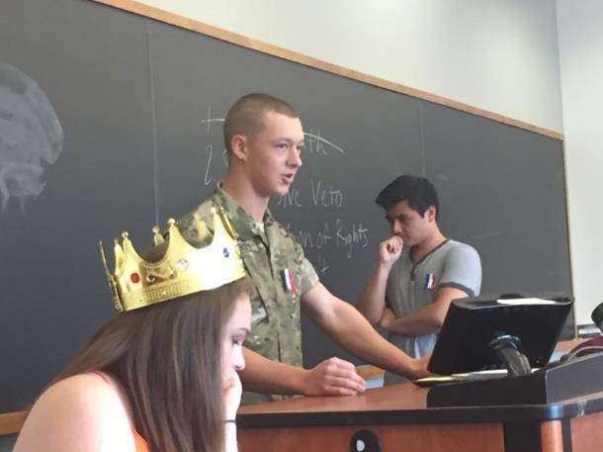
General Education Is Good For…
Building an informed citizenry in a strong democracy.

Slide 22

General Education Is Good For…
Finding the road to a life worth living.

Slide 23
According to Students:
What is General Education?
What is It Good For?

Slide 24
For One Student at VT, General Education Is…
“Oh, that crap outside my major?”
Engineering student in focus group (2014)

Slide 25
For One Student at VT, General Education Is Good For…
Being “an unnecessary burden on STEM students”
Headline of an article in our campus newspaper (2017)

Slide 26
For Students: Engagement Survey
How Animals Think (Intro Bio): “I really enjoy this course and think that the material is very interesting and can be applied to so many different careers.”
Ethics of Autonomous Vehicles (Intro Philosophy): “I really like the thought processes and ethical tools we're learning about, as they're applicable to many cases. The class discussions are always interesting.”
Seeking Sustainability I and II (Intro Geography): “It has been such a great semester and year. This course has really brought a new perspective on life to me.” + “This course changed my education and what I'm doing with it, so thank you.”
Notes:
Based on surveys used to measure student engagement in the course

Slide 27
For Students: Most Memorable Moment
“[Dr. Kinsel] talked about how more rural people might be affected if they have wells. My family has a little farm and a well, so at home it made me think of that as in I want my family to have clean water and be safe.”
- Cat
Notes:
Based on student interviews

Slide 28
For Students: Most Memorable Moment
“I’d be interested in doing something big like that [Flint Water Study]. That was an interesting discussion about finding those opportunities to be involved in something more meaningful than just classwork.”
- Samantha

Slide 29
For Students: Most Memorable Moment
“So we got on the subject of NASA and climate randomly. It turns out he, well, I don’t know if he denies climate change but he thinks if it is happening humans have nothing to do with it and it’s not a big deal. So before this class there is no way I could have had a productive conversation about it, a respectful one where we both make our points… my views wouldn’t have been as sophisticated as they are now.”
- Nick

Slide 30
According to Us:
What Should It Be and What Should It Be Good For?

Slide 31
Let’s Start with your Gen Ed Mission
See Handout

Slide 32


Your General Education Mission Should You Choose To Accept It
Courses in General Education… help to provide students with the common, hallmark qualities of an educated person, the skills and interrelated knowledge that are the foundation and scaffolding for an academic major and a future career.
General education provides the foundation for successful academic study, for lifelong learning, and for carrying out the duties of local, national, and global citizenship. The curriculum helps students acquire an understanding of both self and society, and thus contributes to their personal enrichment while enrolled and after graduation.

Slide 33

Your General Education Mission Should You Choose To Accept It
General Education Core… to ensure that college students have the broad knowledge and skills to become lifelong learners in a global community that will continue to change. [It] provides for its citizens the means to make a better living. It also, perhaps above all, enables its citizens to make a better life. Gen Ed course work is designed to provide a foundation and context on which to build…

Slide 34

Your General Education Mission Should You Choose To Accept It
The University General Education Program promotes a shared core learning experience for all undergraduate students at the University of Memphis and provides a framework upon which the college major can build. The major purpose of the Program is to provide students the opportunity to acquire tools, develop skills and awareness necessary for completing a college career and assuming the roles of a lifelong learner and an active, informed participant in contemporary society.

Slide 35
Time to Recommit to the Mission
A Call through Metaphors

Slide 36
Aristotle on Power of Metaphors
“The greatest thing by far is to be a master of metaphor. It is the one thing that cannot be learnt from others; and it is also a sign of genius.”
- Aristotle in the Poetics

Slide 37
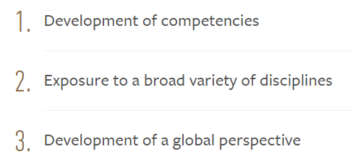
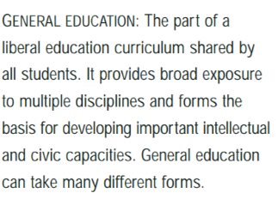

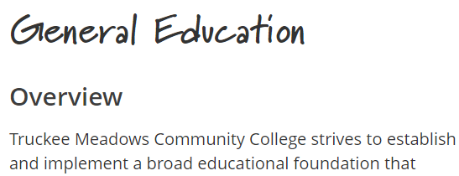
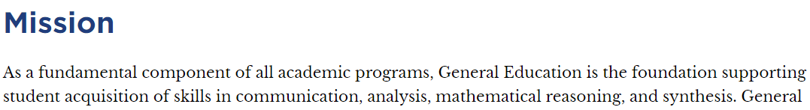
Mission to Metaphors
Heart
Exposure
Core
Foundation
Notes:
Then geniuses are we!

Slide 38
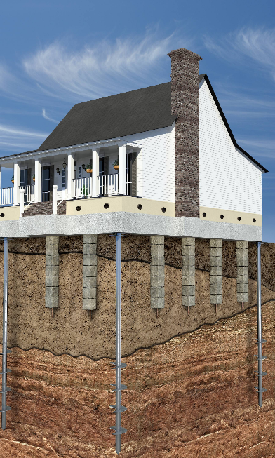
Gen Ed is a Foundation

Slide 39
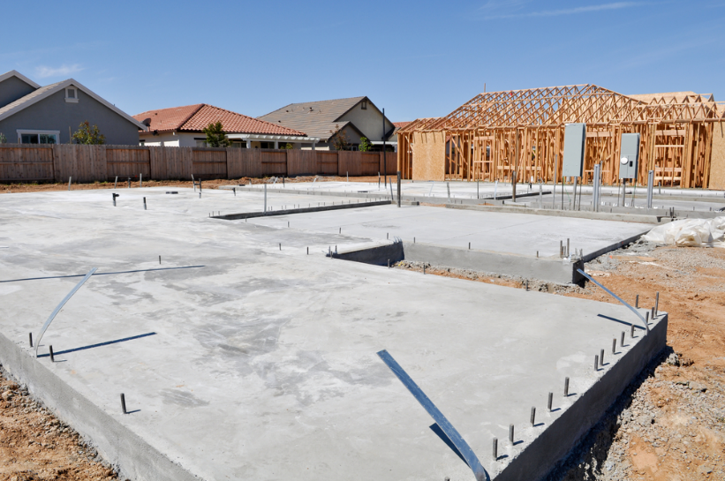
But If We’re Not Committed…

Slide 40
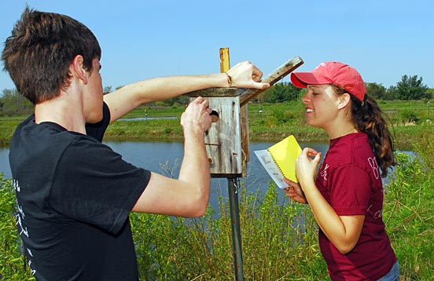
Gen Ed is Exposure

Slide 41
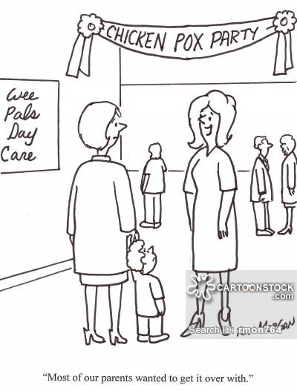
But If We’re Not Committed…

Slide 42

Gen Ed is the Heart

Slide 43

But If We’re Not Committed…

Slide 44

Gen Ed is the Core

Slide 45
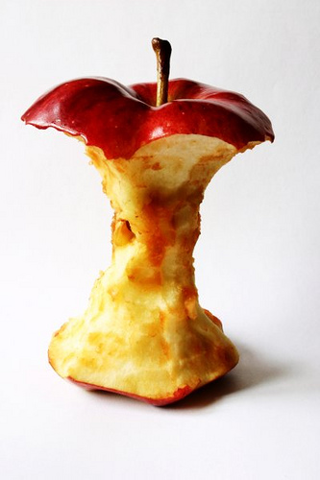
But If We’re Not Committed…

Slide 46
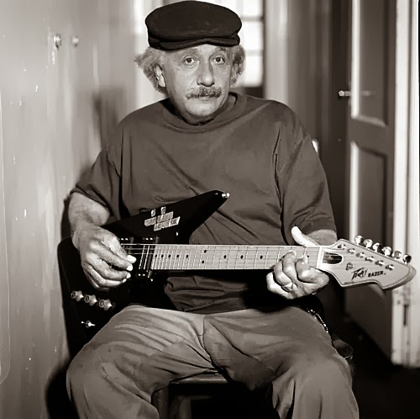
Gen Ed Leads to Well-Rounded Students

Slide 47
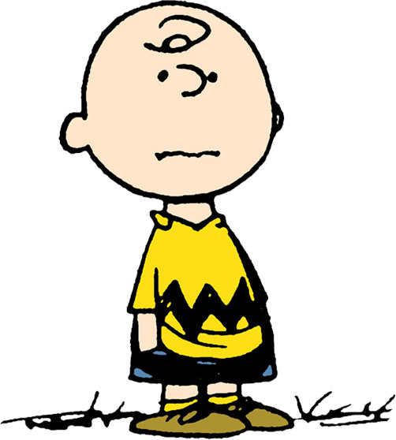
But If We’re Not Committed…

Slide 48

Gen Ed is the Ingredients and Skills to Create a Life Worth Living

Slide 49
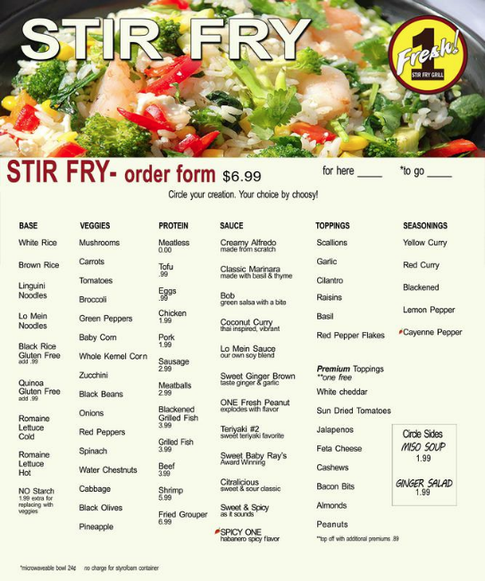
But If We’re Not Committed…

Slide 50

Gen Ed Provides Lenses

Slide 51
But If We’re Not Committed…

Slide 52

Gen Ed Provides Tools

Slide 53

Because If We’re Not Committed…
‘If the only tool you have is a hammer you tend to see every problem as a nail.’
- Abraham Maslow

Slide 54
And If We’ve Really Lost Our Way…

Slide 55

Gen Ed As Vegetables or Inoculation
Gen Ed is Inoculation
Notes:
Inoculation: hold still, get your shot, it’s gonna hurt, you’ll be better off later
Vegetables: I know they taste horrible, but they’re good for your kidney health and can delay heart disease 40 years from now… sigh…

Slide 56

Gen Ed As Vegetables or Inoculation
Gen Ed is Eating Your Vegetables
Gen Ed is Inoculation
Notes:
Inoculation: hold still, get your shot, it’s gonna hurt, you’ll be better off later
Vegetables: I know they taste horrible, but they’re good for your kidney health and can delay heart disease 40 years from now… sigh…

Slide 57
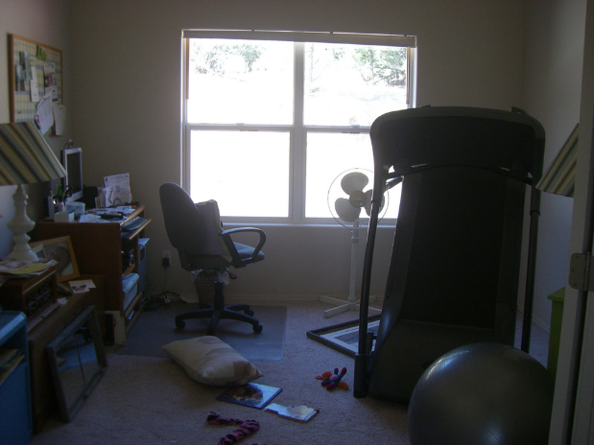
Gen Ed is the Spare Room
Before…

Slide 58
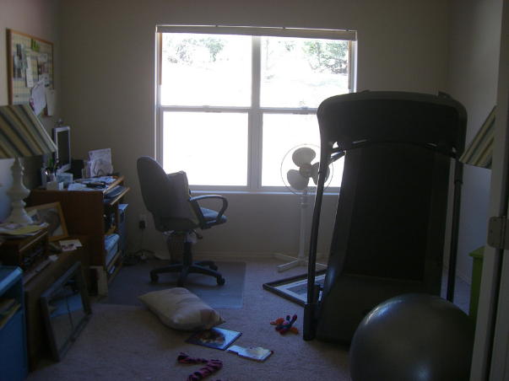


Gen Ed is the Spare Room
AFTER!
Before…

Slide 59
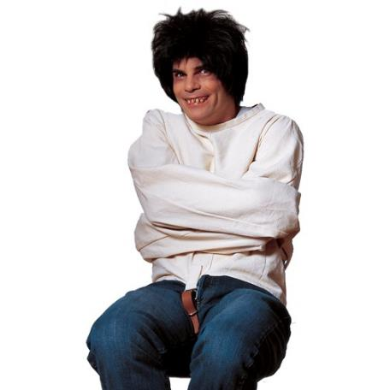
And the One that Still Haunts Me:
“Gen Ed is straitjacket”

Slide 60
So What Do We Do?

Slide 61
Find Out What General Education Means To…
  Your advisors?
  Your admissions staff?
  Your institution website?
  Your hiring and advancement practices?
  Your general education mission and curriculum?
  Your faculty teaching in gen ed… and those NOT teaching in gen ed?
  Your students???

Slide 62
Talk About It at the Institutional Level
Brown Bag Lunches and Department Meetings
Campus News
Gen Ed Listserv and Newsletter
Website and Handouts
Information Tables (orientation, majors fair, family weekend)
Awards Ceremonies
Surveys and Focus Groups

Slide 63
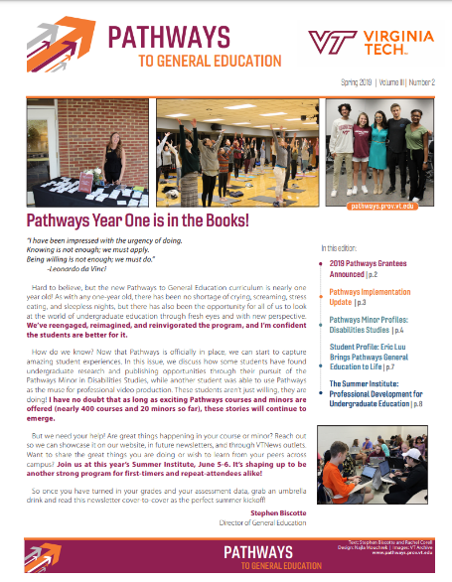
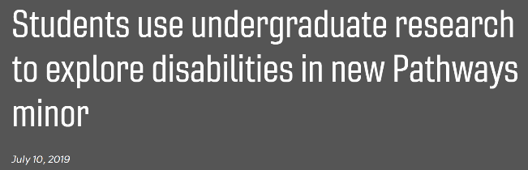
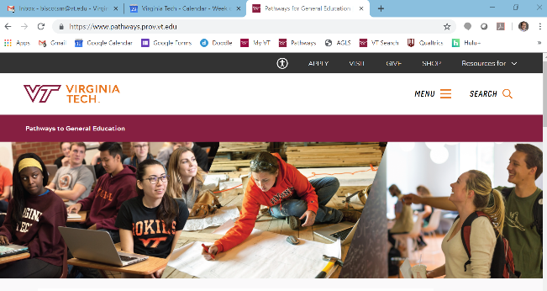
Tell The Institutional Level Story

Slide 64
Talk About It at the State Level
Days of Dialogue and Gen Ed Summits
Faculty Interest Groups and Inquiry Groups
A Central Communication Hub: Reports, Data, Updates, Website
Passport, Transfer VA

Slide 65
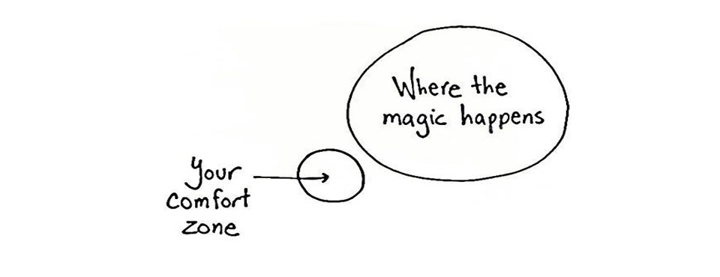
Most Importantly, Get Out of Your Comfort Zone

Slide 66


What I did on my summer vacation

Slide 67
What I did on my summer vacation
“So perhaps general education is you growing accustomed to operating in the world with one set of tools, values, and perspectives then being offered some breadcrumbs (or bombshells) to lead you down a path to consider the world differently. You are uncomfortable. You are conflicted. You are desperate to read more, explore more, and learn more to make sense of it all. The familiar becomes foreign, the common becomes exotic and worthy of further analysis. No matter where you go, you can’t seem to turn it off. It gives you this sort of constant low-grade headache… the good kind of soreness that comes from exercising a muscle that has atrophied in the day-to-day.”

Slide 68
Final Question
So next time a student, advisor, faculty member, parent, administrator asks:
“Why Do I Have to Take This Stuff?”,
how will you respond?

Slide 69


Thank You!
Website: pathways.prov.vt.edu
Email: gened@vt.edu or biscotsm@vt.edu
Twitter: @StephenBiscotte

