Slide 1

Division of Postsecondary State Authorization
Initial Authorization Training
July 2021

Slide 2
Initial Authorization Training Manual
Table of Contents
  Authorized Institutions Overview
  Resource Material
    THEC Website
    Statutes and Rules
  Annual Obligations
    Reauthorization
    Student Level Statistical Data (SLSD) Collection
    Tuition Guaranty Fund
    Break
  Website and Advertising Compliance
  Student Files
  Forms and Applications
  Complaints

Slide 3
Authorized Institutions Overview

Slide 4
Authorized Institutions Overview
Pursuant to the Tennessee Higher Education Authorization Act of 2016 (HEAA) (Tenn. Code Ann. § 49-7-2001, et seq.) the Tennessee Higher Education Commission (THEC) is directly responsible for the oversight and operation of degree and non-degree granting accredited and unaccredited institutions that offer a wide variety of academic, career, technical and trade programs.
The division within THEC that staffs these functions is the Division of Postsecondary State Authorization (DPSA).

Slide 5
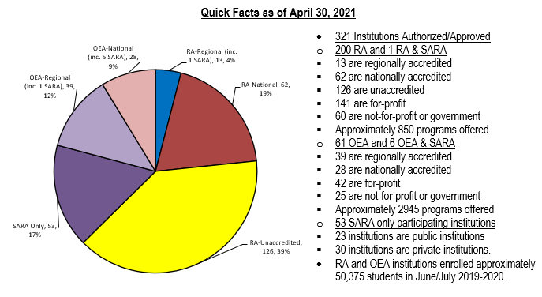
Authorized Institutions Overview

Slide 6
THEC Website
tn.gov/thec

Slide 7
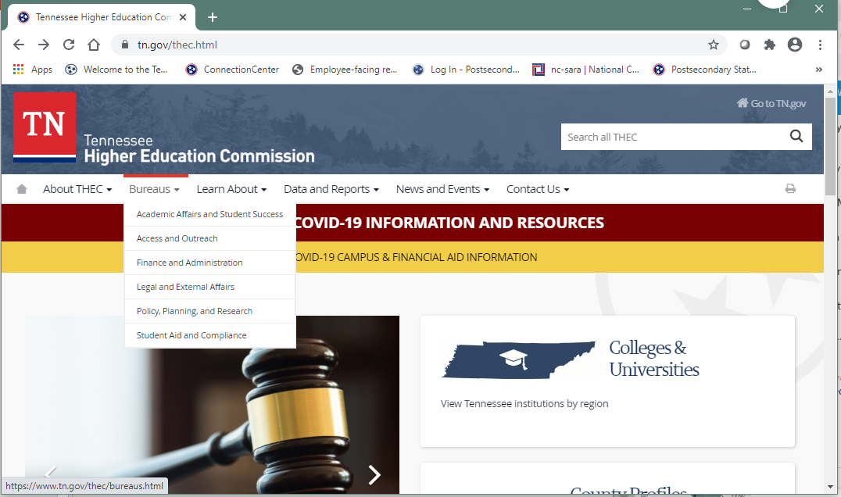
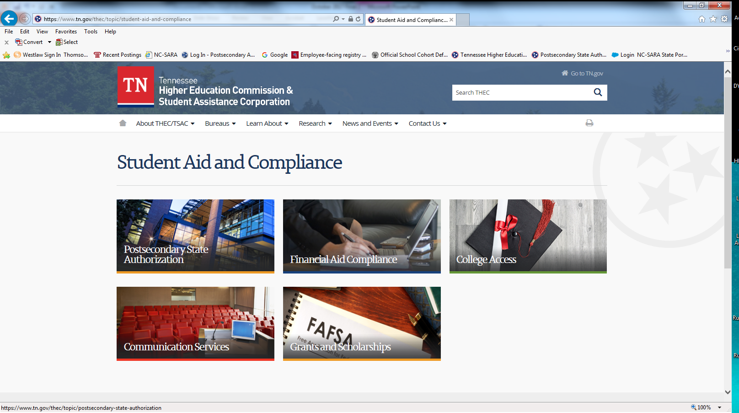
THEC Website: tn.gov/thec

Slide 8
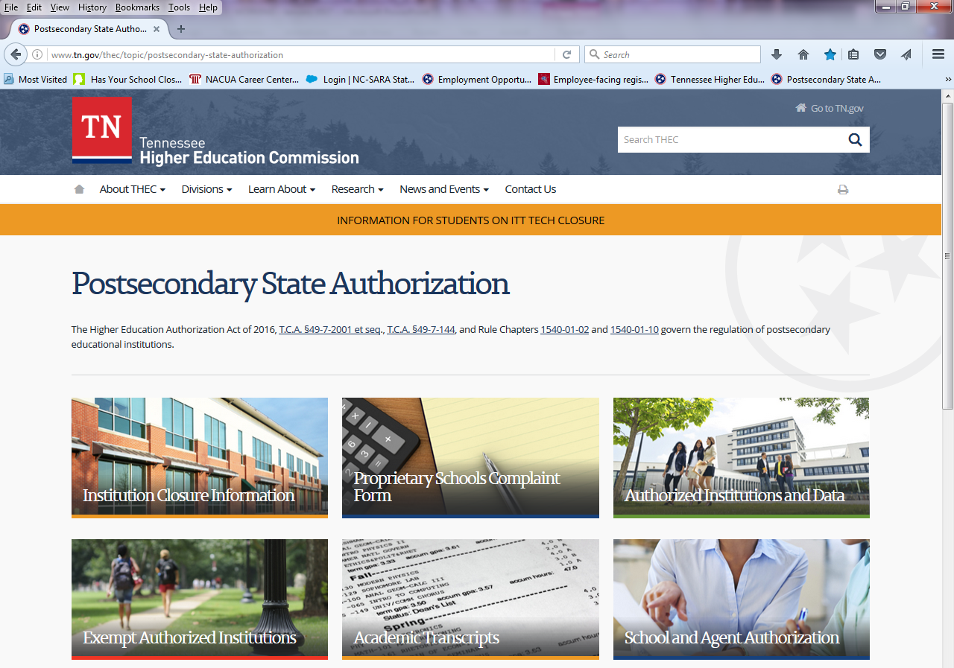
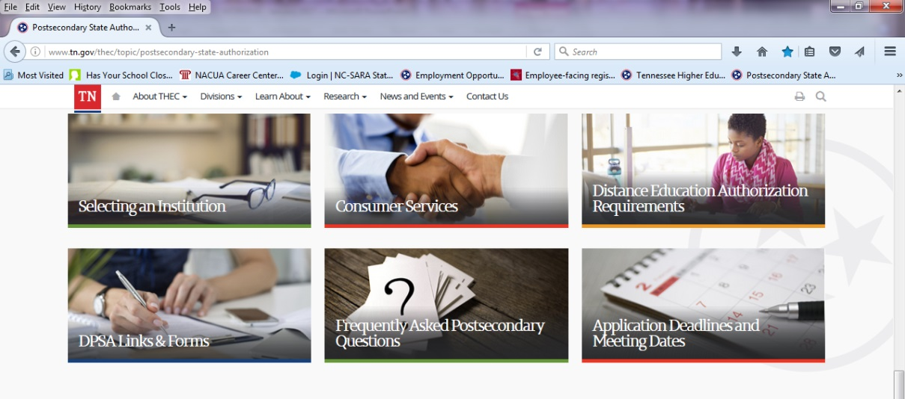
DPSA Homepage:
https://www.tn.gov/thec/bureaus/student-aid-and-compliance/postsecondary-state-authorization.html
Link to Statutes and Rules.
Discussed later in the presentation.

Slide 9
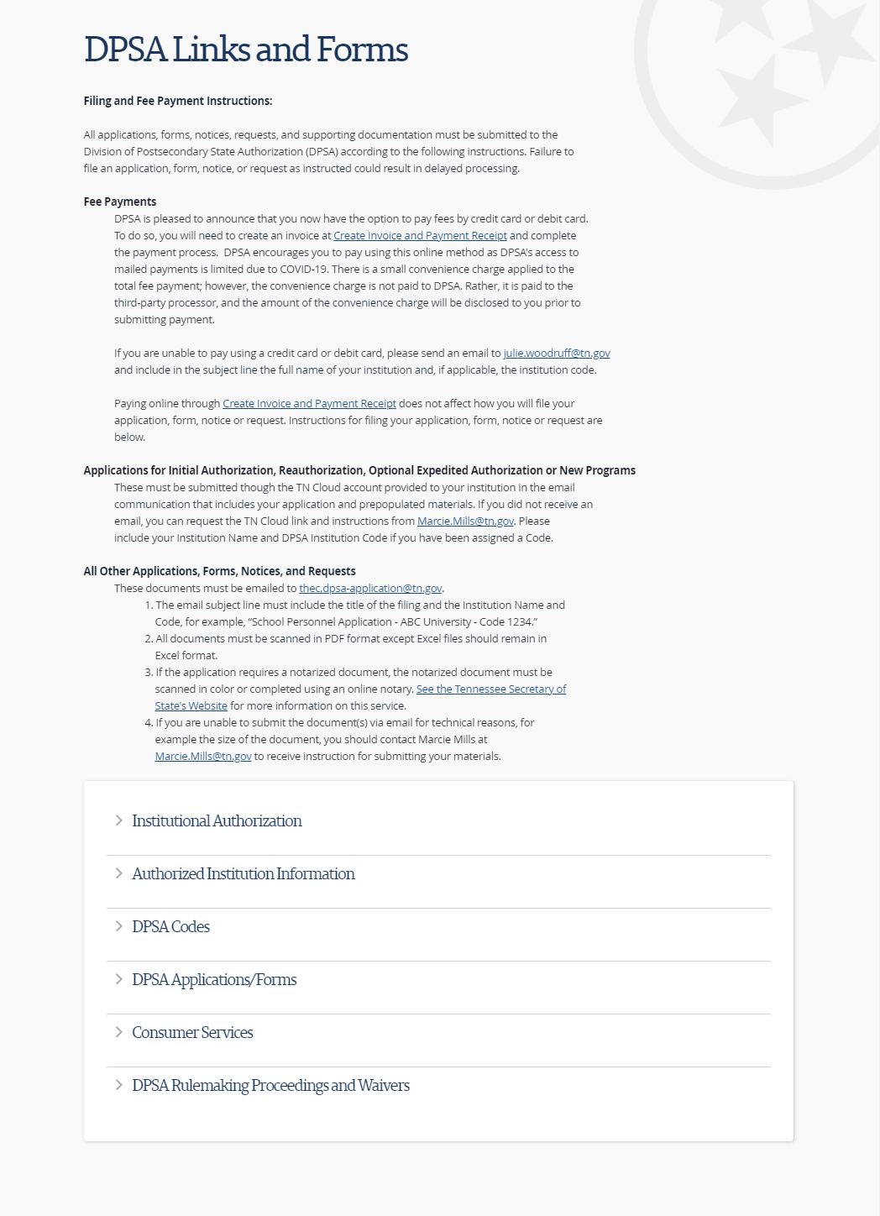
DPSA Links and Forms
URL: https://www.tn.gov/thec/bureaus/student-aid-and-compliance/postsecondary-state-authorization/dpsa-links-and-forms.html
This opening DPSA Links and Forms page contains important information about how to file documents and pay associated fees.
Bookmark this page and open it whenever you need information on these topic as the information changes as we perfect our online filing system.

Slide 10
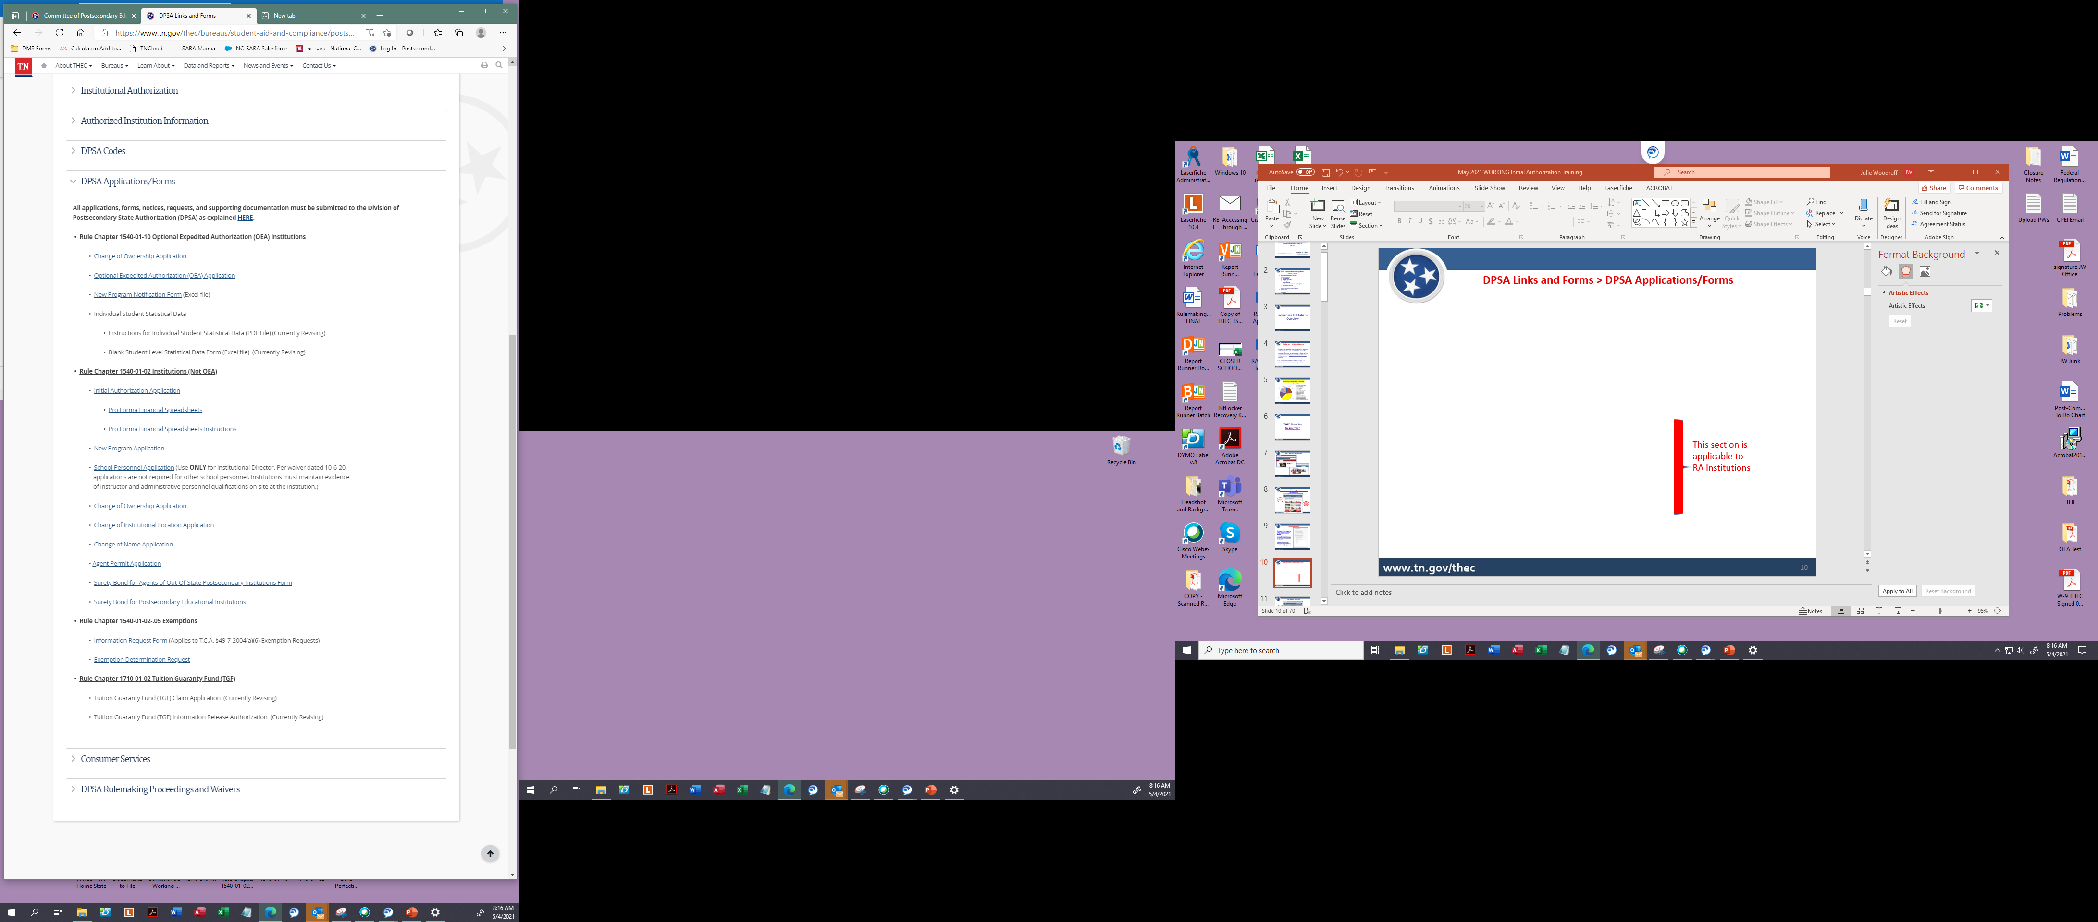
DPSA Links and Forms > DPSA Applications/Forms
This section is applicable to your institution:

Slide 11
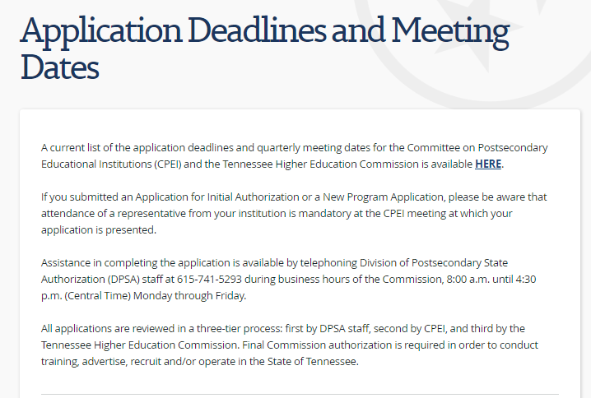
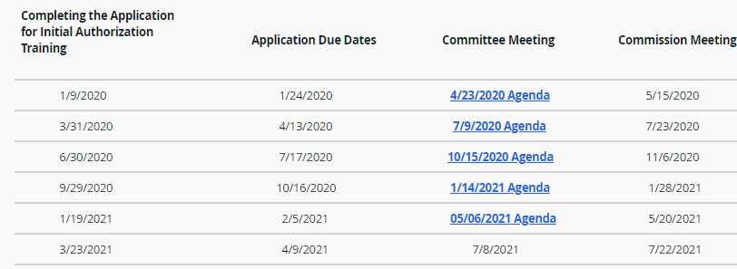
DPSA Application Deadlines and Meeting Dates

Slide 12
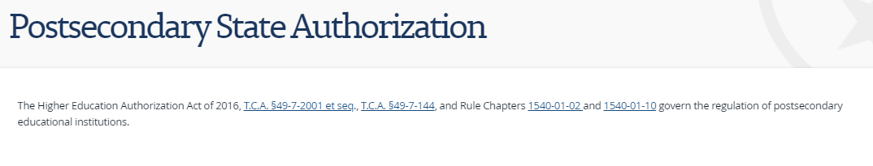
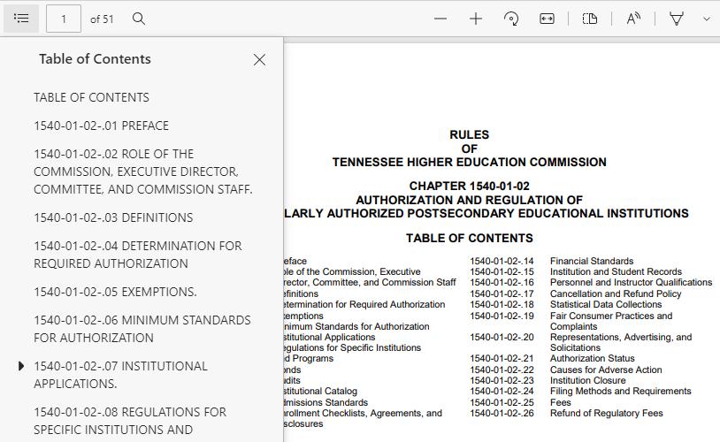
Statutes and Rules
These statutes and rules are applicable to your institution.
Click this icon to open bookmarks

Slide 13
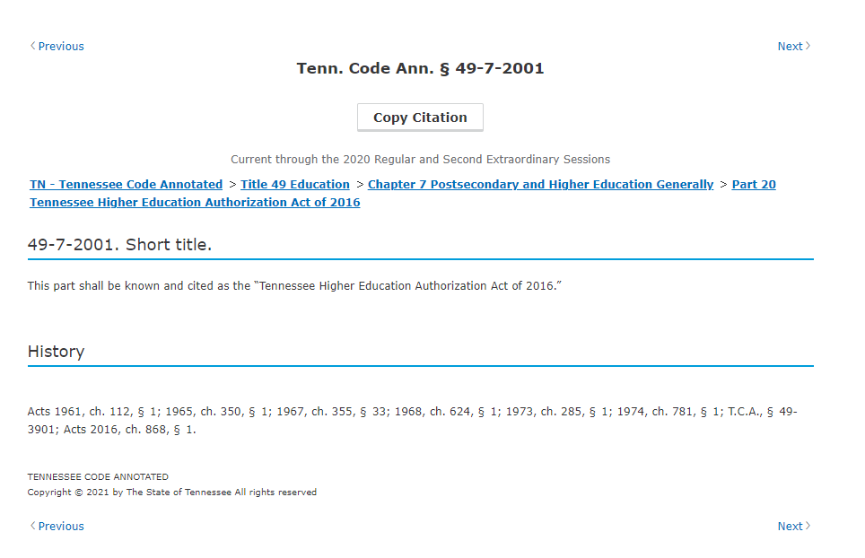
Statutes and Rules
These statutes and rules are applicable to your institution.

Slide 14
Reauthorization

Slide 15
Reauthorization
Institutions are required to submit an annual reauthorization application pursuant to Rule 1540-01-02-.07(3).
The due date for reauthorization applications is dependent on your authorization date. For those of you expected to be authorized by the Commission in July 2021, your reauthorization application will be due on the due date for the July 2022 CPEI meeting.
Generally, we rely on email to send updates to institutions. Therefore, keep your email contact information up-to-date and monitor your spam closely.

Slide 16
Reauthorization
Collected Information & Data
The following information will be requested as part of reauthorization so your institution should put in place procedures now to ensure the information is readily available when needed.
Licensure Passage Rates - Applies to any program leading to employment in a field where licensure is required for employment and there is an examination. Rules 1540-01-02-.07(3) and .08(4)(b).
Student enrollment documents or affirmation statements
Listing of institutional personnel
Total Gross Tuition Collected and Student Funding Sources - Examples include, federal loans, in-house funding, Workforce Investment Act monies, veterans’ benefits, scholarships

Slide 17
Reauthorization
Collected Information & Data
Updates of certain information on file, including lease documentation, bonds, and ownership information
Financial Statements (Income Statement and Balance Sheet) as provided for in Rule 1540-01-02-.14
Gross Tuition Revenues Less Than $1,000,000 But Greater Than $100,000
Gross Tuition Revenues Equal to or Less Than $100,000
Audited Financials Statements Prepared by a CPA in Accordance with GAAP
Gross Tuition Revenues of $1,000,000 or Greater
Reviewed Financials Statements Prepared by a CPA in Accordance with GAAP
Financials Statements on DPSA forms prepared by a CPA or Certified Bookkeeper

Slide 18
Student Level Statistical Data (SLSD) Collection

Slide 19
SLSD Collection
Collected Information & Data
  In June, DPSA will send your institution a blank or prepopulated spreadsheet along with instructions. You should read these instructions carefully. The reporting period is July 1 of the previous year to June 30 of the current year.
  The spreadsheets must be returned by October 15.
  Put in place procedures now to ensure the information is readily available when needed.
    For example, start maintaining dates for all student withdrawals, probation, leave of absence, graduation or any other status changes.
Data is collected on enrolled students. "Enrollment" refers to those students who have attended one (1) session of class, turned in one (1) assignment, or received one (1) distance learning lesson. Rule 1540-01-02-.03(27).

Slide 20
SLSD Collection
Withdrawal and Placement Data
SLSD will be collected on an Excel spreadsheet that includes the following information for each student:
First Name
Middle Initial
Last Name
Student ID Number
Social Security Number
Race
Gender
Date of Birth
Program Name
Program Code
Delivery Mode
Program Length
Credential
Date Started
Date Completed
Date Withdrew
Special Circumstance Withdrew
Placed
Placed In-Field
Special Circumstance Non-Placement
Name, Address, and Telephone Number of Employer
Annual Salary or Hourly Wage

Slide 21
SLSD Collection
Withdrawal and Placement Data
Special Circumstances for Withdrawals:
Health related situation
Family emergency
Death
Incarceration
Full-time military service
Job relocated/transferred
Transferred to a different program at your institution
Special Circumstances for Non-Placements:
Health related situation
Family emergency
Death
Incarceration
Full-time military service
Job relocated/transferred
Continuing education at your institution
Continuing education at a different institution
Pending fulfillment of licensure requirements
International students - unable by law to work
Student could not be contacted/ Refused employment

Slide 22
SLSD Collection
Common Errors
You must provide student’s social security or unique ID number. The social security number is preferred.
You must provide the date of birth.
The date completed should only be filled in when the student completes (graduates) the corresponding program. If no credential is awarded to the student (e.g., they failed or withdrew) then they did not complete the program.
Do not enter a completion or withdrawal date that is later than the end of the reporting period or earlier than the DATE STARTED.
The placed in field column must be completed if the student has completed the corresponding program and is marked as “Y” for Placed.

Slide 23
SLSD Collection
Common Errors, Continued
The name of the employer and related information must be filled in if the student was placed or employed after completing the corresponding program.
The placed column must be completed if the student completed the program.
Failure to update materials: When you receive your first round of data you will need to update two items:
  Website
  Pre-Enrollment Checklist

Slide 24
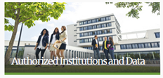
SLSD - THEC Website: tn.gov/thec

Slide 25
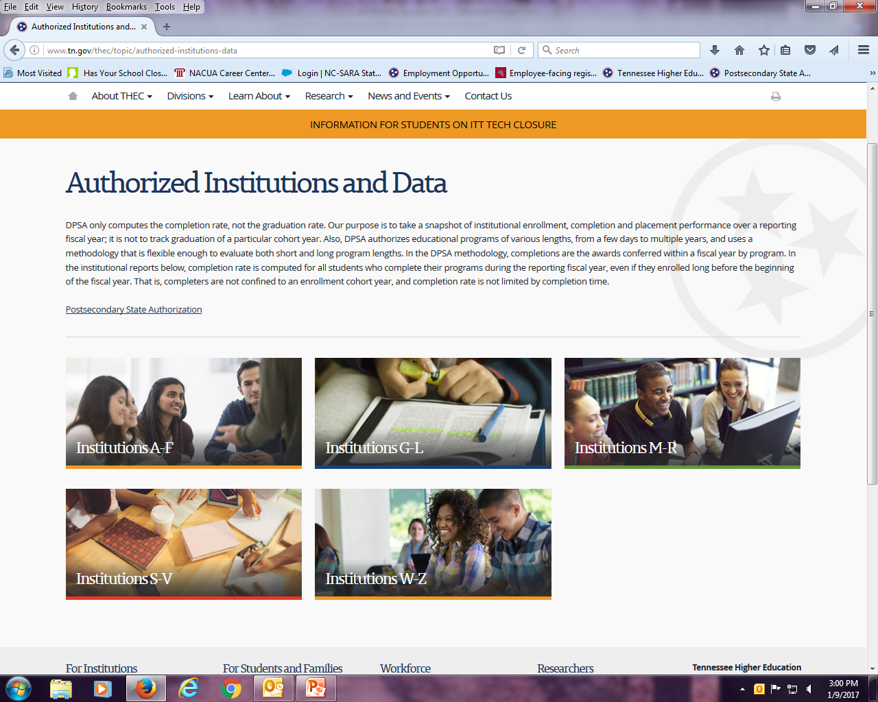
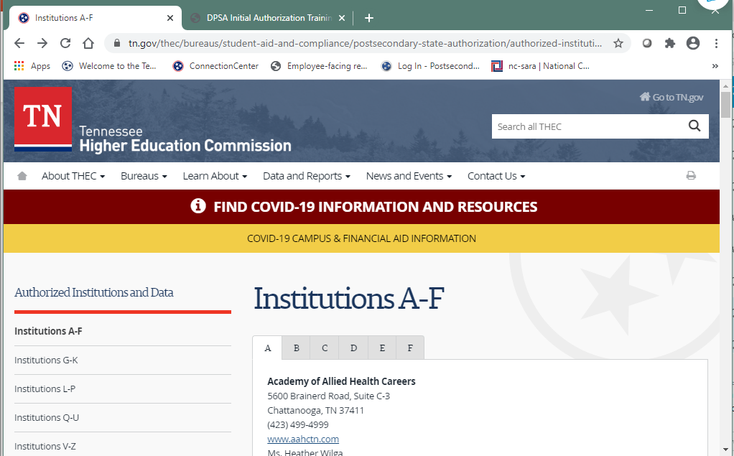
SLSD - THEC Website: tn.gov/thec

Slide 26
Tuition Guaranty Fund

Slide 27
Tuition Guaranty Fund
Rule Chapter 1710-01-02 & Tenn. Code Ann. § 49-7-2018
The tuition guaranty fund was created by the Tennessee General Assembly to establish a fund from which reimbursement can be made to students for unearned tuition.
A Board of Directors administers the fund. The Board is composed of:
  the Comptroller of the Treasury;
  the Commissioner of Finance and Administration;
  the State Treasurer;
  the Executive Director of the Tennessee Higher Education Commission
  a Member of the Committee on Postsecondary Educational Institutions; and
  a representative of the private postsecondary education industry named by the Chair of the Commission.

Slide 28
Tuition Guaranty Fund
Rule Chapter 1710-01-02 & Tenn. Code Ann. § 49-7-2018
The Board is authorized to take any actions necessary to administer the fund, including promulgation of rules, regulations and bylaws.
All institutions must pay into the Tuition Guaranty Fund for six (6) years following authorization.
Failure to pay Tuition Guaranty Fund assessments could result in adverse action against your institution including a fine or, if necessary, a recommendation to the Commission to change the status of your institution’s authorization.

Slide 29
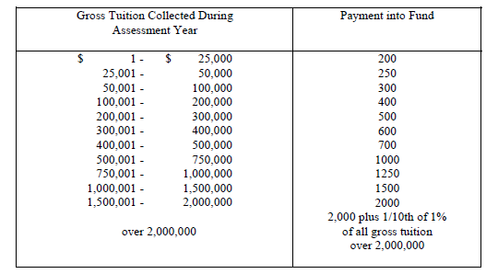
Tuition Guaranty Fund
Rule Chapter 1710-01-02 & Tenn. Code Ann. § 49-7-2018
Institutions will receive the first of SIX notifications concerning the need to contribute to the fund in February of the year following receipt of authorization from THEC. Institutions must pay into the fund for the first six years of authorization as follows:

Slide 30
Website and Advertising Compliance

Slide 31
Website Compliance
Tenn. Code Ann. § 49-7-2019
WHAT ARE INSTITUTIONS REQUIRED TO POST?
Tenn. Code Ann. § 49-7-2019 requires institutions to post the tuition costs provided to the Commission.
WHERE SHOULD THE INFORMATION BE POSTED WITHIN THE WEBSITE?
The tuition costs provided to the Commission should be available along with other information on the applicable program web page.

Slide 32
Website Compliance
Tenn. Code Ann. § 49-7-2019 and Rule 1540-01-02-.20(4)
Information related to graduation and job placement – See Tenn. Code Ann. § 49-7-2019 must be on your website. It is recommended posting the information on the first page of the website, the first Tennessee-specific webpage, or the webpage for each Tennessee authorized site. Commission staff suggests the following language:
  “In order to view detailed job placement and graduation information on the programs offered by [Name of Institution], please visit https://www.tn.gov/thec/bureaus/student-aid-and-compliance/postsecondary-state-authorization/authorized-institutions-and-data.html.”
An authorization statement along with a hyperlink to the THEC’s website. See Rule 1540-01-02-.20(4). The authorization statement must be on the institution’s home page or Tennessee specific page.
  “[Name of Institution] is authorized for operation as a postsecondary educational institution by the Tennessee Higher Education Commission.”
    The entire statement must be used, have the same size font, and type of print.
    The reference to the Tennessee Higher Education Commission must be a hyperlink to www.tn.gov/thec/.

Slide 33
Website Compliance
Tenn. Code Ann. § 49-7-144
WHAT ARE INSTITUTIONS REQUIRED TO POST?
Tenn. Code Ann. § 49-7-144 requires an institution to post the transferability of credit statement as written in paragraph (b)(2) of Tenn. Code Ann. § 49-7-144.
WHERE SHOULD THE INFORMATION BE POSTED WITHIN THE WEBSITE?
Commission staff recommends posting this statement or a link thereto on the first page of the website, the first Tennessee-specific webpage, or the webpage for each Tennessee authorized site.

Slide 34
Website Compliance
Next Steps – Check Your Website!
Authorization by the Commission ≠ Website Compliance You are responsible for ensuring that your website is compliant with all statutes and rules at all times.
Student Level Statistical Data – As mentioned previously, Tenn. Code Ann. § 49-7-2019 requires institutions to post information related to graduation and job placement. After you submit your first set of Student Level Statistical Data, DPSA will provide you with a statistical data report related to graduation and job placement rates. As soon as you receive the report, your website must contain the appropriate language and hyperlinks.

Slide 35
Advertising Compliance
Rule 1540-01-02-.20(7)
Rule 1540-01-02-.20(7) states:
  “All advertisements seeking prospective students must include and clearly indicate the full and correct name of the institution, the authorized location city, and, if out-of-state, the authorized location state.” (emphasis added)
This rule applies to all advertisements, including billboards, radio, television, and newspaper advertisements, and advertisements created and purchased by the institution or its agents.
If your agent takes out an advertisement and it does not comply with .20(7), your institution may be fined.

Slide 36
Advertising Compliance
Rule 1540-01-02-.20(9)
Rule 1540-01-02-.20(9) states:
“Other than entry level salary data available on a Tennessee or federal government website, no dollar amount will be quoted in any advertisement as representative or indicative of the earning potential of graduates without prior approval by Commission Staff.”

Slide 37
Advertising Compliance
Rule 1540-01-02-.20
I have simply highlighted a few Rule 1540-01-02-.20 paragraphs. The rule has 18 paragraphs in total. Review the rules thoroughly to ensure your representations, advertisements, and solicitations are compliant.

Slide 38
BREAK
20 Minutes

Slide 39
Forms and Applications

Slide 40
Program Revisions
An institution revises a program when it changes any element of a program that has been approved by Tennessee Higher Education Commission, for example, the name of the program, tuition, credit or contact hours, other fees, length, and curriculum.
Pursuant to Rule 1540-01-02-.07(5)(c), when an institution makes any revision(s) to an approved program, the institution must notify the Commission by submitting a Program Revision and Status Change Notification to Commission Staff at least thirty (30) days prior to implementing the revision. Moreover, “If the program revision amounts to a change of more than twenty-five percent (25%) in the last twelve (12) months or if Commission Staff determines a significant revision has occurred, then the institution must submit a New Program Application prior to implementing the revision.

Slide 41
Program Revisions
However, on October 6, 2020, the Tennessee Higher Education Commission’s Executive Director temporarily waived this rule, in part. This temporary waiver allows an institution to revise a program without filing a Status Change Notification to Commission Staff. The institution will notify Commission Staff of program revision(s) during annual reauthorization.
Change of program name or credential: An institution must notify Commission staff at least thirty (30) days prior to the effective date of the change and must explain the specific change and the proposed effective date.
The institution will be required to file an Application for New Program:
  If Commission Staff determines that the institution has implemented program revision of more than twenty-five percent (25%) in the last twelve (12) months, or
  If Commission Staff determines a significant revision has occurred.
Changes to delivery mode (residential, online or blended) are significant and require an Application for New Program.

Slide 42
Program Revisions
Rule 1540-01-02-.07(5)(d) provides: “Institutions shall not arbitrarily add a course to an existing program in which a student would incur additional time or expense beyond the catalog requirements at the time of enrollment, unless the addition is in response to: demonstrated educational necessity; a reasonable program completion period elapsed; state approval agency requirements; U. S. Department of Education recognized accreditor requirements or professional licensure requirements.”

Slide 43
School Personnel Applications
Rule 1540-01-02-.07(7)(a) requires institutions to submit a School Personnel Application for instructors and administrative personnel “no later than ten (10) business days after the hire date.”
  Unaccredited institutions must submit applications for all instructors and administrative personnel.
  Accredited institutions must submit applications for administrative personnel only.
However, on October 6 , 2020, the Tennessee Higher Education Commission’s Executive Director temporarily waived this rule, in part. With the exception of the institutional director, the temporary waiver suspends the requirement for accredited and unaccredited institutions to file an Application for School Personnel for instructors and administrative personnel.

Slide 44
School Personnel Applications
Instructors and administrative personnel must meet the minimum qualifications listed in Rule 1540-01-02-.16(5). Institutions must maintain evidence of the qualifications on-site at the institution. Institutions must submit a copy of this evidence at any time upon receiving a request from Commission staff.
  Administrative personnel are individuals that oversee operational and administrative standards. This includes, but is not limited to, financial aid administrator; director of admissions; director of education; business officer or manager; director of student services and the registrar.
  Support and clerical staff are not considered administrative personnel.

Slide 45
School Personnel Applications
Institutional Directors MUST submit an Application for School Personnel to the Commission.
Use the Application for School Personnel available on THEC’s website.
When completing the Application for School Personnel, complete the application in its entirety and include the attachments requested in the application’s checklist.
If the institutional director will also be an instructor, list program/subject to be taught.
Qualifications
  Place a check mark by applicable qualifications
  Only mark the qualifications for level to be taught (i.e., instructors for certificate level programs need only to mark certificate level qualifications)
Submit the application with the signatures of all required persons.
All information placed on applications is subject to verification by Commission staff.

Slide 46
Agent Permit Applications
Rule 1540-01-02-.07(8)(a) provides: “Agents must submit an Agent Permit Application, as provided by Commission Staff, and must receive approval and an agent permit from Commission Staff prior to any solicitation.”
WHAT IS AN AGENT?
T.C.A. § 49-7-2003 and Rule 1540-01-02-.03(6)
Agent means any person representing a postsecondary educational institution for payment, who solicits in any form and enrolls, or seeks to enroll, a student for education offered by an authorized institution, or offers to award educational credentials, for remuneration, on behalf of any such institution. Persons owning an interest in an institution and the institution’s full-time employees and directors shall not be considered agents under this part.

Slide 47
Agents
Rule 1540-01-02-.07(8) and .16(8)
AGENT REQUIREMENTS
All agents must:
  receive approval and an agent permit; and
  If the institution is out-of-state, secure an appropriate bond prior to any solicitation.
Agent permits must be renewed annually and the renewal application is available on THEC’s website.
Institutional Directors and the Institution are responsible for an Agent’s actions.
An agent whose permit has expired must submit a New Agent Application if submitted more that 60 days following the expiration date.

Slide 48
Agents
Rule 1540-01-02-.07(8) and .16(8)
WHY IS THIS IMPORTANT?
Any contract signed by a prospective student as a result of solicitation or enrollment by a non-licensed agent may be unenforceable and the student may be entitled to a refund of all moneys paid.
The institution could be fined or the institution’s authorization status changed to conditional or revoked.
ANSWERS TO COMMON AGENT QUESTIONS
An institution must obtain approval for an agent prior to the individual engaging in any agent activity.
A full-time employee of the institution is not an agent.
A part-time or contract employee of the institution, who the institution compensates for enrolling or seeking to enroll students, is an agent. This includes a person working from a remote location, who enrolls students or makes cold calls, or as part of a recruiting firm.

Slide 49
Other Required Forms
Change of Location – Rule 1540-01-02-.07(6)
  Your institution may not conduct instruction at an unauthorized site. Submit an Application for Change of Institutional Location at least 30 days prior to the scheduled relocation.
  DPSA must inspect the facilities and equipment.
Institution Name Change – Rule 1540-01-02-.07(9)
Change of Ownership – Rule 1540-01-02-.07(4)
New Program Application – Rule 1540-01-02-.07(5)
  An institution must receive approval to offer a program prior to advertising for or soliciting enrollment.
  For equipment heavy programs, DPSA will inspect the equipment prior to approving the program.
Surety Bonds for Agents and Institutions – Rule 1540-01-02-.09

Slide 50
Student Files

Slide 51
Student Files
Pursuant to Rule 1540-01-02-.15(5), “Institutions must maintain a file for each student enrolled in a program or course for three (3) years after the student’s withdrawal from or completion of the program or course of enrollment.” The file shall contain at a minimum ¹
  Documentation for the basis of admission;
  Pre-enrollment checklist executed by the student;
  Enrollment agreement executed by the student;
  Transferability of credits disclosure statement in compliance with T.C.A. § 49-7-144;
  Documentation of all special circumstances placement and withdrawal exceptions; and
  Account Ledger
Institutions shall retain student transcripts or certificate of completion from your institution for the life of the institution.
¹ This is not an exhaustive list. See Rule 1540-01-02-.15(5) for a complete list of requirements.

Slide 52
Account Ledger/Tuition Charges
Institutions must charge the approved tuition amount and the account ledger should reflect that the student was charged the approved amount.
Rule 1540-01-02-.19(8) states:
“An institution may award a scholarship, tuition waiver, or other similar award provided:
(a) The eligibility requirements for the offering, including terms, conditions, application procedures, due dates, basis for selection, and amount to be awarded, are clearly defined in writing;
(b) The institution has a form and procedure to verify eligibility; and
(c) The amount of the award is a flat dollar amount or subject to calculation using a defined formula or scale.”

Slide 53
Admission Standards
Each institution is approved with specific admission standards set by the institution, subject to Rule 1540-01-02-.12.
Admission standards must be applied as approved by THEC.
Do not admit students that you know or should know are ineligible for licensure unless you get written acknowledgement from the student.

Slide 54
Admission Standards
  Students enrolling in a certificate or diploma program must possess a high school diploma, a high school diploma equivalency, a current Tennessee license in the field for which the training is intended, postsecondary credit in a degree program, or a passing score on an ability to benefit test.
  Students enrolling in an associate or bachelor degree program must possess, at a minimum, a high school diploma, a high school diploma equivalency, or postsecondary credit in a degree program.
  Students enrolling in a post-baccalaureate program must possess, at a minimum, a baccalaureate degree from an institution judged to be appropriate by the Commission.

Slide 55
Student Files
  An official high school transcript, high school equivalency transcript or GED score sheet shall be maintained in the student’s file, not a copy of the high school diploma, or GED Certificate or HSE diploma. An official high school transcript, high school equivalency transcript or GED score sheet must be:
  Signed by an institutional official or have an official seal.
  If a hard copy of the transcript or score sheet is scanned and stored electronically, then it must be accompanied by documentation that verifies it was received directly from the issuing institution/agency such as the envelope that contained the transcript or score sheet. Please note such is not necessary when the document itself is addressed to the receiving institution.
  If faxed or emailed the transcript or score sheet must include indicia that the transcript or score sheet was received directly from the issuing institution or agency such as accompanying email correspondence or fax cover sheet from the issuing institution/agency.
  If an official postsecondary transcript is used for admission to an undergraduate program, then the transcript must indicate that the student graduated from high school or that the student was enrolled in and received credit in a degree program. If used for admission to a graduate program, then the postsecondary transcript must be official and indicate that the person holds a postsecondary degree.

Slide 56
Student Files
  As of January 1, 2014 the High School Equivalency Test (HiSET) is available as an alternative option to earn the state-government issued high school equivalency diploma. While the GED is still an option, the State of Tennessee and the State Board of Education will not make a distinction between the two tests when awarding the credential. Successful test takers of either test will be issued a Tennessee High School Equivalency Diploma (HSE).

Slide 57
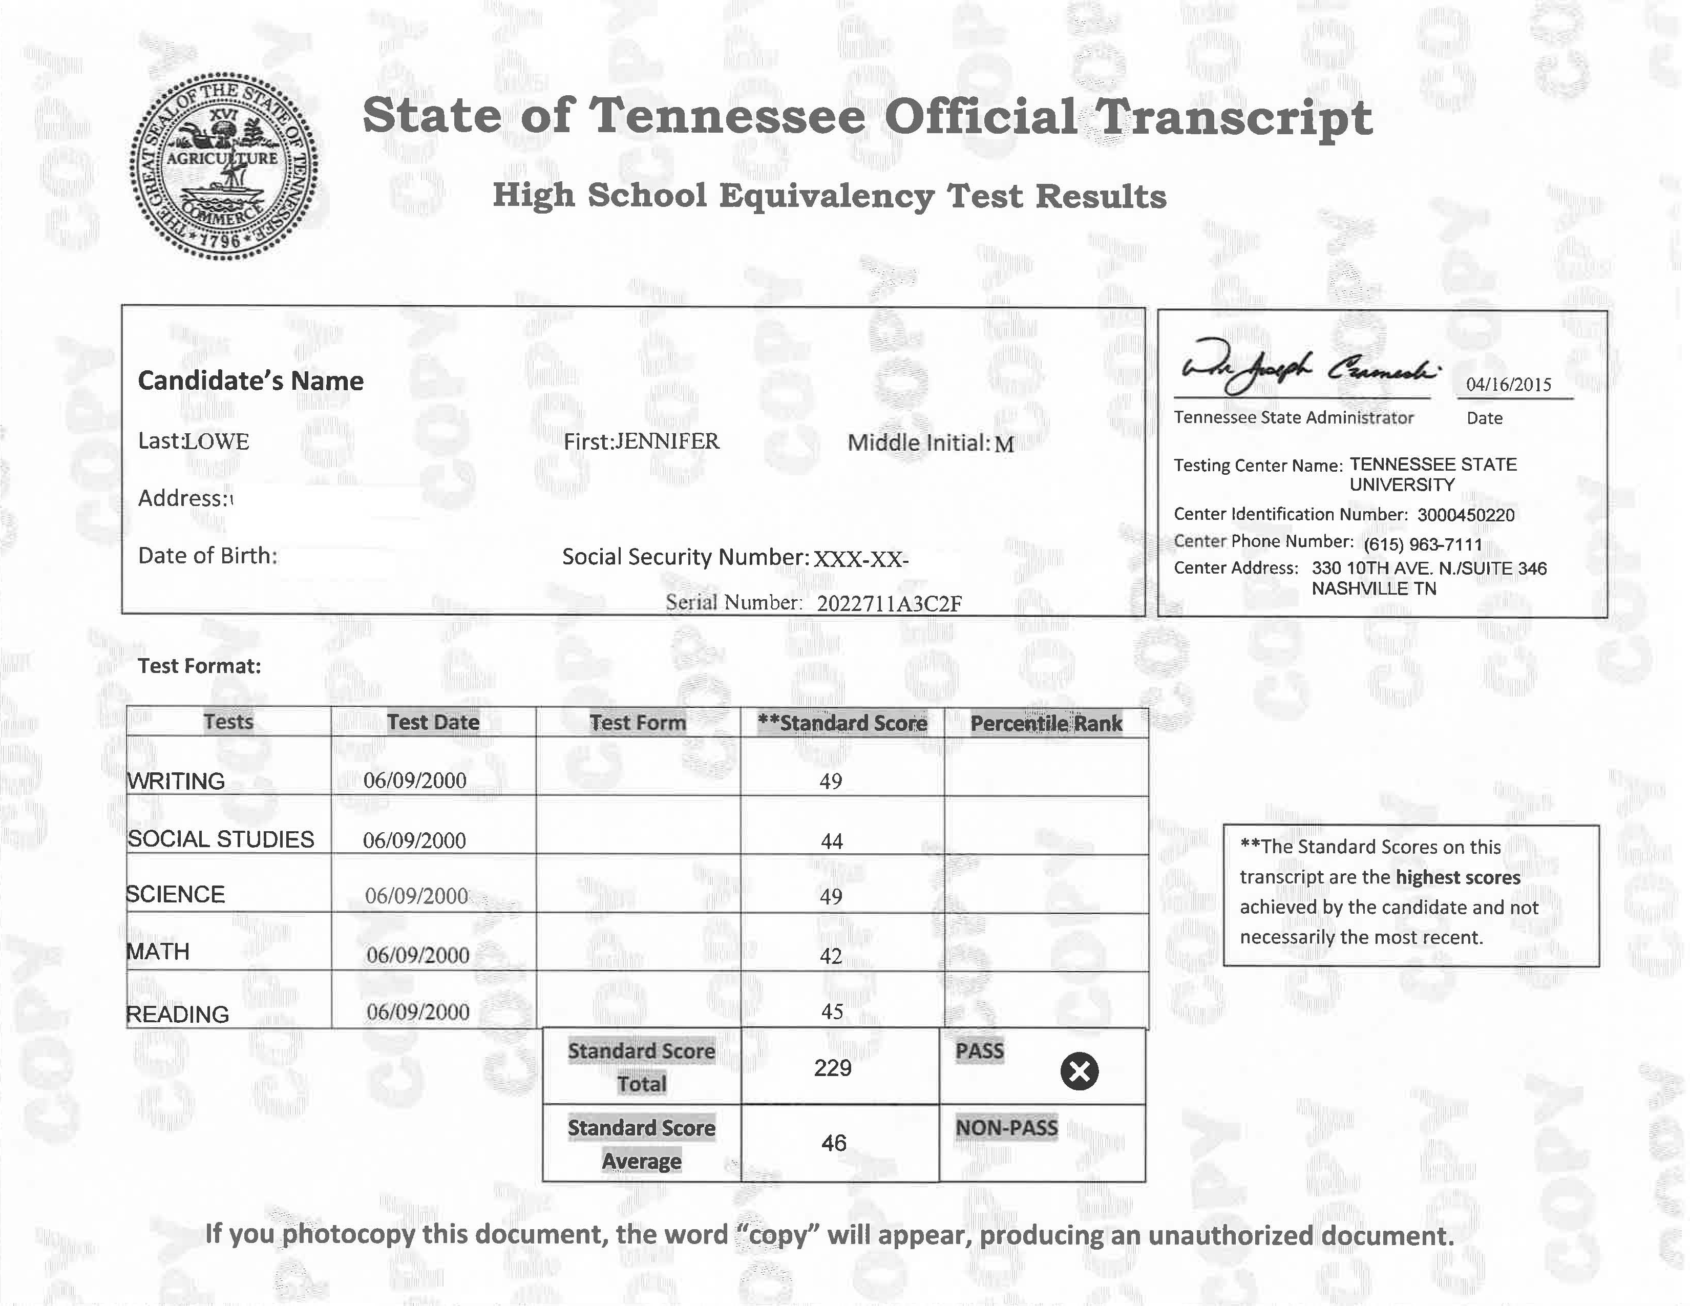
Student Files

Slide 58
Student Files
The Student File Should Contain:
Student Seeks to Enroll in a Certificate or Diploma Program
Student Passes an Ability to Benefit Test (ATB)¹
A Copy of the Scored ATB or a Graded Score Sheet¹
Student has a High School Equivalency
Student has a High School Diploma
Student has Postsecondary Credit in a Degree Program
Official GED Score Sheet or Official High School Equivalency Transcript From the Issuing Entity
Official High School Transcript
Official Transcript from a Postsecondary Institution Indicating that Degree Program Credit Awarded
Official Military Documentation Indicating High School Completion
¹ The test should be approved by DPSA or it must be one previously approved by the U.S. Department of Education (USDOE). The institution must notify DPSA if it intends to use a USDOE approved test.

Slide 59
Student Files
Student Seeks to Enroll in an Undergraduate Degree Program
Student has a High School Equivalency
Student has a High School Diploma
Student has Postsecondary Credit in a Degree Program
Official GED Score Sheet or Official High School Equivalency Transcript From the Issuing Entity
Official High School Transcript
Official Transcript from a Postsecondary Institution Indicating that Degree Program Credit Awarded
Official Military Documentation Indicating High School Completion
The Student File Should Contain:

Slide 60
Student Files
Student Seeks to Enroll in a Post-Baccalaureate Program
Student Has a Baccalaureate Degree or Higher Credential from an Institution Judged to be Appropriate by the Commission
An Official Copy of the Transcript from the Postsecondary Institution Indicating that the Student Received the Credential
The Student File Should Contain:

Slide 61
Student Files
Student Has a Tennessee license in the field for which the training is intended
An Official Copy of the License
Student Seeks to Enroll in
Student has a Tennessee license in the field for which the training is intended.
Verification of current licensure from the issuing Tennessee subject matter expert agency, such as a current screenshot from the agency’s website.
The Student File Should Contain:

Slide 62
Complaints

Slide 63
Complaints
The investigation of complaints against institutions is one of the most important functions performed by this agency.
Sources of complaints:
  Students
  Parents
  Employees
  Elected Officials
  Better Business Bureau
  Other State Agencies
DPSA is a neutral party in the complaint process. It reviews both sides and will make a determination based on the facts presented.
  Maintain communication with DPSA throughout the process!!

Slide 64
Complaint Process
When a complainant first contacts DPSA by phone, a DPSA staff member:
Documents the call as an informal complaint
Explains the complaint process and applicable statutes and rules
Suggests that complainant contact the Institutional Director if the complainant has not already done so
Follows up with email explaining the process for initiating a formal complaint and copy the Institutional Director if the complainant agrees
  Opportunity for institutions to resolve the complaint without any further involvement by DPSA
If the complainant does not submit a written complaint within 30 days of the informal complaint, the complaint is closed.

Slide 65
Formal Complaint Process
When a complaint is received in writing, it is considered formal and will be investigated. DPSA sends a copy of the complaint to the institution along with a letter requesting a response to specific allegations and documentation to assist with the investigation.
The institution’s response to DPSA should fully address the allegations and include all documentation requested by DPSA.

Slide 66
Formal Complaint Process
The complainant will get an opportunity to reply to the institutional response. Afterwards, DPSA may request additional information/documentation from both parties or complete a site visit as part of the investigation process.
DPSA will review all information to determine if there were any violations of statutes, rules, or the institution’s internal policies.

Slide 67
Formal Complaint Process
Every attempt is made to resolve the dispute between the parties. If no resolution is reached, DPSA will issue its written determinations.
If DPSA determines that a violation has occurred, the institution is given an opportunity to provide substantial reasons as to why adverse action should not be taken.

Slide 68
Formal Complaint Process
DPSA will evaluate the institution’s response and take appropriate action, including recommending that the Executive Director assess a fine, changing authorization status, or requiring the institution to issue a refund or take some other action.
In the event that either party is not satisfied with the determination made by DPSA, the party may seek further review by the Executive Director or through the Uniform Administrative Procedures Act.

Slide 69
Common Issues in Complaints
Fair Consumer Practices – Rule 1540-01-02-.19
  Includes violations of institutional policies
Cancellation and Refund Policy – 1540-01-02-.17
  Inconsistency in how withdrawal or last date of attendance is recorded
Personnel and Instructor Qualifications – 1540-01-02-.16
  Administrative personnel/instructors not approved in timely manner
  Not evaluated annually by both students and administrators as required by Rule 1540-01-02-.16(7) or evaluations not kept on file

Slide 70
Complaints
How can my institution reduce or eliminate complaints filed with DPSA?
Document communications
Educate your staff to resolve issues internally
Adhere to DPSA’s rules and institutional policies

Slide 71
Conclusion
Thank you for your attendance today. Each institution will receive an email by close of business tomorrow. The email will include an affirmation statement, electronic copy of the rules, and this presentation.
This statement must be completed and returned to carolyn.qualls@tn.gov by the due date listed in the email.
Questions regarding this presentation should be directed to Julie.Woodruff@tn.gov or Latonya.Todd@tn.gov

