Slide 1
2021-25 Outcomes-Based Funding
Formula Review Committee
July 8, 2021
1PM CDT

Slide 2
Formula Review Committee
Welcome and Introductions
Charge and Responsibilities
Agenda Overview

Slide 3
Timeline
Formula Working Group Convenings
March thru June 2021
Formula Review Committee Convenings
July thru Fall 2021
TN Higher Education Commission Meetings
July & November 2021
House & Senate Education and Finance Committees Presentations
Spring 2022
TN Higher Education Commission Meeting
(if needed)
May 2022
THEC Staff Implement Approved Changes and Revisions
Summer 2022
Institutions Submit Data Under New Definitions
Fall 2022
FY23-24 Budget Recommendation to TN Higher Education Commission Meeting
November 2022
Submit Approved FY23-24 Budget to State Stakeholders
By December 1, 2022

Slide 4
Review of 2015-2021 Outcomes-Based Funding Formula

Slide 5
Sector-Differentiated Outcomes
University
Students accumulating 30 hours
Students accumulating 60 hours
Students accumulating 90 hours
Bachelors and Associate degrees
Masters/Ed. Specialist degrees
Doctoral/Law degrees
Research & Service
Degrees per 100 FTE
Six-year graduation rate
Community College
Students accumulating 12 hours
Students accumulating 24 hours
Students accumulating 36 hours
Dual enrollment
Associate degrees
Long-term certificates
Short-term certificates
Job placement
Transfer out with 12 hours
Workforce training
Awards per 100 FTE

Slide 6







Overview of Focus Populations
Populations
Adult
Low-Income
Academically
Underprepared (CC)
Premiums
80% 100% 120%
1 2 3
2
2
1
2
1.8
1
2.2
1.8
2
1
2.2
1.8

Slide 7
Overview of University Weights
Weights Based on Institutional Mission | UTM | APSU | TTU | UTC | MTSU | ETSU | TSU | UM | UTK
Students Accumulating 30 hrs | 4.0% | 3.0% | 4.0% | 4.0% | 3.0% | 6.0% | 4.0% | 3.0% | 2.0%
Students Accumulating 60 hrs | 6.0% | 4.5% | 6.0% | 6.0% | 4.5% | 7.5% | 6.0% | 4.5% | 4.0%
Students Accumulating 90 hrs | 10.0% | 7.5% | 10.0% | 10.0% | 7.5% | 9.0% | 10.0% | 7.5% | 6.5%
Bachelors and Associates | 30.0% | 27.5% | 25.0% | 25.0% | 22.5% | 20.0% | 22.5% | 22.5% | 20.0%
Masters/Ed Specialist Degrees | 15.0% | 20.0% | 15.0% | 10.0% | 20.0% | 15.0% | 12.5% | 10.0% | 10.0%
Doctoral / Law Degrees | 0.0% | 0.0% | 5.0% | 5.0% | 7.5% | 15.0% | 7.5% | 15.0% | 12.5%
Research, Service and Sponsored Programs | 5.0% | 10.0% | 10.0% | 10.0% | 10.0% | 10.0% | 15.0% | 10.0% | 12.5%
Degrees per 100 FTE | 10.0% | 17.5% | 10.0% | 15.0% | 10.0% | 7.5% | 12.5% | 10.0% | 17.5%
Six-Year Graduation Rate | 20.0% | 10.0% | 15.0% | 15.0% | 15.0% | 10.0% | 10.0% | 17.5% | 15.0%

Slide 8
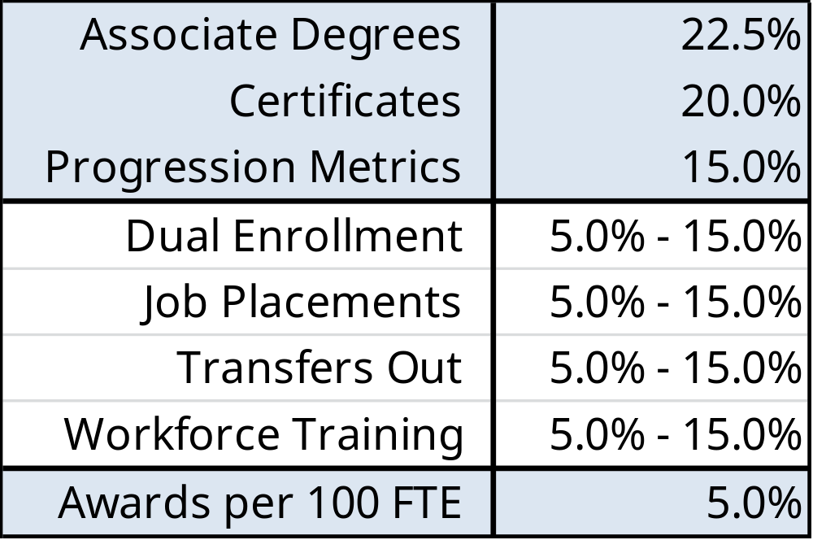
Overview of Community College Weights

Slide 9
OBF Impact: Undergraduate Degree Production

Slide 10
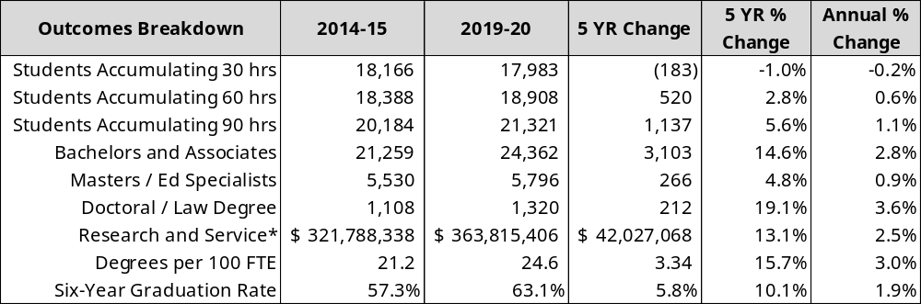
University Outcome Changes

Slide 11
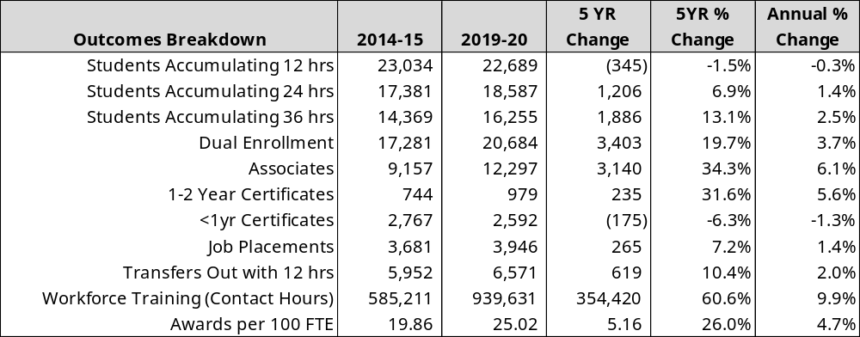
Community College Outcome Changes

Slide 12
Discussion of Proposed Immediate Revisions to Formula

Slide 13
Associate Degrees at Universities

Slide 14
University Associate Degrees
Scaling Changes to Associate Degrees at Universities
  THEC Staff Recommended Proposed Change — Implement same scale at universities for associate degrees as at community colleges
Definitional Changes to Associate Degrees at Universities
  THEC Staff Recommended Proposed Change — Limit the inclusion of university associate degrees to those awarded to students who do not re-enroll the following academic year.

Slide 15
Discussion of Proposed Five-Year Revisions to Formula

Slide 16
Workforce Investment Premium

Slide 17
Workforce Investment Premium
Quality Assurance Funding
High Need Academic Programs Definition
  01 Agriculture, Ag Operations, and Related Sciences
  03 Natural Resources and Conservation
  11 Computer and Information Sciences
  14 Engineering
  15 Engineering Technologies/Technicians
  26 Biological and Biomedical Sciences
  27 Mathematics and Statistics
  40 Physical Sciences
  51 Health Professions and Related Clinical Sciences

Slide 18
Workforce Investment Premium
Awards eligible for a Workforce Investment Premium
  Bachelor’s degrees
  Associate degrees
  Long-term certificates
  Short-term certificates
Technical issue with identifying associate degrees in the community college sector
  Rely on Tennessee Transfer Pathway (TTP) degrees completed in an Area of Emphasis (AOE) that correlates to a qualifying CIP code

Slide 19
Workforce Investment Premium
Implementation of Workforce Investment Premium
  THEC Staff Recommended Proposed Change — Implement Workforce Investment Premium (WIP) that recognizes completion of Bachelor’s and Associate degrees at universities, and Associate degrees and long- and short-term certificates at community colleges in majors aligned with high-need academic programs.

Slide 20
Graduation Rate Outcome

Slide 21
Graduation Rate Metric

Slide 22
Graduation Rate Metric

Slide 23
Graduation Rate Metric
53.5%
59.6%
57.4%
38.2%
65.0%
56.6%
66.3%
80.4%
62.6%

Slide 24
Graduation Rate Metric
University Cohort Graduation Rates

Slide 25
Graduation Rate Metric
Movement to an on-time graduation rate metric
  THEC Staff Proposed Change — Transition the graduation rate metric in the formula from 150% time to on-time graduation.

Slide 26
Fixed Costs

Slide 27
Fixed Costs Review
Measures
  Education & General Square Footage
    All E&G
    Portables
    20+ Years Old
  Utility Estimate (based on national database)
  Equipment Inventory
  Rental Space
Comprises ~22% of the overall formula
Annual calculation
Highly sensitive to new buildings/demolitions/renovations/off-line decisions
Most time intensive portion of formula

Slide 28
Fixed Costs Potential Solutions
Proposed Fixed Costs Solution
  Phase out Fixed Costs as a measure in the formula
    Gradually reduce from 22% to 0%
    Over 3-to-5-year period
  Reduce Fixed Costs Influence on Formula
    Reduce ratio to 10%
    Move to a 3-year average of campus footprint
  Streamline Fixed Costs:
    Hold fixed costs at status quo ratio
    Remove non-renovated premium
    Move to a 3-year average to limit volatility

Slide 29
Low-Income Focus Population
Notes:
Steven

Slide 30
Low-Income Focus Population
Inclusion of Out-of-State Low-Income Students
  THEC Staff Recommended Proposed Change — Expand data collection process to include out-of-state students in the low-income focus population premium to align this premium with all others in the formula.

Slide 31
Discussion

