Slide 1
Tennessee State Veterans Cemeteries
Cemetery Operations- 2023
East (Knoxville) Director -Kevin Knowles
Middle(Nashville) Director-Robert Million
Parkers Crossroads Director- Eddie Long
West (Memphis) Director-Rodney Shaw
TDVS Accreditation Course Presentation
Cemetery Operations

Slide 2
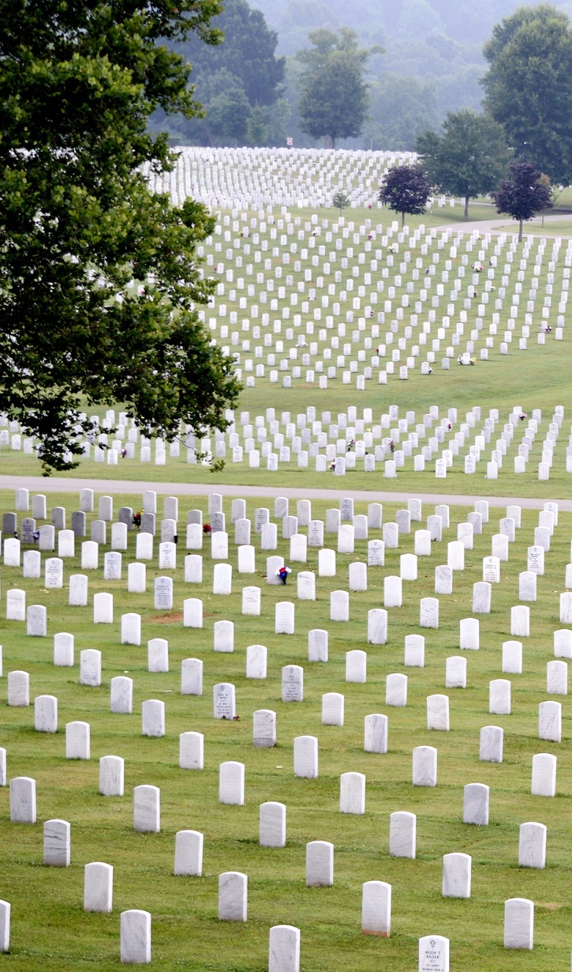
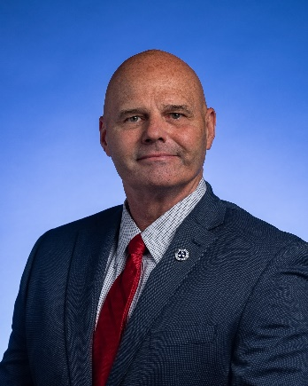
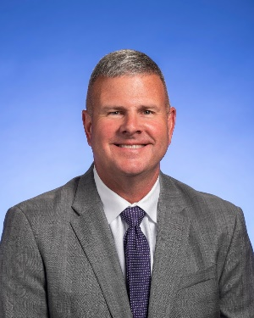
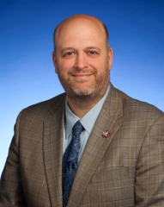
Tennessee Department of Veterans Services Leadership
Tommy H. Baker
Commissioner
Veterans Services
Deputy Commissioner
Mike Scholes
312 Rosa L. Parks Avenue 13th Floor
Nashville,TN 37243
Assistant Commissioner
Cemetery Operations
Patrick Rice
5901 Lyons View Pike
Knoxville, TN 37919

Slide 3
TDVS
Mission: Our mission is to serve veterans of all eras through passionate advocacy, informative outreach, and an honorable final resting place.
Vision: To make Tennessee the national leader in serving veterans and their families.
About
The Tennessee State Veterans Cemeteries are in Nashville, Knoxville, Memphis and Parkers Crossroads Tennessee. The Administration Building is open 5 days a week; Monday - Friday from 8:00AM - 4:30PM, excluding holidays. The cemetery grounds are open every day from dawn to dusk.
Please note that Tennessee State Veterans Cemeteries do not make funeral arrangements, provide mortuary services or perform cremations.
Scheduling & Services
Cemetery staff may schedule a service once the burial application is received along with supporting documentation. New applications will be processed for eligibility in the order received. All graves are assigned based on a first come, first serve basis and cannot be selected in advance. Eligible dependents (spouse/child) are placed in the same burial space (in-ground/niche/crypt). In the event both spouses are eligible veterans; each would be entitled to their own space; however, no reservations of spaces are accepted.
Contact the cemetery in your area for service times.

Slide 4
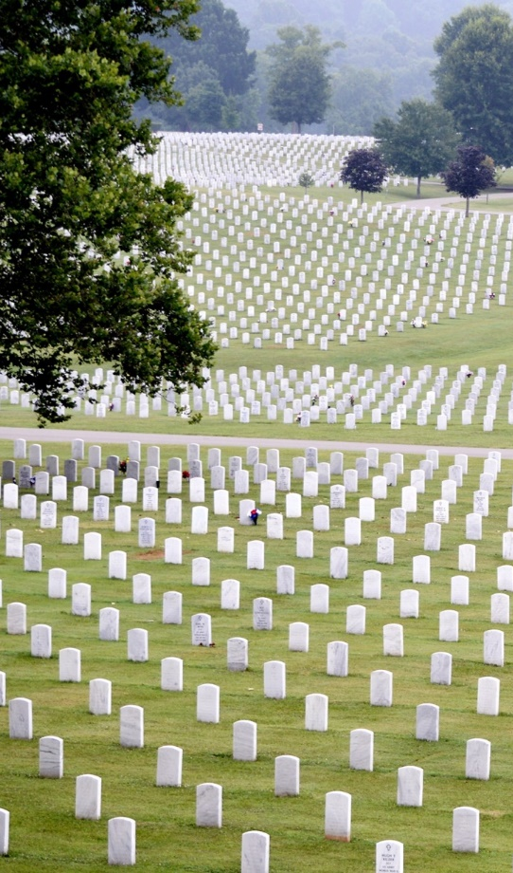
Tennessee State Veterans Cemeteries
East Tennessee State Veterans Cemetery
(Closed for first interments.)
Director Kevin Knowles
5901 Lyons View Pike
Knoxville, TN 37919
865-577-3228
Established in August 1990
East Tennessee State Veterans Cemetery
Director Kevin Knowles
2200 E. Gov. John Sevier Hwy 168
Knoxville, TN 37920
865-577-3228
Established in August 2011
West Tennessee State Veterans Cemetery
Director Rodney Shaw
4000 Forest Hill / Irene Road
Memphis TN 38125
901-543-7005
Established in January 1992
Tennessee State Veterans Cemetery at Parkers Crossroads
Director Eddie P. Long
693 Wildersville
Parkers Crossroads TN 38388
731-421-2077
Established in May 2018
Middle Tennessee State Veterans Cemetery
Director Robert Million
7931 McCrory Lane
Nashville TN 37221
615-532-2238
Established January 1993

Slide 5
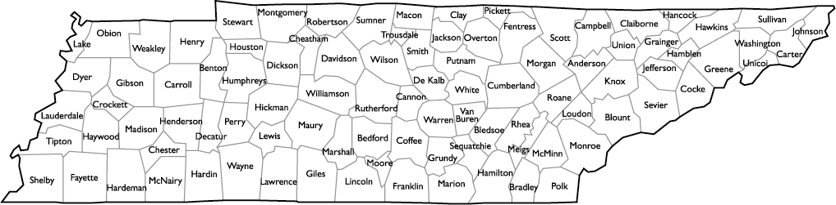
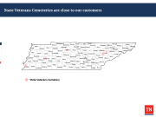
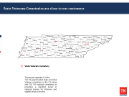
State Veterans Cemeteries are close to our customers
State Veterans Cemetery
Tennessee operates 5 of the
122 VA grant-funded state and tribal Veteran cemeteries in the US along with 155 VA national cemeteries in providing a dignified burial in national shrines for Veterans and eligible family members.
Notes:
We have two State Veterans Cemeteries in Knoxville. The East Tennessee State Veterans Cemetery on Lyons View is for second interments with the majority of our work focused on the cemetery on John Sevier Highway.

Slide 6
Values
The core values define "who we are," our culture, and how we care for Veterans and eligible beneficiaries. Our values are more than just words – they affect outcomes in our daily interactions with Veterans and eligible beneficiaries and with each other. Taking the first letter of each word—TRUST, RESPECT, ADVOCACY, COMMITMENT, EXCELLENCE—creates a powerful acronym, "TRACE." The term The definition of "TRACE" is finding or discovering by investigation. The acronym will remind each TDVS employee of the importance of their role to be laser-focused on finding those Veterans and their families who require our vital services. These core values come together as five promises we make as individuals and as a TEAM to those we serve.
Trust: Maintain the trust and confidence of all with whom I engage. Protect and cherish that trust with those Veterans and their families we support.
Respect: There is no higher calling or more noble mission than to serve the Veterans and their families who sacrificed so much for the freedoms we enjoy. Treat all of them, partner agencies, stakeholders, and my fellow TDVS teammates with dignity and respect.
Advocacy: Be truly Veteran-centric by identifying, fully considering, and appropriately advancing the interests of Veterans and other beneficiaries.
Commitment: Work diligently to serve Veterans and other beneficiaries. Be driven by an earnest belief in TDVS's mission. Fulfill my individual, leader, and collective organizational responsibilities.
Excellence: Adhere to the highest professional standards. Strive for the highest quality and seek continuous improvement. Be thoughtful and decisive in leadership, accountable for my actions, willing to admit mistakes, and rigorous in correcting them.

Slide 7
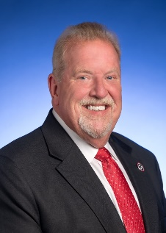

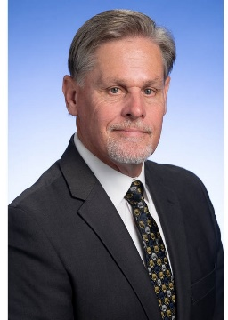
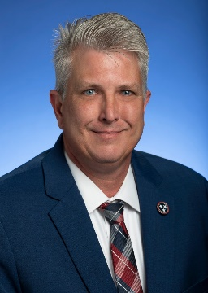
Tennessee State Veterans Cemeteries
East Tennessee State Veterans Cemetery
(Closed for first interments.)
Director Kevin Knowles
5901 Lyons View Pike
Knoxville, TN 37919
865-577-3228
Established in August 1990
East Tennessee State Veterans Cemetery
Director Kevin Knowles
2200 East Governor John Sevier Hwy
Knoxville, TN 37920
865-577-3228
Established in August 2011
West Tennessee State Veterans Cemetery
Director Rodney Shaw
4000 Forest Hill / Irene Road
Memphis, TN 38125
901-543-7005
Established in January 1992
Tennessee State Veterans Cemetery
at Parkers Crossroads
Director Eddie P. Long
693 Wildersville
Parkers Crossroads, TN 38388
731-421-2077
Established in May 2018
Middle Tennessee State Veterans Cemetery
Director Robert Million
7931 McCrory Lane
Nashville, TN 37221
615-532-2238
Established January 1993

Slide 8
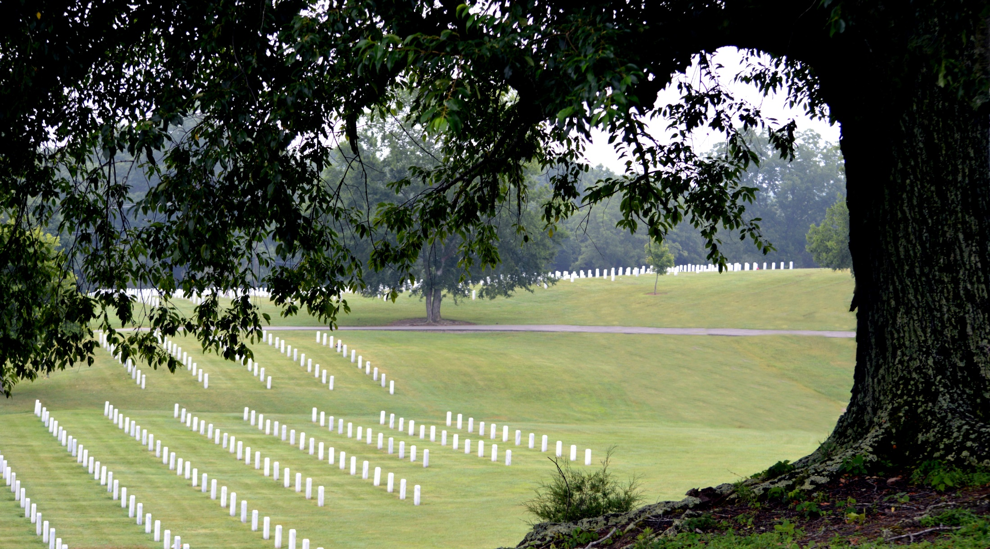
Costs
Veterans are interred at no charge.
Monuments for all eligible individuals are provided at no charge.
Spouse/Dependent interment costs: None
No cost for anything provided by the Tennessee State Veteran Cemeteries.

Slide 9
Eligibility for Interment
ELIGIBILITY FOR INTERMENT OF FAMILY MEMBERS
Surviving spouses of Veterans who died on or after Jan. 1, 2000, do not lose eligibility for burial in a national cemetery if they remarry.
In addition, an unmarried adult child of an eligible Veteran, that became permanently incapable of self-support because of a physical or mental disability before attaining age of 21 years, may also be eligible for interment with the veteran.
A Veteran’s minor child (under 21 years of age or, under 23 years of age if pursuing a course of instruction at an approved educational institution), or unmarried adult child who was physically or mentally disabled and incapable of self-support, in the same grave with the Veteran or in an adjoining gravesite if prior reservation for that grave was in effect.
Certain parents. The biological or adopted parents of a service member who died in combat or while performing training for a combat mission, who leaves no surviving spouse or dependent child, may be buried with the deceased service member if there is available space. Eligibility is limited to those who died on or after 10/07/2001, and biological or adoptive parents who died on or after 10/13/2010.

Slide 10
TDVS FY 2022-2023 Interments
Total = 2,708

Slide 11

TDVS Cemetery/Pre-Registration
Pre-Registration
  Secure online process established in 2013
  Allows peace of mind for Veterans and family members
  Allows verification of eligibility before time of loss
  Customers receive a written verification in less than 2 weeks for their records.
  Allows the cemetery to archive
  necessary documents before
  time of stress and loss
Select your desired State Veterans Cemetery tn.gov/veteran

Slide 12
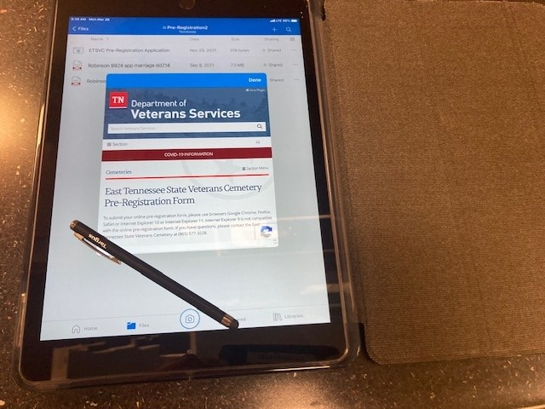
Customer Services/Pre-Registration
East Tennessee Administration sampling pilot program to Allow pre-registration off-site at Veteran events. iPad used to photograph DD-214 and enter information to TDVS system via wireless link.

Slide 13
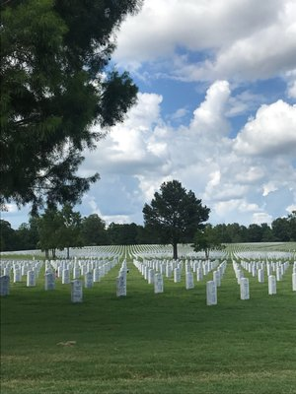
TDVS- Memphis

Slide 14
State of TN Pre-Registrations Total 19,000+: 2013 – current
Decreased response time to customers from 4 to 6 weeks to less than 10 business days.

Slide 15
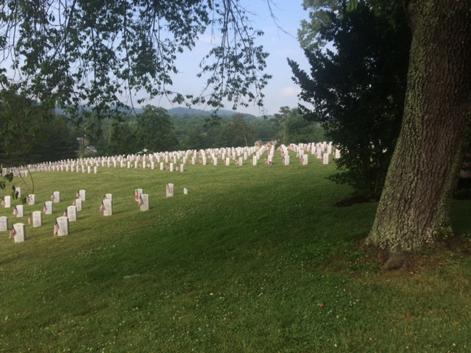
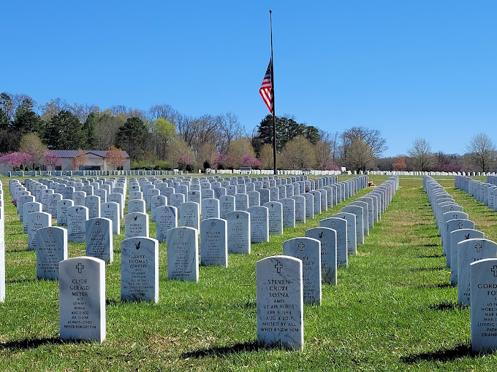
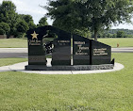
TDVS-Knoxville- Lyons View & Gov. John Sevier

Slide 16
Unclaimed Veteran Remains I
TSDVS Cemeteries have interred 59 unaccompanied Veterans with burial honors and services since 2020
The Tennessee Department of Veterans Services is committed to serving Veterans with dignity and compassion. The department policy regarding unclaimed Veteran remains is established to create a formal partnership with funeral directors in the State of Tennessee to ensure unclaimed Veteran remains receive military honors in one of the State's Veterans Cemeteries which were established for the sole purpose of providing a pristine final resting place for service members, eligible Veterans and eligible dependents.

Slide 17
Unclaimed Veteran II
Any person who does not exercise the right of disposition within seventy-two (72) hours of notification of the decedent’s death or within one hundred and sixty-eight (168) hours of the decedent's death, whichever is earlier.
Funeral directors are required to keep and maintain written records of attempts to contact next of kin and results of each attempt. Upon establishing a partnership with TDVS, the funeral director will provide a copy of the written records to be kept and maintained at the pertinent State Veterans Cemetery.
Funeral directors must also provide evidence of Veteran status to the nearest TDVS Cemetery Director, for confirmation of eligibility for burial in the nearest State Veterans Cemetery.
In order to maintain the appropriate chain of custody of the unclaimed Veteran remains, the funeral director is responsible for transportation of the remains to the State Veterans Cemetery or National Veterans Cemetery.
In conclusion, The Tennessee Department of Veterans Services is committed to serving Veterans with dignity and compassion. The department policy regarding unclaimed Veteran remains is established to create a formal partnership with funeral directors in the State of Tennessee to ensure unclaimed Veteran remains receive military honors in one of the State's Veterans Cemeteries which were established for the sole purpose of providing a pristine final resting place for service members, eligible Veterans and eligible dependents.

Slide 18
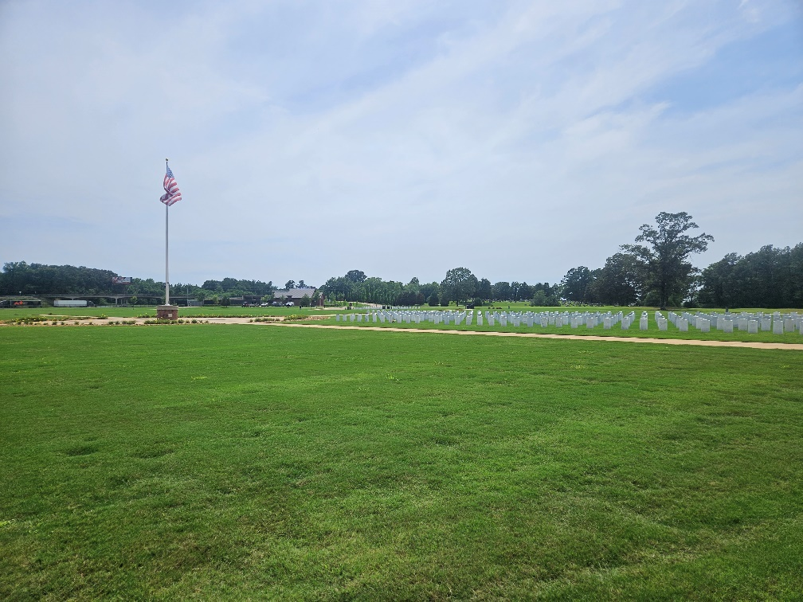
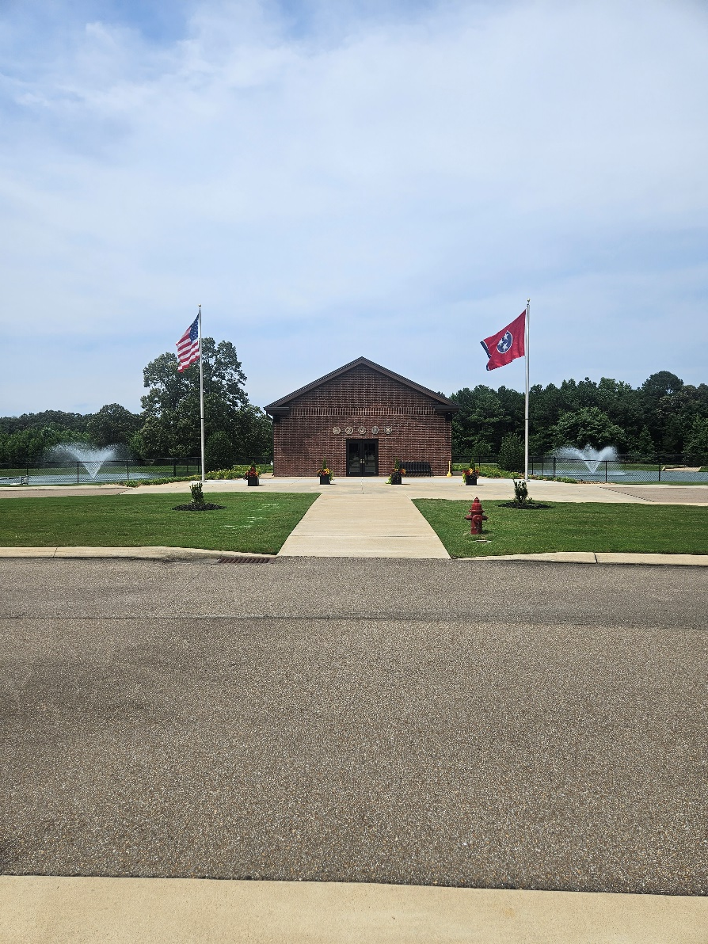
TDVS-Parkers Crossroads

Slide 19
Outreach
COORDINATING PRESENTATIONS WITH
VFW, American Legion, WAA, CSO, VSO, Hospice, Nursing Homes, Chaplin’s, and Senior Groups.
To help educate TN Veterans and their families on the Veterans Benefits and the importance cemetery pre-registration available to them across the state.
Funeral Director CE
Presented a TDVS Funeral Directors 3 hr. Continuing Education program to the Tennessee Board of funeral Directors and Embalmers for approval.
The program will allow all TDVS cemeteries to teach CE classes to licensed Funeral Directors across TN.
Program will education our funeral/cremation partners on TDVS cemetery services offered and pre-registration for their veteran customers.

Slide 20
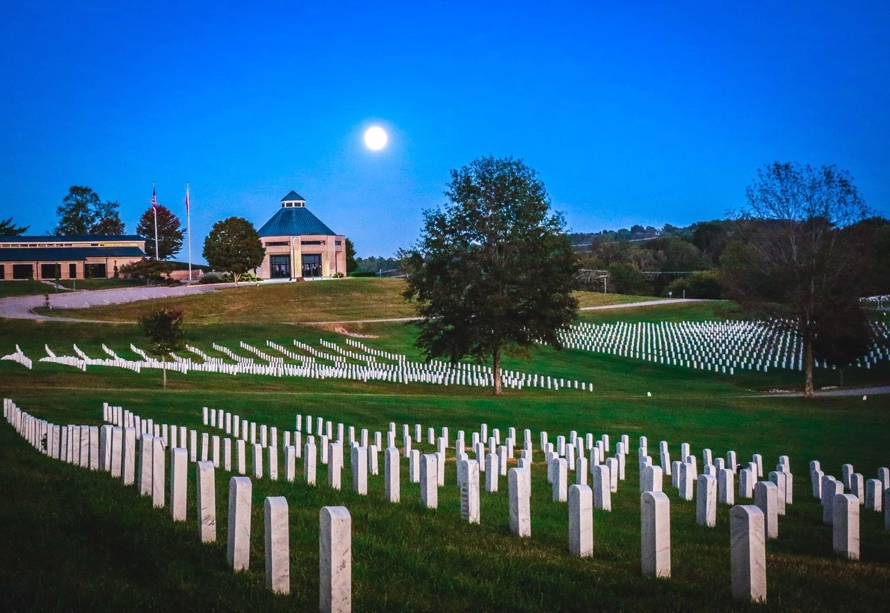
TDVS-Nashville
  Questions?
Questions?

